Slide 1
Etop

Slide 2
Erlang Top, etop jest narzędziem do
prezentowania informacji o procesach erlanga
podobny do informacji prezentowanych przez
UNIX’owy top

Slide 3
Licencja, dostęp
Copyright Ericsson AB 2002-2013. All Rights Reserved. Licensed under the Apache License, Version 2.0
Etop znajduje się w bibliotece observer

Slide 4
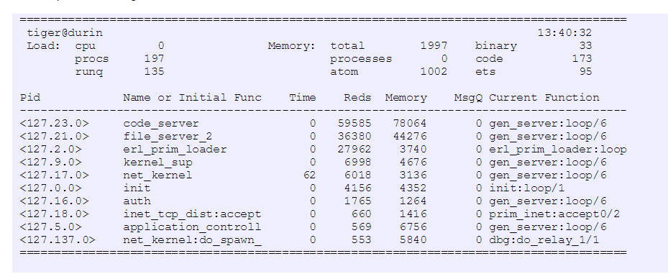
Przykładowy widok:

Slide 5
Load cpu is Runtime/Wallclock, i.e. the percentage of time where the node has been active, procs is the number of processes on the node, and runq is the number of processes that are ready to run.
MemoryThis is the memory allocated by the node in kilo bytes.For each process the following information is presented:

Slide 6
TimeThis is the runtime for the process, i.e. the actual time the process has been scheduled in.
RedsThis is the number of reductions that has been executed on the processMemoryThis is the size of the process in bytes, obtained by a call to process_info(Pid,memory).MsgQThis is the length of the message queue for the process.

