Slide 1
This is a Title of a Talk
Subtitle line 1
Line 2
Line 3

Slide 2
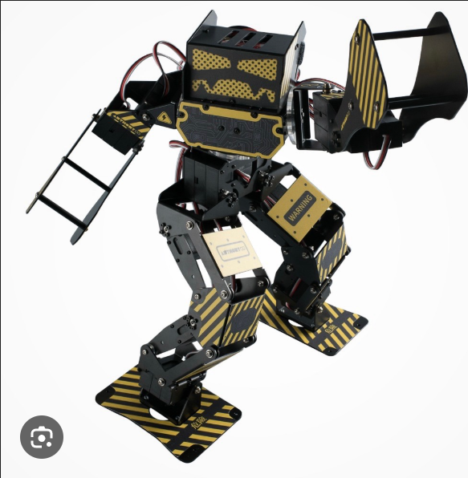
Title: Just a Figure

Slide 3

Title: Text left, Figure right
This is some itemized text
This is more text

Slide 4

Title: Small figure on the bottom right
Text left
Text left
More text left
Text left
Text left
More text left
Text left
Text left
More text left
Short text right
More text right

Slide 5
Title: Text + some table
This is some text above the table
Table is width-centered
Ninjas vs. Professors: a comparative analysis
Ninjas | Professors
Experts in methods of subterfuge | Experts in methods no longer used
Always shown wearing the same outfit | Always wears the same outfit
People think they‘re pretty cool | They think they‘re pretty cool
Shrouded in mystery | Shrouds you in misery

Slide 6
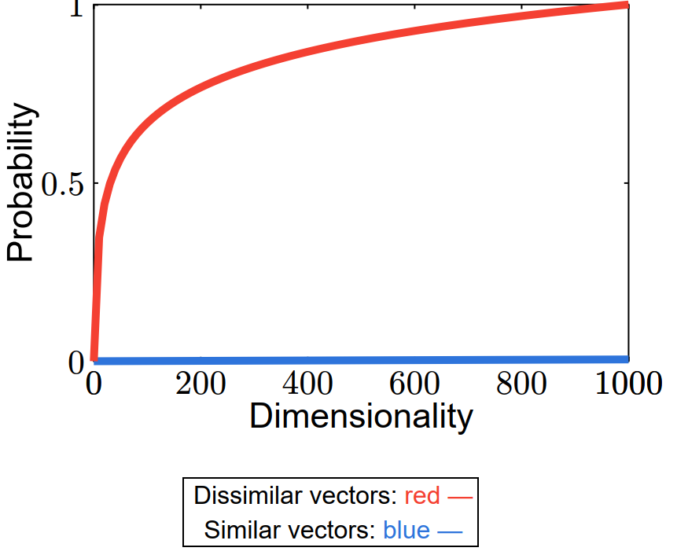
Title: Text, 1 figure below
This is some text above a figure
Figure is width-centered

Slide 7
Title: Text, 1 figure, small text
This is some text above a figure
Figure is width-centered
This figure has been shamelessly stolen from C. Smith, „This Paper is worth not(h)ing“, Journal of obsolete methods and irrelevant applications, 6(1), 2026

Slide 8
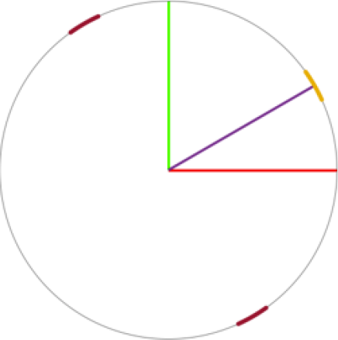
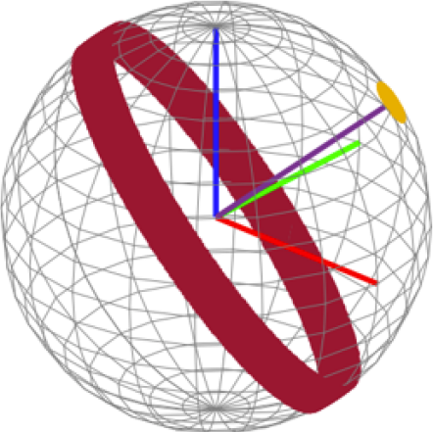
Title: Text, 2 figures, small text
This is some text above figures
Figures are probably in 2x1 grid and „column-centered“ etc.
Stolen from L. U. Cipher, „Why round things are better than square things“, Journal of pointless, extremely lenghtly, and convoluted research works, 5(3), 2025

Slide 9
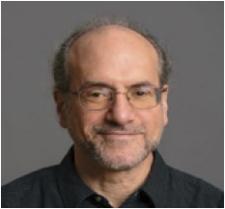
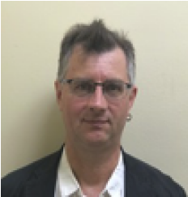
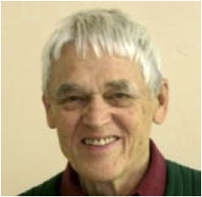
Title: Several rows, each with a figure + text (optional)
A smart-looking guy, great at his peak (not so important after all)
This fellow had a bad luck when this picture was taken (his wife run away with his brother)
Another forgotten researcher
Maybe I should create such slides as a 3x2 table in pptx to make the conversion easier?

