Slide 1
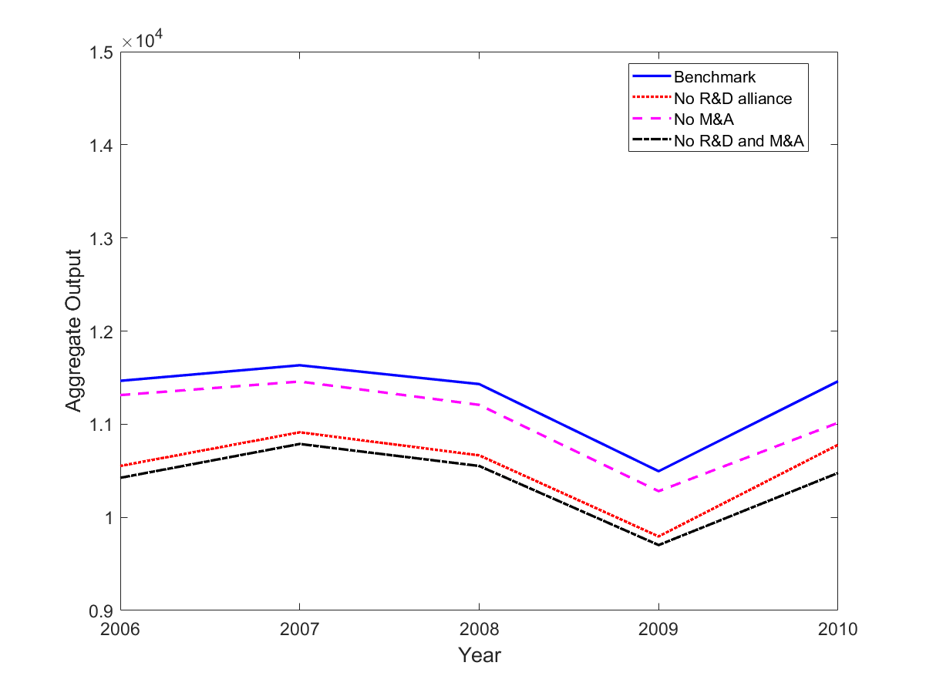
Benchmark
No R&D alliances
No M&As
No R&D alliances nor M&As
Aggregate Output
Year

