Slide 1
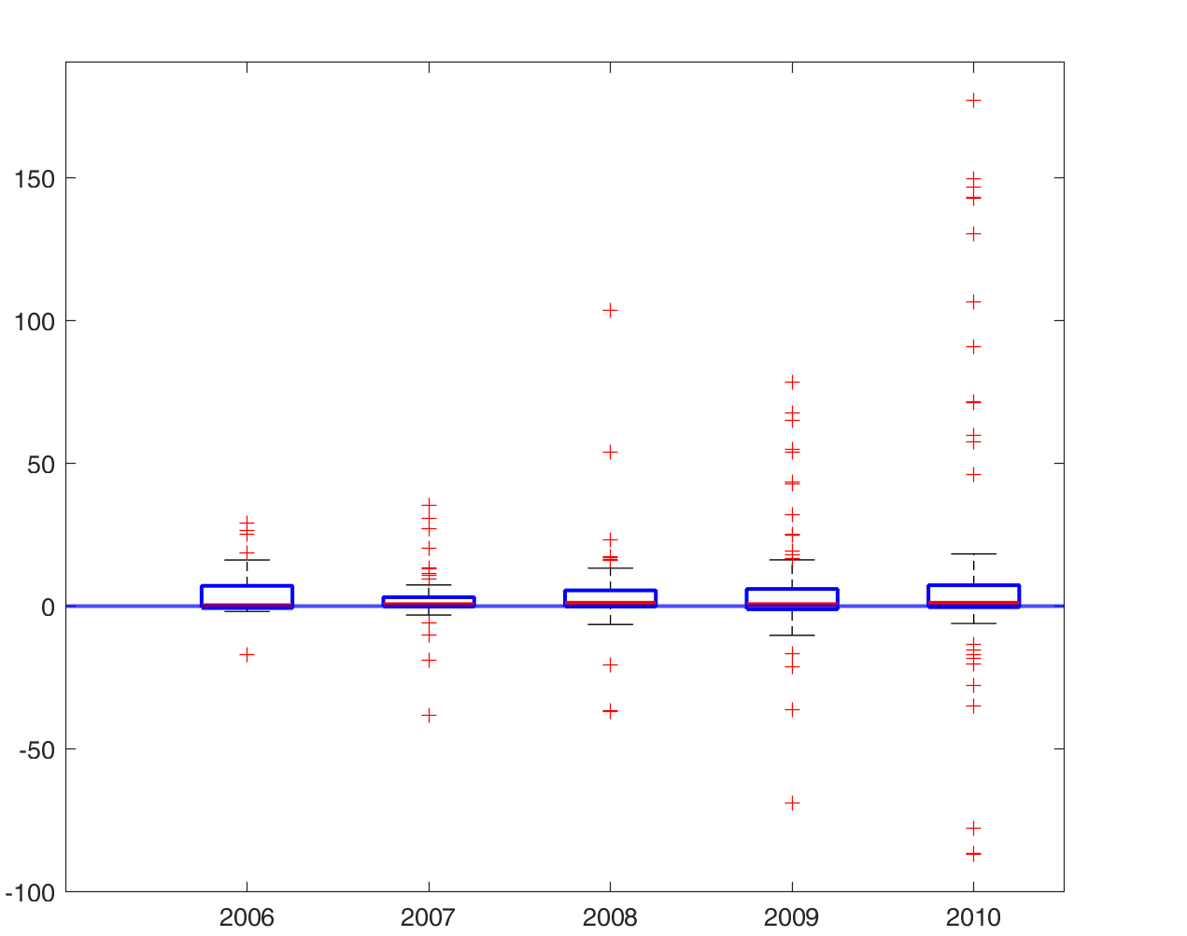
Change Aggregate Output (Counterf. – Benchm.)
Year

