Slide 1
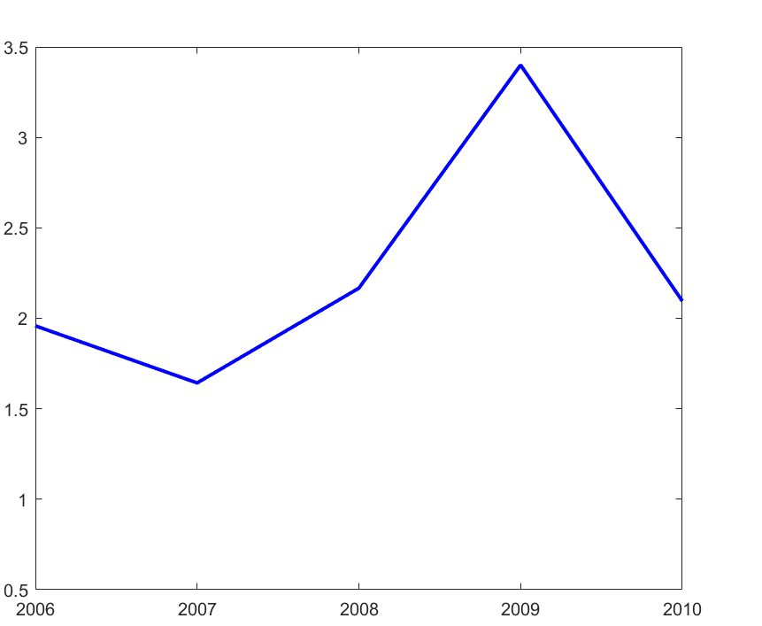
# of R&D Alliances / # of M&As
Year

