Slide 1
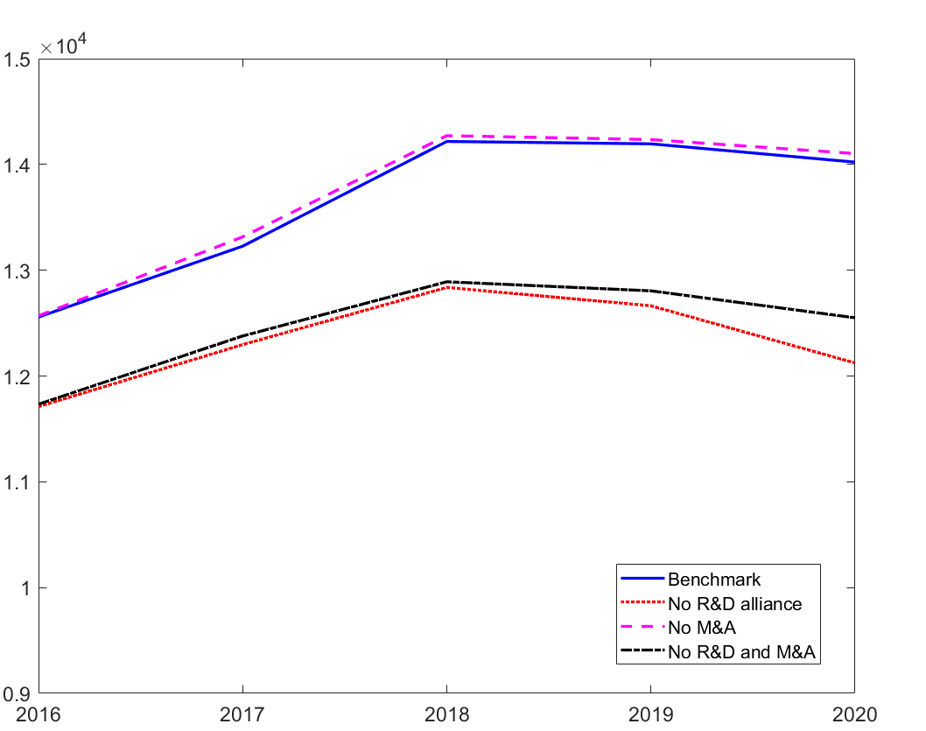
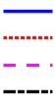
Aggregate Output
Benchmark
No R&D alliances
No M&As
No R&D alliances nor M&As
Year

