Slide 1
Breiman Random Forests
Meghana Killi, Nam Tran
Notes:
Good Morning! I’m Meghana and our presentation is on a Machine Learning algorithm called Breiman Random Forests.

Slide 2
Introduction
Machine Learning
Deterministic
Eg: AdaBoost
Random
Eg: Random Forests
Strong Law of Large Numbers
~
1
2
3
Notes:
Machine learning is basically an optimization problem where you train an algorithm on some data and then apply the optimized algorithm to make predictions for new data.
Machine learning can be done in 2 ways – the first is a deterministic approach, where each step follows directly from the previous one. Moving up the levels in a game – you need information from one level to begin the next. A good example of this is AdaBoost, in which the misclassified variables are weighted higher after every iteration. We’re going to talk about this later this afternoon, I think.
The second approach is random. So, each step is independent of the previous steps, like a drunk guy walking. This random approach is what I’m going to talk about today – random forests.
Interestingly, according to the Breiman paper, for a sufficiently large number of iterations, these two models are equivalent. That’s because of the Strong Law of Large Numbers, which states that for a large enough sample of observations, the average value approaches the expected value. This is why a large group of people can guess the correct number of pennies in a jar.

Slide 3
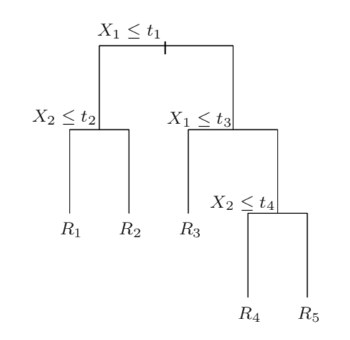
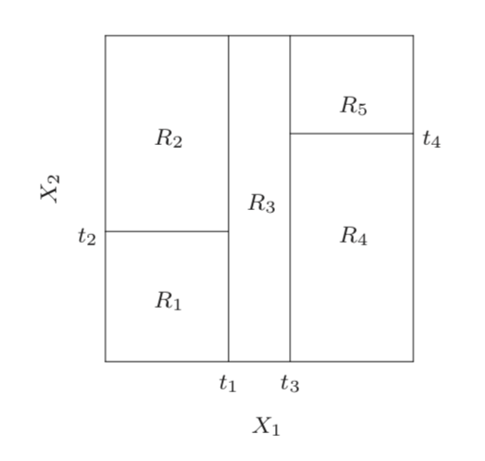
Decision Trees
Image source: Elements of Statistical Learning by Hastie et.al.
Notes:
The main building block of a random forest is a decision tree – something that looks like this. You begin with a dataset that can be parametrized by some Xs. At each node, you pick one or more features to best split the data, ie., to obtain the biggest and fastest division.
It’s easier to think of this in terms of splitting the parameter space like the figure on the right. So, you have a bunch of data points that can be plotted with 2 parameters or features x1 and x2 and each region represents a sub category of points.
It could be different kinds of coins, say – x1 is the diameter and x2 is the thickness. So if it’s a thin, small coin, it’s a 1 krone. If it’s a thick, big coin, it’s a twenty kroner. And so on.

Slide 4
Random Forests
Bootstrapping - Random Sampling Technique with Replacement
Random Forests
Bagging – (B)ootstrap (Agg)regat(ing)
{1 2 3 4 5 6}
{1 1 2 2 3 3}, {1 1 1 2 2 2}, {1 2 3 4 5 5}, {5 5 6 6 6 6}
Decision Trees
Notes:
Okay so if it isn’t obvious from the name, random forests are a collection of decision trees, with some randomness introduced somewhere. The question is - where? One thing you could do is to bootstrap the input data set for each tree.
Bootstrapping is a sampling technique that randomly, and with replacement, chooses data points from the initial dataset. So you end up with a bunch of datasets like that. Once you have these, you can use bootstrap aggregating or bagging to combine the results.
When you apply bagging to decision trees, you get a random forest!

Slide 5
Random Subspace Method
Total number of features = N
Generate a subspace at random with m (<N) features
Select features from subspace to best split data
Notes:
But that wasn’t enough randomness for Breiman. What he did was inject even more randomness into the system through something called the random subspace method. Say you had N features in total. But instead of sampling from all N features at every node, you create a subspace of m features at each node and then you sample to best split your data.

Slide 6
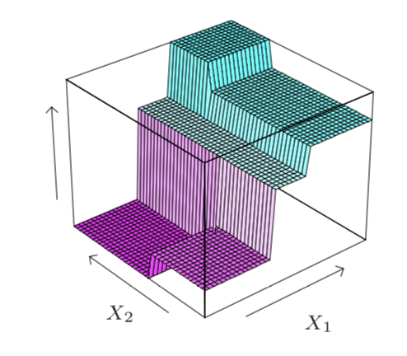
Decision Trees in a Subspace
Image source: Elements of Statistical Learning by Hastie et.al.
Notes:
So if we go back to our decision tree for, you actually had 3 features in total, but you chose to build your tree in a subspace with only two of them.
In the coin example, additional parameters could be is there a hole in the middle? Are the edges ridged or smooth? What kind of metal is it made of? So you can have a parameter space in higher dimensions.

Slide 7
Breiman Random Forests
Bootstrapping - Random Sampling Technique with Replacement
Random Subspace Method
Random Forests
Breiman Random Forests
Bagging – (B)ootstrap (Agg)regat(ing)
Decision Trees
Notes:
So what you have now is random forests just like before, but you add the random subspace method, so that now you get a Breiman random forest!

Slide 8
Features of BRFs
Classification and Regression
Avoid overfitting
Insensitive to number of features sampled
Robust to outliers and noise - more than Adaboost
Faster than bagging and boosting
Notes:
Some nice features of Breiman Random Forests are that they can perform both classification and regression – for the former, you output a discrete label for each new pbservation, while for the latter, you output a continuous quantity; a number.
They avoid overfitting, which is a common problem in machine learning algorithms which means you pick up some irrelevant features from the training data that are statistical fluctuations and not real features. But because you’re sampling over a different random subspace for each tree, any such features will be averaged out.
Breiman’s experiments showed that brfs are insensitive to the number of features sampled at each node (m), and usually 1 or 2 are sufficient
Also, brfs are more robust to outliers and noise that AdaBoost because ada reweights misclassified data more heavily, meaning it reweights noise more heavily, but brfs weight every tree equally
Finally, they’re much faster than bagging and boosting and even AdaBoost for the same total number of trees.

Slide 9
Thank you!

