Slide 1

Chempy: A flexible chemical evolution model for abundance fitting

Slide 2
What is Chempy?
Chempy is a code for modeling galatic chemical evolution. Chempy stands out by being able to calculate the posterior probability distribution in a given parameter space. By incorporating free parameters of chemical evolution, the magnitudes of each feedback channel and the constraints of observational data, provides a powerful tool for insight in stellar nucleosynthesis.

Slide 3
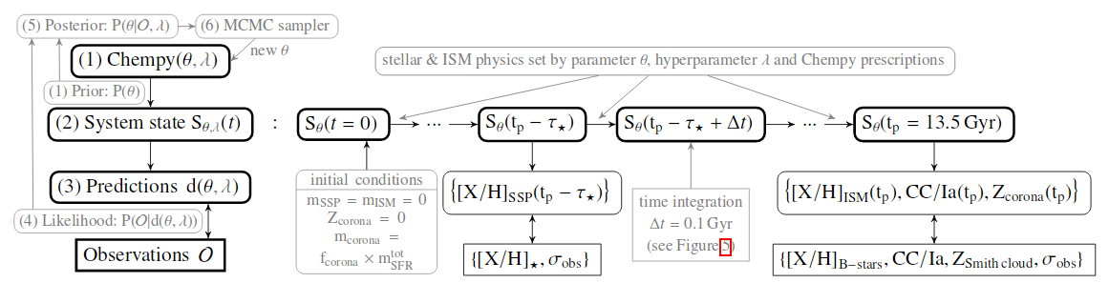
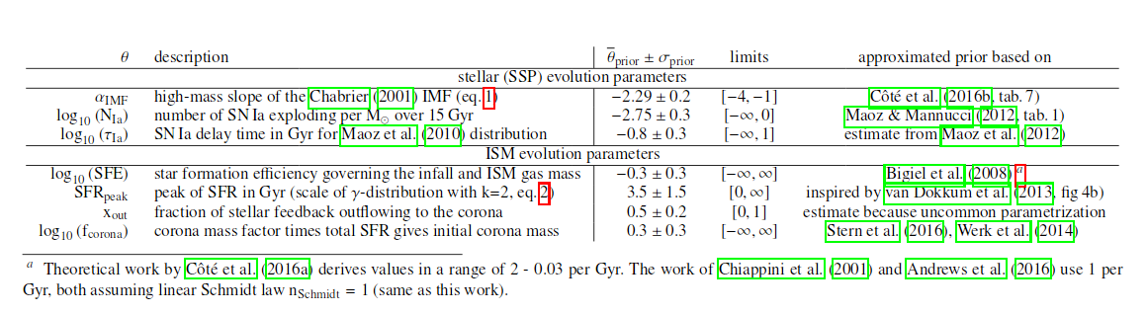

Slide 4
Sun+ model
Protosolar abundances
CC-1a ratio in Sbc galaxies
Corona metalicity

Slide 5
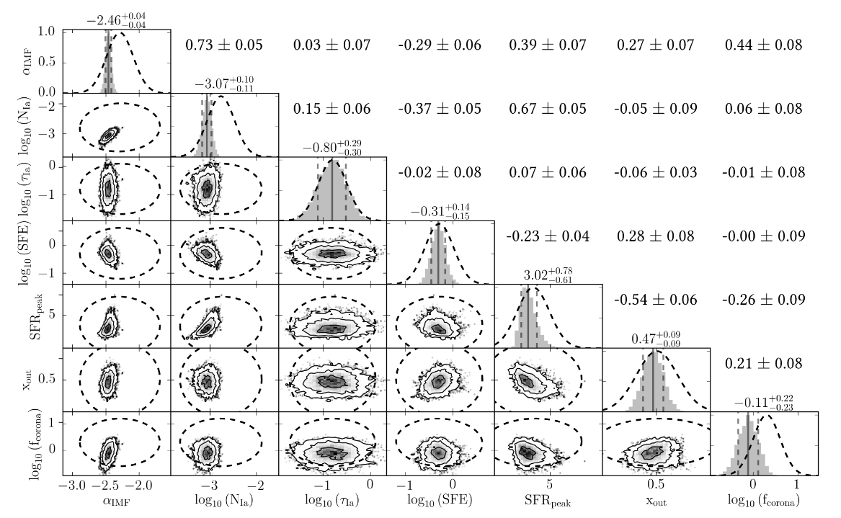

Slide 6
Multi-zone
Galactic chemical evolution modeling too simplified by using single zone.
By using multiple stars with different properties as constraints a more complex modeling is achieved.

Slide 7
Results
There is a discrepancy between the prediction of some elemental abundances and the observed abundances. Might imply unknown nucleosynthesis processes.

