Slide 1
Programmering af Mobile Robotter
RB1-PMR – Module 4: Object-Oriented Programming (OOP) and Actuator Interface
Jes Hundevadt Jepsen | jegj@mmmi.sdu.dk
SDU Drone Center, MMMI, University of Southern Denmark, Odense, Denmark

Slide 2
Agenda
Recap of last module
Object-Oriented Programming (OOP) concepts
Actuators
  DC motors
    H-Bridge
    Pulse-Width Modulation (PWM)
  Servo motors
  Stepper motors
Introduction to Extra Credit Activities #2: Stepper Motor Controller class
Assignments

Slide 3
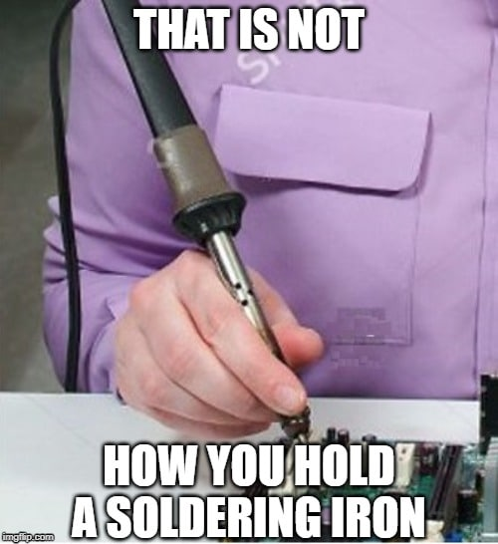
Recap
Recap of last module
Hardware walk-through
  RP2040, Raspberry Pi Pico, Monk Makes, etc.
Software walk-through
  Flash firmware, Thonny Python IDE, etc.
Introduction to IO programming using MicroPython
  Standard libraries and micro-libraries
  Key modules, classes and functions
    Work with the Machine, Pin, and Timer modules
Assignments and Portfolio 1
Soldered the Practice PCB
  Which we will be using for some of the assignments as well
Illustration: https://anasounds.com/learn-how-to-solder-like-a-pro/

Slide 4
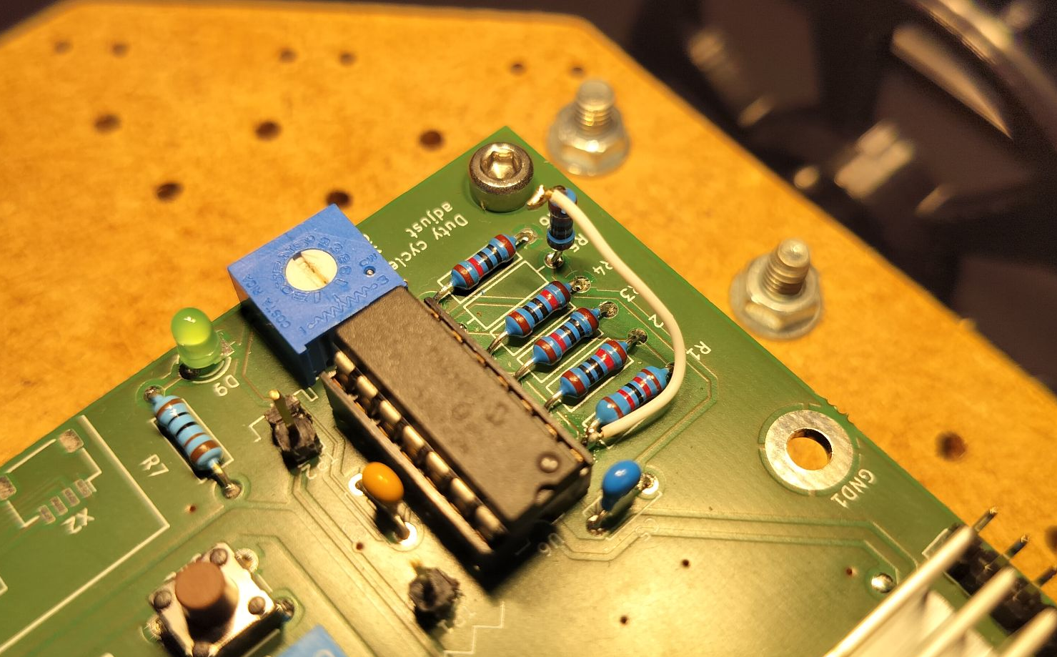
Practice PCB (Hardware fix)

Slide 5
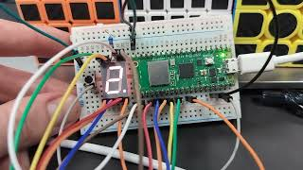
Portfolio 1
Q/A?

Slide 6
Object-Oriented Programming (OOP) concepts

Slide 7
Object-Oriented Programming (OOP)
“...a programming paradigm based on the concept of “objects”, which can contain data and code”

Slide 8
Object-Oriented Programming (OOP)
“...a programming paradigm based on the concept of “objects”, which can contain data and code”
Data in the form of fields (often known as attributes or properties), and
Code in the form of procedures (often known as methods or functions)

Slide 9
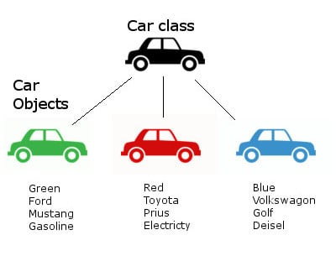
Object-Oriented Programming (OOP)
“...a programming paradigm based on the concept of “objects”, which can contain data and code”
Data in the form of fields (often known as attributes or properties), and
Code in the form of procedures (often known as methods or functions)
Like a car factory
  Produces multiple cars (Objects)
  Each car might look the same
    but with different attributes (color,engine, etc.)
Programming languages that are known for their OOP capabilities:
  C++, Java, Python, C#
Illustration: https://medium.com/pongpichs/oop-object-oriented-programing-4dda39dbb745

Slide 10
Object-Oriented Programming (OOP)
“...a programming paradigm based on the concept of “objects”, which can contain data and code”
Why?
Illustration: https://medium.com/pongpichs/oop-object-oriented-programing-4dda39dbb745

Slide 11
Object-Oriented Programming (OOP)
“...a programming paradigm based on the concept of “objects”, which can contain data and code”
Why?
  Modularity: An object can be written and maintained independently of the source code for other objects.
    They can be removed, added, or replaced without affecting the rest of the program (to much…).
Illustration: https://medium.com/pongpichs/oop-object-oriented-programing-4dda39dbb745

Slide 12
Object-Oriented Programming (OOP)
“...a programming paradigm based on the concept of “objects”, which can contain data and code”
Why?
  Modularity: An object can be written and maintained independently of the source code for other objects.
    They can be removed, added, or replaced without affecting the rest of the program (to much…).
  Reusability / Distribution: Objects can be reused across programs and can easily be shared.
Illustration: https://medium.com/pongpichs/oop-object-oriented-programing-4dda39dbb745

Slide 13
Object-Oriented Programming (OOP)
“...a programming paradigm based on the concept of “objects”, which can contain data and code”
Why?
  Modularity: An object can be written and maintained independently of the source code for other objects.
    They can be removed, added, or replaced without affecting the rest of the program (to much…).
  Reusability / Distribution: Objects can be reused across programs and can easily be shared.
  Scalability and Manageability: OOP helps in managing and scaling large software projects by breaking them down into smaller, manageable objects.
    If they object is well defined, the task of developing can be assigned to each group member or outsourced.
Illustration: https://medium.com/pongpichs/oop-object-oriented-programing-4dda39dbb745

Slide 14
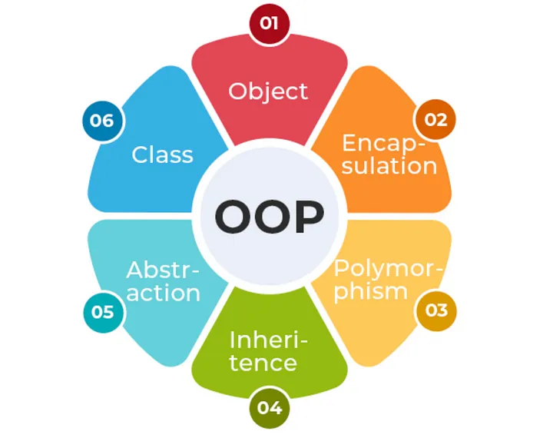
Object-Oriented Programming (OOP)
“...a programming paradigm based on the concept of objects, which can contain data and code”
Key concepts
Illustration: https://medium.com/@sounder.rahul/python-oops-concepts-for-data-engineer-beginners-0b49d0fbce3e

Slide 15
Object-Oriented Programming (OOP)
“...a programming paradigm based on the concept of objects, which can contain data and code”
Key concepts
  Classes and Objects: A class is a template (or blueprint) for creating objects.
    It defines a set of attributes and methods that the created objects will have. An object is an instance of a class.
Illustration: https://medium.com/@sounder.rahul/python-oops-concepts-for-data-engineer-beginners-0b49d0fbce3e

Slide 16
Object-Oriented Programming (OOP)
“...a programming paradigm based on the concept of objects, which can contain data and code”
Key concepts
  Classes and Objects: A class is a template (or blueprint) for creating objects.
    It defines a set of attributes and methods that the created objects will have. An object is an instance of a class.
  Encapsulation: This principle involves bundling the data (attributes) and procedures (methods/functions) that operate on the data into a single unit or class.
    Encapsulation helps in keeping the internal state of an object hidden from the outside, exposing only what is necessary.
Illustration: https://medium.com/@sounder.rahul/python-oops-concepts-for-data-engineer-beginners-0b49d0fbce3e

Slide 17
Object-Oriented Programming (OOP)
“...a programming paradigm based on the concept of objects, which can contain data and code”
Key concepts
  Classes and Objects: A class is a template (or blueprint) for creating objects.
    It defines a set of attributes and methods that the created objects will have. An object is an instance of a class.
  Encapsulation: This principle involves bundling the data (attributes) and procedures (methods/functions) that operate on the data into a single unit or class.
    Encapsulation helps in keeping the internal state of an object hidden from the outside, exposing only what is necessary.
  Inheritance: Inheritance allows one class (child class) to inherit attributes and methods from another class (parent class).
    This promotes code reuse and establishes a natural hierarchy between classes.
Illustration: https://medium.com/@sounder.rahul/python-oops-concepts-for-data-engineer-beginners-0b49d0fbce3e

Slide 18
Object-Oriented Programming (OOP)
“...a programming paradigm based on the concept of objects, which can contain data and code”
Key concepts
  Classes and Objects: A class is a template (or blueprint) for creating objects.
    It defines a set of attributes and methods that the created objects will have. An object is an instance of a class.
  Encapsulation: This principle involves bundling the data (attributes) and procedures (methods/functions) that operate on the data into a single unit or class.
    Encapsulation helps in keeping the internal state of an object hidden from the outside, exposing only what is necessary.
  Inheritance: Inheritance allows one class (child class) to inherit attributes and methods from another class (parent class).
    This promotes code reuse and establishes a natural hierarchy between classes.
  Polymorphism: Polymorphism enables objects of different classes to be treated as objects of a common super class.
    This is often implemented through method overriding, where a subclass provides a specific implementation of a method that is already defined in its superclass.
Illustration: https://medium.com/@sounder.rahul/python-oops-concepts-for-data-engineer-beginners-0b49d0fbce3e

Slide 19
Object-Oriented Programming (OOP)
“...a programming paradigm based on the concept of objects, which can contain data and code”
Key concepts
  Classes and Objects: A class is a template (or blueprint) for creating objects.
    It defines a set of attributes and methods that the created objects will have. An object is an instance of a class.
  Encapsulation: This principle involves bundling the data (attributes) and procedures (methods/functions) that operate on the data into a single unit or class.
    Encapsulation helps in keeping the internal state of an object hidden from the outside, exposing only what is necessary.
  Inheritance: Inheritance allows one class (child class) to inherit attributes and methods from another class (parent class).
    This promotes code reuse and establishes a natural hierarchy between classes.
  Polymorphism: Polymorphism enables objects of different classes to be treated as objects of a common super class.
    This is often implemented through method overriding, where a subclass provides a specific implementation of a method that is already defined in its superclass.
  Abstraction: The concept of hiding complex implementation details and showing only the essential features of an object.
    It simplifies interaction with the object by providing a clear and simple interface.
Illustration: https://medium.com/@sounder.rahul/python-oops-concepts-for-data-engineer-beginners-0b49d0fbce3e

Slide 20
Classes and Objects
“...a template for creating objects.”
In this example:
The Car class defines
  Three attributes (brand, model, year) and
  a method (start_engine).
The my_car object is an instance of the Car class, with specific values for its attributes.
Example: Define a Class and make an Object of the class
class Car: def __init__(self, brand, model, year): self.brand = brand self.model = model self.year = year def start_engine(self): return f"The {self.year} {self.brand} {self.model}'s engine starts." # Creating an object my_car = Car("Toyota", "Corolla", 2020) # Accessing attributes and methods print(my_car.brand) # Output: Toyota print(my_car.start_engine()) # Output: The 2020 Toyota Corolla's engine starts.
Illustration: https://medium.com/pongpichs/oop-object-oriented-programing-4dda39dbb745

Slide 21
Classes and Objects
“...a template for creating objects.”
In this example:
The Car class defines three attributes (brand, model, year) and a method (start_engine).
The my_car object is an instance of the Car class, with specific values for its attributes.
Key concepts
Example: Define a Class and make an Object of the class
class Car: def __init__(self, brand, model, year): self.brand = brand self.model = model self.year = year def start_engine(self): return f"The {self.year} {self.brand} {self.model}'s engine starts." # Creating an object my_car = Car("Toyota", "Corolla", 2020) # Accessing attributes and methods print(my_car.brand) # Output: Toyota print(my_car.start_engine()) # Output: The 2020 Toyota Corolla's engine starts.
Illustration: https://medium.com/pongpichs/oop-object-oriented-programing-4dda39dbb745

Slide 22
Classes and Objects
“...a template for creating objects.”
In this example:
The Car class defines three attributes (brand, model, year) and a method (start_engine).
The my_car object is an instance of the Car class, with specific values for its attributes.
Key concepts
  Constructor (or __init__ method): When an instance of the object is created, the __init__ method is automatically called.
    It take the arguments as inputs
    …typically used for initializing variable
    Input to the Car class:
      make, model, year (no defaults)
      However, __init__ takes four?
Example: Define a Class and make an Object of the class
class Car: def __init__(self, brand, model, year): self.brand = brand self.model = model self.year = year def start_engine(self): return f"The {self.year} {self.brand} {self.model}'s engine starts." # Creating an object my_car = Car("Toyota", "Corolla", 2020) # Accessing attributes and methods print(my_car.brand) # Output: Toyota print(my_car.start_engine()) # Output: The 2020 Toyota Corolla's engine starts.
Illustration: https://medium.com/pongpichs/oop-object-oriented-programing-4dda39dbb745

Slide 23
Classes and Objects
“...a template for creating objects.”
In this example:
The Car class defines three attributes (brand, model, year) and a method (start_engine).
The my_car object is an instance of the Car class, with specific values for its attributes.
Key concepts
  Constructor (or __init__ method): When an instance of the object is created, the __init__ method is automatically called.
    It take the arguments as inputs
    …typically used for initializing variable
    Input to the Car class:
      make, model, year (no defaults)
      However, __init__ takes four?
  self Parameter: a reference to the current instance of the class, and is used to access variables that belongs to the class.
Example: Define a Class and make an Object of the class
class Car: def __init__(self, brand, model, year): self.brand = brand self.model = model self.year = year def start_engine(self): return f"The {self.year} {self.brand} {self.model}'s engine starts." # Creating an object my_car = Car("Toyota", "Corolla", 2020) # Accessing attributes and methods print(my_car.brand) # Output: Toyota print(my_car.start_engine()) # Output: The 2020 Toyota Corolla's engine starts.
Illustration: https://medium.com/pongpichs/oop-object-oriented-programing-4dda39dbb745

Slide 24
Classes and Objects
“...a template for creating objects.”
Organize: Same example but in separate files:
The Car class is defined in it own file (garage.py).
The main.py file imports the Car class from the garage file.
= Simplifies the main file
= (Modularity) The class can be imported by multiple files at the same time
Example: Split up into separate files
File: garage.py
class Car: def __init__(self, brand, model, year): self.brand = brand self.model = model self.year = year def start_engine(self): return f"The {self.year} {self.brand} {self.model}'s engine starts."
File: main.py
from garage import Car # Import the Car class from Garage.py # Creating an object my_car = Car("Toyota", "Corolla", 2020) # Accessing attributes and methods print(my_car.brand) # Output: Toyota print(my_car.start_engine()) # Output: The 2020 Toyota Corolla's engine starts.

Slide 25
File structure (on the Pico)
“...organizing files and directories (folders) in a logical and modular way to make code more manageable, readable, and maintainable.”
In this example:
First, put your class definitions in separate Python files (modules).
  For example, you have a class Car that you want to use in multiple files.
  Create a file named garage.py and put your class there.
Then, in the main script (or another file where you want to use the class):
  import it using the import statement.
Ensure both files are in the same directory, or
handle imports by specifying relative or absolute paths.
Example: Split up into separate files
File: garage.py
class Car: def __init__(self, brand, model, year): self.brand = brand self.model = model self.year = year def start_engine(self): return f"The {self.year} {self.brand} {self.model}'s engine starts."
File: main.py
from garage import Car # Import the Car class from Garage.py # Creating an object my_car = Car("Toyota", "Corolla", 2020) # Accessing attributes and methods print(my_car.brand) # Output: Toyota print(my_car.start_engine()) # Output: The 2020 Toyota Corolla's engine starts.

Slide 26
File structure (on the Pico)
“...organizing files and directories (folders) in a logical and modular way to make code more manageable, readable, and maintainable.”
In this example:
First, put your class definitions in separate Python files (modules).
  For example, you have a class Car that you want to use in multiple files.
  Create a file named garage.py and put your class there.
Then, in the main script (or another file where you want to use the class):
  import it using the import statement.
Ensure both files are in the same directory, or
handle imports by specifying relative or absolute paths.
Example using Thonny
Example: Split up into separate files
File: garage.py
class Car: def __init__(self, brand, model, year): self.brand = brand self.model = model self.year = year def start_engine(self): return f"The {self.year} {self.brand} {self.model}'s engine starts."
File: main.py
from garage import Car # Import the Car class from Garage.py # Creating an object my_car = Car("Toyota", "Corolla", 2020) # Accessing attributes and methods print(my_car.brand) # Output: Toyota print(my_car.start_engine()) # Output: The 2020 Toyota Corolla's engine starts.

Slide 27
Encapsulation
“...bundling the data (attributes) and procedures (methods/functions) that operate on the data into a single unit or class.”
In this example:
Created a class for managing a bank account
Example: Define a Class and make an Object of the class
class BankAccount: def __init__(self, owner, balance): self.owner = owner self.__balance = balance # Private attribute def deposit(self, amount): if amount > 0: self.__balance += amount return f"${amount} deposited. New balance: ${self.__balance}" return "Deposit amount must be positive." def withdraw(self, amount): if 0 < amount <= self.__balance: self.__balance -= amount return f"${amount} withdrawn. New balance: ${self.__balance}" return "Insufficient balance or invalid amount." def get_balance(self): return f"Balance: ${self.__balance}" # Creating an object account = BankAccount("Alice", 1000)

Slide 28
Encapsulation
“...bundling the data (attributes) and procedures (methods/functions) that operate on the data into a single unit or class.”
In this example:
Created a class for managing a bank account
The __balance attribute is private and cannot be accessed directly from outside the class.
Methods like deposit, withdraw, and get_balance provide controlled access to the __balance attribute.
Example: Define a Class and make an Object of the class
class BankAccount: def __init__(self, owner, balance): self.owner = owner self.__balance = balance # Private attribute def deposit(self, amount): if amount > 0: self.__balance += amount return f"${amount} deposited. New balance: ${self.__balance}" return "Deposit amount must be positive." def withdraw(self, amount): if 0 < amount <= self.__balance: self.__balance -= amount return f"${amount} withdrawn. New balance: ${self.__balance}" return "Insufficient balance or invalid amount." def get_balance(self): return f"Balance: ${self.__balance}" # Creating an object account = BankAccount("Alice", 1000) # Using methods to interact with the balance print(account.deposit(500)) # Output: $500 deposited. New balance: $1500 print(account.withdraw(200)) # Output: $200 withdrawn. New balance: $1300 print(account.get_balance()) # Output: Balance: $1300 # print(account.__balance) # This would raise an AttributeError

Slide 29
Inheritance
“...allows one class (child class) to inherit attributes and methods from another class (parent class).”
In this example:
Created a class for a generic animal
Example: Define a Class and make an Object of the class
class Animal: def __init__(self, name): self.name = name def speak(self): return f"{self.name} makes a sound."

Slide 30
Inheritance
“...allows one class (child class) to inherit attributes and methods from another class (parent class).”
In this example:
Created a class for a generic animal
Dog and Cat classes inherit from the Animal class.
They override the speak method to provide behavior specific to dogs and cats.
Example: Define a Class and make an Object of the class
class Animal: def __init__(self, name): self.name = name def speak(self): return f"{self.name} makes a sound." class Dog(Animal): # Dog inherits from Animal def speak(self): return f"{self.name} barks." class Cat(Animal): # Cat inherits from Animal def speak(self): return f"{self.name} meows." # Creating objects dog = Dog("Buddy") cat = Cat("Whiskers") # Using inherited and overridden methods print(dog.speak()) # Output: Buddy barks. print(cat.speak()) # Output: Whiskers meows.

Slide 31
Polymorphism
“...enables objects of different classes to be treated as objects of a common super class.”
= "having multiple forms."
In this example:
Created a class for a generic bird, and inherit from it for two other classes.
Example: Define a Class and make an Object of the class
class Bird: def __init__(self, name): self.name = name def speak(self): return f"{self.name} chirps." class Parrot(Bird): def speak(self): return f"{self.name} talks." class Crow(Bird): def speak(self): return f"{self.name} caws."

Slide 32
Polymorphism
“...enables objects of different classes to be treated as objects of a common super class.”
= "having multiple forms."
In this example:
Created a class for a generic bird, and inherit from it for two other classes.
The make_bird_speak function can take any object of a class that inherits from Bird and call the speak method, demonstrating polymorphism.
Example: Define a Class and make an Object of the class
class Bird: def __init__(self, name): self.name = name def speak(self): return f"{self.name} chirps." class Parrot(Bird): def speak(self): return f"{self.name} talks." class Crow(Bird): def speak(self): return f"{self.name} caws." # Function that takes a Bird object and calls its speak method def make_bird_speak(bird): print(bird.speak()) # Creating objects parrot = Parrot("Polly") crow = Crow("Blackie") # Using polymorphism make_bird_speak(parrot) # Output: Polly talks. make_bird_speak(crow) # Output: Blackie caws.

Slide 33
Abstraction
“...the concept of hiding complex implementation details and showing only the essential features of an object.”
In this example:
Shape is an abstract class with an abstract method area.
  Simplify what is relevant
  Define what is needed for the Class, and “hide” the rest
Rectangle is a concrete class that implements the area method.
The user interacts with the Rectangle object through the area method without needing to know how the area is calculated internally.
Example: Define a Class and make an Object of the class
from abc import ABC, abstractmethod class Shape(ABC): @abstractmethod def area(self): pass class Rectangle(Shape): def __init__(self, width, height): self.width = width self.height = height def area(self): return self.width * self.height # Creating an object and using the abstracted method rect = Rectangle(5, 3) print(rect.area()) # Output: 15

Slide 34
Actuators

Slide 35
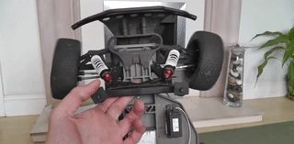
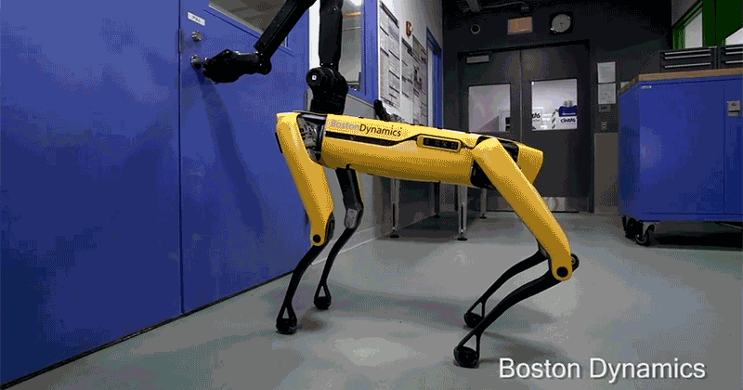
Actuators
“Components that are responsible for moving or controlling the robot's mechanical systems. They convert electrical signals (energy) from the robot's control system into physical motion”
Roles of Actuators in Mobile Robots:
Illustrations: from Google Images

Slide 36
Actuators
“Components that are responsible for moving or controlling the robot's mechanical systems. They convert electrical signals (energy) from the robot's control system into physical motion”
Roles of Actuators in Mobile Robots:
Locomotion: Moving the robot from one place to another, either through wheels, tracks, legs, or other means.
Illustrations: from Google Images

Slide 37
Actuators
“Components that are responsible for moving or controlling the robot's mechanical systems. They convert electrical signals (energy) from the robot's control system into physical motion”
Roles of Actuators in Mobile Robots:
Locomotion: Moving the robot from one place to another, either through wheels, tracks, legs, or other means.
Manipulation: Controlling robotic arms or grippers to pick up, move, or manipulate objects.
Illustrations: from Google Images

Slide 38
Actuators
“Components that are responsible for moving or controlling the robot's mechanical systems. They convert electrical signals (energy) from the robot's control system into physical motion”
Roles of Actuators in Mobile Robots:
Locomotion: Moving the robot from one place to another, either through wheels, tracks, legs, or other means.
Manipulation: Controlling robotic arms or grippers to pick up, move, or manipulate objects.
Steering: Controlling the direction in which the robot moves.
Illustrations: from Google Images

Slide 39
Actuators
“Components that are responsible for moving or controlling the robot's mechanical systems. They convert electrical signals (energy) from the robot's control system into physical motion”
Roles of Actuators in Mobile Robots:
Locomotion: Moving the robot from one place to another, either through wheels, tracks, legs, or other means.
Manipulation: Controlling robotic arms or grippers to pick up, move, or manipulate objects.
Steering: Controlling the direction in which the robot moves.
(...so essentially, the "muscles" of a robot, allowing it to
move, manipulate objects, and interact with its environment.)
Illustrations: from Google Images

Slide 40
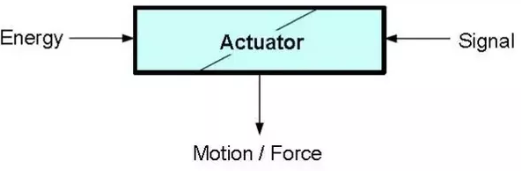
Actuators
“Components that are responsible for moving or controlling the robot's mechanical systems. They convert electrical signals (energy) from the robot's control system into physical motion”
Types of Actuators (typical source of energy)
Illustrations: https://www.quora.com/What-is-electric-actuator and Google Images

Slide 41
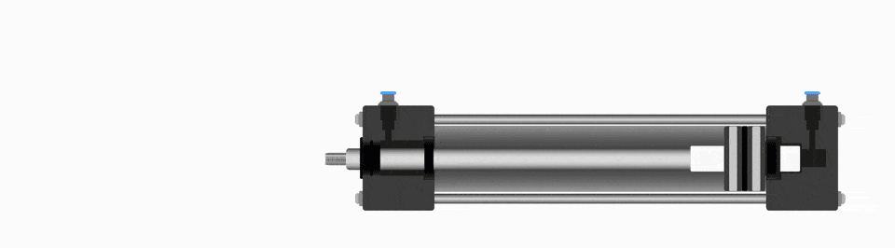
Actuators
“Components that are responsible for moving or controlling the robot's mechanical systems. They convert electrical signals (energy) from the robot's control system into physical motion”
Types of Actuators (typical source of energy)
Pneumatic Actuators: Use compressed air to generate movement, often used in robots where rapid motion is required.
Illustrations: https://www.quora.com/What-is-electric-actuator and Google Images

Slide 42
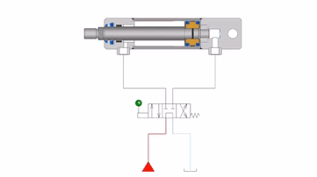
Actuators
“Components that are responsible for moving or controlling the robot's mechanical systems. They convert electrical signals (energy) from the robot's control system into physical motion”
Types of Actuators (typical source of energy)
Pneumatic Actuators: Use compressed air to generate movement, often used in robots where rapid motion is required.
Hydraulic Actuators: Use pressurized fluid to create strong forces, suitable for heavy-duty tasks.
Illustrations: https://www.quora.com/What-is-electric-actuator and Google Images

Slide 43
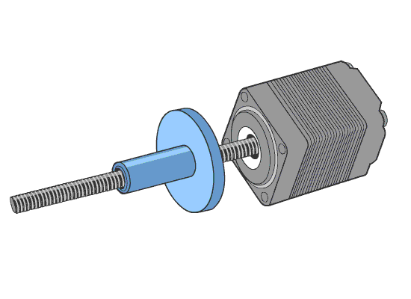
Actuators
“Components that are responsible for moving or controlling the robot's mechanical systems. They convert electrical signals (energy) from the robot's control system into physical motion”
Types of Actuators (typical source of energy)
Pneumatic Actuators: Use compressed air to generate movement, often used in robots where rapid motion is required.
Hydraulic Actuators: Use pressurized fluid to create strong forces, suitable for heavy-duty tasks.
Electric Actuators: Use electrical energy to generate movement, typically using electromagnetism.
Illustrations: https://www.quora.com/What-is-electric-actuator and Google Images

Slide 44
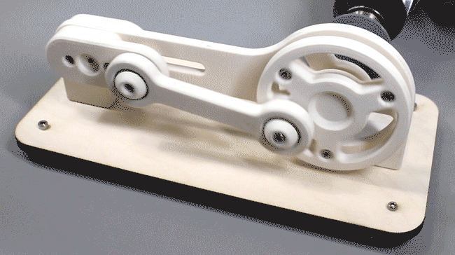
Actuators
“Components that are responsible for moving or controlling the robot's mechanical systems. They convert electrical signals (energy) from the robot's control system into physical motion”
Electric Actuators (two types)
Rotary Actuators: Produce rotational motion, meaning they rotate a component or a shaft around an axis.
Linear Actuators: Produce straight-line motion, eg. by converting rotational motion into linear motion.
Illustration: https://ar.pinterest.com/pin/308707749472703218/

Slide 45
Actuators
“Components that are responsible for moving or controlling the robot's mechanical systems. They convert electrical signals (energy) from the robot's control system into physical motion”
Electric Actuators (Rotary Actuators)

Slide 46
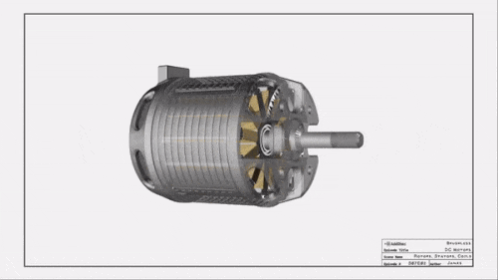
Actuators
“Components that are responsible for moving or controlling the robot's mechanical systems. They convert electrical signals (energy) from the robot's control system into physical motion”
Electric Actuators (Rotary Actuators)
DC Motors: Operate on direct current and provide continuous rotational motion.
Illustrations: from Google Images

Slide 47
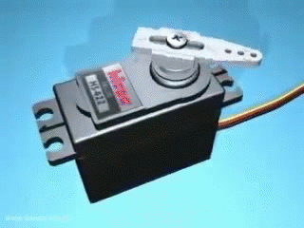
Actuators
“Components that are responsible for moving or controlling the robot's mechanical systems. They convert electrical signals (energy) from the robot's control system into physical motion”
Electric Actuators (Rotary Actuators)
DC Motors: Operate on direct current and provide continuous rotational motion.
Servo Motors: A specialized type of motor that is designed for precise control of angular or linear position, velocity, and acceleration.
Illustrations: from Google Images

Slide 48
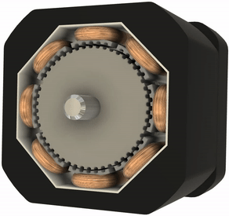
Actuators
“Components that are responsible for moving or controlling the robot's mechanical systems. They convert electrical signals (energy) from the robot's control system into physical motion”
Electric Actuators (Rotary Actuators)
DC Motors: Operate on direct current and provide continuous rotational motion.
Servo Motors: A specialized type of motor that is designed for precise control of angular or linear position, velocity, and acceleration.
Stepper Motors: Move in discrete steps, allowing precise control over position, speed, and acceleration.
Illustrations: from Google Images

Slide 49
Actuators
“Components that are responsible for moving or controlling the robot's mechanical systems. They convert electrical signals (energy) from the robot's control system into physical motion”
Electric Actuators (Linear Actuators)

Slide 50
Actuators
“Components that are responsible for moving or controlling the robot's mechanical systems. They convert electrical signals (energy) from the robot's control system into physical motion”
Electric Actuators (Linear Actuators)
Screw Actuators (Lead or Ball): Use a threaded screw mechanism where a motor turns the screw to move a nut along its length.
Illustrations: from Google Images

Slide 51
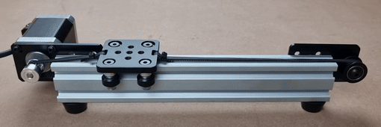
Actuators
“Components that are responsible for moving or controlling the robot's mechanical systems. They convert electrical signals (energy) from the robot's control system into physical motion”
Electric Actuators (Linear Actuators)
Screw Actuators (Lead or Ball): Use a threaded screw mechanism where a motor turns the screw to move a nut along its length.
Belt-Driven Actuators: Use a belt and pulley system for linear motion.
Illustrations: from Google Images

Slide 52
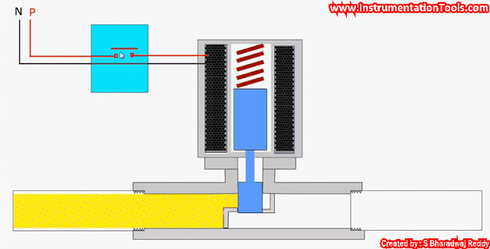
Actuators
“Components that are responsible for moving or controlling the robot's mechanical systems. They convert electrical signals (energy) from the robot's control system into physical motion”
Electric Actuators (Linear Actuators)
Screw Actuators (Lead or Ball): Use a threaded screw mechanism where a motor turns the screw to move a nut along its length.
Belt-Driven Actuators: Use a belt and pulley system for linear motion.
Solenoid Actuators: Use electromagnetic force to move a plunger or armature in a linear direction.
Illustrations: from Google Images

Slide 53
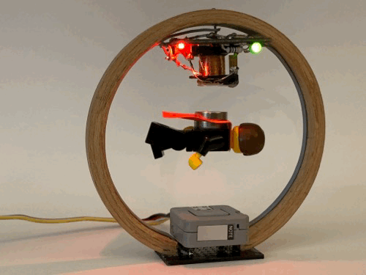
Actuators
“Components that are responsible for moving or controlling the robot's mechanical systems. They convert electrical signals (energy) from the robot's control system into physical motion”
Electric Actuators (Linear Actuators)
Screw Actuators (Lead or Ball): Use a threaded screw mechanism where a motor turns the screw to move a nut along its length.
Belt-Driven Actuators: Use a belt and pulley system for linear motion.
Solenoid Actuators: Use electromagnetic force to move a plunger or armature in a linear direction.
Magnetic Linear Actuators: Use magnetic fields to produce linear motion, often seen in magnetic levitation systems.
Illustrations: from Google Images

Slide 54
DC Motors

Slide 55
DC Motors
“Operates on Direct Current (DC) and provide continuous rotational motion (mechanical force)”
Control Methods: DC motors are relatively easy to control, which makes them popular in robotics and automation, typically:
  Voltage Control: The speed of a DC motor is directly proportional to the applied voltage.
    = by varying the voltage, the speed of the motor can be adjusted.

Slide 56
DC Motors
“Operates on Direct Current (DC) and provide continuous rotational motion (mechanical force)”
Control Methods: DC motors are relatively easy to control, which makes them popular in robotics and automation, typically:
  Voltage Control: The speed of a DC motor is directly proportional to the applied voltage.
    = by varying the voltage, the speed of the motor can be adjusted.
  For most applications, we want to be able to do two things with a motor:
    Run it in forward and backward directions
    Change its speed

Slide 57
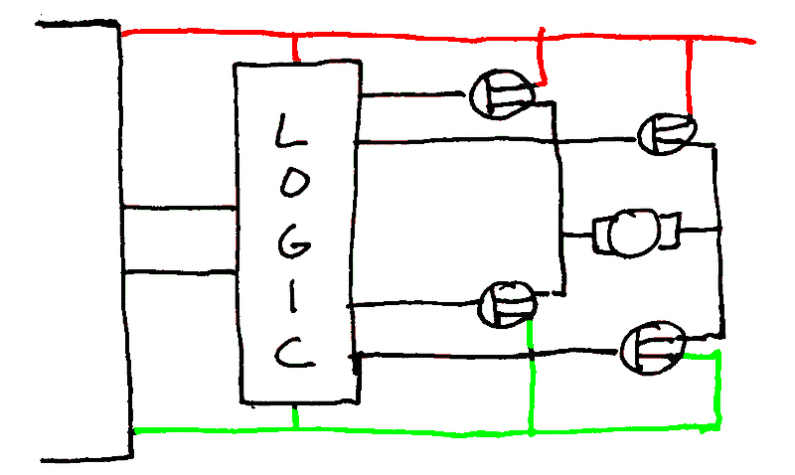
DC Motors
“Operates on Direct Current (DC) and provide continuous rotational motion (mechanical force)”
Control Methods: DC motors are relatively easy to control, which makes them popular in robotics and automation, typically:
  Voltage Control: The speed of a DC motor is directly proportional to the applied voltage.
    = by varying the voltage, the speed of the motor can be adjusted.
  For most applications, we want to be able to do two things with a motor:
    Run it in forward and backward directions
      Using a H-Bridge
    Change its speed
Microcontrollers are very limited output power
(eg. the Pico has a maximum of 16mA per pin)
(Typically) Used to drive other logic chips, but never a motor directly.

Slide 58
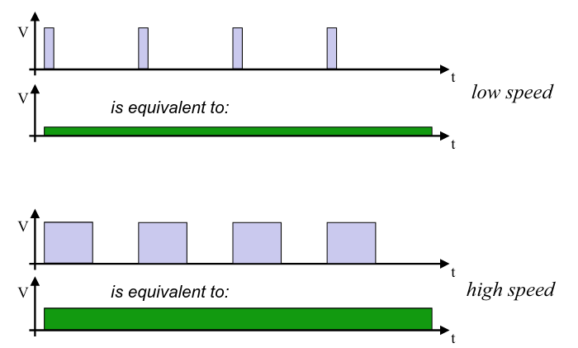
DC Motors
“Operates on Direct Current (DC) and provide continuous rotational motion (mechanical force)”
Control Methods: DC motors are relatively easy to control, which makes them popular in robotics and automation, typically:
  Voltage Control: The speed of a DC motor is directly proportional to the applied voltage.
    = by varying the voltage, the speed of the motor can be adjusted.
  For most applications, we want to be able to do two things with a motor:
    Run it in forward and backward directions
      Using a H-Bridge
    Change its speed
      Using Pulse Width Modulation (PWM)

Slide 59
H-Bridge

Slide 60
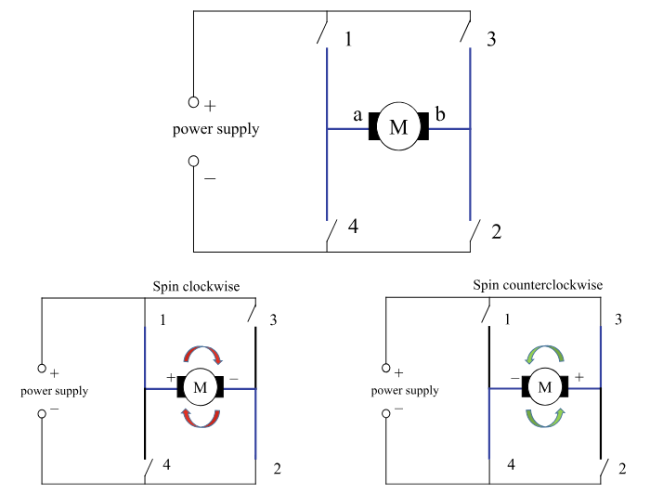
H-Bridge
“An electronic circuit that allows a voltage to be applied across a load, such as a DC motor, in either direction.”
= change polarity of the supply voltage on the motor…
Gets its name from the typical arrangement of its four switching elements, which resemble the shape of the letter "H."
Illustration: [eB1] From Mobile Robots to Autonomous Vehicles with Raspberry Pi and Arduino

Slide 61
H-Bridge
“An electronic circuit that allows a voltage to be applied across a load, such as a DC motor, in either direction.”
= change polarity of the supply voltage on the motor…
Gets its name from the typical arrangement of its four switching elements, which resemble the shape of the letter "H."
Basic Structure of an H-Bridge
  Four Switches: The H-bridge has four switches
    Eg. labeled S1, S2, S3, and S4.
  Load (Motor)
  Power Supply: provide the necessary voltage and current.
Illustration: [eB1] From Mobile Robots to Autonomous Vehicles with Raspberry Pi and Arduino

Slide 62
H-Bridge
“An electronic circuit that allows a voltage to be applied across a load, such as a DC motor, in either direction.”
Controlling a H-Bridge
Illustration: [eB1] From Mobile Robots to Autonomous Vehicles with Raspberry Pi and Arduino

Slide 63
H-Bridge
“An electronic circuit that allows a voltage to be applied across a load, such as a DC motor, in either direction.”
Controlling a H-Bridge
Coasting (Motor Freewheeling):
  All switches open (1, 2, 3, and 4)
  No current flows through the motor.
Illustration: [eB1] From Mobile Robots to Autonomous Vehicles with Raspberry Pi and Arduino

Slide 64
H-Bridge
“An electronic circuit that allows a voltage to be applied across a load, such as a DC motor, in either direction.”
Controlling a H-Bridge
Coasting (Motor Freewheeling):
  All switches open (1, 2, 3, and 4)
  No current flows through the motor.
Forward Direction (Clockwise Rotation)
  Switches Closed: 1 and 2, Switches Open: 3 and 4
  Current flows from the power supply, through 1, across the motor (from one terminal to the other), and then through 2 to ground.
Illustration: [eB1] From Mobile Robots to Autonomous Vehicles with Raspberry Pi and Arduino

Slide 65
H-Bridge
“An electronic circuit that allows a voltage to be applied across a load, such as a DC motor, in either direction.”
Controlling a H-Bridge
Coasting (Motor Freewheeling):
  All switches open (1, 2, 3, and 4)
  No current flows through the motor.
Forward Direction (Clockwise Rotation)
  Switches Closed: 1 and 2, Switches Open: 3 and 4
  Current flows from the power supply, through 1, across the motor (from one terminal to the other), and then through 2 to ground.
Reverse Direction (Counterclockwise Rotation)
  Switches Closed: 3 and 4, Switches Open: 1 and 2
  Current flows from the power supply, through 3, across the motor in the opposite direction, and then through 4 to ground.
Illustration: [eB1] From Mobile Robots to Autonomous Vehicles with Raspberry Pi and Arduino

Slide 66
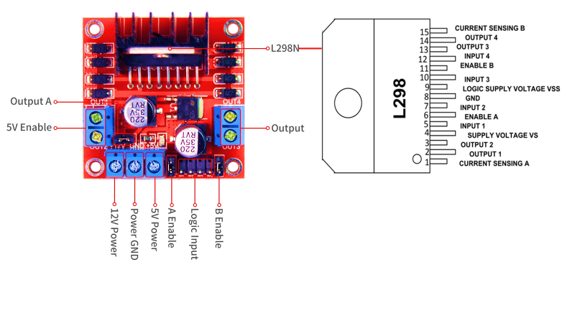
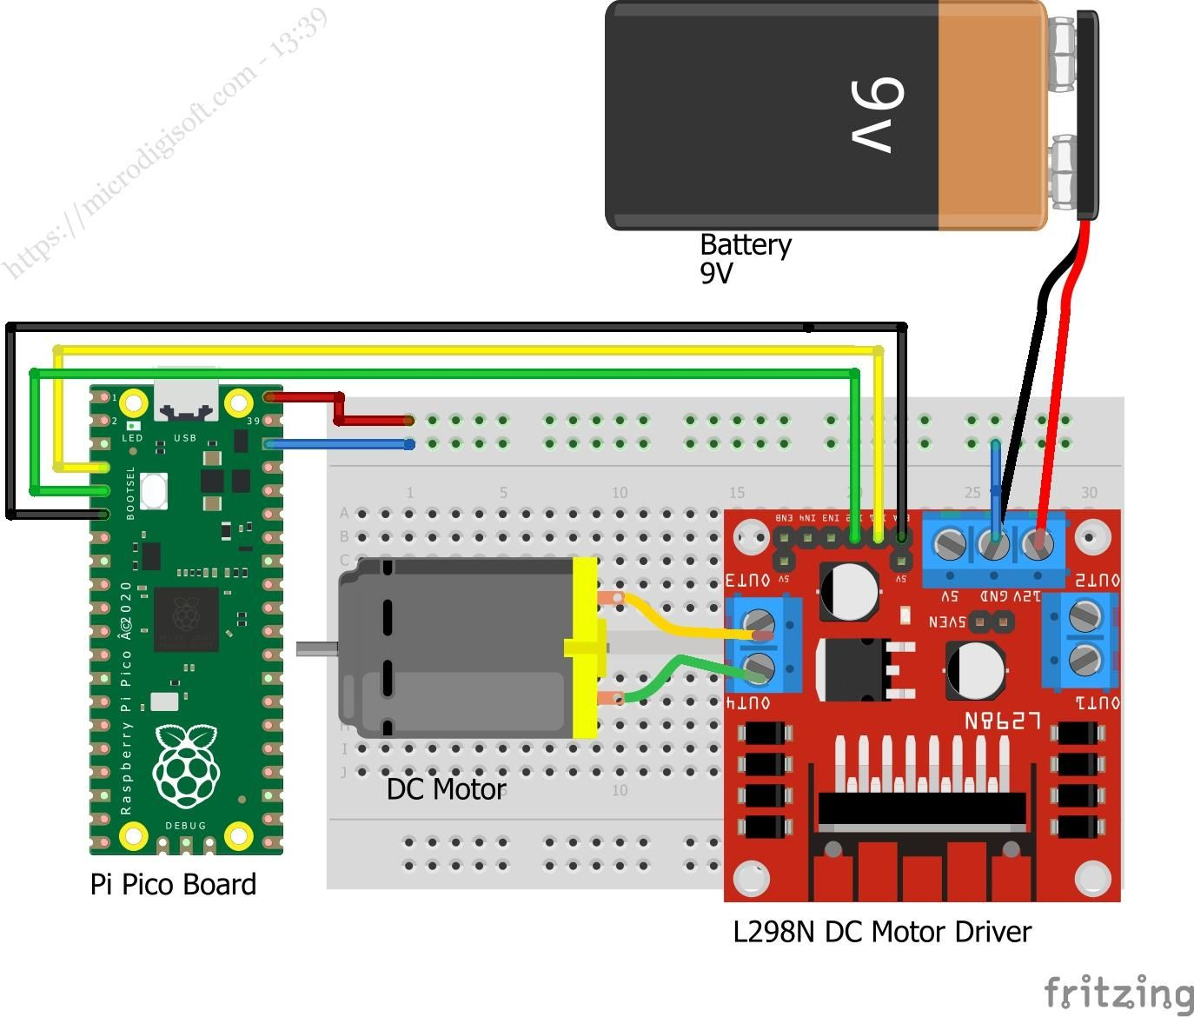
H-Bridge
“An electronic circuit that allows a voltage to be applied across a load, such as a DC motor, in either direction.”
Example: L298N DC Driver (use Pin class as interface)
Illustrations: from Google Images

Slide 67
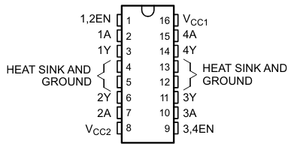
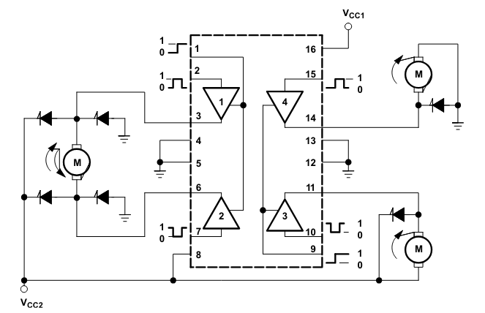
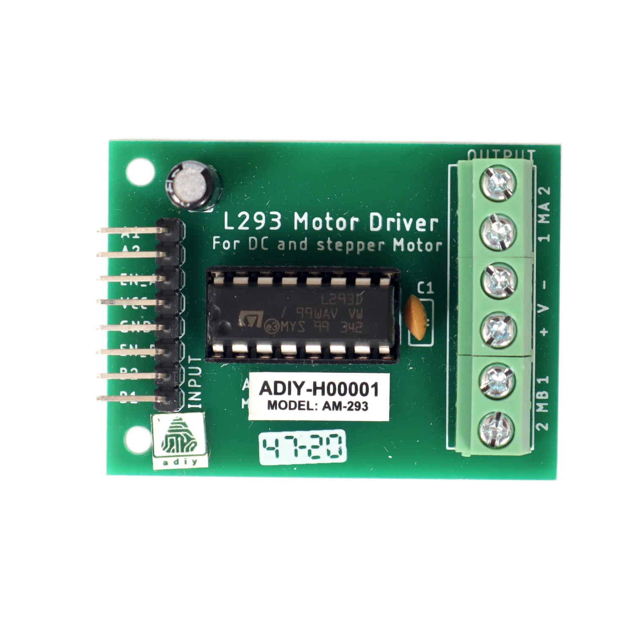
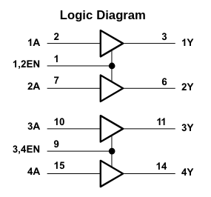
H-Bridge
“An electronic circuit that allows a voltage to be applied across a load, such as a DC motor, in either direction.”
Example: L293x Quadruple Half-H Drivers (Test PCB)
  Datasheet: https://www.ti.com/lit/ds/symlink/l293.pdf

Slide 68
Pulse Width Modulation (PWM)

Slide 69
Pulse Width Modulation (PWM)
“A digital technique to control a signal by repeatedly toggling a signal between a HIGH and a LOW state in a consistent pattern”
Image: https://www.phidgets.com/education/learn/getting-started-kit-tutorial/dutycycle/

Slide 70
Pulse Width Modulation (PWM)
“A digital technique to control a signal by repeatedly toggling a signal between a HIGH and a LOW state in a consistent pattern”
Duty Cycle: The amount of time the signal stays high (on) compared to the time it stays low (off) within a single cycle.
  0% Duty Cycle: The signal is always off (0% of the time on). The load receives no power.
  50% Duty Cycle: The signal is on for half of the time and off for the other half. The load receives 50% of the maximum possible power.
  100% Duty Cycle: The signal is always on (100% of the time on). The load receives full power.
Frequency: The pulses are generated at a fixed frequency, for example 20 kHz, so they are beyond the human hearing range.
Image: https://www.phidgets.com/education/learn/getting-started-kit-tutorial/dutycycle/

Slide 71
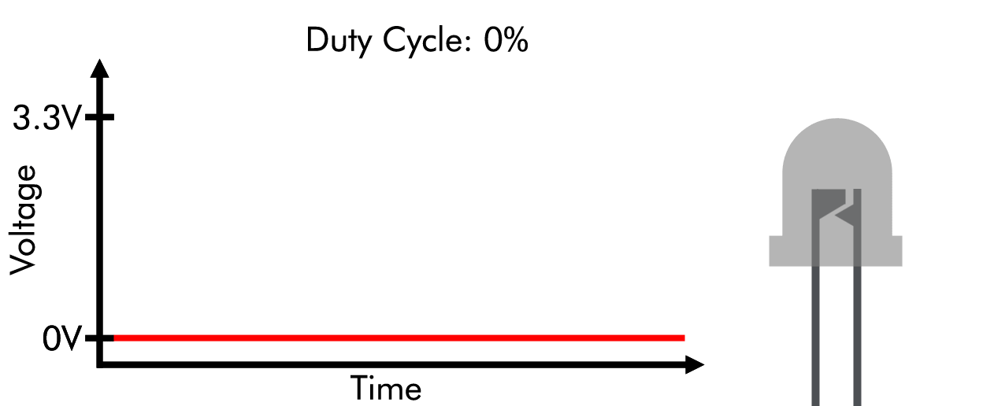
Pulse Width Modulation (PWM)
“A digital technique to control a signal by repeatedly toggling a signal between a HIGH and a LOW state in a consistent pattern”
Applications
  LED Dimming: By adjusting the duty cycle, you can control the brightness of the LED. A lower duty cycle makes the LED dimmer, while a higher duty cycle makes it brighter.
  DC Motor Speed Control: Same principle as the LED; A lower duty cycle makes the motor slower, while a higher duty cycle makes faster. Zero PWM is full stop.
Image: https://www.phidgets.com/education/learn/getting-started-kit-tutorial/dutycycle/

Slide 72
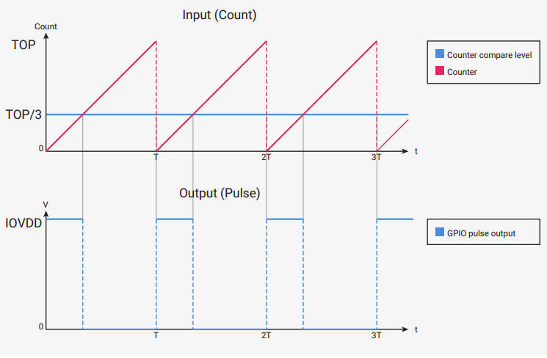
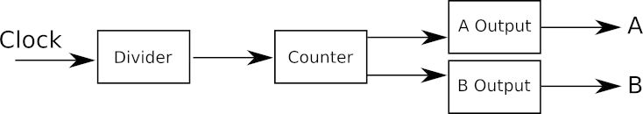
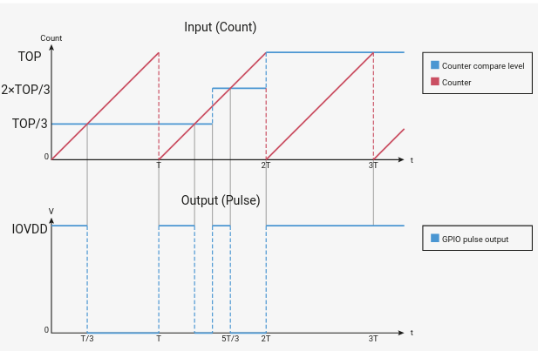
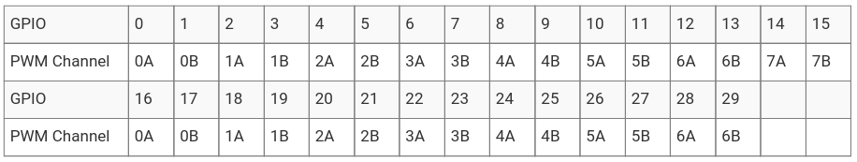
On-chip PWM (RP2040)
The RP2040 has 8 PWM slices.
Each slice can control two independent channels, labeled A and B.
This allows up to 16 PWM channels in total, where each channel can be connected to a GPIO pin (subject to pin availability and alternate functions).
The PWM counters are 16-bit, meaning the duty cycle can be set from 0 to 65535 (CC / Counter compare)
Default behaviour of a PWM slice
  Count upward until the maximum value (TOP / 65535 cycles) is reached,
    if CC is higher than the counter, set output high, else low
Source: https://datasheets.raspberrypi.com/rp2040/rp2040-datasheet.pdf

Slide 73
Key modules, classes and functions
PWM class: A PWM object provides pulse width modulation output.
Constructor
  class machine.PWM(dest, *, freq, duty_u16, duty_ns, invert)
Methods:
  init(): Initialize a PWM signal on a specific pin.
    PWM.init(*, freq, duty_u16, duty_ns)
    (You first need to initialize a Pin object, and then pass it to the PWM constructor)
  freq(): Set the frequency of the PWM signal.
  duty_u16(): Set the proportion of time the signal stays high within each period.
    Accepts a 16-bit integer (0 to 65535):
      0 represents a 0% duty cycle
      65535 represents a 100% duty cycle
  duty_ns(): Set the current pulse width of the PWM output, as a value in nanoseconds.
  deinit(): De-initializes the PWM object. Disable the PWM output and free up resources.
Classes (PWM module)
class Pin – control I/O pins class Signal – control and sense external I/O devices class ADC – analog to digital conversion class ADCBlock – control ADC peripherals class PWM – pulse width modulation class UART – duplex serial communication bus class SPI – a Serial Peripheral Interface bus protocol (controller side) class I2C – a two-wire serial protocol class I2S – Inter-IC Sound bus protocol …
Constants: None
Example: Import PWM module
from machine import Pin, PWM import time led = PWM(Pin("GP15")) # Initialize the PWM signal on pin 15 led.freq(1000) # Gradually increase brightness for duty in range(0, 65536, 256): led.duty_u16(duty) time.sleep(0.01) led.duty_u16(0) # Turn it of once done

Slide 74
Key modules, classes and functions
PWM class: A PWM object provides pulse width modulation output.
Constructor
  class machine.PWM(dest, *, freq, duty_u16, duty_ns, invert)
Methods:
  init(): Initialize a PWM signal on a specific pin.
    PWM.init(*, freq, duty_u16, duty_ns)
    (You first need to initialize a Pin object, and then pass it to the PWM constructor)
  freq(): Set the frequency of the PWM signal.
  duty_u16(): Set the proportion of time the signal stays high within each period.
    Accepts a 16-bit integer (0 to 65535):
      0 represents a 0% duty cycle
      65535 represents a 100% duty cycle
  duty_ns(): Set the current pulse width of the PWM output, as a value in nanoseconds.
  deinit(): De-initializes the PWM object. Disable the PWM output and free up resources.
Demo using an LED and EMG49
Classes (PWM module)
class Pin – control I/O pins class Signal – control and sense external I/O devices class ADC – analog to digital conversion class ADCBlock – control ADC peripherals class PWM – pulse width modulation class UART – duplex serial communication bus class SPI – a Serial Peripheral Interface bus protocol (controller side) class I2C – a two-wire serial protocol class I2S – Inter-IC Sound bus protocol …
Constants: None
Example: Import PWM module
from machine import Pin, PWM import time led = PWM(Pin("GP15")) # Initialize the PWM signal on pin 15 led.freq(1000) # Gradually increase brightness for duty in range(0, 65536, 256): led.duty_u16(duty) time.sleep(0.01) led.duty_u16(0) # Turn it of once done

Slide 75
Servo Motors

Slide 76
Servo motor
“A specialized type of motor that is designed for precise control of angular or linear position, velocity, and acceleration”
(Typically: cannot perform a continuous rotation like a normal DC motor)
Range: ±90° from its middle position (depending on the model)
Image: https://www.phidgets.com/education/learn/getting-started-kit-tutorial/dutycycle/

Slide 77
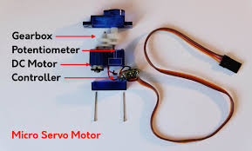
Servo motor
“A specialized type of motor that is designed for precise control of angular or linear position, velocity, and acceleration”
(Typically: cannot perform a continuous rotation like a normal DC motor)
Range: ±90° from its middle position (depending on the model)
Basic Components of a Servo Motor
  Motor: typically a DC motor
  Control Circuit: interprets input signals (usually PWM) and adjusts the motor's operation to reach the target position.
  Position Sensor (feedback): a potentiometer or encoder, is used to measure the current position of the motor shaft.
  (optional) Gearbox: to reduce the motor’s speed and increase torque.
Image: https://www.phidgets.com/education/learn/getting-started-kit-tutorial/dutycycle/

Slide 78
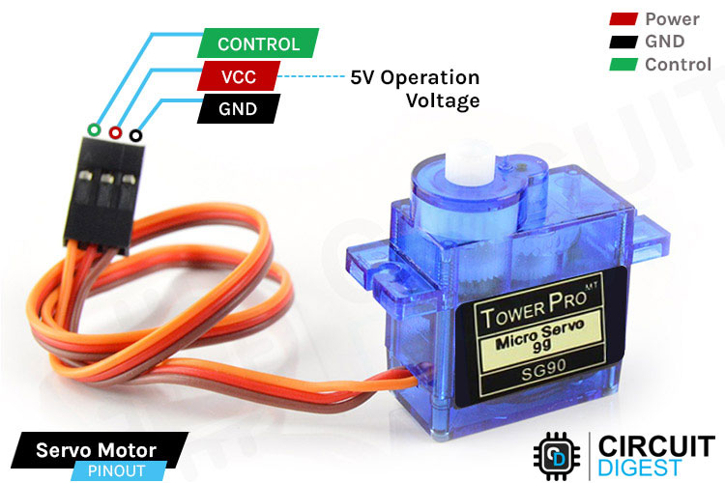
Servo motor
“A specialized type of motor that is designed for precise control of angular or linear position, velocity, and acceleration”
Control of a Servo Motor (using PWM)
  Typically three wires:
    Vcc (power input),
    Gnd (ground), and
    Control signal (PWM)
      …but not any PWM signal…
Image: https://circuitdigest.com/microcontroller-projects/interface-servo-motor-with-arduino

Slide 79
Servo motor
“A specialized type of motor that is designed for precise control of angular or linear position, velocity, and acceleration”
  Control signal
    Frequency: The PWM signal used for servos always has a frequency of 50 Hz (pulses are generated every 20 ms).
    Pulse Width: The width of the pulse within each PWM cycle determines the target position of the servo.
Image: https://circuitdigest.com/microcontroller-projects/interface-servo-motor-with-arduino

Slide 80
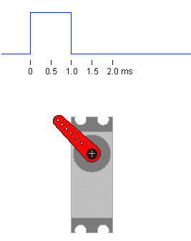
Servo motor
“A specialized type of motor that is designed for precise control of angular or linear position, velocity, and acceleration”
Pulse Width: Typically, the pulse width ranges from 1 ms to 2 ms within a 20 ms cycle.
1 ms pulse: Positions the motor shaft at one extreme (e.g., 0 degrees).
1.5 ms pulse: Positions the motor shaft at the midpoint (e.g., 90 degrees).
2 ms pulse: Positions the motor shaft at the other extreme (e.g., 180 degrees).
Image: https://kroboblogs.wordpress.com/2016/11/17/servo-motor/

Slide 81
Key modules, classes and functions
PWM class: A PWM object provides pulse width modulation output.
Constructor
  class machine.PWM(dest, *, freq, duty_u16, duty_ns, invert)
Methods:
  init(): Initialize a PWM signal on a specific pin.
    PWM.init(*, freq, duty_u16, duty_ns)
    (You first need to initialize a Pin object, and then pass it to the PWM constructor)
  freq(): Set the frequency of the PWM signal.
  duty_u16(): Set the proportion of time the signal stays high within each period.
    Accepts a 16-bit integer (0 to 65535):
      0 represents a 0% duty cycle
      65535 represents a 100% duty cycle
  duty_ns(): Set the current pulse width of the PWM output, as a value in nanoseconds.
  deinit(): De-initializes the PWM object. Disable the PWM output and free up resources.
Example: Import PWM module
from machine import Pin, PWM import time # Initialize the servo on GP15 and set PWM frequency to 50Hz servo_pin = Pin("GP15") servo = PWM(servo_pin) servo.freq(50) # Calculate min and max duty cycles for 0° and 180° positions duty = 65535 max_duty = int(2.0 / 20 * duty) min_duty = int(1.0 / 20 * duty) # Move servo to 0°, wait, then move to 180° servo.duty_u16(min_duty) time.sleep(5) servo.duty_u16(max_duty)

Slide 82
Key modules, classes and functions
PWM class: A PWM object provides pulse width modulation output.
Constructor
  class machine.PWM(dest, *, freq, duty_u16, duty_ns, invert)
In this example:
  duty = 65535 represents the full range of the 16-bit PWM (from 0 to 65535).
  max_duty is calculated for the 2.0 ms pulse width, corresponding to 180°.
  min_duty is calculated for the 1.0 ms pulse width, corresponding to 0°.
  Moving the servo:
    servo.duty_u16(min_duty) sets the duty cycle to min_duty, moving the servo to its 0° position,
    then pauses for 5 seconds, and then
    servo.duty_u16(max_duty) sets the duty cycle to min_duty, moving the servo to its 180° position,
Example: Import PWM module
from machine import Pin, PWM import time # Initialize the servo on GP15 and set PWM frequency to 50Hz servo_pin = Pin("GP15") servo = PWM(servo_pin) servo.freq(50) # Calculate min and max duty cycles for 0° and 180° positions duty = 65535 max_duty = int(2.0 / 20 * duty) min_duty = int(1.0 / 20 * duty) # Move servo to 0°, wait, then move to 180° servo.duty_u16(min_duty) time.sleep(5) servo.duty_u16(max_duty)

Slide 83
Key modules, classes and functions
PWM class: A PWM object provides pulse width modulation output.
Actual (full) range for the SG90: from 0.7 ms → 2.4 ms
Example: Import PWM module
from machine import Pin, PWM import time # Initialize the servo on GP15 and set PWM frequency to 50Hz servo_pin = Pin("GP15") servo = PWM(servo_pin) servo.freq(50) # Calculate min and max duty cycles for 0° and 180° positions duty = 65535 max_duty = int(2.4 / 20 * duty) min_duty = int(0.7 / 20 * duty) # Move servo to 0°, wait, then move to 180°, wait, and back servo.duty_u16(min_duty) time.sleep(5) servo.duty_u16(max_duty) time.sleep(5) servo.duty_u16(min_duty)
Image: https://circuitdigest.com/microcontroller-projects/interface-servo-motor-with-arduino

Slide 84
Key modules, classes and functions
PWM class: A PWM object provides pulse width modulation output.
Actual (full) range for the SG90: from 0.7 ms → 2.4 ms
Example: Import PWM module
from machine import Pin, PWM import time # Initialize the servo on GP15 and set PWM frequency to 50Hz servo_pin = Pin("GP15") servo = PWM(servo_pin) servo.freq(50) # Calculate min and max duty cycles for 0° and 180° positions duty = 65535 max_duty = int(2.4 / 20 * duty) min_duty = int(0.7 / 20 * duty) # Move servo to 0°, wait, then move to 180°, wait, and back servo.duty_u16(min_duty) time.sleep(5) servo.duty_u16(max_duty) time.sleep(5) servo.duty_u16(min_duty)
Demo
using
Thonny
Image: https://circuitdigest.com/microcontroller-projects/interface-servo-motor-with-arduino

Slide 85
Stepper Motors

Slide 86
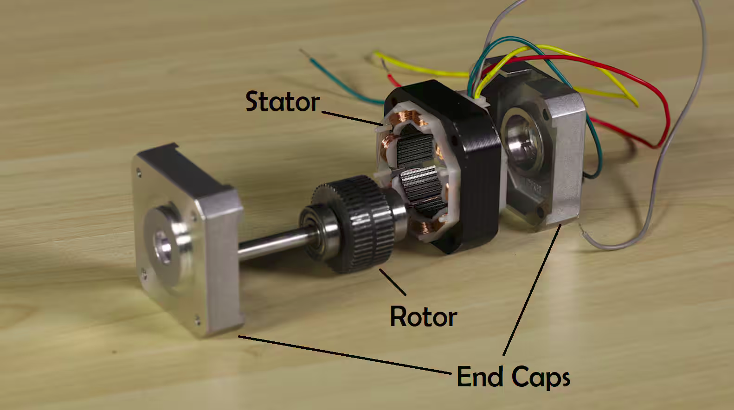
Stepper motors
“Move in discrete steps, allowing precise control over position, speed, and acceleration”
Designed to move in discrete steps rather than continuously rotating like traditional DC motors
Basic Components of a Servo Motor
  Rotor: The rotor is the rotating part of the motor, typically made of a permanent magnet or soft iron.
  Stator: The stator is the stationary part surrounding the rotor, composed of multiple coils (also called windings). These coils are energized in a specific sequence to create a magnetic field that interacts with the rotor, causing it to move.
Image: https://www.digikey.dk/da/blog/the-basics-of-stepper-motors

Slide 87
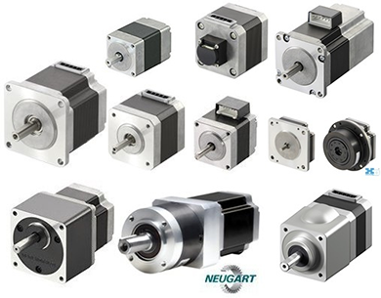
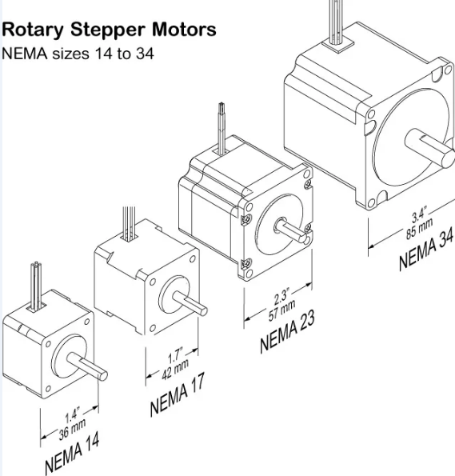
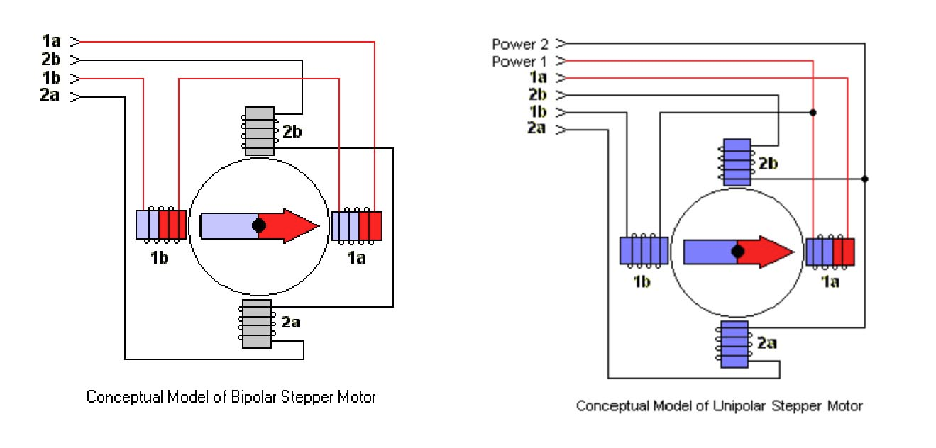
Stepper motors
“Move in discrete steps, allowing precise control over position, speed, and acceleration”
Stepper motor types (typical)
  Unipolar Stepper Motors
  Bipolar Stepper Motors
Image: https://fabacademy.org/archives/2014/students/begle.moritz/week13.html and from Google Images

Slide 88
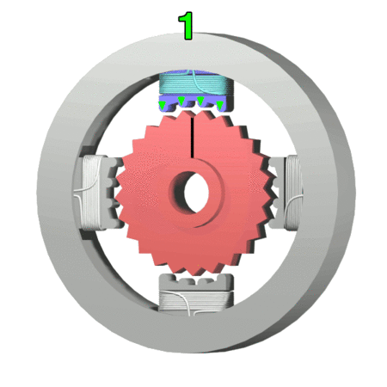
Stepper motors
“Move in discrete steps, allowing precise control over position, speed, and acceleration”
Stepping (key concepts)
Image: https://en.wikipedia.org/wiki/Stepper_motor

Slide 89
Stepper motors
“Move in discrete steps, allowing precise control over position, speed, and acceleration”
Stepping (key concepts)
  A stepper motor moves in fixed angular increments called steps.
Image: https://en.wikipedia.org/wiki/Stepper_motor

Slide 90
Stepper motors
“Move in discrete steps, allowing precise control over position, speed, and acceleration”
Stepping (key concepts)
  A stepper motor moves in fixed angular increments called steps.
  Each step is controlled by energizing the coils in a specific sequence, which creates a rotating magnetic field that pulls the rotor into the next position.
Image: https://en.wikipedia.org/wiki/Stepper_motor

Slide 91
Stepper motors
“Move in discrete steps, allowing precise control over position, speed, and acceleration”
Stepping (key concepts)
  A stepper motor moves in fixed angular increments called steps.
  Each step is controlled by energizing the coils in a specific sequence, which creates a rotating magnetic field that pulls the rotor into the next position.
  …by changing the order and timing of the pulses to the coils, you can control the motor's direction, speed, and position.
Image: https://en.wikipedia.org/wiki/Stepper_motor

Slide 92
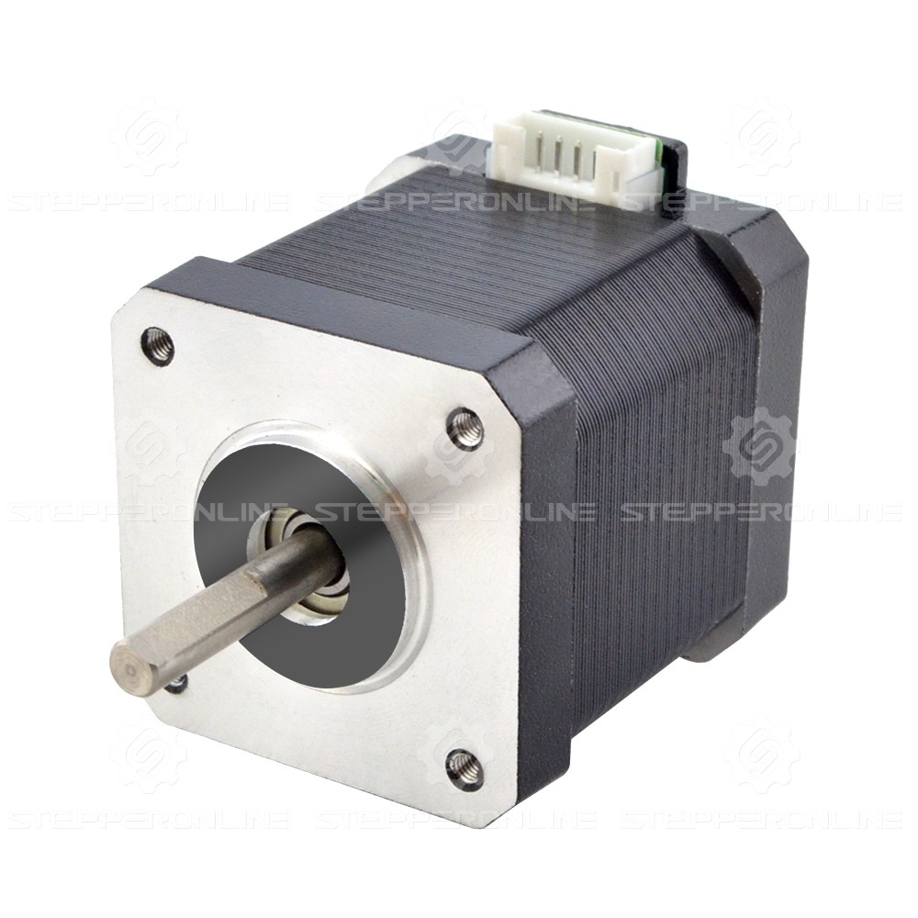
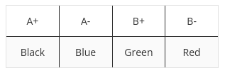
Stepper motors
“Move in discrete steps, allowing precise control over position, speed, and acceleration”
Stepping (key concepts)
  A stepper motor moves in fixed angular increments called steps.
    Example: 17HE19-2004S
      Motor Type: Bipolar Stepper
      Step Angle: 1.8deg (200 steps per revolution)
      Number of Leads: 4
Datasheet:
https://www.omc-stepperonline.com/e-series-nema-17-bipolar-55ncm-77-88oz-in-2a-42x48mm-4-wires-w-1m-cable-connector-17he19-2004s
Image: https://en.wikipedia.org/wiki/Stepper_motor

Slide 93
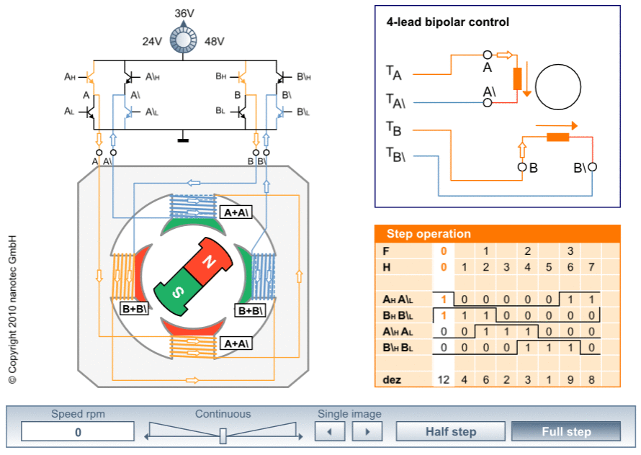
Stepper motors
“Move in discrete steps, allowing precise control over position, speed, and acceleration”
Stepping Modes:
Full Step: The motor moves one full step per pulse. This is the simplest and most common mode.
Half Step: The motor moves half a step per pulse, offering more precision but less torque.
Microstepping: By controlling the current through the coils, the motor can be made to take fractional steps, providing smoother motion and higher resolution.
Full step
Image: https://www.nanotec.com/eu/en/knowledge-base/stepper-motor-animation#

Slide 94
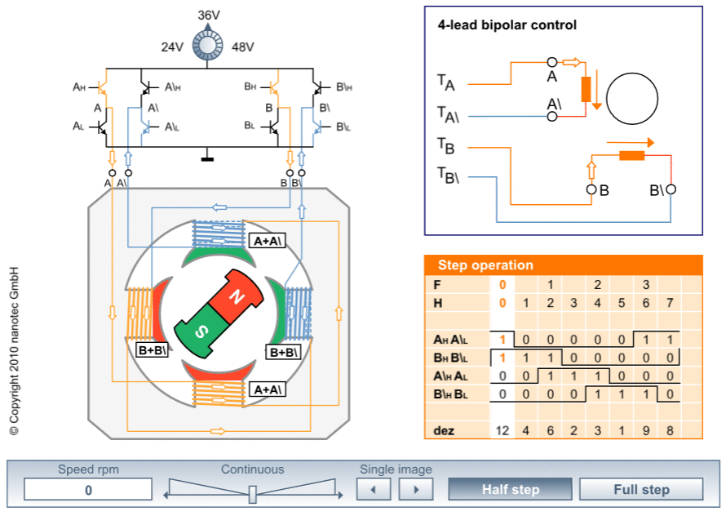
Stepper motors
“Move in discrete steps, allowing precise control over position, speed, and acceleration”
Stepping Modes:
Full Step: The motor moves one full step per pulse. This is the simplest and most common mode.
Half Step: The motor moves half a step per pulse, offering more precision but less torque.
Microstepping: By controlling the current through the coils, the motor can be made to take fractional steps, providing smoother motion and higher resolution.
Half step
Image: https://www.nanotec.com/eu/en/knowledge-base/stepper-motor-animation#

Slide 95
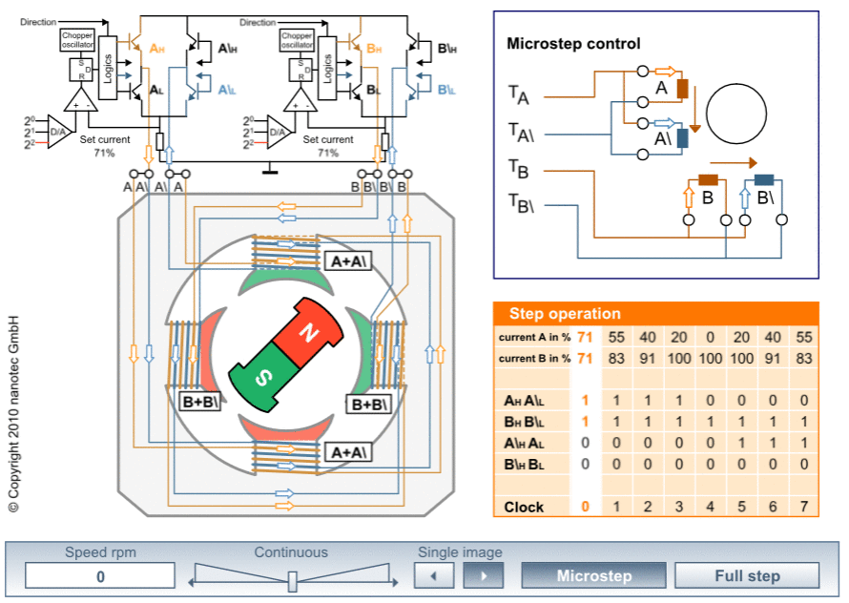
Stepper motors
“Move in discrete steps, allowing precise control over position, speed, and acceleration”
Stepping Modes:
Full Step: The motor moves one full step per pulse. This is the simplest and most common mode.
Half Step: The motor moves half a step per pulse, offering more precision but less torque.
Microstepping: By controlling the current through the coils, the motor can be made to take fractional steps, providing smoother motion and higher resolution.
Microstepping
Image: https://www.nanotec.com/eu/en/knowledge-base/stepper-motor-animation#

Slide 96
Grey Code
“a binary numeral system where two successive values differ in only one bit.”
The stepping sequence pattern resembles a gray code
  A form of binary that uses a different method of incrementing from one number to the next.
    Only a single bit changes at each transition
  Reduces the likelihood of errors during the transition.
Half step
Decimal | Binary | Gray Code |  | Stepping sequence
0 | 0000 | 0000 |  | 1100
1 | 0001 | 0001 |  | 0100
2 | 0010 | 0011 |  | 0110
3 | 0011 | 0010 |  | 0010
4 | 0100 | 0110 |  | 0011
5 | 0101 | 0111 |  | 0001
6 | 0110 | 0101 |  | 1001
7 | 0111 | 0100 |  | 1000
8 | 1000 | 1100
9 | 1001 | 1101
10 | 1010 | 1111
11 | 1011 | 1110
12 | 1100 | 1010
13 | 1101 | 1011
14 | 1110 | 1001
15 | 1111 | 1000
Image: https://www.nanotec.com/eu/en/knowledge-base/stepper-motor-animation#

Slide 97
Key modules, classes and functions
Pin class: A pin object is used to control digital I/O pins
Constructor
  class machine.Pin(id, mode=-1, pull=-1, *, value=None, drive=0, alt=-1)
Example:
  Define GPIO Pins: The GPIO pins connected to the motor driver are defined as outputs.
  Full-Step Sequence: The full_step_sequence list contains the binary values for each full step. The sequence energizes two coils at a time, which ensures that the motor moves in full steps.
  set_step Function: This function sets the GPIO pins' states according to the current step in the sequence.
  rotate_full_step Function: This function loops through the full_step_sequence to rotate the motor. The steps parameter specifies the number of steps, and the delay parameter specifies the delay between steps, controlling the speed of the motor.
  Turning Off the Coils: After completing the rotation, the set_step([0, 0, 0, 0]) function call ensures that all coils are turned off to prevent unnecessary power consumption.
  Example Usage: The motor is rotated 10 steps forward and then 10 steps backward, with a 10ms delay between each step.
Example: Stepper motor
from machine import Pin from time import sleep # Define the GPIO pins connected to the stepper motor driver coil_A1 = Pin("GP0", Pin.OUT) coil_A2 = Pin("GP1", Pin.OUT) coil_B1 = Pin("GP2", Pin.OUT) coil_B2 = Pin("GP3", Pin.OUT) # Define the full-step sequence full_step_sequence = [ [1, 1, 0, 0], # Step 0 [0, 1, 1, 0], # Step 1 [0, 0, 1, 1], # Step 2 [1, 0, 0, 1], # Step 3 ] def set_step(step): # Set the GPIO outputs according to the step coil_A1.value(step[0]) coil_A2.value(step[1]) coil_B1.value(step[2]) coil_B2.value(step[3]) def rotate_full_step(steps, delay): # Rotate the motor for a given number of steps for _ in range(steps): for step in full_step_sequence: set_step(step) sleep(delay) # Turn off all coils after rotation set_step([0, 0, 0, 0]) # Example usage: rotate_full_step(10, 0.01) # Rotate the motor 10 full steps

Slide 98
Key modules, classes and functions
PWM class: A PWM object provides pulse width modulation output.
Constructor
  class machine.PWM(dest, *, freq, duty_u16, duty_ns, invert)
Example:
  PWM Setup: Each GPIO pin connected to the stepper motor is configured as a PWM output. The frequency is set to 16 kHz, which is a good starting point.
  Full-Step Sequence with PWM: The full_step_sequence now includes PWM duty cycles instead of simple binary values. The duty cycle values are represented as percentage (0 = 0% → 1 = 100%), which correspond to the motor coil's current level.
  set_step Function: This function sets the PWM duty cycle for each coil according to the current step. The duty cycle is multiplied by 65535 to convert it into the 16-bit format expected by duty_u16().
  rotate_full_step Function: This function rotates the motor for a given number of steps, with a specified delay between each step. It runs the full-step sequence in the forward or reverse direction, depending on the sign of steps.
  Turning Off the Coils: After completing the rotation, the set_step([0, 0, 0, 0]) function call ensures that all coils are turned off to prevent unnecessary power consumption.
  Example Usage: The motor is rotated 10 steps forward and then 10 steps backward, with a 10ms delay between each step.
Example: Stepper motor
from machine import Pin, PWM from time import sleep # Define the GPIO pins connected to the stepper motor driver as PWM coil_A1 = PWM(Pin("GP0", Pin.OUT)) coil_A2 = PWM(Pin("GP1", Pin.OUT)) coil_B1 = PWM(Pin("GP2", Pin.OUT)) coil_B2 = PWM(Pin("GP3", Pin.OUT)) # Set the PWM frequency (a good starting point is 16 kHz) coil_A1.freq(16_000) coil_A2.freq(16_000) coil_B1.freq(16_000) coil_B2.freq(16_000) # Define the full-step sequence with 50% PWM duty cycles full_step_sequence = [ [0.5, 0.5, 0, 0], # Step 0 [0, 0.5, 0.5, 0], # Step 1 [0, 0, 0.5, 0.5], # Step 2 [0.5, 0, 0, 0.5], # Step 3 ] def set_step(step): # Set the PWM duty cycle according to the step coil_A1.duty_u16(int(step[0] * 65535)) # Convert to 16-bit duty cycle coil_A2.duty_u16(int(step[1] * 65535)) coil_B1.duty_u16(int(step[2] * 65535)) coil_B2.duty_u16(int(step[3] * 65535)) def rotate_full_step(steps, delay): # Rotate the motor for _ in range(abs(steps)): for step in full_step_sequence: set_step(step) sleep(delay) set_step([0, 0, 0, 0]) # Turn off all coils after rotation rotate_full_step(50, 0.01) # Rotate the motor 50 full steps seqeunces

Slide 99
Extra Credit Activities #2:
Stepper Motor Controller class

Slide 100
Test setup

Slide 101
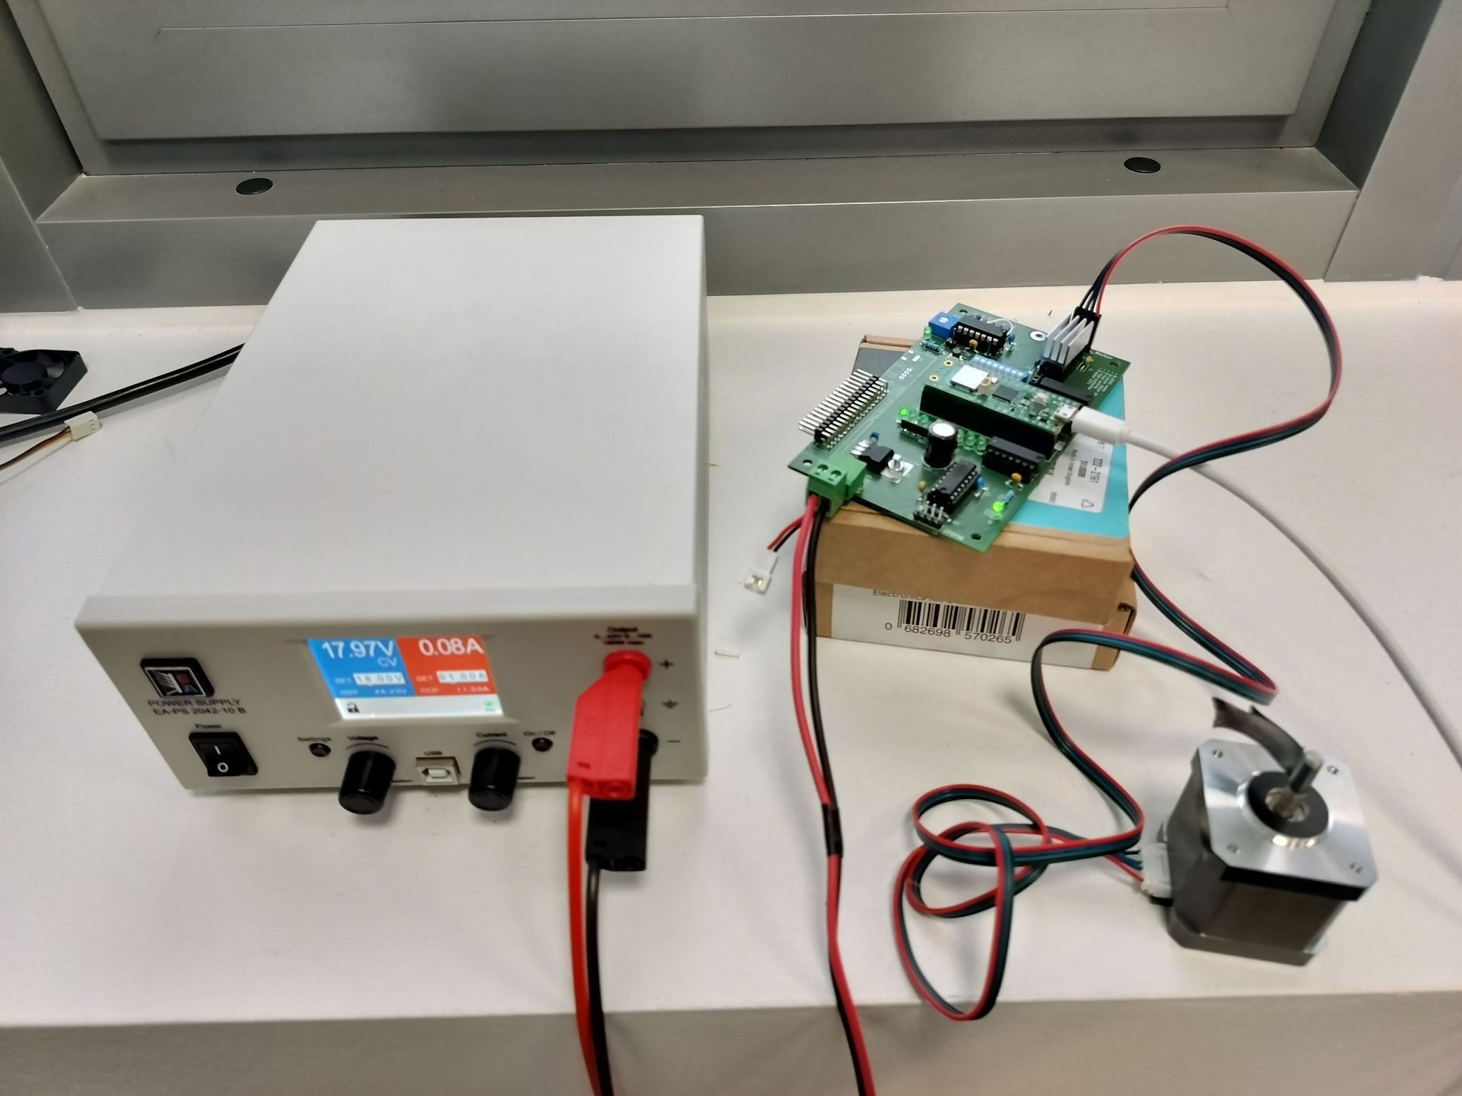
Test setup
Practice PCB

Slide 102
Test setup
Stepper motor
(with tape)

Slide 103
Test setup
Power Supply
(18V/1A)

Slide 104
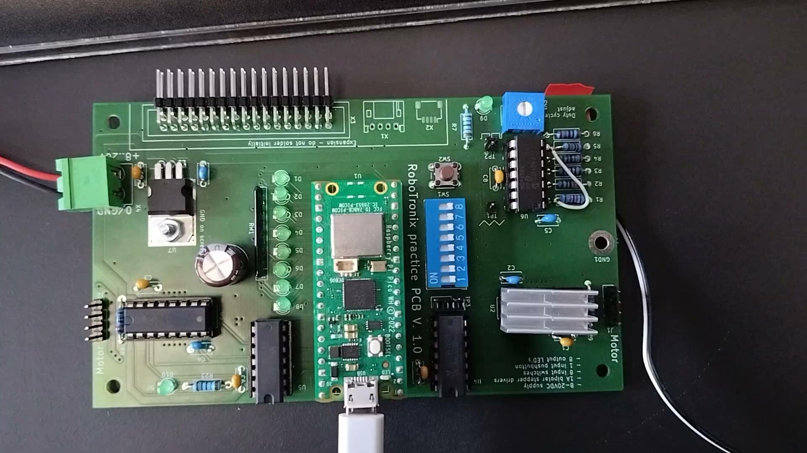
Full stepper: https://photos.app.goo.gl/hCaH4DwYtxyzFBie9

Slide 105
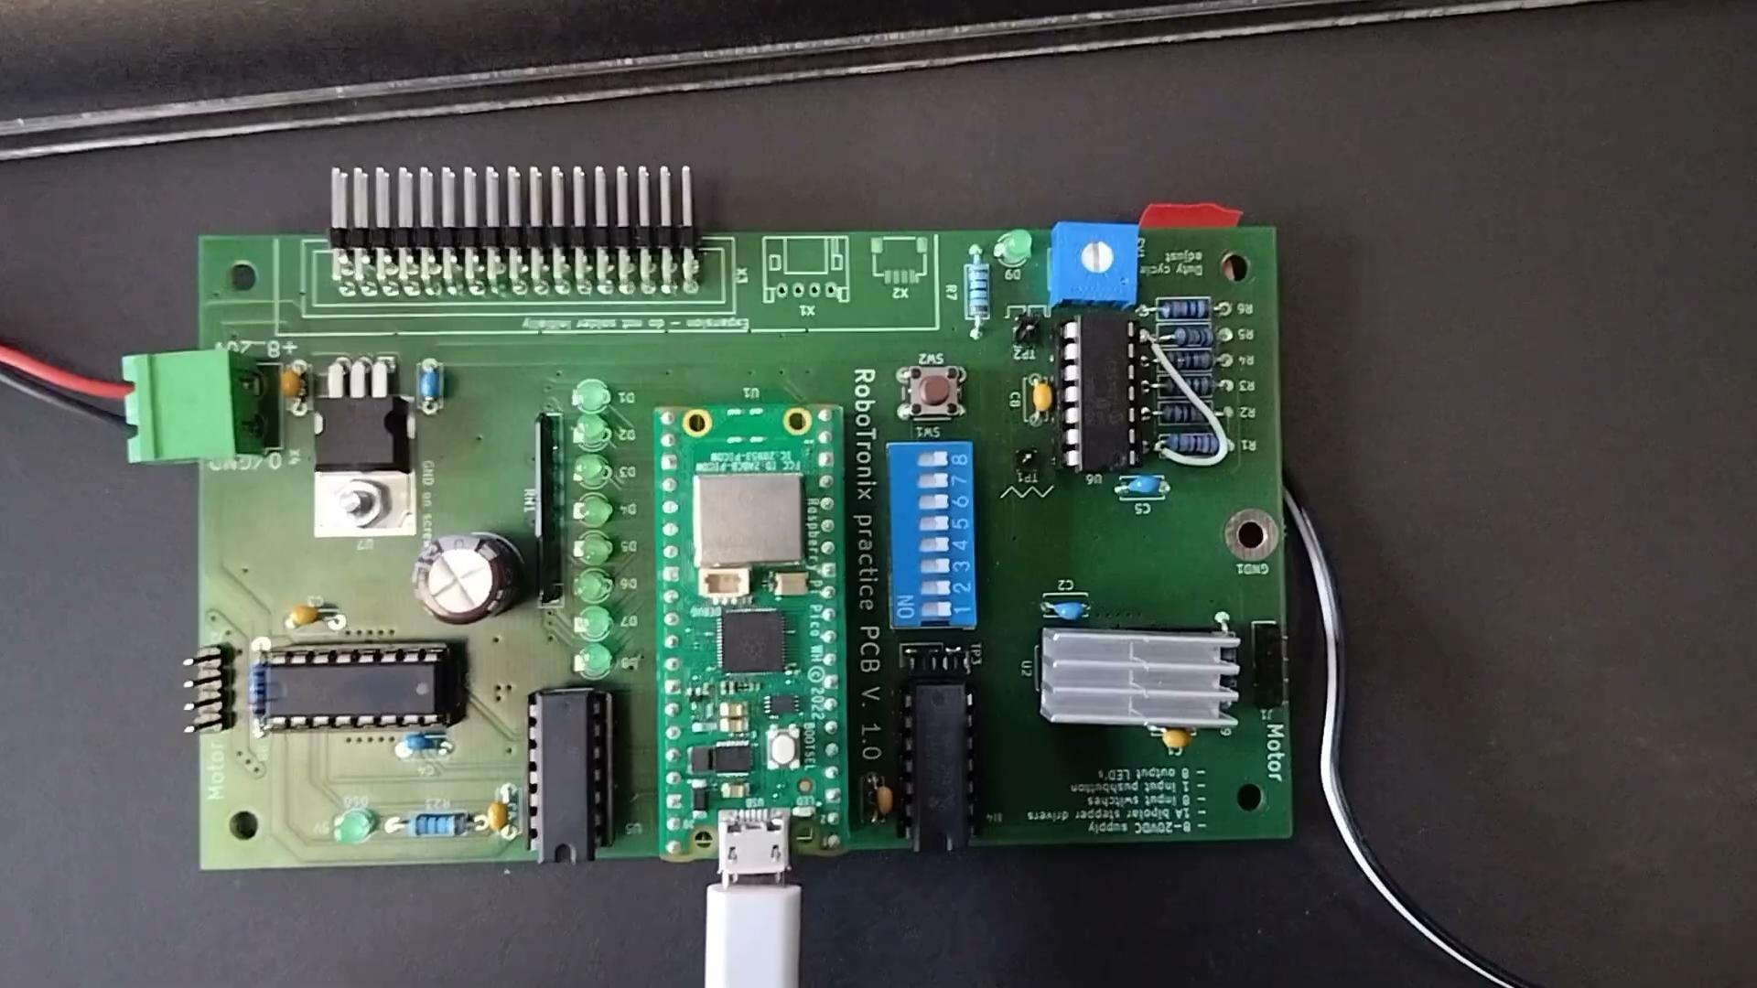
Half stepper: https://photos.app.goo.gl/WK56r75MM9Zwzdr16

Slide 106
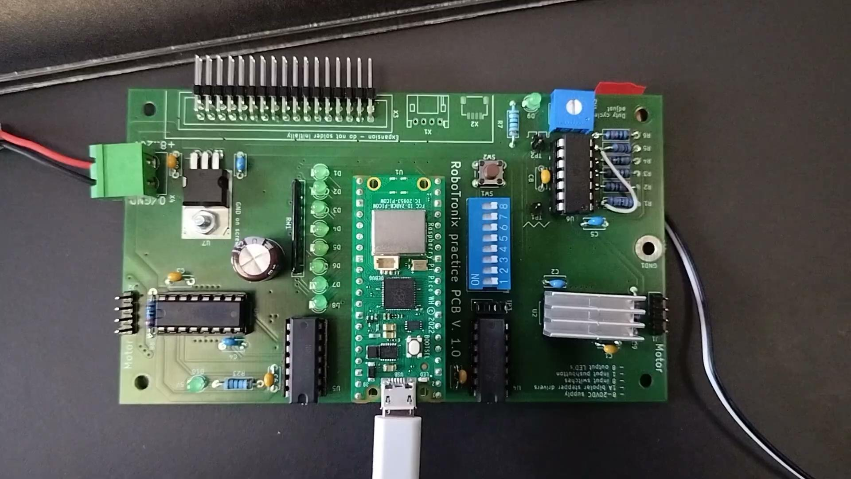
Micro stepper: https://photos.app.goo.gl/UL5M3smoSGfwaNX97 (solution)

Slide 107
Demo using Thonny

Slide 108
Assignments

