Slide 1

Process Mining Visualization Tool in Python
01
Student: Argjend Rustemi
Supervisor: Dipl.-Ing. Dr.techn Marian Lux

Slide 2
Table of Content
The key points we'll go through are:
Motivation
Introduction.
Objectives.
Bug Fixing for Handling Huge Input Data.
Enhancing the Heuristic Miner.
Implementing the Alpha Miner
Collaboration and Contribution
Conclusion
Q&A
References
02

Slide 3
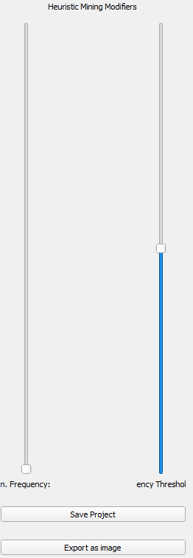
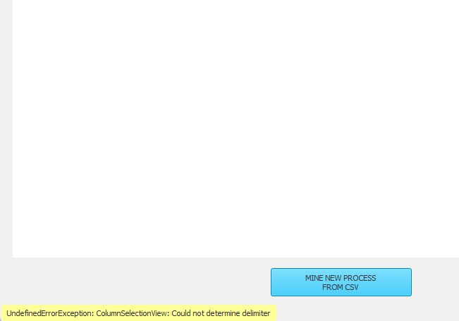
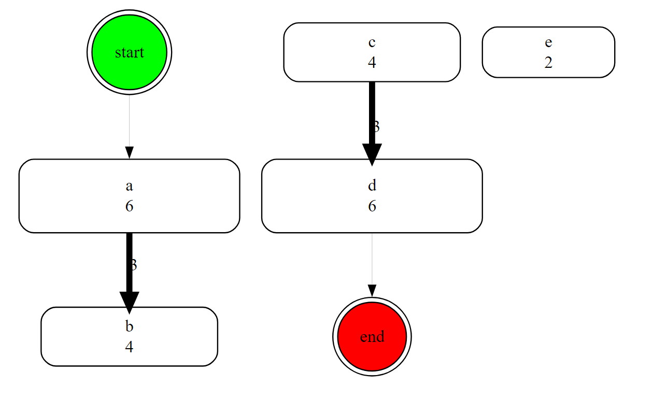

Motivation
Overview of the existing process mining tool.
Technology
Algorithms: Fuzzy[8] vs Heuristic[9] vs Alpha[3]
Contribution to an Open-Source Application
Limitations and issues identified in the previous tool
Importing large data files
Small screens
Connection of start and end nodes after filtration
04

Slide 4
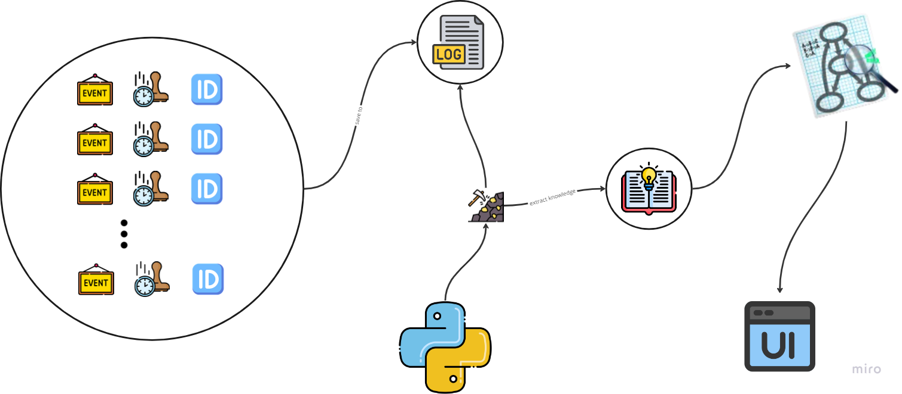
Introduction
Process mining?
"Process mining aims to discover, monitor, and improve real processes by extracting knowledge from event logs readily available in today’s information systems”.[5]
Three types of process mining[7]:
Process Discovery, Conformance Checking and Process Enhancement
03
Native understanding
“Process mining involves the extraction of knowledge from event logs.”

Slide 5
Objectives
New Mining Algorithm
Metrics
01
02
Implementing Alpha Miner
Enhancing Heuristic Miner (spm)
05
Bug fixing
03
UI for small screens, Delimiter Selection and Start and End nodes connecting

Slide 6
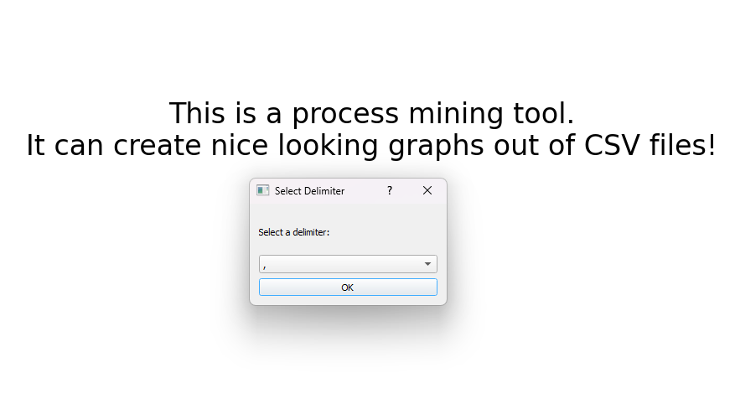
Bug Fixing for Handling Huge Input Data
Description of the bug and its impact.
Our solution
Demonstration
Problem: Tool throws exception when importing large CSV files.
Solution: Added a popup for manual delimiter selection.
07

Slide 7

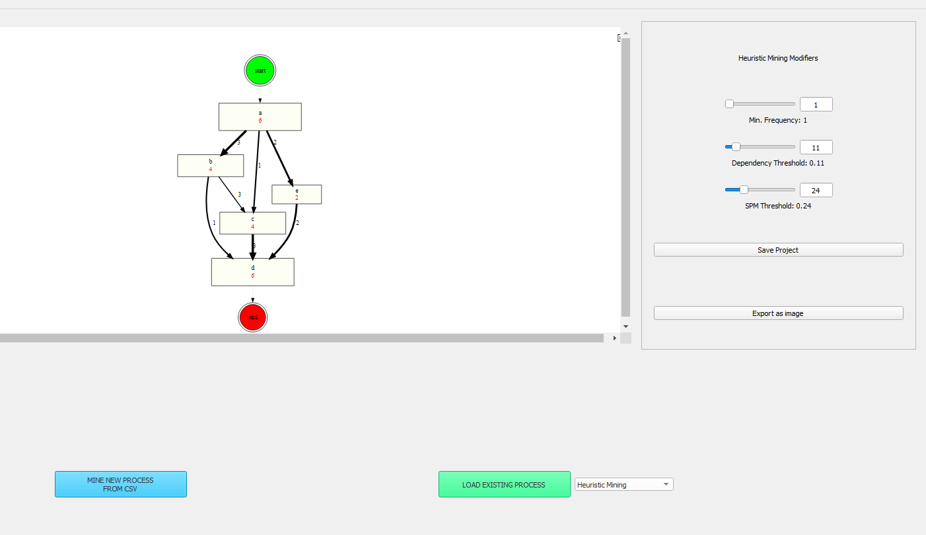
Enhancing the Heuristic Miner
Explanation of the metric[6].
Implementation details.
UI enhancements (horizontal sliders, input fields)
Demonstration
08

Slide 8
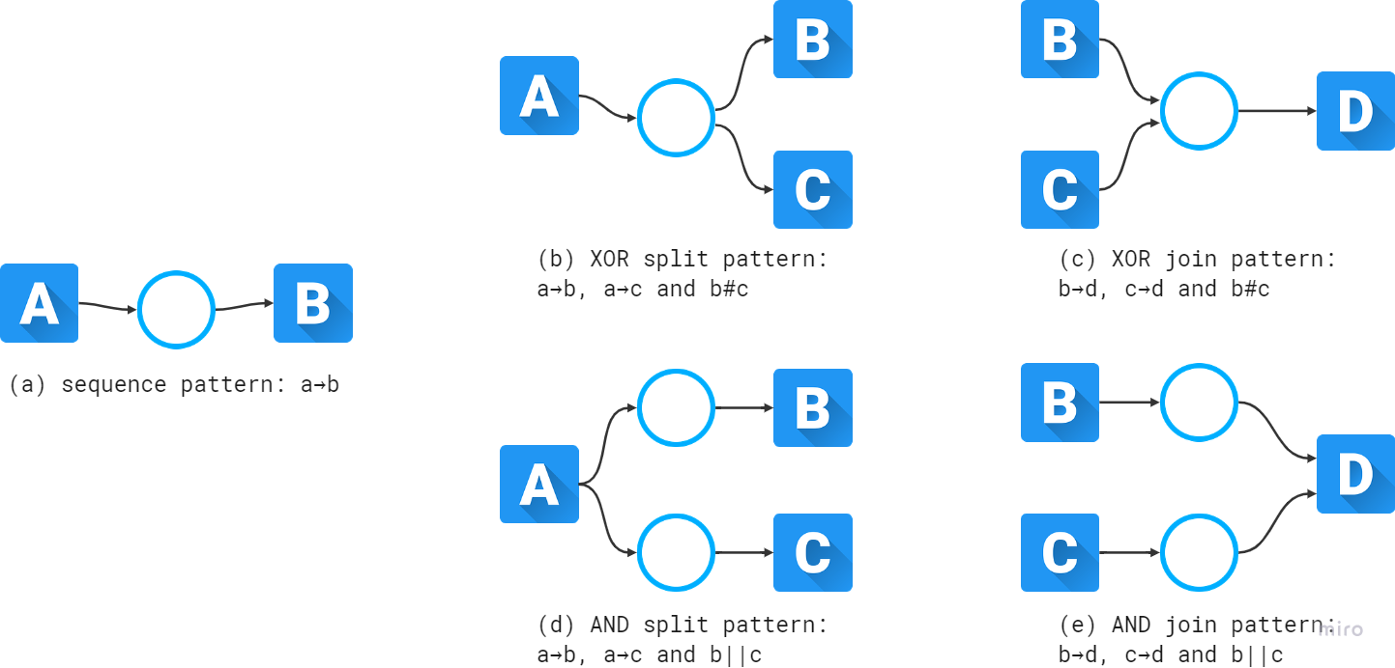
Implementing the Alpha Miner
Overview of the Alpha Miner algorithm.
Relationships between activities belonging to various cases.[1]
Direct succession: x>y iff for some case x is directly followed by y
Causality: x→y iff x>y and not y>x
Parallel: x||y iff x>y and y>x
Choice: x#y iff not x>y and not y>x
Patterns.[1]
09

Slide 9
Implementing the Alpha Miner
Implementation steps [1] [2] [3].
Step 1: Defining all the unique events
Step 2: Defining all possible start events
Step 3: Defining all possible end events
Step 4: Calculate pairs (A,B)
Step 5: Delete non-maximal pairs
Step 6: Determine places p(A,B) from pairs (A,B)
Step 7: Draw the connections
Step 8: Return the model
10
Challenges.
Calculating pairs (A,B)
Deleting non-maximal pairs (A,B)
Visualizing relationships between events using Graphviz
Demonstration.

Slide 10
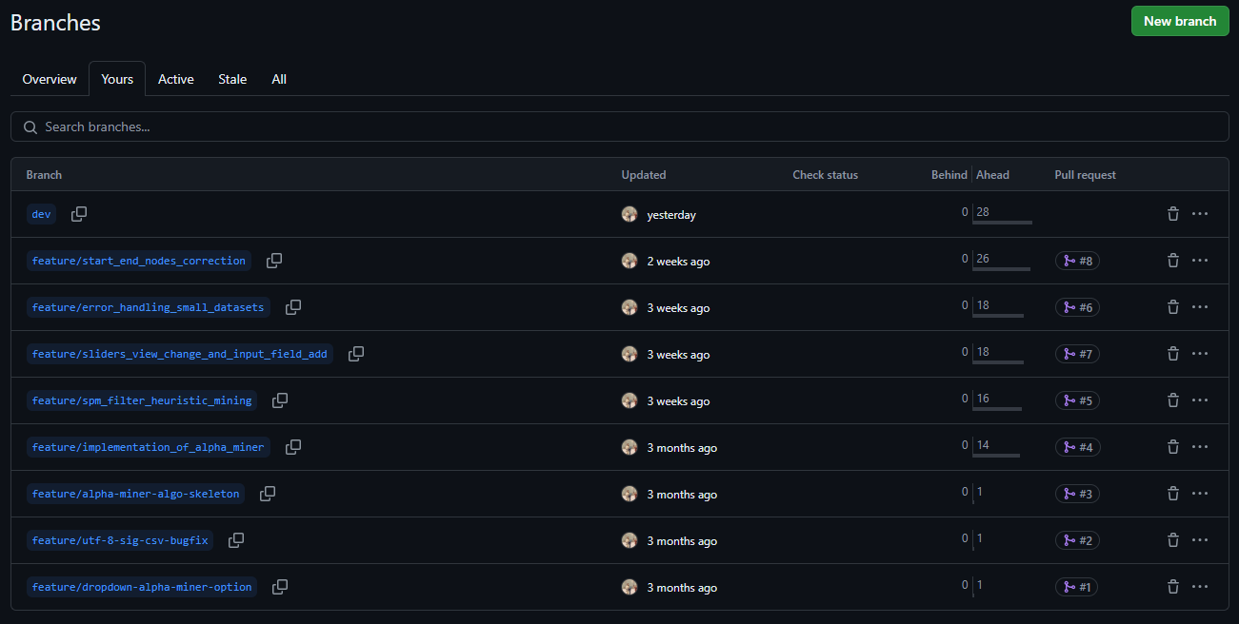
Collaboration and Contribution
Working in a collaborative environment.
Code management in GitHub.
Merging changes into the main project
11

Slide 11
Conclusion
Summary of the improvements made.
Impact on the usability and functionality of the tool.
Key takeaways.
Challenges.
12
Potential future work and improvements.

Slide 12
Q&A
13

Slide 13
References
1. Van Der Aalst, W. M., & Van Dongen, B. F. (2013). Discovering petri nets from event logs. In Transactions on Petri nets and other models of concurrency vii (pp. 372-422). Springer Berlin Heidelberg
2. Küsters, A., & van der Aalst, W. M. (2023, June). Revisiting the Alpha Algorithm To Enable Real-Life Process Discovery Applications. In ATAED/PN4TT@ Petri Nets.
3. Nafasa, P., Waspada, I., Bahtiar, N., & Wibowo, A. (2019, October). Implementation of alpha miner algorithm in process mining application development for online learning activities based on moodle event log data. In 2019 3rd International Conference on Informatics and Computational Sciences (ICICoS) (pp. 1-6). IEEE.
4. Van der Aalst, W. M., & van der Aalst, W. M. (2011). Process discovery: An introduction. Process mining: Discovery, conformance and enhancement of business processes, 125-156.
5. Van Der Aalst, W. (2012). Process mining: Overview and opportunities. ACM Transactions on Management Information Systems (TMIS), 3(2), 1-17.
6. Lux, M., Rinderle-Ma, S., & Preda, A. (2018). Assessing the quality of search process models. In Business Process Management: 16th International Conference, BPM 2018, Sydney, NSW, Australia, September 9–14, 2018, Proceedings 16 (pp. 445-461). Springer International Publishing.
7. der Aalst, V., & Mining, W. P. (2011). Discovery, Conformance and Enhancement of Business Processes. Media; Springer: Berlin/Heidelberg, Germany, 136.
14

Slide 14
References
8. Günther, C. W., & Van Der Aalst, W. M. (2007, September). Fuzzy mining–adaptive process simplification based on multi-perspective metrics. In International conference on business process management (pp. 328-343). Berlin, Heidelberg: Springer Berlin Heidelberg
9. Kurniati, A. P., Kusuma, G., & Wisudiawan, G. (2016). Implementing heuristic miner for different types of event logs. vol, 11, 5523-5529.
15

Slide 15
Thank you for your attention!

