Slide 1
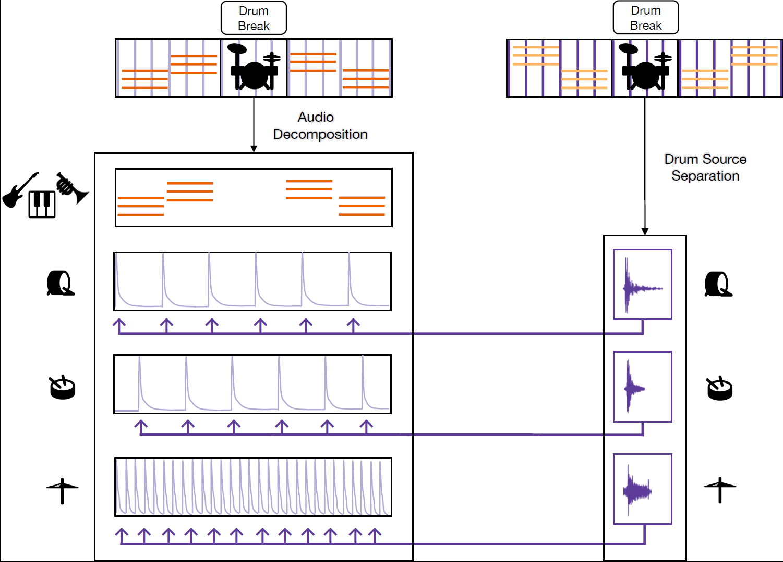




Drum Break
Drum Break
Audio Decomposition
Drum Source Separation
Melodic
instruments
Kick drum
Snare drum
Hi-hat

