Slide 1





On the influence of instrument specifics and cognitive load on walking bass improvisation
Klaus Frieler¹, Jakob Abeßer², Wolf-Georg Zaddach¹, Benjamin Burkhart¹, Frank Höger¹, Martin Pfleiderer¹
¹University of Music “Franz Liszt” Weimar, Germany
²Fraunhofer IDMT, Ilmenau, Germany

Slide 2
Introduction
Not only solos are improvised but also accompaniment (bs, p, dr), even though to lesser degree.
Walking bass is the prevailing standard of jazz accompaniment since late 1930 / early 1940s.
Walking bass lines seldom investigated in jazz research (Skinner 2016, Thongpae 2011, Pfleiderer et al. 2015)
Several walking bass generation algorithms available (Johnson-Laird 1991, Dias & Guedes 2013, Band-In-The-Box).
Textbooks and teaching materials are relatively scarce compared with other jazz instruments (Goldsby 2002, Reid 2000, Brown 1999, Carter 1998, Downes 2004).

Slide 3
Walking Bass Improvisation
Walking bass improvisation (WBI) can be viewed as creative problem solving under constraints.
A bass player is expected to provided a solid harmonic and rhythmic foundation:
Spelling out chord changes with smooth and/or interesting melodic lines.
Moving in quarter notes plus tonal and rhythmic embellishments.

Slide 4
Walking Bass Improvisation
Double bass is a particularly clumsy instrument.
Large spacing, strong forces, low volume (played without amplification till the 1950s).
Finding musical meaningful, non-redundant and playable melodic connections between chords is challenging (particularly in high tempo).
Prevalent keys in jazz (F, Bb, C, Eb) sit not well with double-bass tuning in E1, A1, D1, G1.

Slide 5
Aims
Explorative and descriptive study of a large corpus of automatically transcribed walking bass lines (first study in both regards).
Generating hypotheses about musical constraints, cognitive load and instrument affordances.
Walking bass lines relatively simple and rule-based compared to other jazz improvisation: Promising testbed to examine improvisation as problem solving.

Slide 6
Data

Slide 7
Data
456 solos from the Weimar Jazz Database, beat-annotated.
Bass notes extracted using deep learning methods (Abeßer, Balke, Frieler, Pfleiderer, & Müller, M. 2017).
Additional metadata (e.g. chord symbols, tempo, tonality).
Selected solos with SWING rhythm feel in 4/4 time.
Removed “no chord” sections and incomplete bars.
332 transcriptions of walking bass lines by 78 different players with 94.149 tones in total.
Mean accuracy 83% for pitches and 89% for pitch classes.
#Tones: AM = 283.0, SD = 206, Range = 47-1718(!).
Pitch range: 28-53 (E1-F3).
Time span: 1936-2001.

Slide 8
Data: Players
Player | Number of solos
Paul Chambers | 26
Ray Brown | 18
Dave Holland | 15
Curly Russell | 14
Ron Carter | 14
UNKNOWN | 13
Percy Heath | 11
Doug Watkins | 9
Milt Hinton | 8
Rodney Richardson | 8
OTHER | 195

Slide 9
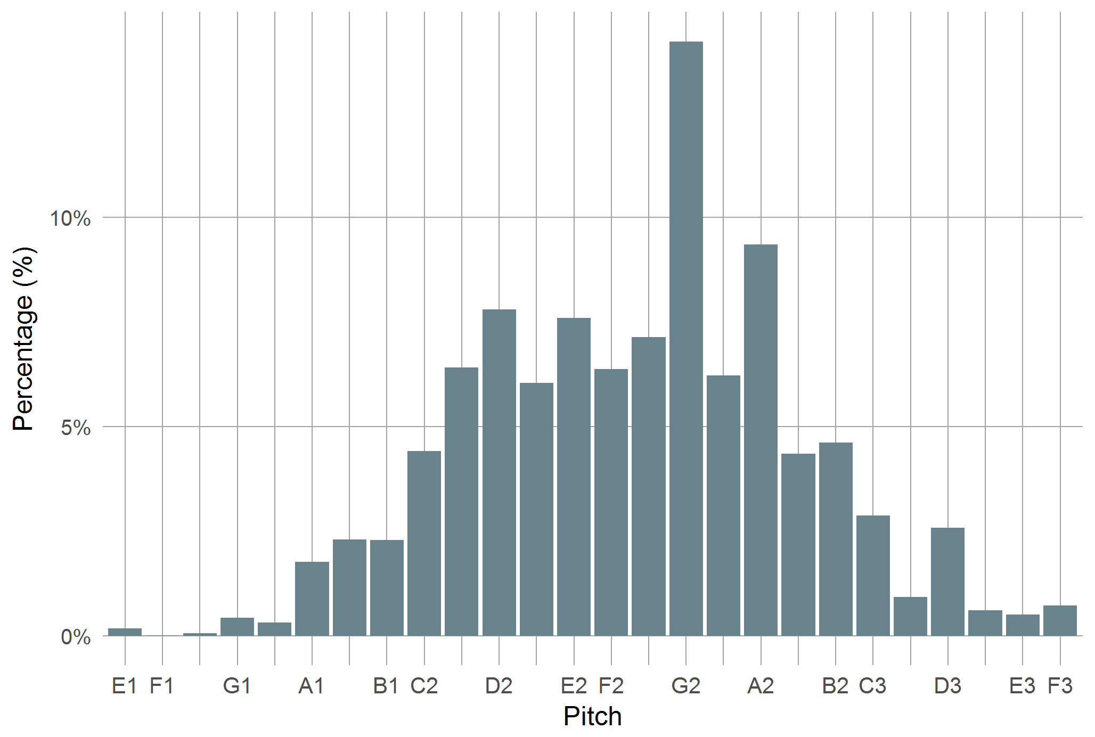
Data: Pitches

Slide 10
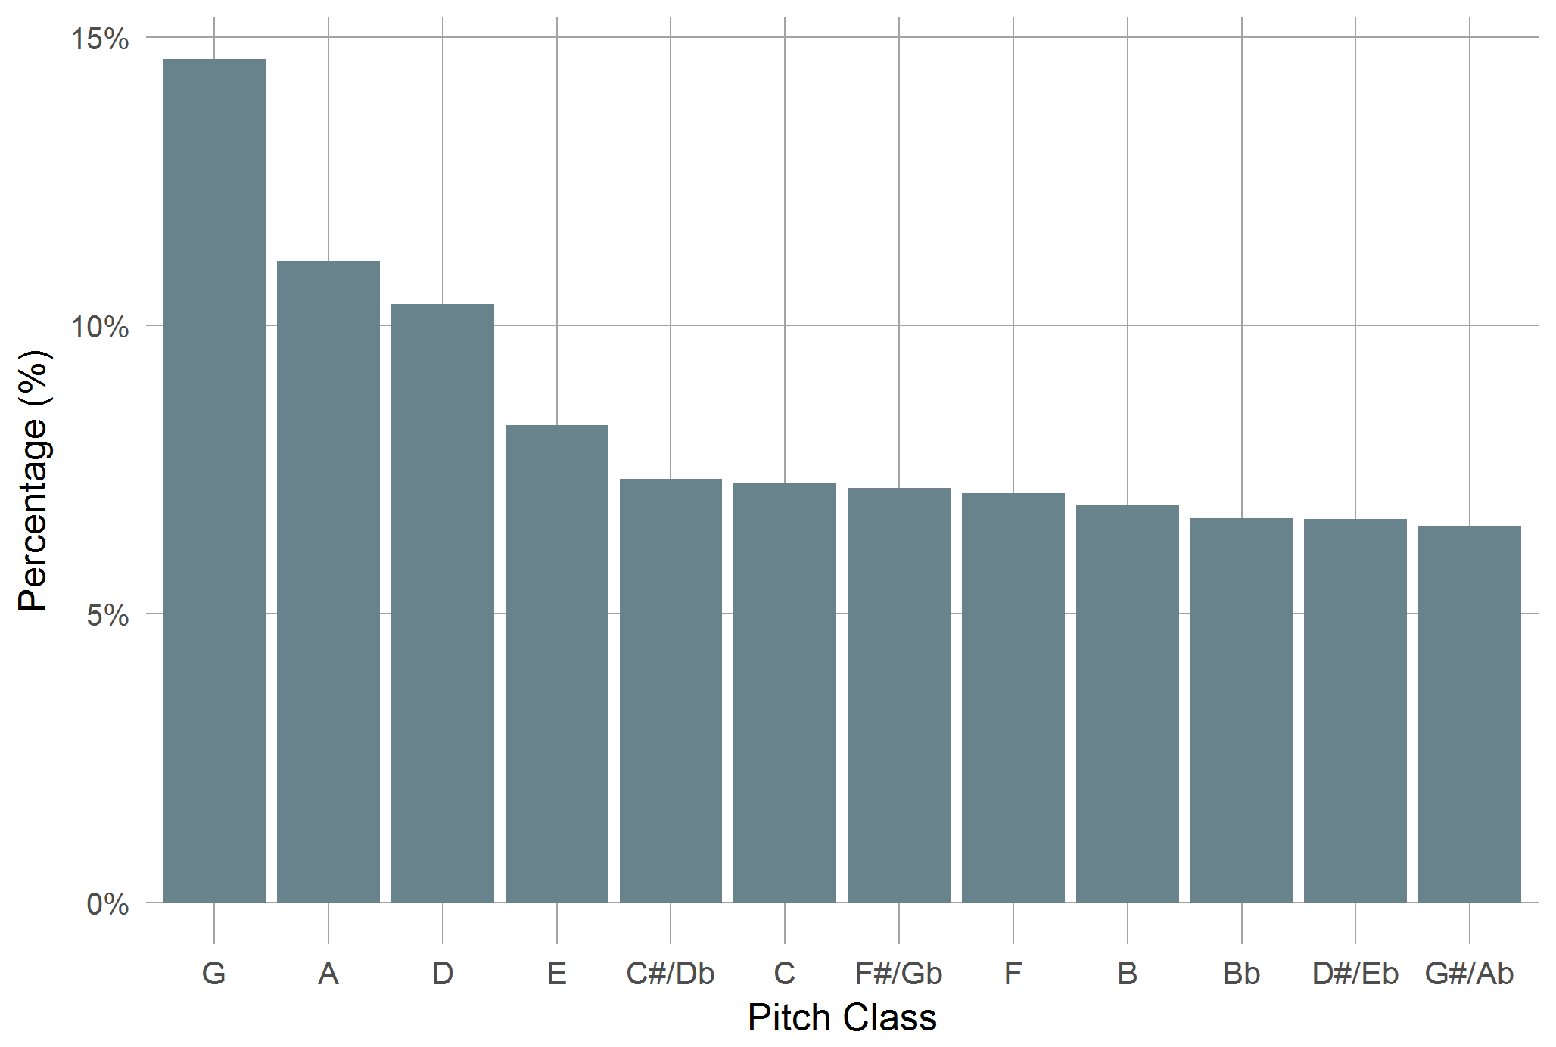
Data: Pitch Classes

Slide 11
Results: CPC Frequencies
Chordal pitch classes (CPC): Pitch class with the root of the surrounding chord as reference (root = 0, m3 = 3, M3 = 4, P4 = 5, P5 = 7 etc.)

Slide 12
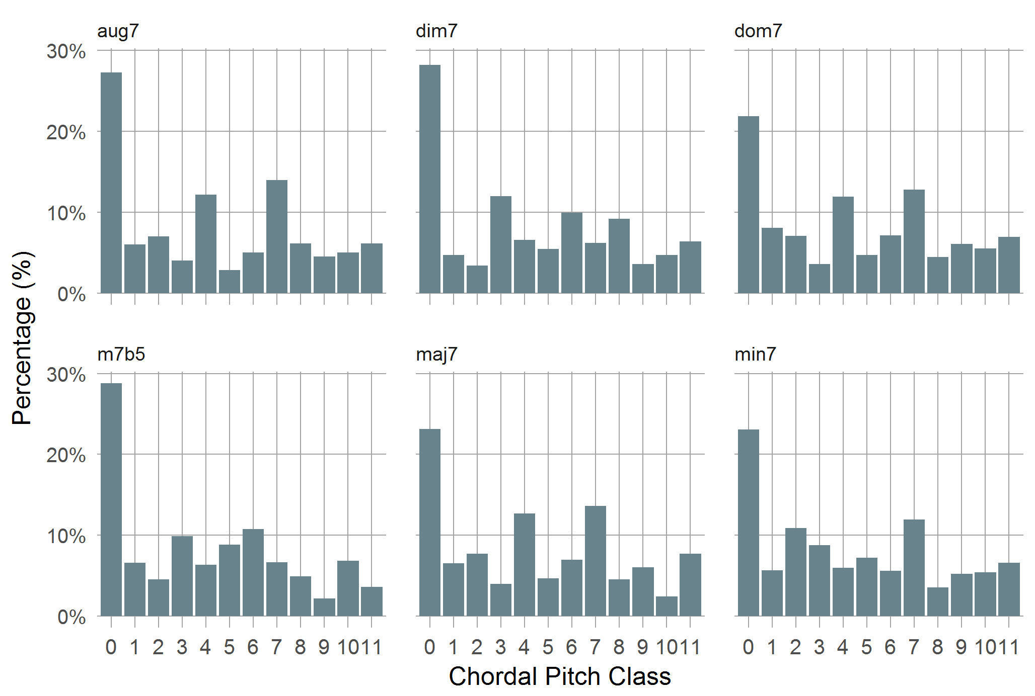
CPC Frequencies / Chord Type
χ²: p <.001, φ = .186

Slide 13
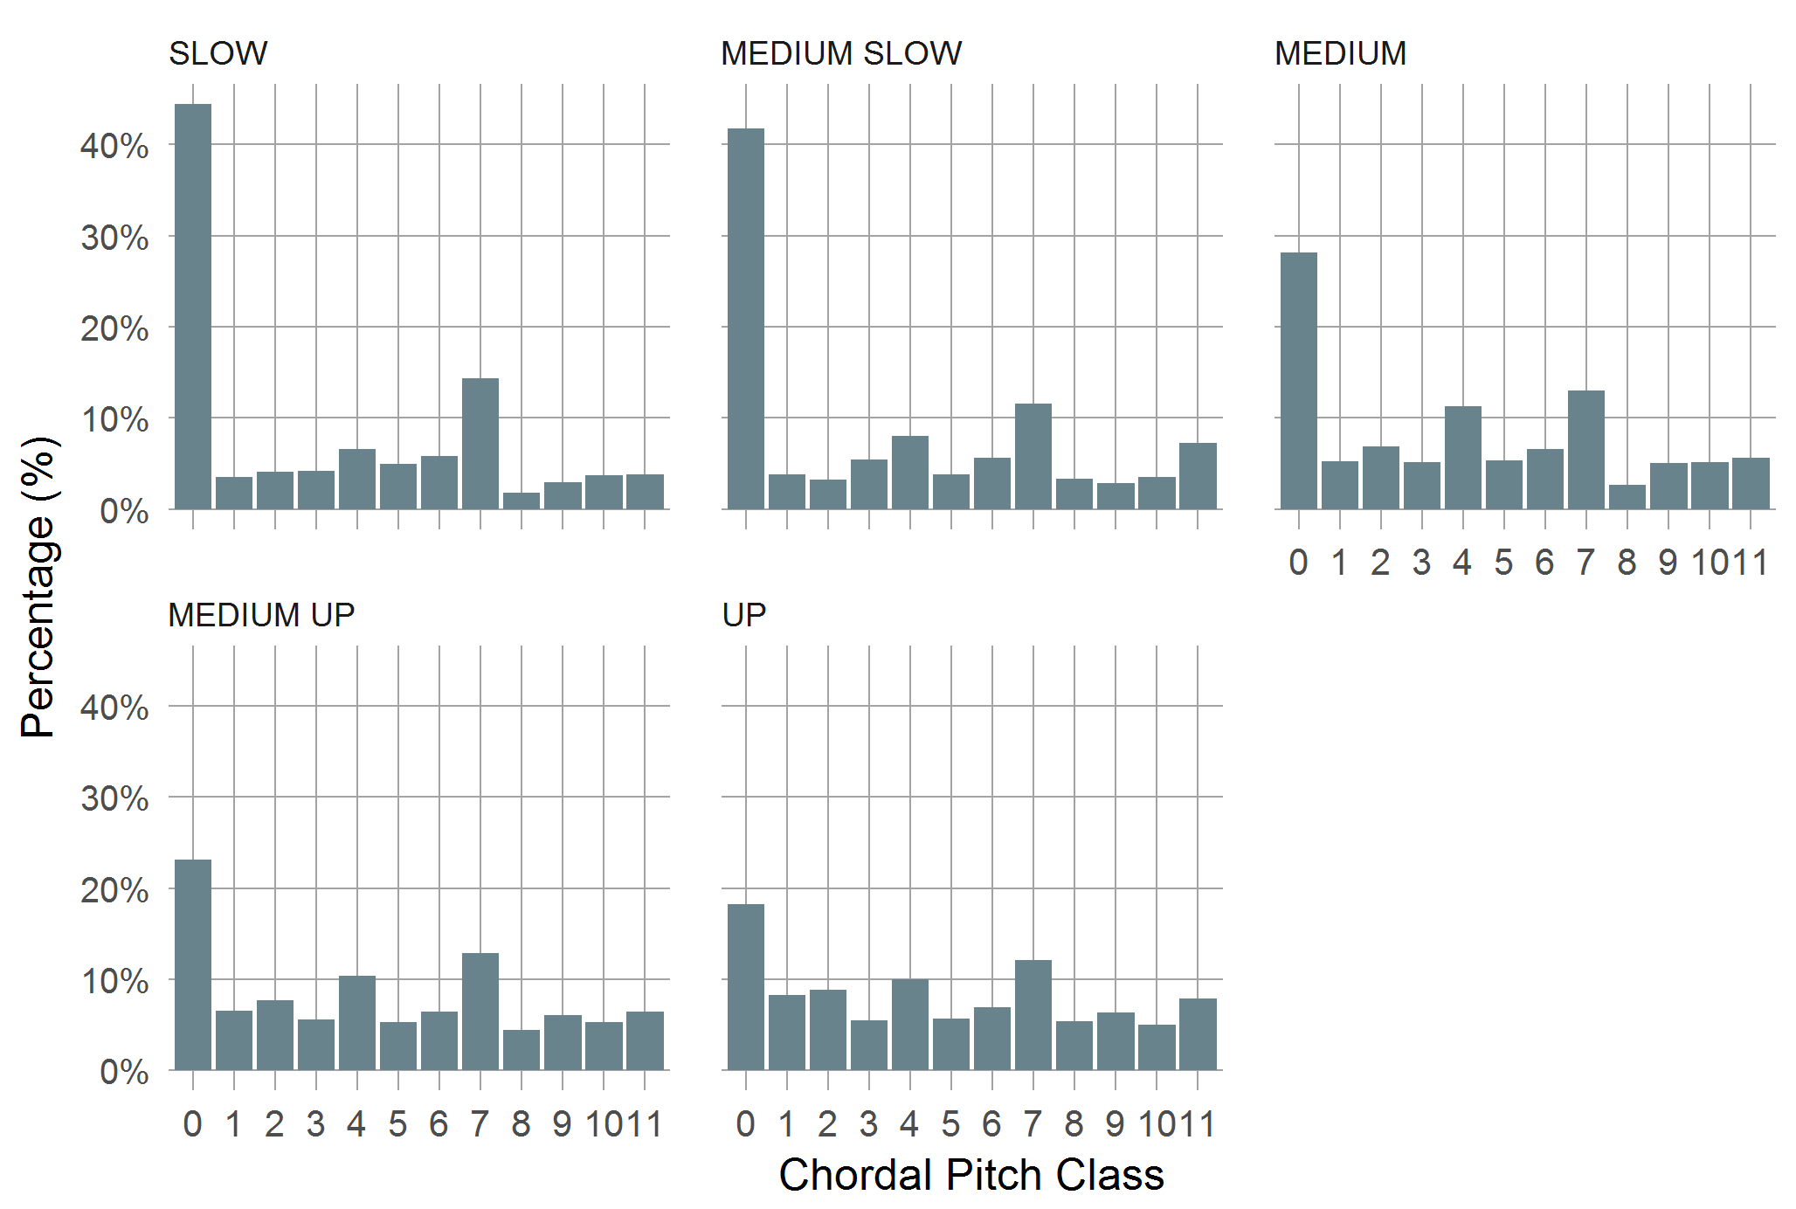
CPC Frequencies / Tempo class
χ²: p <.001, φ = .182

Slide 14
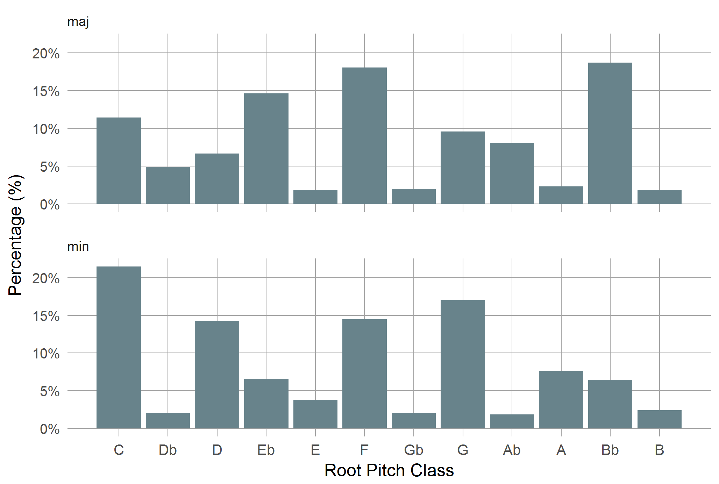
Chord Root Frequencies

Slide 15
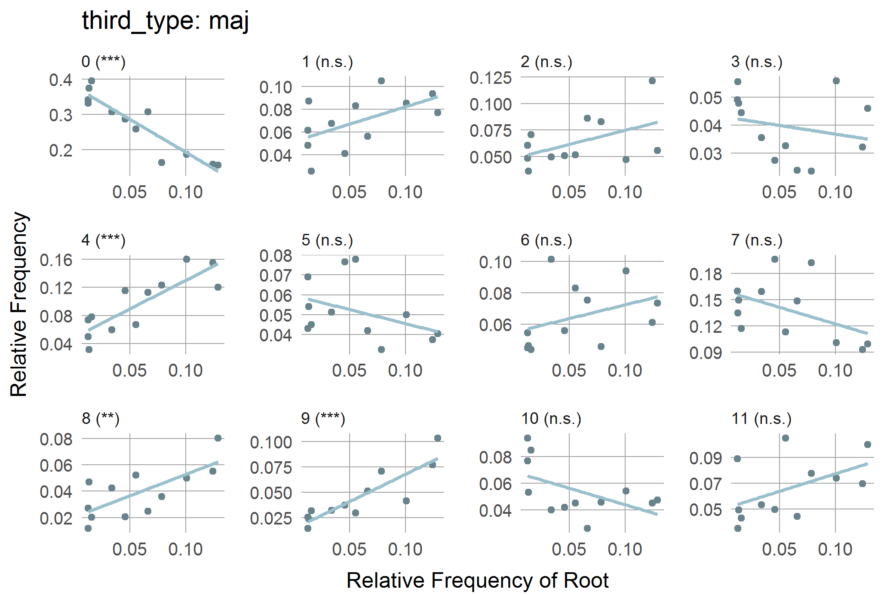
CPC Freq / Root Freq / Maj

Slide 16
Results: CPC Consonance
CPC consonance: Weighted sum of basic consonances (root = 5, fifth = 4, third = 3, diatonic = 2, chromatic = 1with adjustments for diminished and augmented chords).

Slide 17
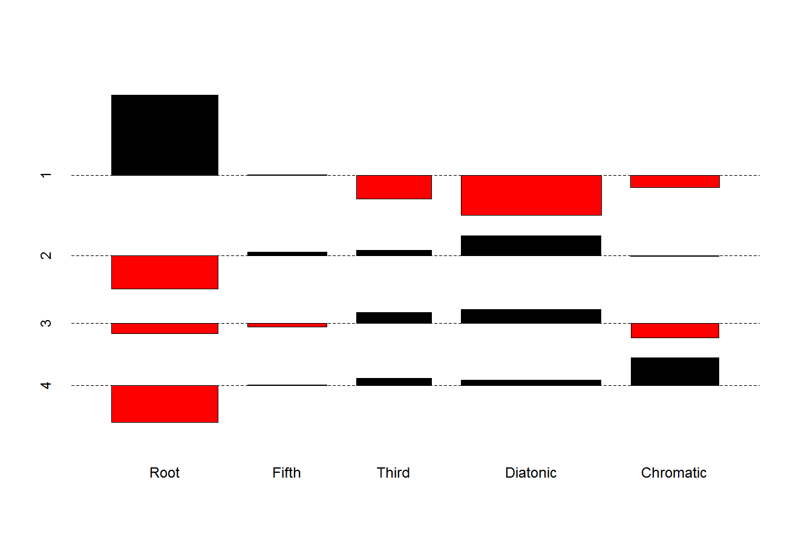
CPC Consonance x Beat matrix

Slide 18
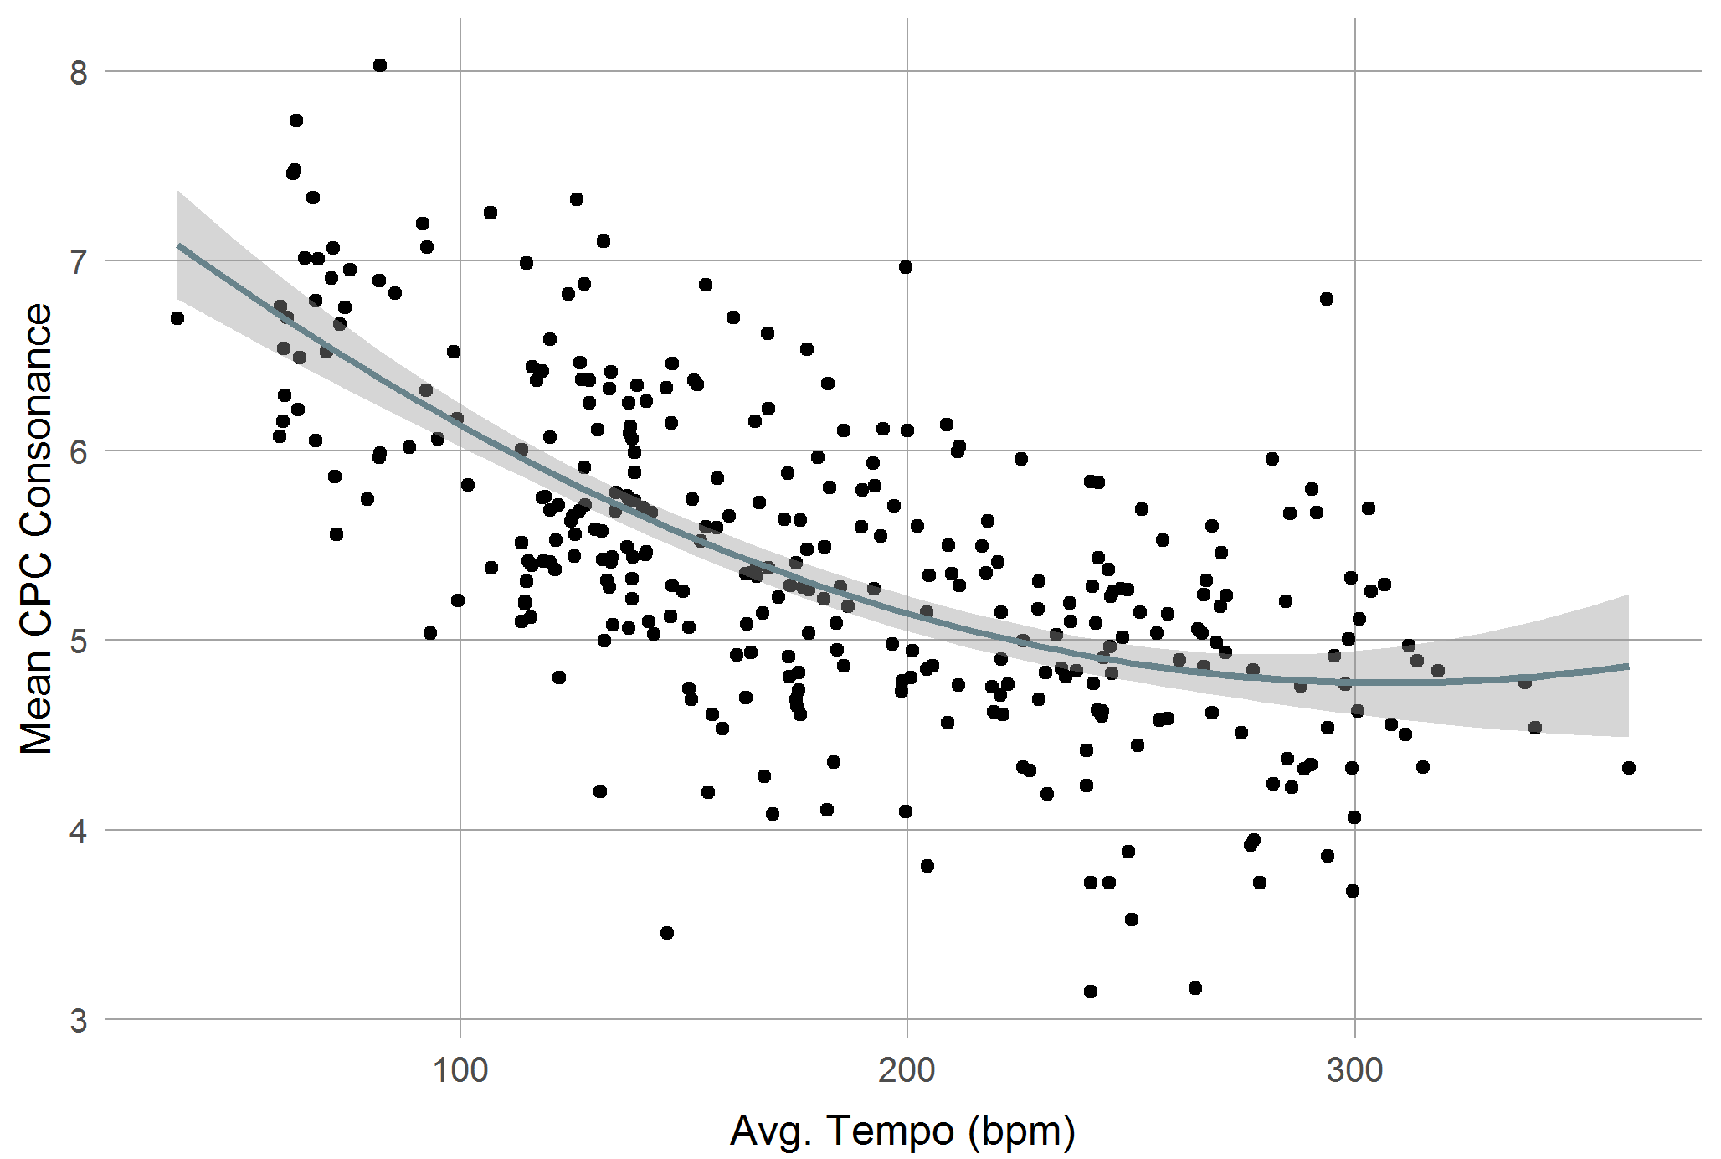
CPC Consonance / Tempo
Poly LM: p < .001, R² = .43

Slide 19
Results: Intervals

Slide 20
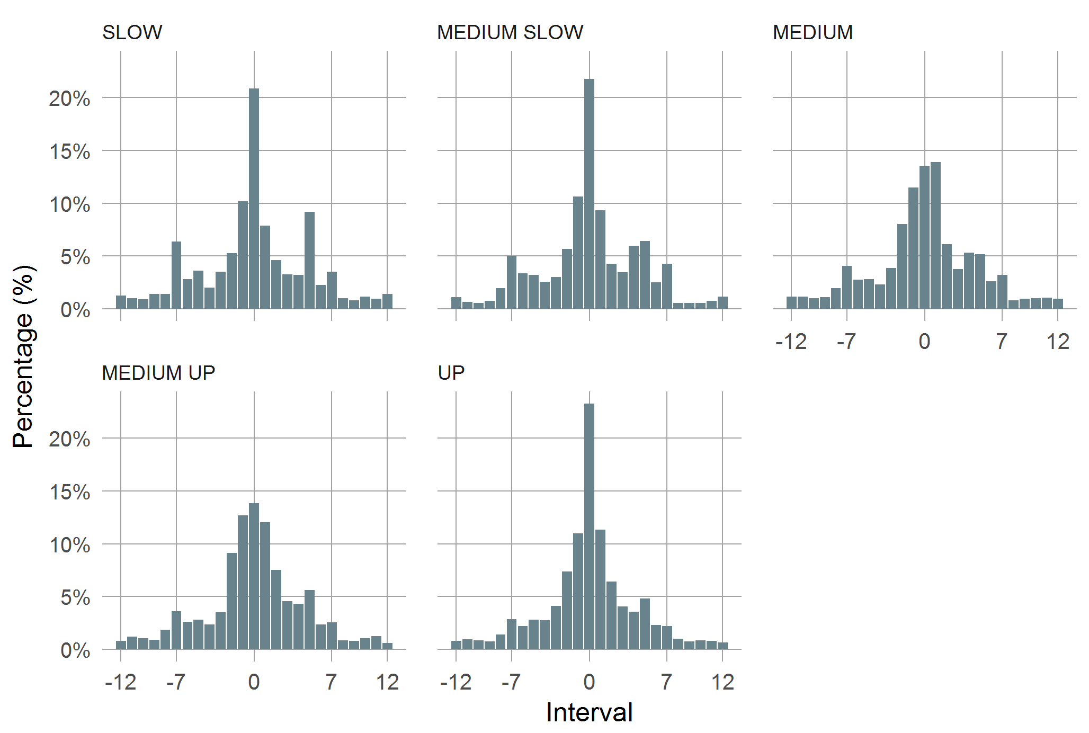
Intervals: Tempo class
χ²: p <.001, φ = .148

Slide 21
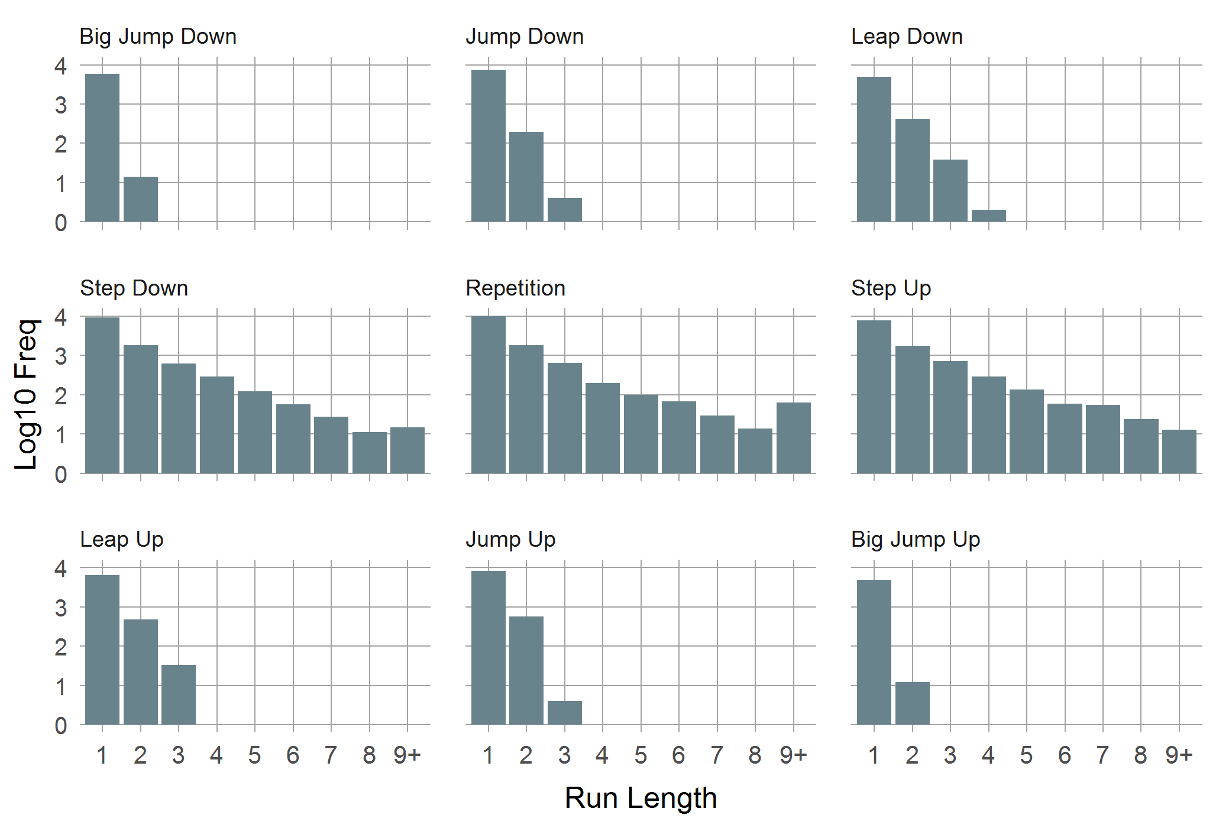
Intervals: Run Lengths
χ²: p <.001, φ = .122

Slide 22
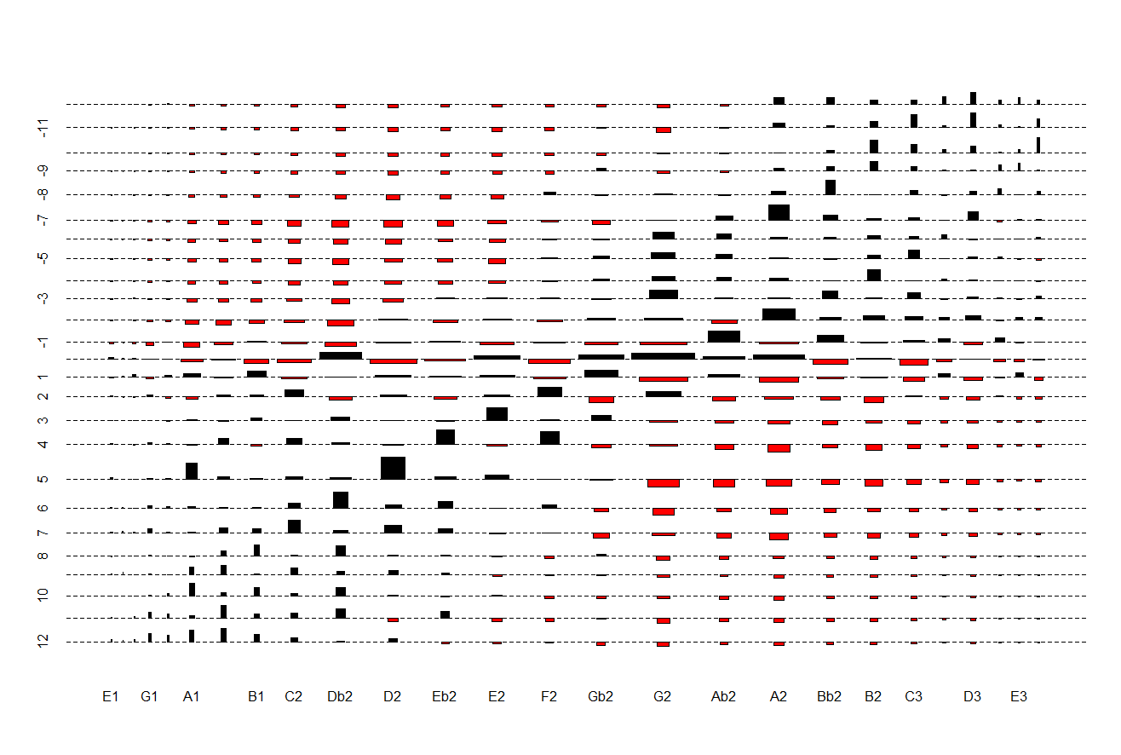
Interval x Pitch matrix
G2 as gravitational center
Upwards
Downwards

Slide 23
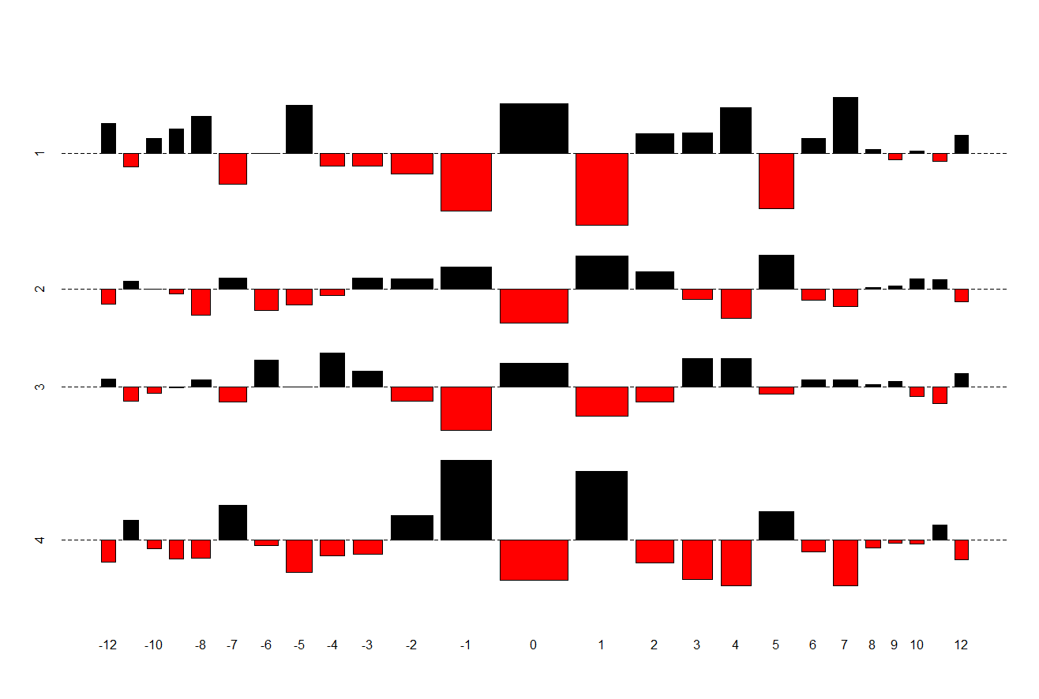
Interval x Beat matrix

Slide 24
Results: Interval Pattern Entropy (IPE)
For each (four-beat) bar determine (3-element) interval pattern.
Define Interval Pattern Entropy (IPE) as Shannon entropy over the distribution of pattern frequencies: H = - Σ p log₂ p.
Correlation of CPC entropy and IPE: r = -.12 (p = .035).

Slide 25
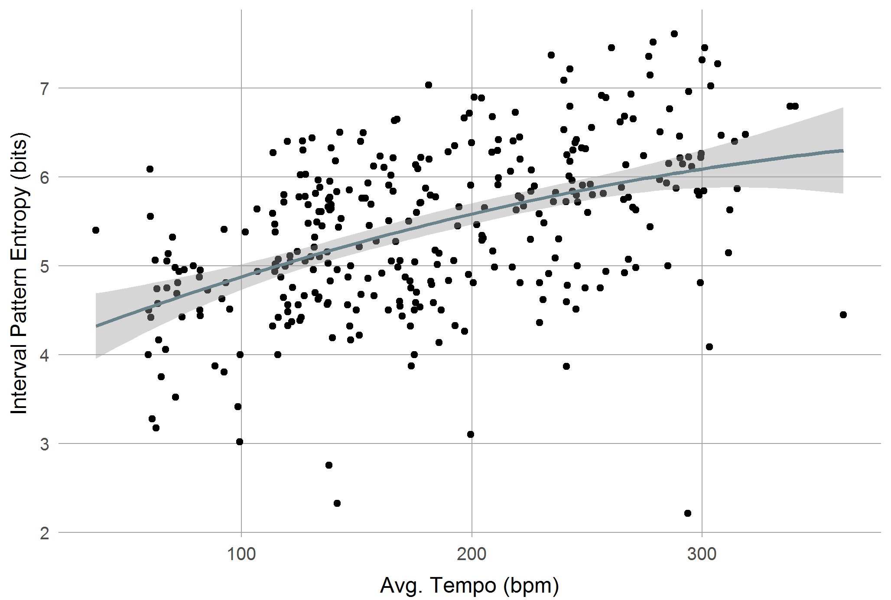
IPE / Tempo
Poly LM: p < .001, R² = .23

Slide 26
Summary
Empty strings most frequent (as far as we can tell).
G2 as gravitational center.
Most frequent chord pitch classes: root, fifth, third, minor/major second, leading tone.
The more seldom a chord root, the more players stick to primary chord tones.
CPC consonance decrease with tempo: higher chromaticism, lower precision in laying-out the chords.

Slide 27
Summary
Small intervals prevail, mostly repetitions, semitones, whole-tones (56%).
Repetitions less often used in medium and medium up tempos.
In slow and medium slow tempo rarely true walking.
Interval sequence often angular. (Run lengths of interval categories are short, travelled distance and pitch range per bar are independent r = .0, p < .001).

Slide 28
Summary
Number of bar-wise interval patterns large.
Entropy of interval patterns increases with tempo.
Median of max. rel. frequency of interval and CPC patterns across all solos is about 6%: Low redundancy, high variability.

Slide 29
Conclusion
Create lines beyond basic root and fifths by filling the spaces with step-wise motion (reason why walking bass was invented?)
Step-wise motion is easiest to play on the bass.
Frequency of intervals roughly proportional to playing difficulty.
Usage of empty strings and tone repetitions to ease task.
Patterns are present but not abundant.
Bass lines in high tempo are less redundant, more chromatic, but also harmonically less precise.
Interaction of musical and physical constraints.

Slide 30
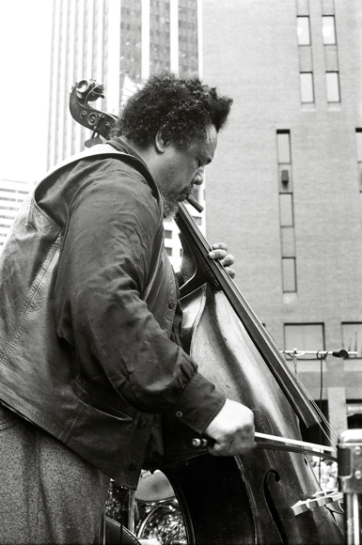
Thank you!
By Tom Marcello -https://www.flickr.com/photos/tommarcello/365445060/, CC BY-SA 2.0

Slide 31
Data: Transcription
Mean accuracy of transcription algorithm on test set is 83% (SD= 13%) for pitches and 89% (SD= 11%) for pitch classes.
Typical errors: Octave, fifth, semitone.
Allowed pitch range: 28-67.
Observed pitch range: 28-53.
Pitches seem to be squeezed to the second octave.
However, interval distribution shows few suspicious intervals resulting from octave errors.

Slide 32
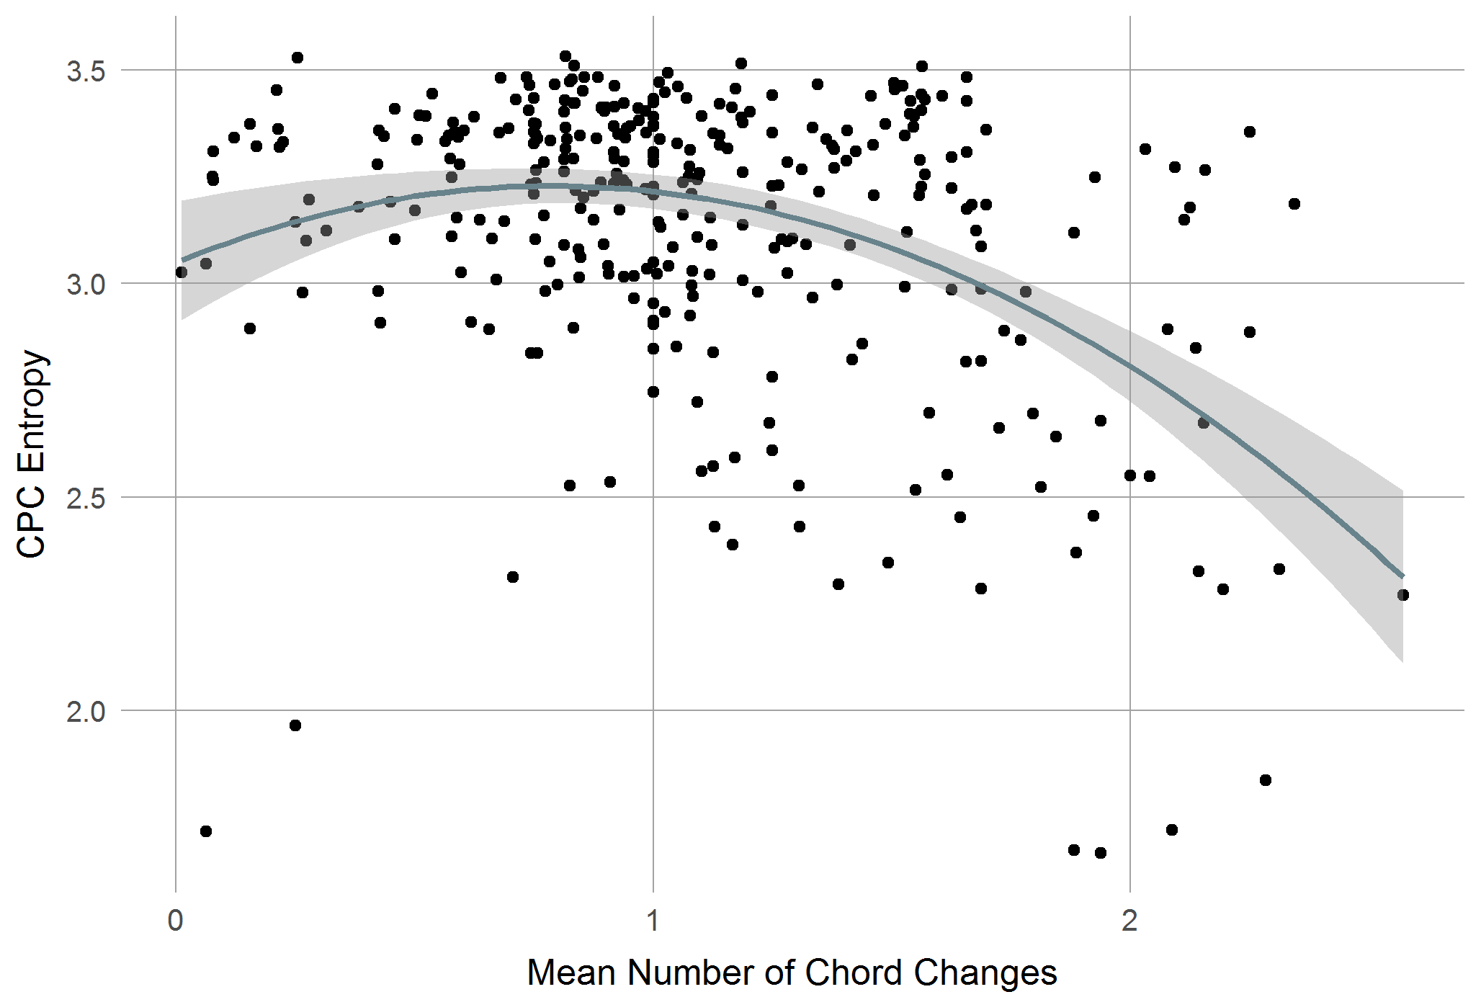
CPC Entropy / #Chord Changes/bar
Poly LM: p < .001, R² = .18

Slide 33
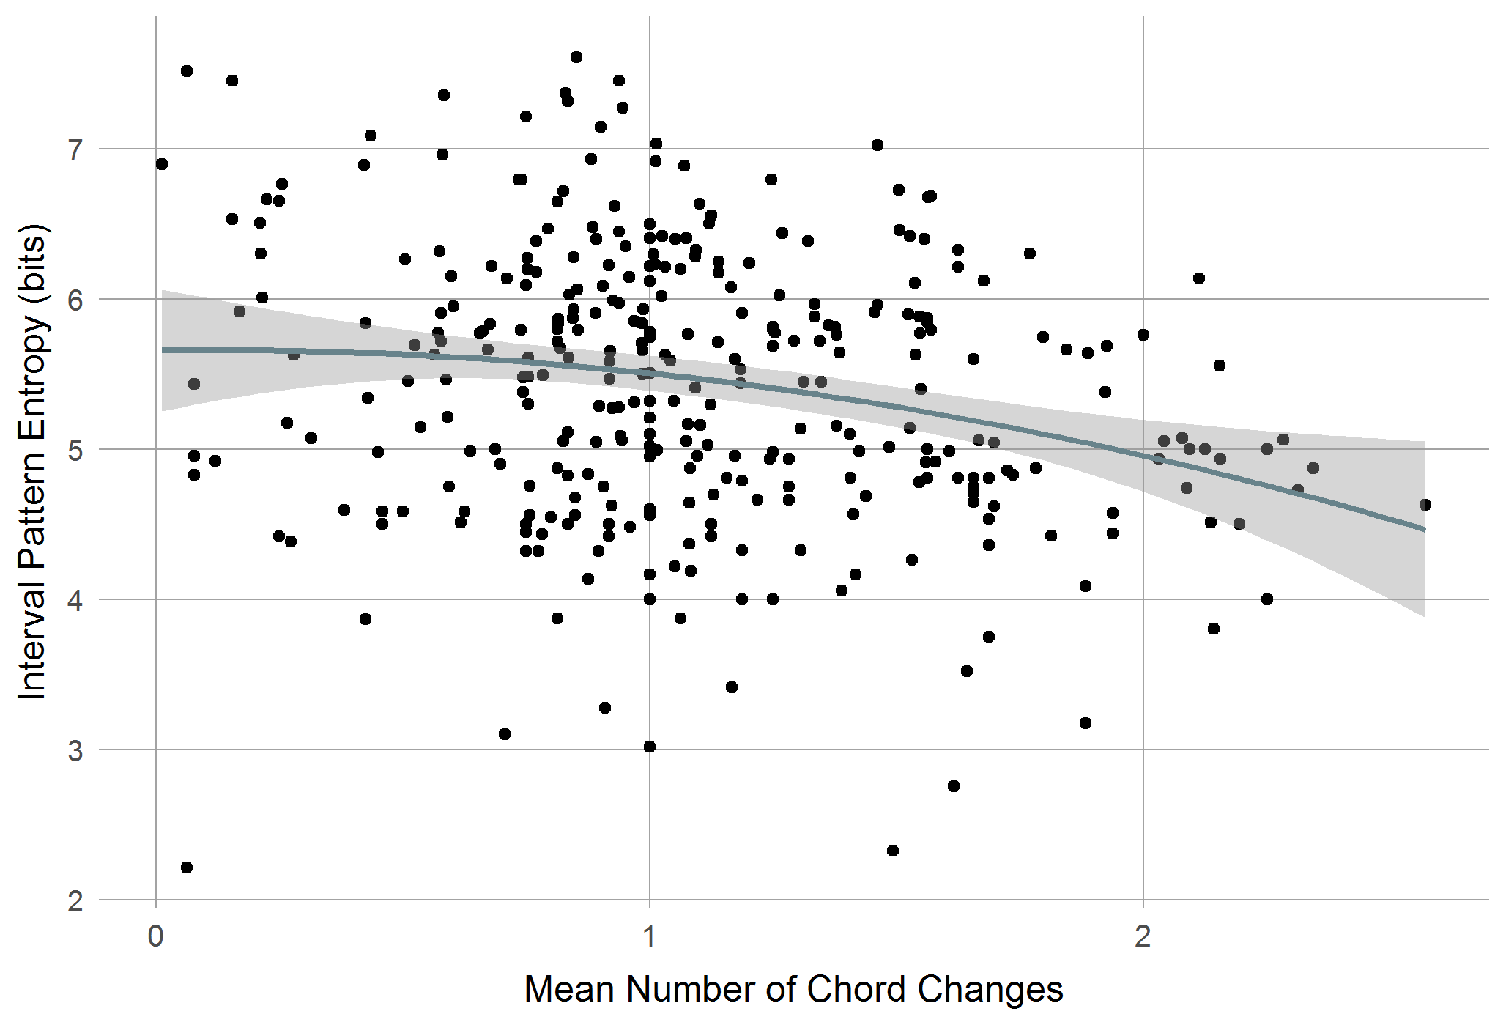
IPE / #Chord Changes
Poly LM p < .001, R² =-.04

Slide 34
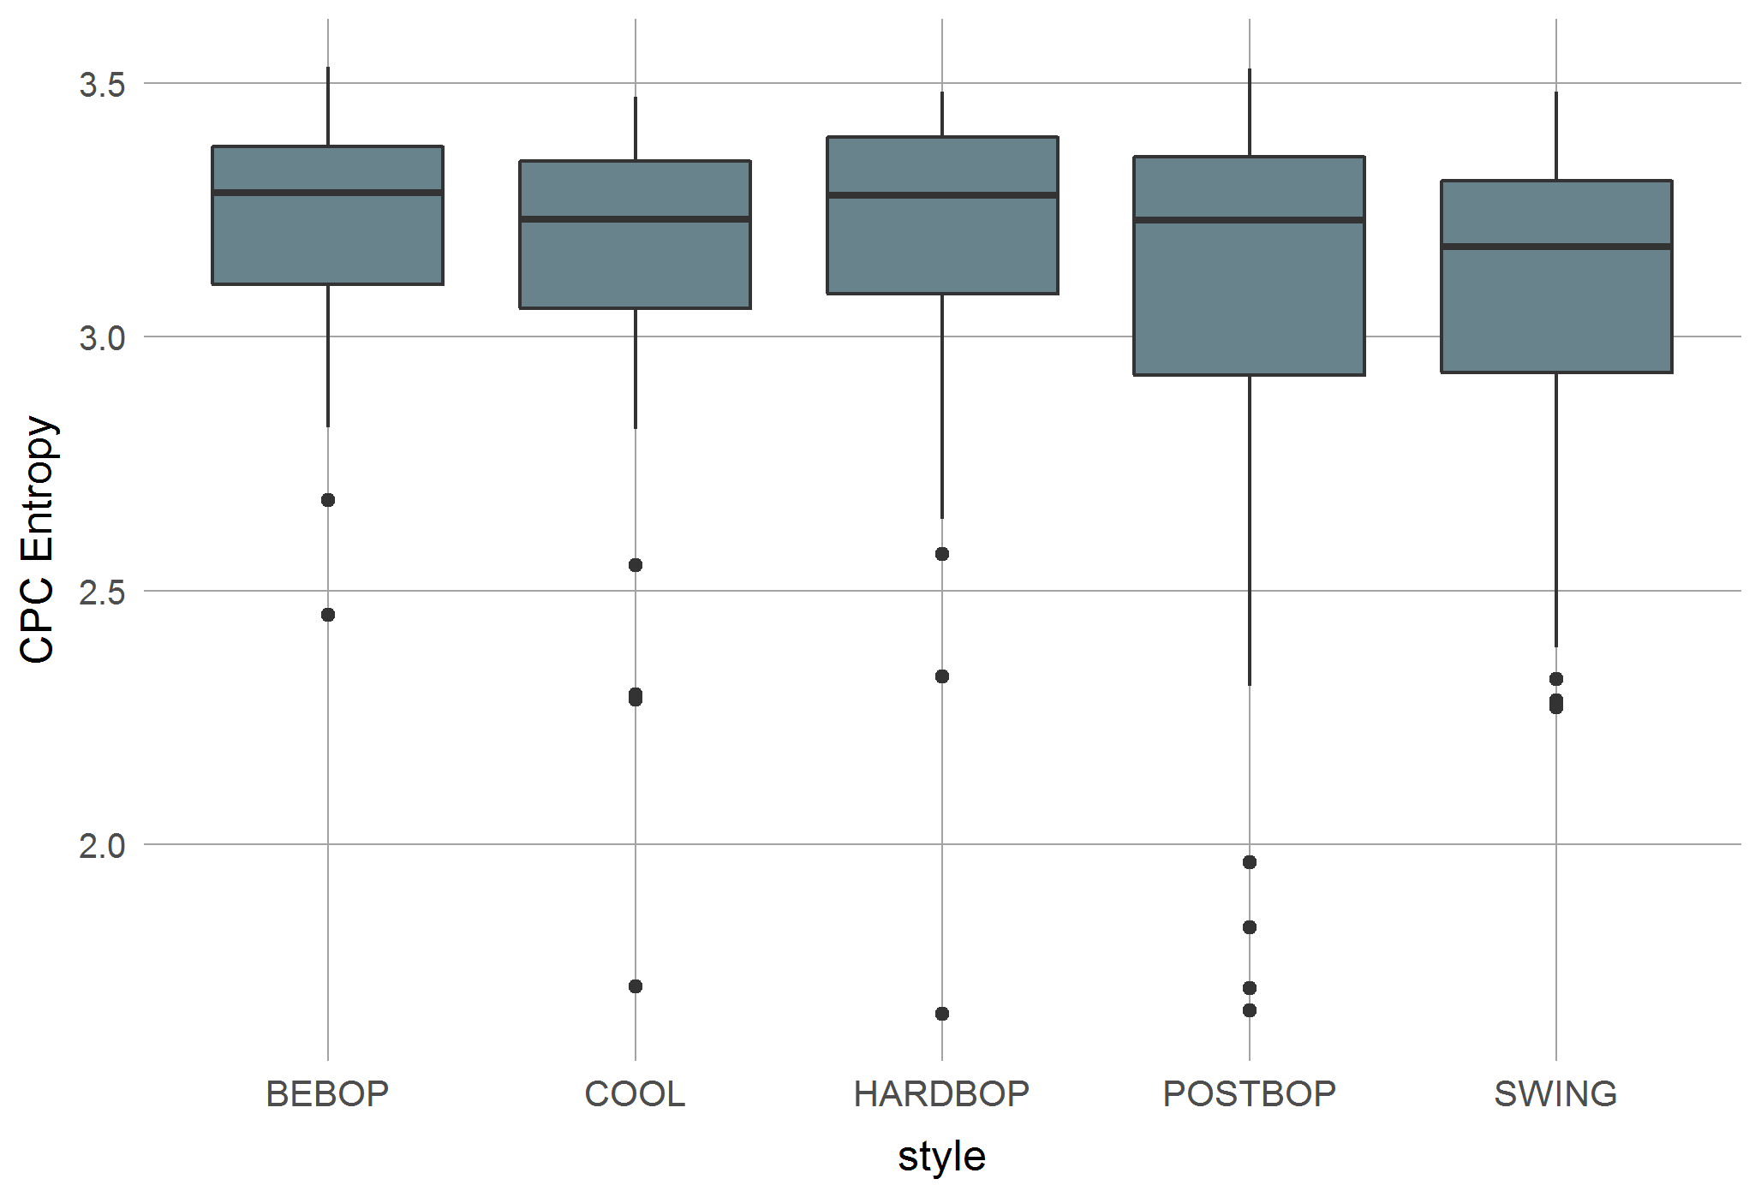
CPC Entropy / Style
Kruskal-Wallis-Test: p = .046

Slide 35
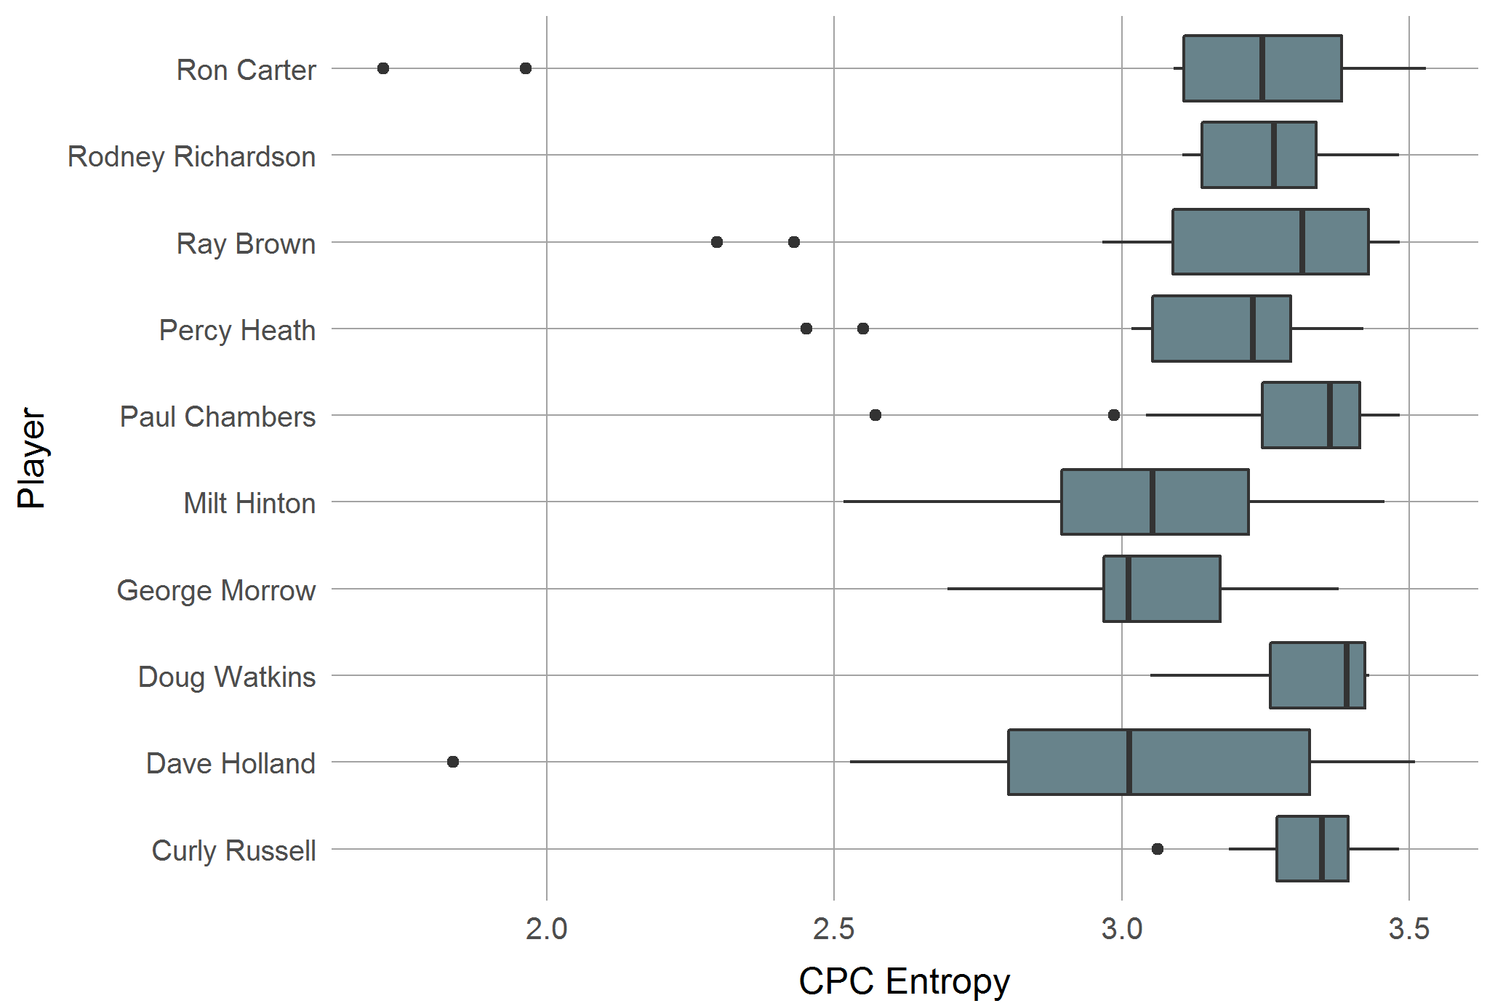
CPC Entropy / Top players
Kruskal-Wallis-Test: p = .013

Slide 36
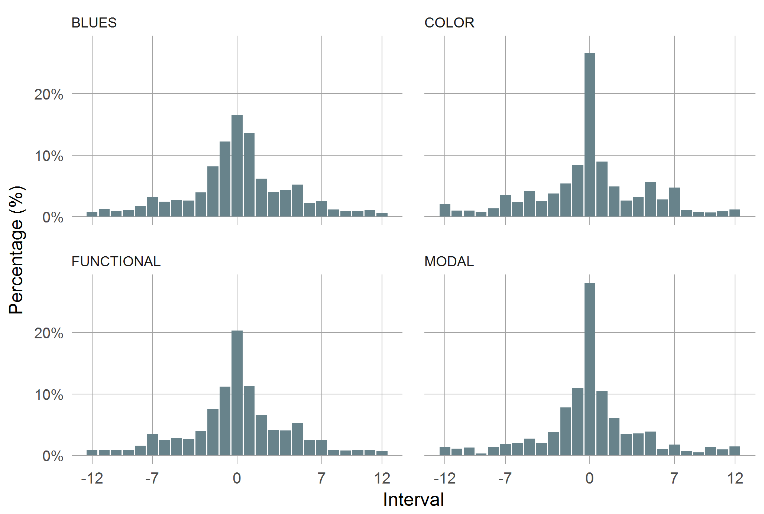
Intervals: Tonality Type
χ²: p <.001, φ = .111

Slide 37
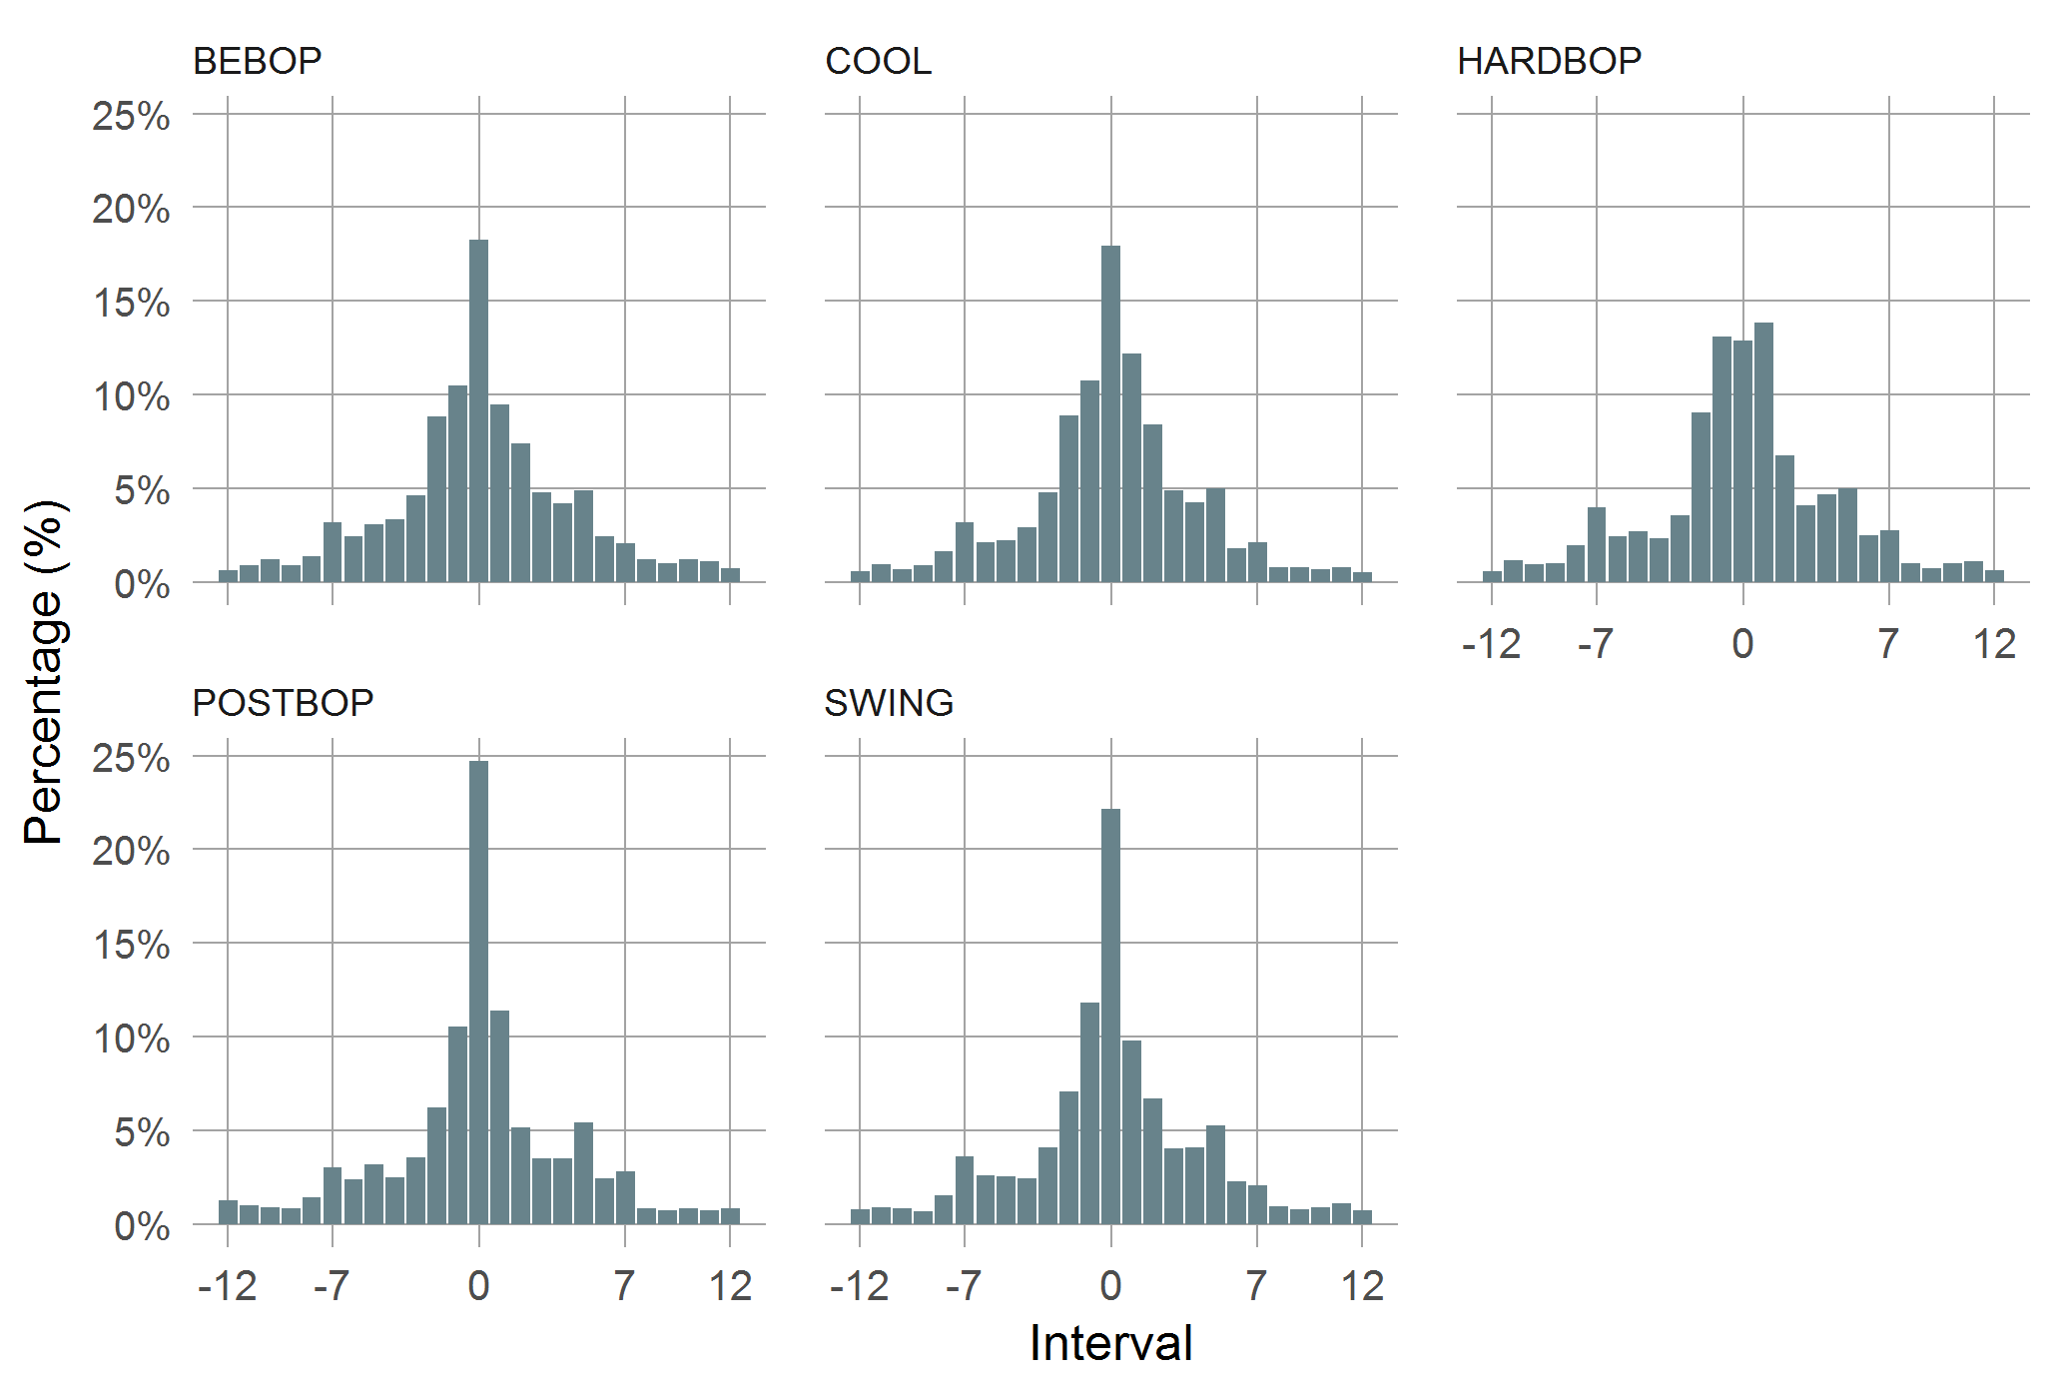
Intervals: Style
χ²: p <.001, φ = .156

Slide 38
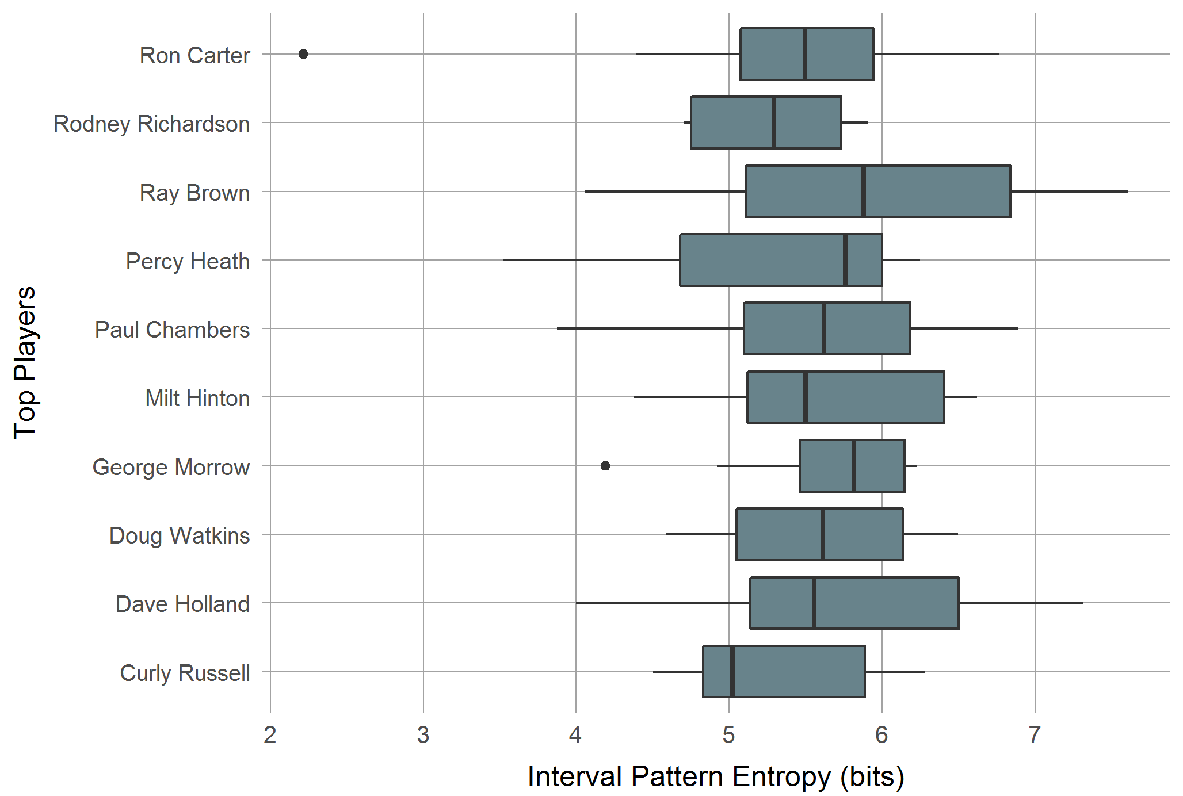
IPE/ Top players
Kruskal-Wallis-Test: p = .50

Slide 39
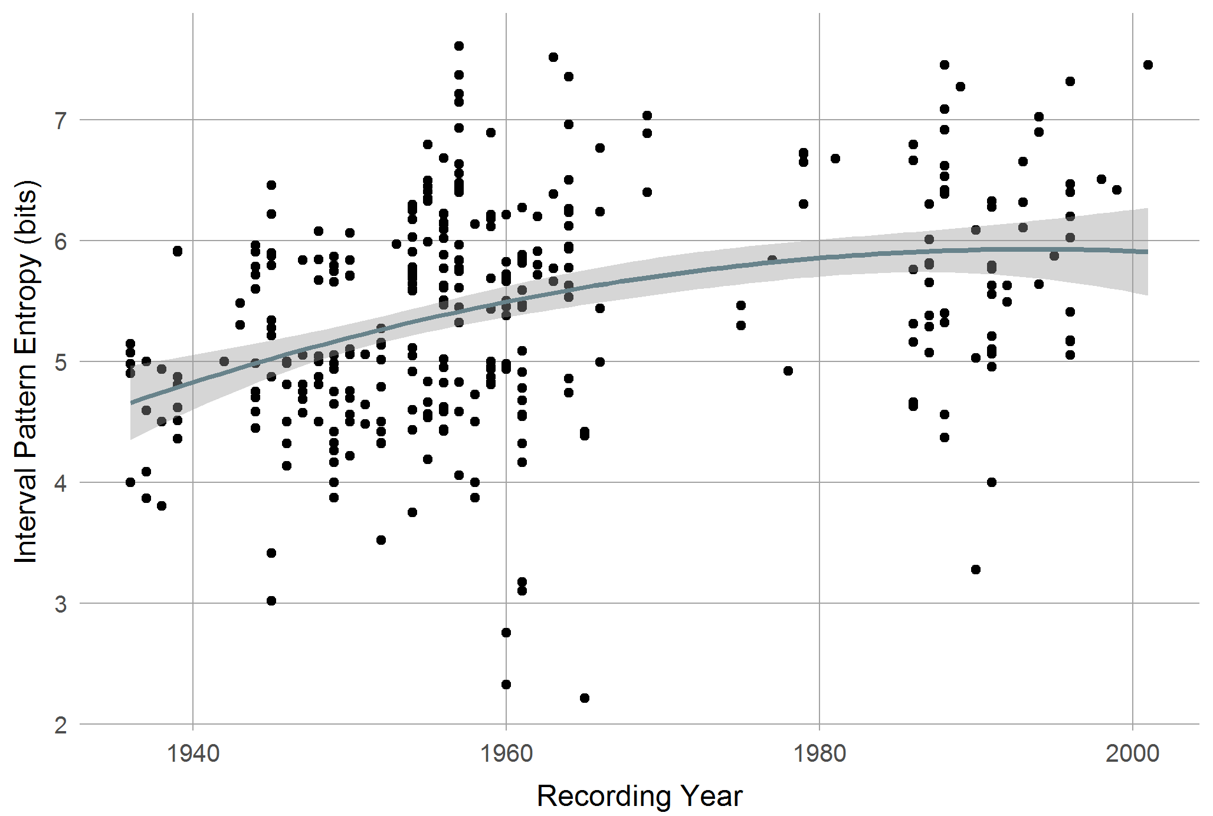
IPE / Recording Year
Poly LM: p < .001, R² = .13

Slide 40
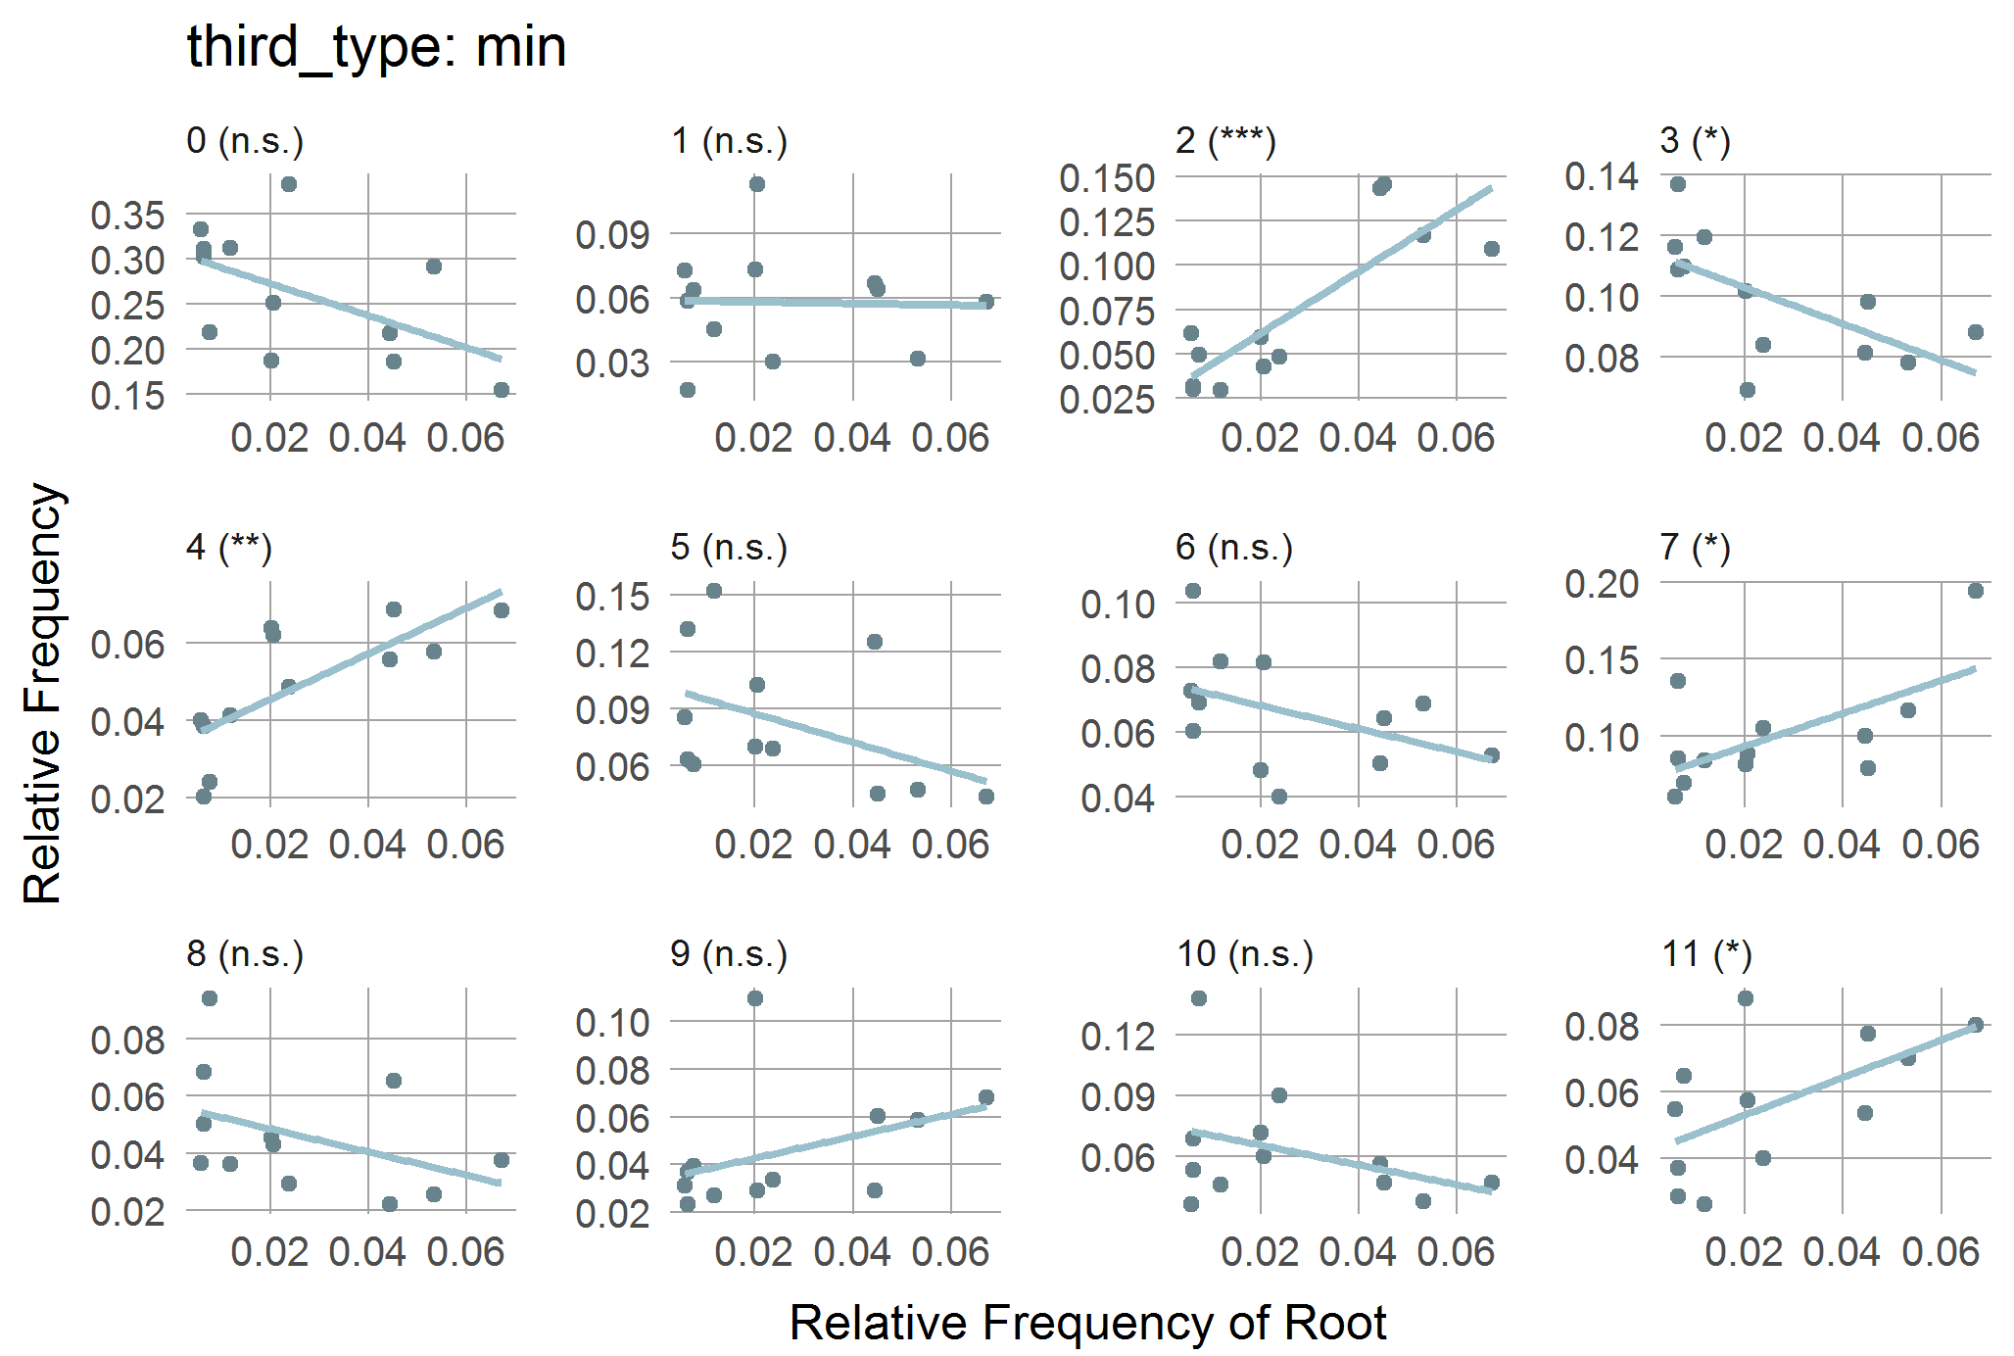
CPC Freq / Root Freq / Min

Slide 41
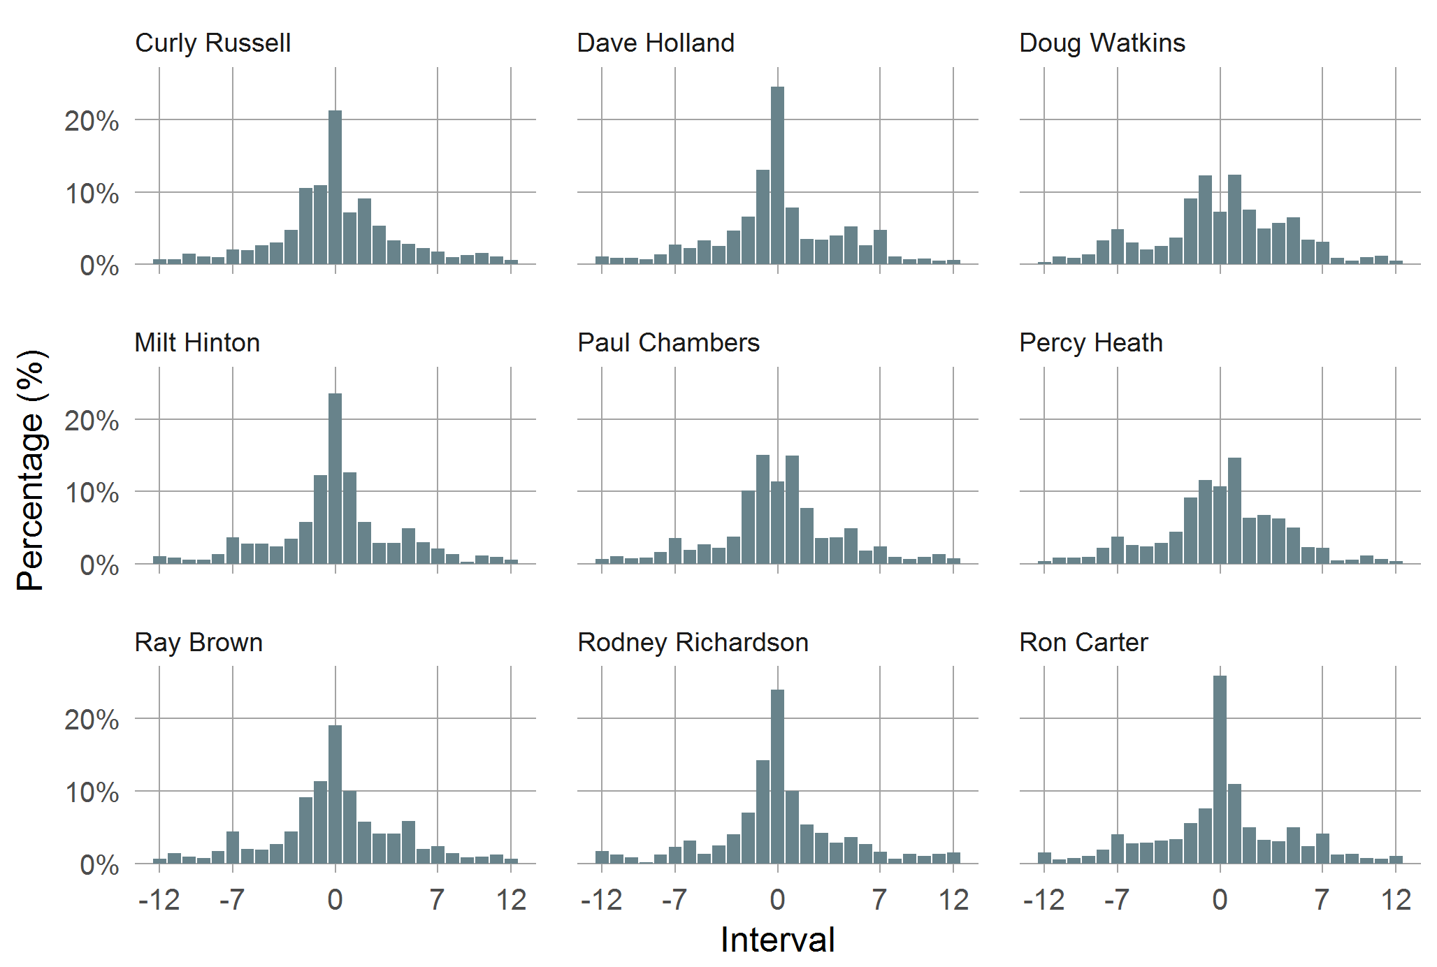
Intervals: Top Players
χ²: p <.001, φ = .244

Slide 42
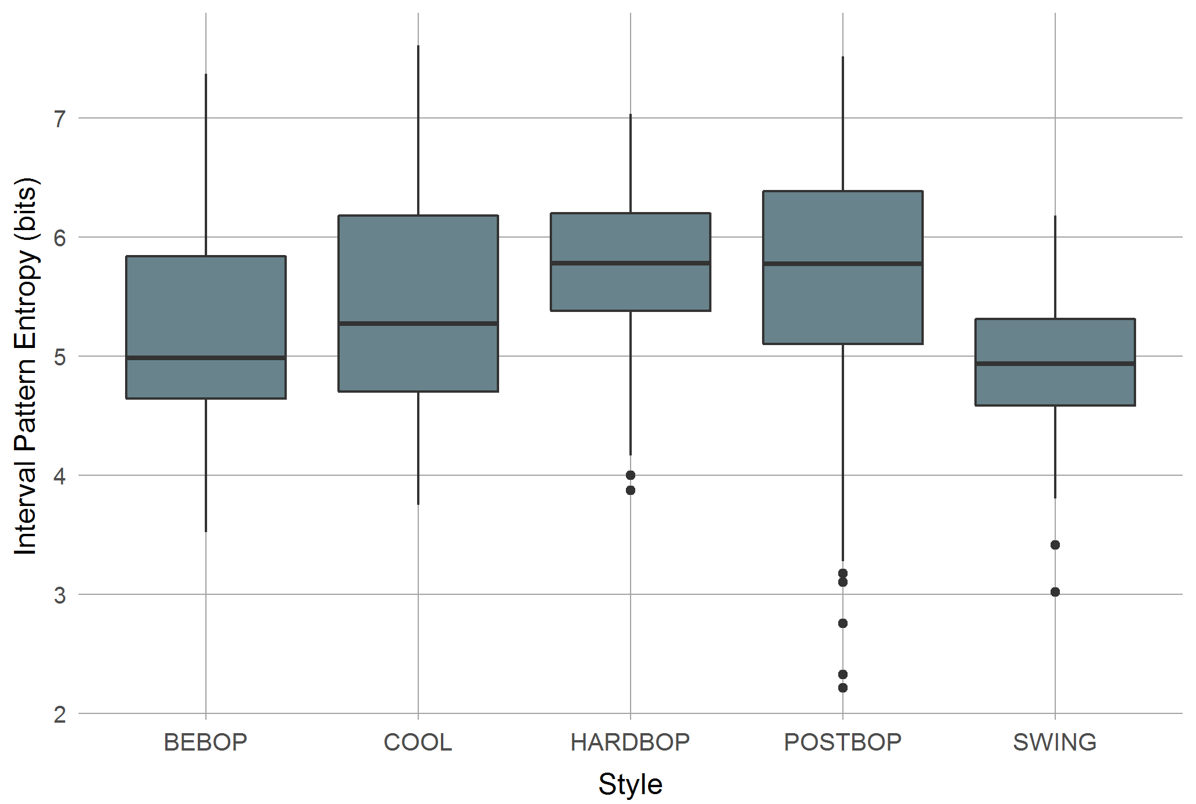
IPE / Style
Kruskal-Wallis-Test: p < .001

Slide 43
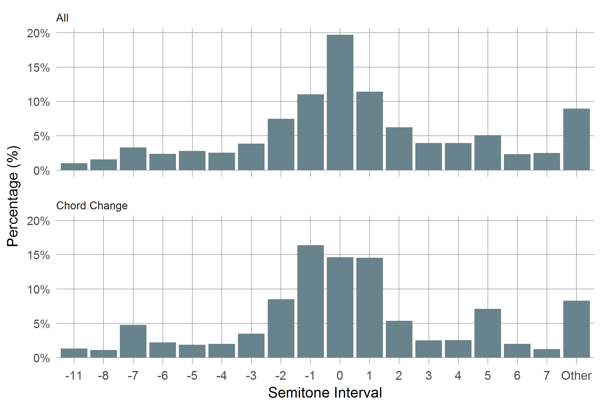
Intervals: Approaches
χ²: p <.001, φ = .122

Slide 44
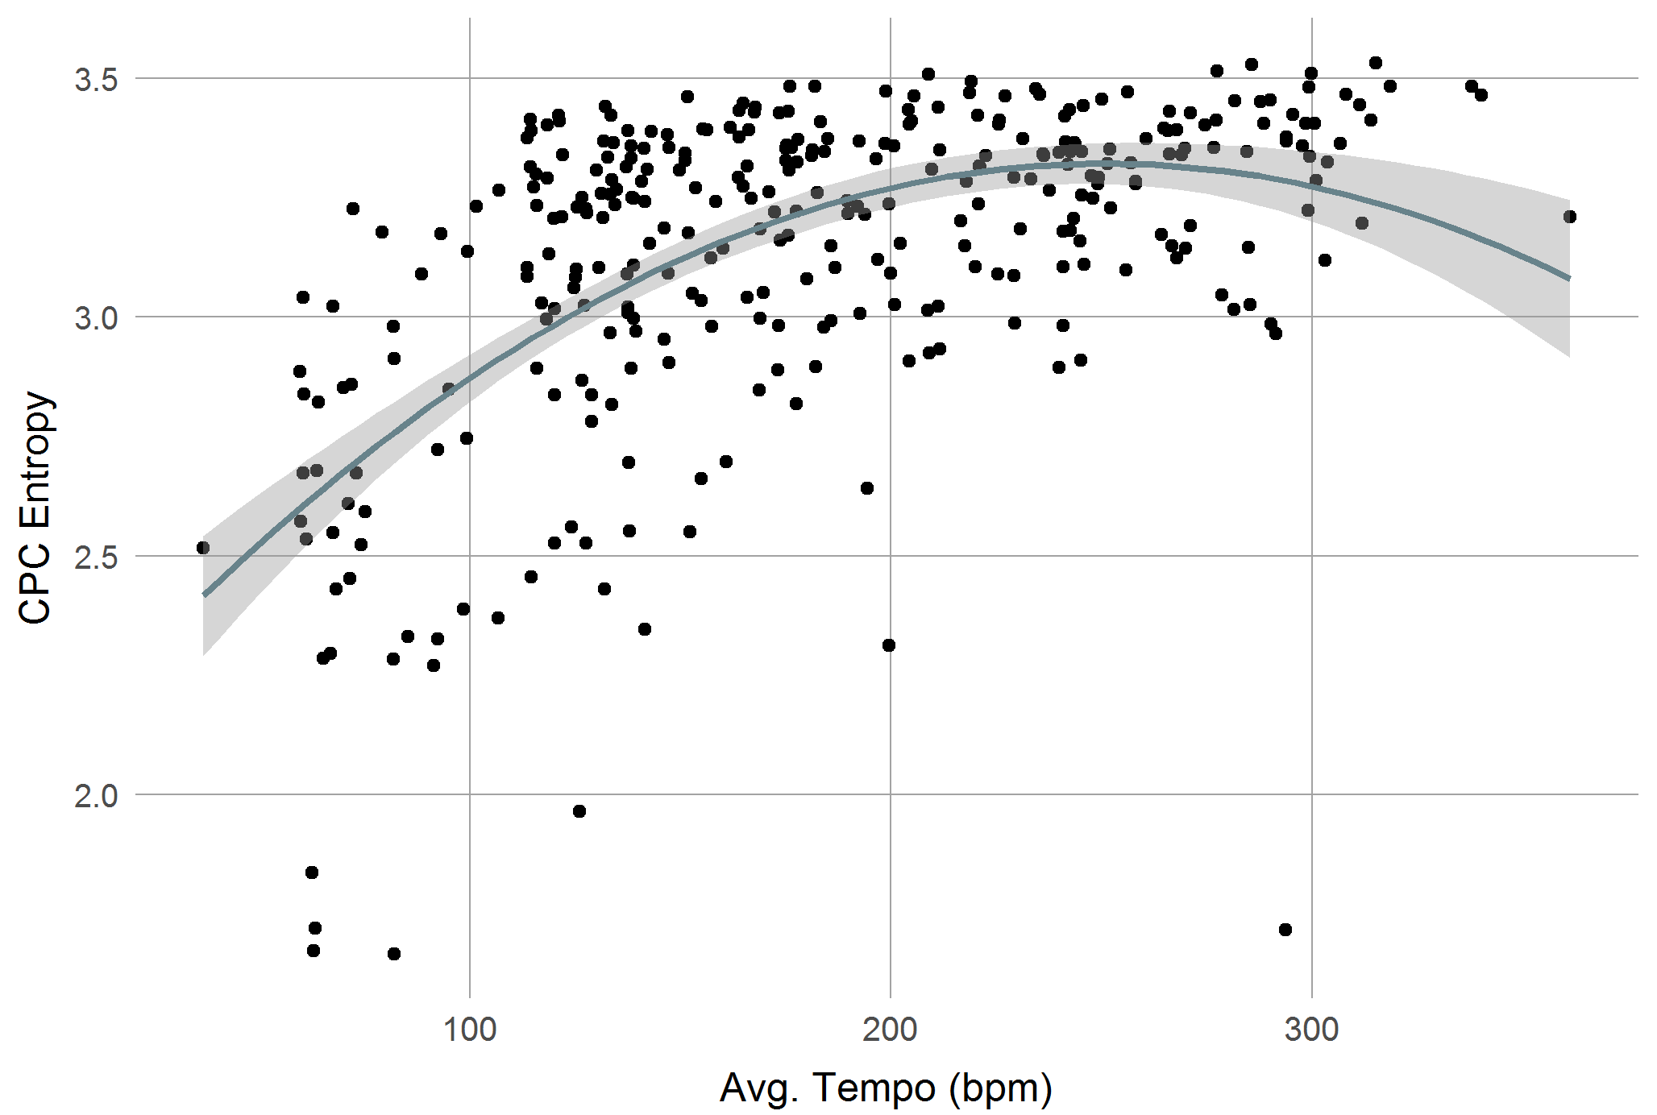
CPC Entropy / Tempo
Poly LM: p < .001, R² = .34

Slide 45
Results: Interactions
Association plot for contingency tables:
Black up: More than expected/the average.
Red down: Less than expected/ the average.

