Slide 1
Remove reverb from sound
Jakob Löber and Oskar Klaja

Slide 2
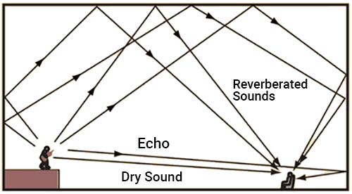
Reverb = echo from walls
source: https://www.softdb.com/what-is-reverberation-in-acoustical-analysis/

Slide 3
Use cases
professional music production
    real time
    high quality of sound required
home recordings
    post production of recordings for e.g. youtubers
    not real time
speech transfer
    zoom, phone calls
    real time
    lower quality is sufficient

Slide 4
Generate sound with reverb
anechoic sound + convolution with IR = sound with reverb
IR: Impulse Response characterizes the room acoustics
can be computed with FFT
IR depends on:
    room size and shape
    position of source and receiver
    shape and size of objects in the room

Slide 5
Strategies for dereverberation
IR is known:
    deconvolve signal with IR
IR is unknown:
    known as blind dereverberation/deconvolution
    classify IR with neural network and deconvolve with a known IR
    predict dereverberated signal directly with autoencoder

Slide 6
Deconvolution
deconvolution requires a known IR
can be done by FFT
numerically unstable: strong amplification of even small noise
better, but not perfect: Wiener deconvolution
many problems, e.g.
  deconvolved sound with length of 10s
  same sound, same deconvolution, but length of 11s

Slide 7
Blind dereverberation by classification
train
  sufficiently sample space of relevant IRs
  generate sound with reverb
  train a neural network for IR classification
deploy
  classify IR with a neural network
  deconvolve with closest IR or a linear combination of IRs
classification of 20 different IRs works well with a network similar as for speech MNIST

Slide 8
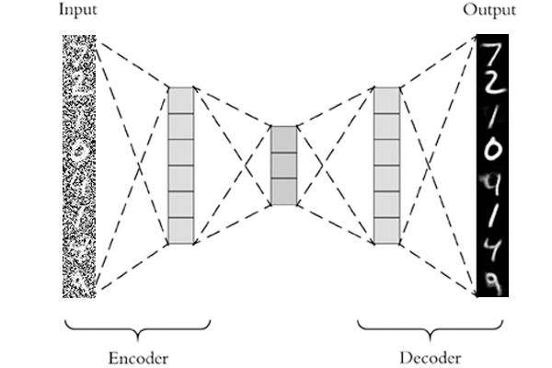
Possible strategies
AE
Work with MEL spectrograms
  AE and WaveGlow
  (too slow for RT execution)
  AE and WaveGAN
  (rather slow but possible)
Work with audio signal
  LSTM (bad quality)
  Use WaveNet AE (slow convergence, no results, bad for reverb)
  Train WaveGAN to omit reverb in translation (transfer learning)
Work with STFT and complex numbers
  Unknown territory! (potential to be fast)
Image source: pyimagesearch.com/wp-content/uploads/2020/02/keras_denoising_autoencoder_header.png

Slide 9
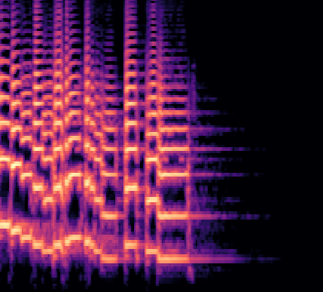
MEL (Text-to-Speech SOTA)
Text
output
audio
Tocotron2
Text2mel
pretrained:
WaveGlow
MelGAN
MEL
frequency
MEL
time

Slide 10
MEL SOTA
Slow!
Reverb
No Reverb
input
audio
output
audio
pretrained:
WaveGlow
MelGAN
preprocessing
MSE loss
Conv2D
Conv2D
MEL
Latent
MEL
real
real
Reverb
No Reverb

Slide 11
MelGAN - transfer learning
feature loss
600 epoch
Reverb
target
input
audio
output
audio
No Reverb
MelGAN
pretrained
on speech
MEL
frequency
MEL
time
Unseen speaker
MelGAN trained on speech
1600 epoch

Slide 12
MEL-to-STFT
add random reverb
target
spectral loss
input
audio
output
audio
imaginary
Conv2D
Conv2D
MEL
Latent
iSTFT
real
real
Unseen speaker
Mel-to-STFT test

Slide 13
STFT
add random reverb (FFT)
spectral loss
target
input
audio
output
audio
imaginary
imaginary
Conv2D
Conv2D
STFT
Latent
iSTFT
real
real
x
element-wise
multiplication
input STFT
real data
test
add room
reverb
or a big
reverb

Slide 14
Conclusions
high sound quality requires sufficient sampling of IRs→requires a lot of resources
NNs can work with complex numbers (STFT) when the right architecture is used
combination of architecures and/or postprocessing with e.g. noise filters might yield better results

