Slide 1
Remove reverb from sound

Slide 2
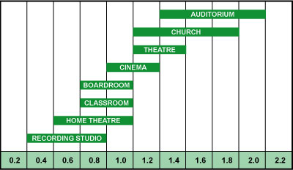
Reverberation times

Slide 3
Test sound

