Slide 1
Remove reverb from sound

Slide 2
Possible strategies
Deconvolve signal with a linear combination of known IR responses (Reverb Classifier)
Predict IR with NN and deconvolve
Predict dereverberated signal directly with AE

Slide 3
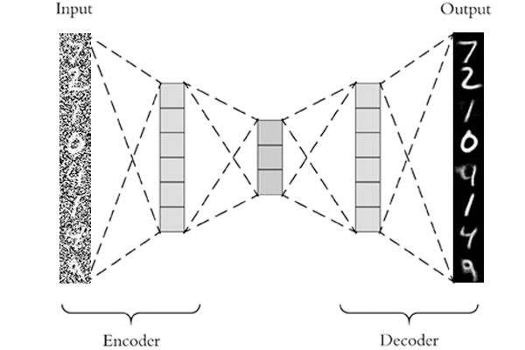
Autoencoder (AE)
WaveNet
Spectrograms
Autoregressive
Combinations
Source: pyimagesearch.com/wp-content/uploads/2020/02/keras_denoising_autoencoder_header.png

Slide 4
Possible strategies
Work with MEL spectrograms
  AE and WaveGlow (to slow for RT execution)
  AE and WaveGAN (rather slow but possible)
Work with audio signal
  LSTM (bad quality)
  Use WaveNet AE (slow convergence, no results, bad for reverb)
  Train WaveGAN to omit reverb in translation (transfer learning)
Work with STFT and complex numbers
  Unknown territory!

Slide 5
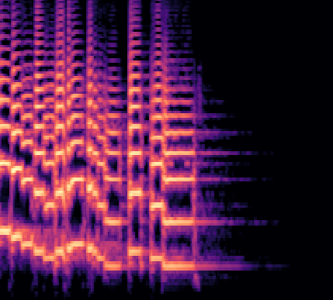
SOTA Methods (Text-to-Speech)
Text
output
audio
Tocotron2
Text2mel
pretrained:
WaveGlow
MelGAN
frequency
MEL
MEL
time

Slide 6
SOTA Methods
Slow!
Reverb
No Reverb
input
audio
output
audio
pretrained:
WaveGlow
MelGAN
preprocessing
MSE loss
Conv2D
Conv2D
MEL
Latent
MEL
real
real
Reverb
No Reverb

Slide 7
MelGAN - transfer learning
feature loss
600 epoch
Reverb
target
input
audio
output
audio
No Reverb
MelGAN
pretrained
on speech
frequency
MEL
MEL
time
Unseen speaker
MelGAN trained on speech

Slide 8
MEL-to-STFT (AE)
add random reverb
target
spectral loss
input
audio
output
audio
imaginary
Conv2D
Conv2D
MEL
Dense
STFT
real
5x
real
Unseen speaker
Mel-to-STFT test

Slide 9
STFT (AE)
add random reverb (FFT)
spectral loss
target
input
audio
output
audio
imaginary
imaginary
Conv2D
Conv2D
STFT
Dense
STFT
real
5x
real
x
element-wise
multiplication
input STFT
real data
test
add room
reverb
or a big
reverb

