Slide 2
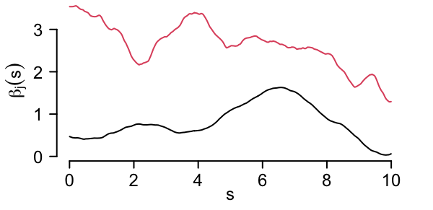

varycoef
$$y_{i}=β_{1}\left(s\right)+β_{2}\left(s\right)x_{i}$$

