Slide 1
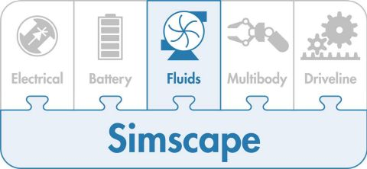
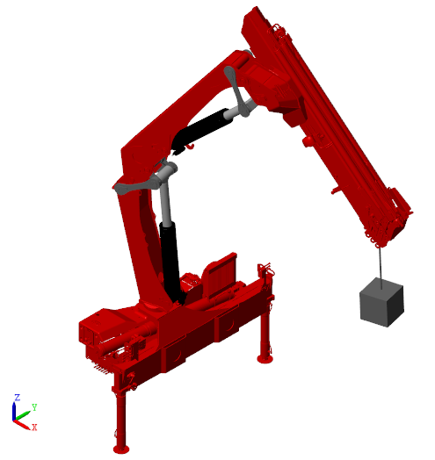

Reference Data
Main System
Control System
Multibody Model
Actuator Forces
Feedback signals

