Slide 1
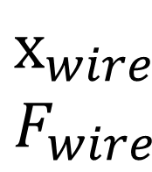
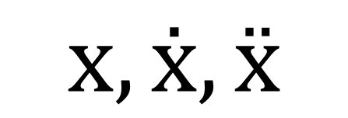
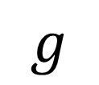

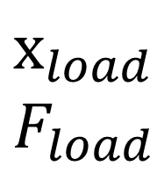
$$g$$
$$х,ẋ,ẍ$$
$$х_{wire}$$
$$F_{wire}$$
$$n_{sh}=3$$
$$х_{load}$$
$$F_{load}$$
Load

