Slide 1


Word Count Functional implementation in
Jakob Friedl if20b089 – Philipp Haider if20b097

Slide 2
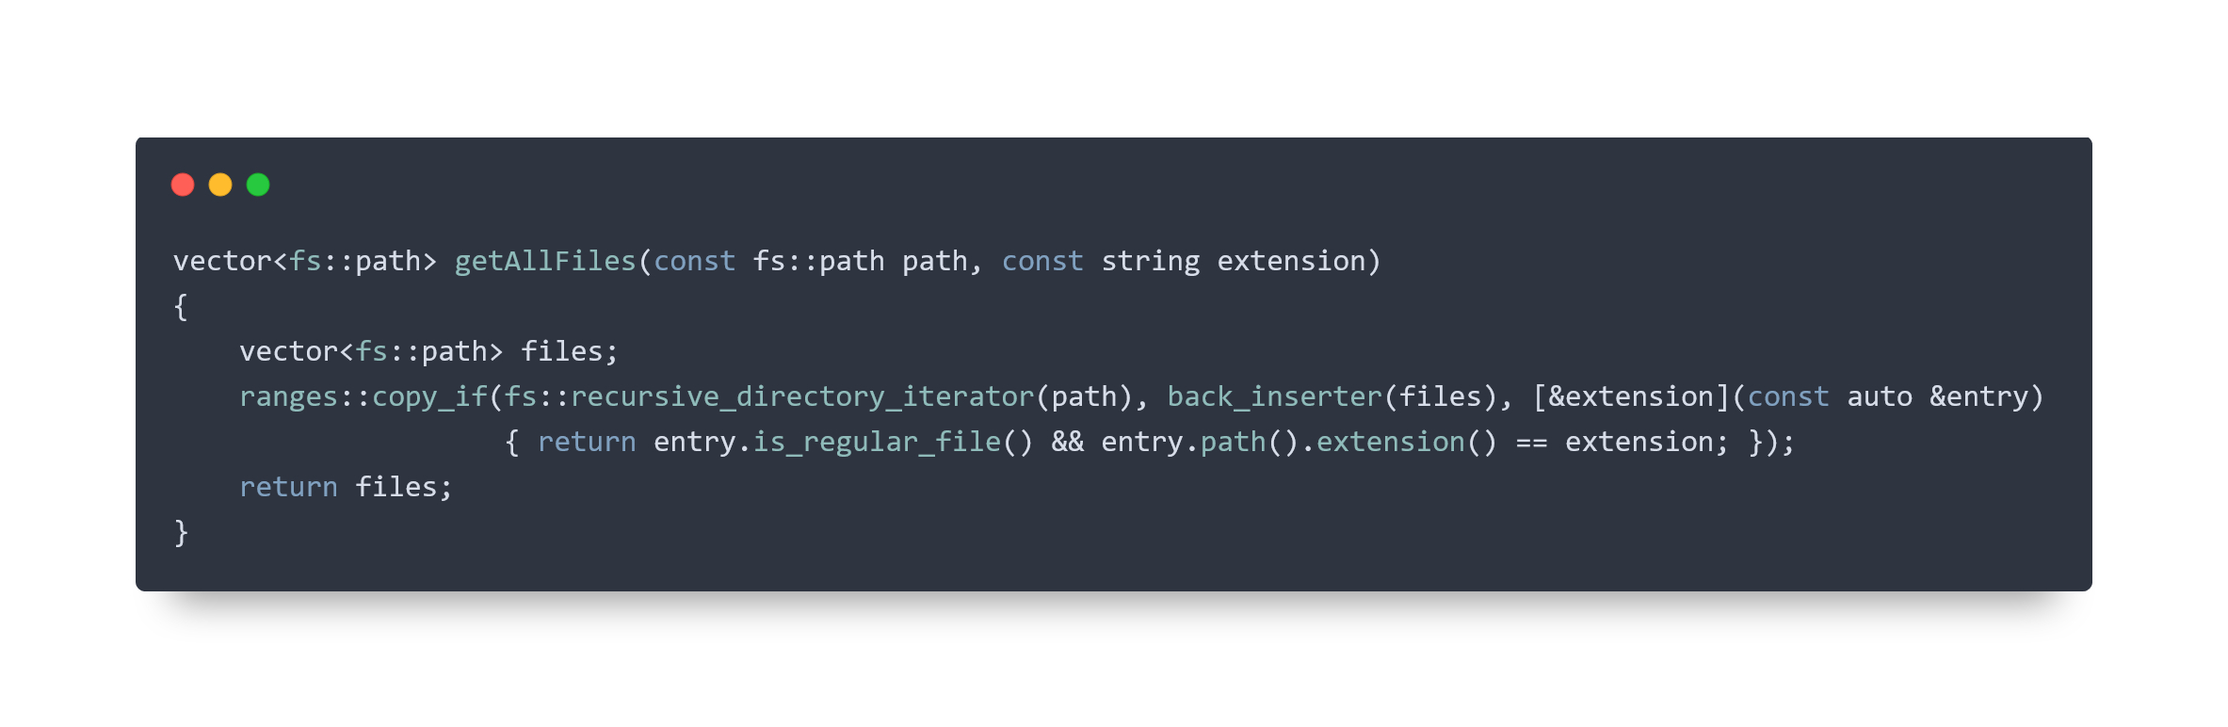
reading files

Slide 3
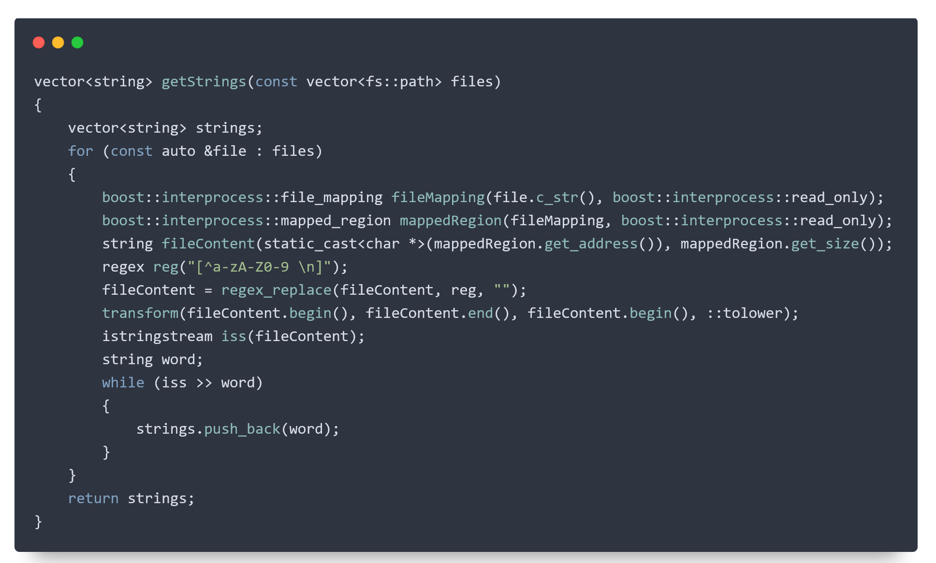
getting strings

Slide 4
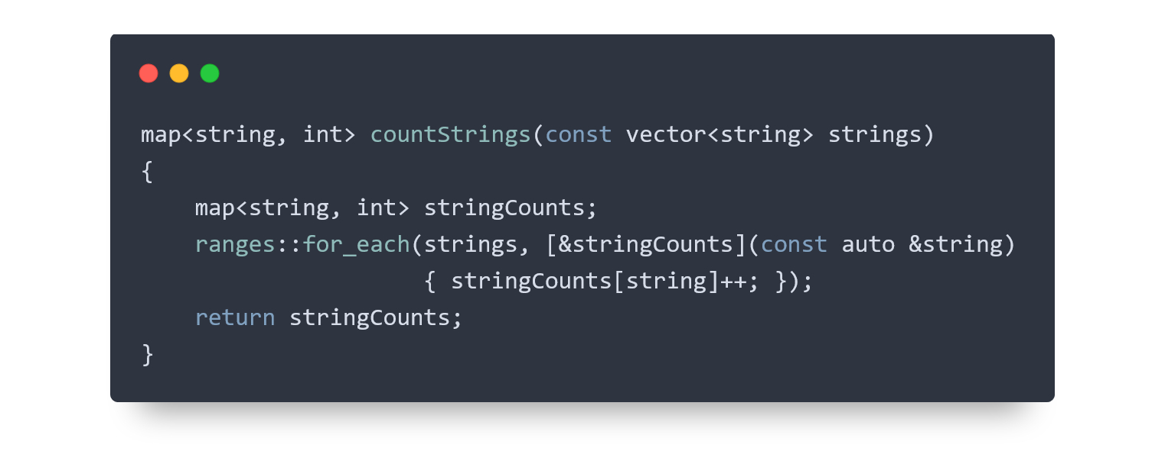
counting strings

Slide 5
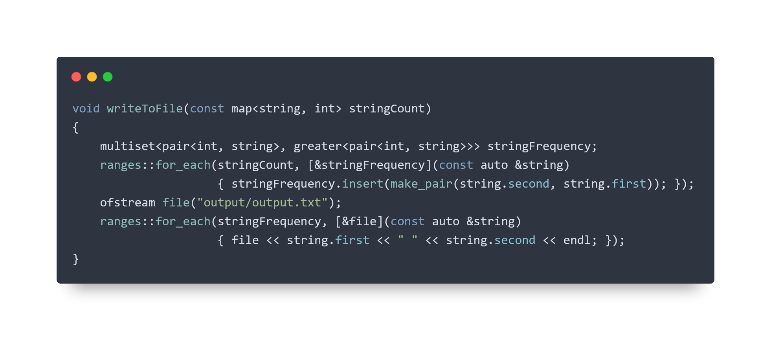
writing to output-file

Slide 6
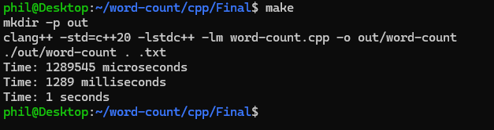
runtime analysis

Slide 7
functional concepts used
Lambdas
C++ Ranges
Pure functions

Slide 8
lessons learned

