Slide 1

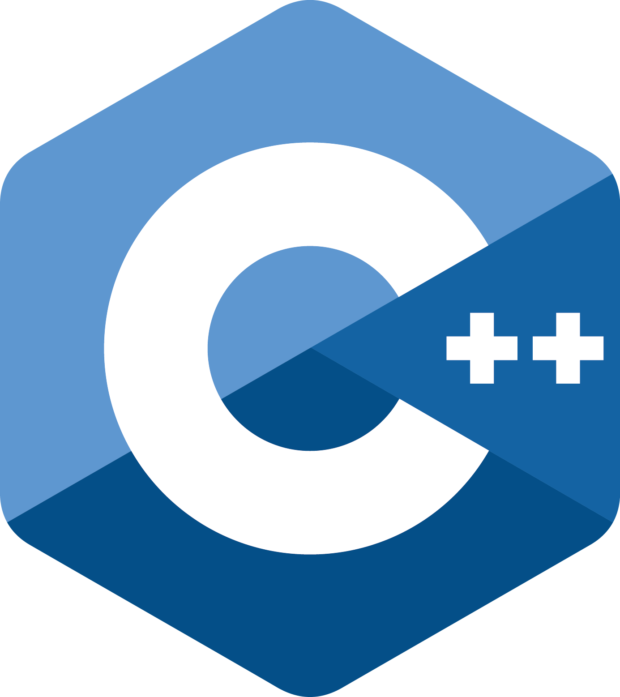

Word Count Functional implementation in
Jakob Friedl if20b089 – Philipp Haider if20b097

Slide 2
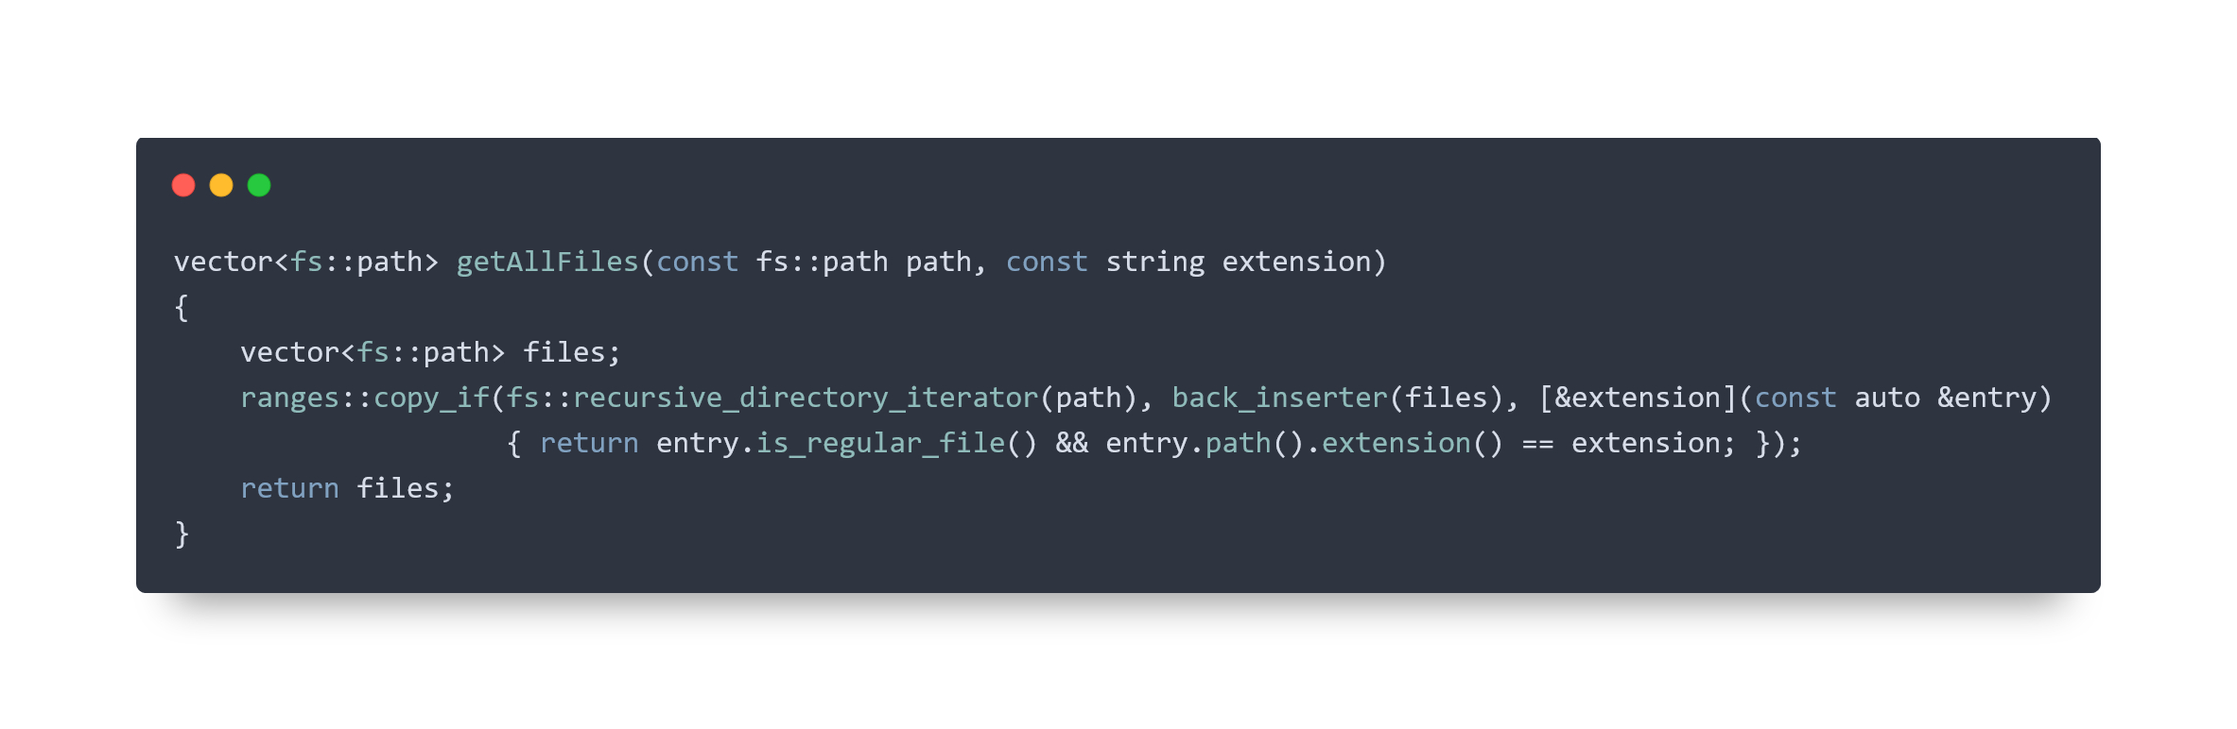
reading files

Slide 3
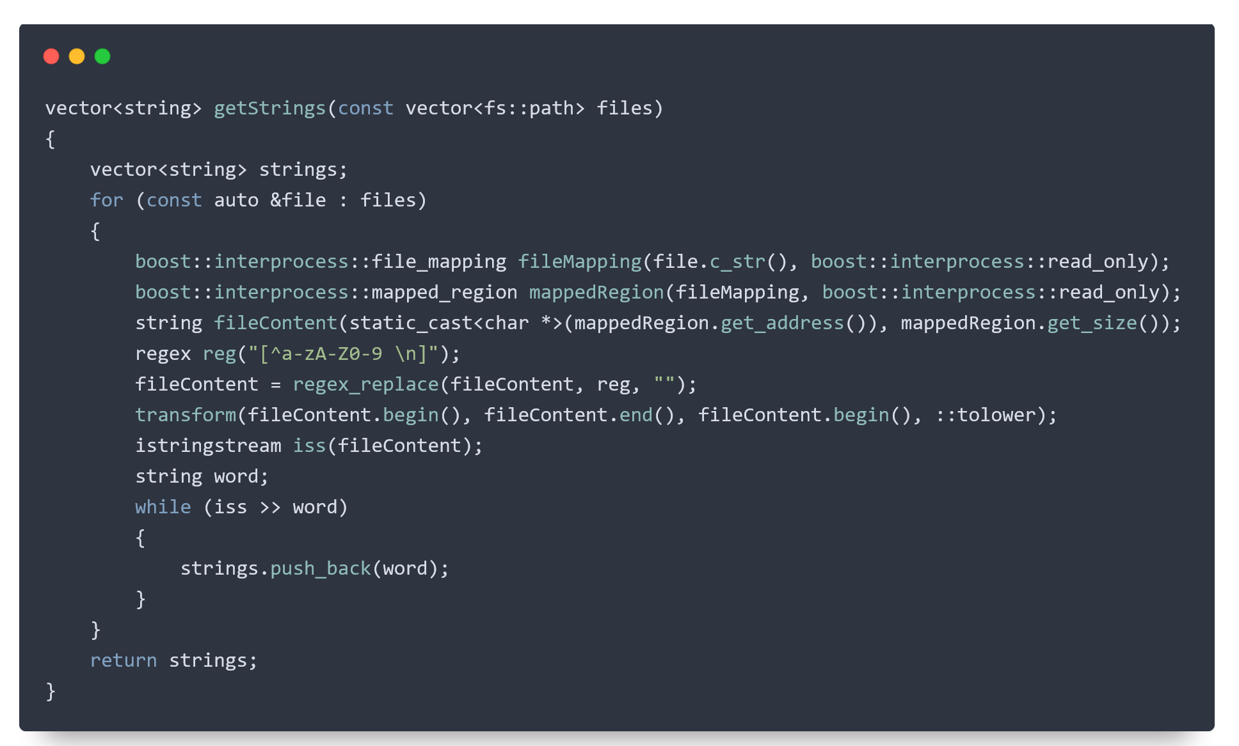
getting strings

Slide 4
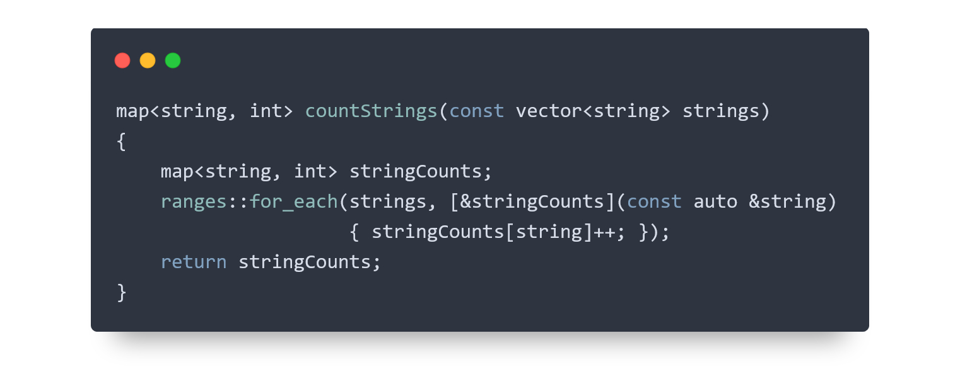
counting strings

Slide 5
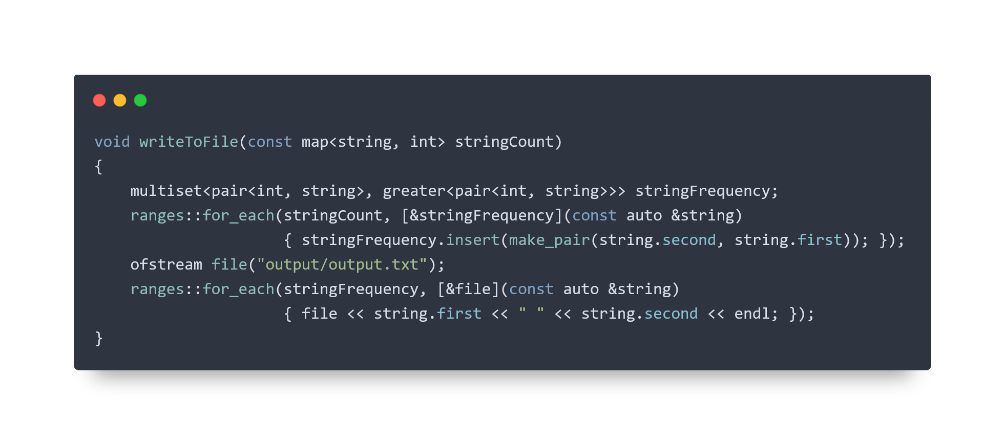
writing to output-file

Slide 6
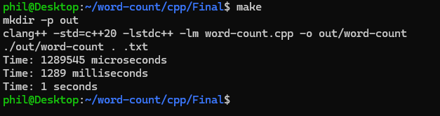
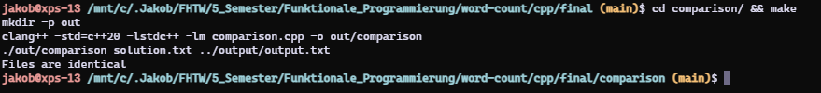
runtime analysis & tests

Slide 7
functional concepts used
Lambdas
C++ Ranges
Pure functions
Immutability

Slide 8
lessons learned
Functional programming concepts in C++
Lambdas, C++ Ranges
Memory checks with valgrind
Time optimization
libboost-Library
use of performance-optimized methods

Slide 9
failed/other approaches
Runtime optimization by multithreading
Functional word count in other programming languages
Python
Nim

