Slide 1

Implementation of a multi One Instruction Set Computer (mOISC) in the hardware description language Clash
Bachelor Thesis Presentation
Jakob Groß
07.11.2022

Slide 2
Agenda
01
Modern Hardware Description Languages
02
Multi One Instruction Set Computer
03
Clash
04
Optimization and Tests
05
Results
06
Outlook

Slide 3
Modern Hardware Description Languages

Slide 4
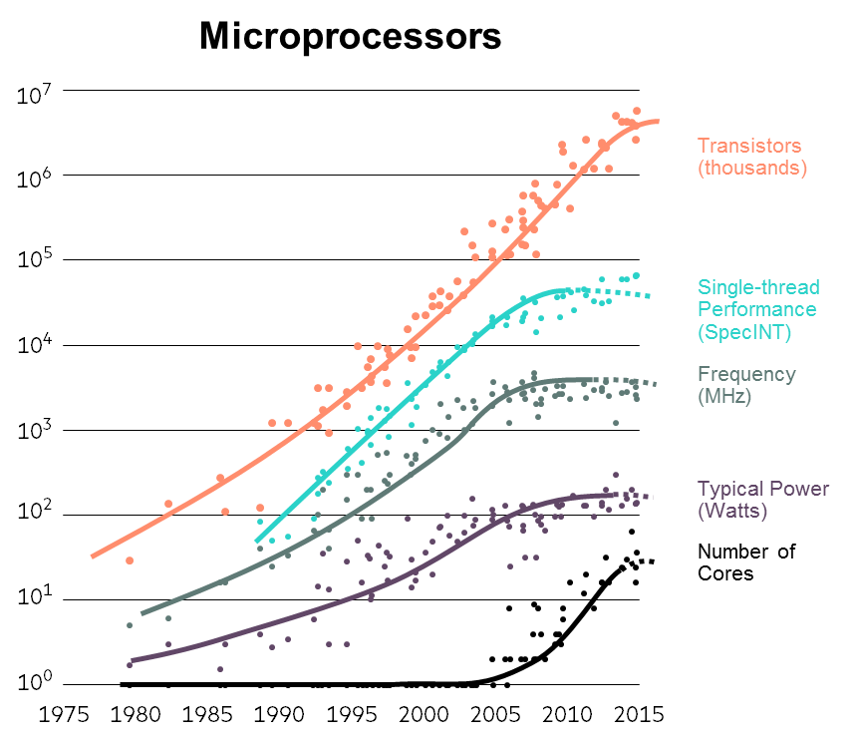
Modern Hardware Description Languages
Moores Law
Transistors still scaling logarithmic
Performance and frequency not
i.E. medium processors at 3.5 Ghz

Slide 5
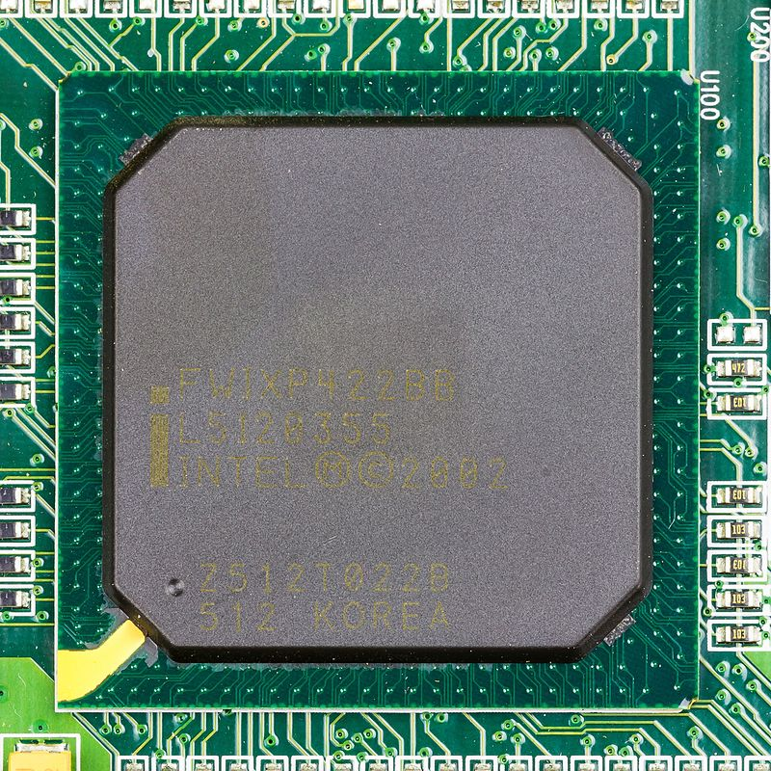

Modern Hardware Description Languages
General Purpose Processors
General Purpose Processor
Electronic Control Units
Machine Learning
Bitcoin Mining

Slide 6



Modern Hardware Description Languages
Application Specific Integrated Circuits
HDL
i.E. Google TPU
Electronic Control Units
Machine Learning
Bitcoin Mining

Slide 7




Modern Hardware Description Languages
Goals
Small Developer Teams
Lower Budgets
Correctness
Security
Shorter Development Cycles
Performance
Reuseability

Slide 8
Modern Hardware Description Languages
Types of modern HDLs
Term Rewriting Systems
High-Level Synthesis
Functional HDLs
Bluespec
System C
Chisel
Vivado HLS
Lava
Clash

Slide 9
Multi One Instruction Set Computer

Slide 10
Multi One Instruction Set Computers
One Instruction Set Computers
„Ultimate RISC“
Small logic budget
Simple Implementation
Memory Inefficient
High Power Consumption
Large Standart Library must be developed for compilation
SUBLEQ a b c
mem[b] = mem[b] - mem[a]
if mem[b] <= 0
pc = c
else
pc += 3

Slide 11
Multi One Instruction Set Computers
One Instruction Set Computers
Transport Triggered Architectures
Execution based on written Address
Only Instruction is MOV
i.E Address for „ADD &0x18 &0x19 &0x20“
Commercially used in the MaxQ Processor
Other SubLeq like
OrLeq, AndLeq, XorLeq
CryptoLeq allowing computation on encrypted datasets
0x00 | 0x18
3. Addr2 & Exec
MOV 0x18 0x00
0x01 | 0x19
2. Write Addr1
MOV 0x19 0x01
0x02 | 0x20
1. Write GoalAddr
MOV 0x20 0x02

Slide 12
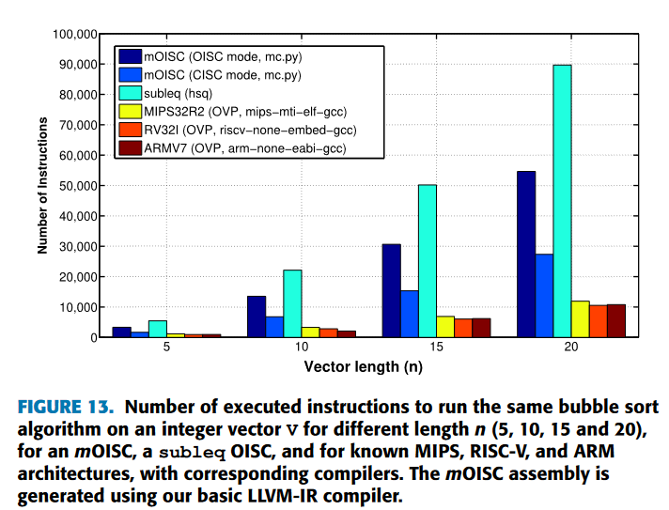
Multi One Instruction Set Computers
mOISC
By M. Crepaldi et al.
Different OSICs can handle different situations
14 One-Instruction-Sets
Still small logic budget
Low power consumption
Only double the instructions of standart IS
Compiler has been developed
Compile targets are still buggy

Slide 13
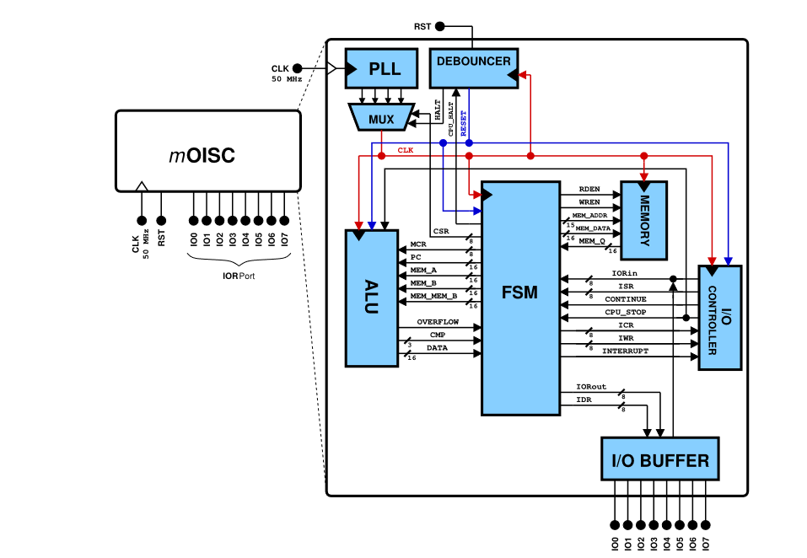
Multi One Instruction Set Computers
Composition

Slide 14
Clash

Slide 15
Clash
A simple counter
Existential Quantifier allowing Reuse
counter :: forall n dom. (KnownNat n , HiddenClockResetEnable dom)
=> Signal dom (BitVector n)
counter = result
where
result = register 0 $ fmap (+ 1) result
Domain of the Signal with a defined clock period, reset type …
Infinite Stream of values over a given type
Data Type of the Signal
register saves the result for one cycle
Clash.Prelude> sampleN 10 $ withClockResetEnable (clockGen @System) (resetGen @System) (enableGen @System) counter
[0,0,1,2,3,4,5,6,7,8]
Clash.Prelude> sampleN 10 $ withClockResetEnable (clockGen @System) (resetGen @System) (enableGen @System) (counter :: Signal System (BitVector 3))
[0b000,0b000,0b001,0b010,0b011,0b100,0b101,0b110,0b111,0b000]
Simulate function
Generator on a specific domain
Specific length BitVector
27.06.2023
15
Notes:
Funktionen nehmen Eingaben und Produzieren Ausgaben
Nebeneffekte machen Tests und Entwicklung schwerer
Signale als endloser traversierbarer Funktor auf einer festen Domäne
Register zum speichern eines States
Generisch durch Type-Constraints

Slide 16

Clash
Quartus to Xilinx
Not Vivado-VHDL but Quartus
ClockGen
Memory
IoBuffer
MemInit Files
Initialization
LIBRARY cyclone10lp;
USE cyclone10lp.all;
--synthesis_resources = cyclone10lp_io_ibuf 8 cyclone10lp_io_obuf 8
LIBRARY ieee;
USE ieee.std_logic_1164.all;
ENTITY iobuf_iobuf_bidir_30p IS
PORT
(
datain : IN STD_LOGIC_VECTOR (7 DOWNTO 0);
dataio : INOUT STD_LOGIC_VECTOR (7 DOWNTO 0);
dataout : OUT STD_LOGIC_VECTOR (7 DOWNTO 0);
oe : IN STD_LOGIC_VECTOR (7 DOWNTO 0)
);
END iobuf_iobuf_bidir_30p;

Slide 17
Clash
Incoming Data
ALU
data Fsm2Alu memSize = Fsm2Alu
{ _mcr :: Instruction, -- Machine Code Register
_mem_a :: Signed memSize, -- Memory at address A (in reference 'E')
…
}
deriving (Show, Generic, NFDataX)
alu :: forall memSize.(KnownNat memSize) =>
Fsm2Alu memSize -> Alu2Fsm memSize
alu Fsm2Alu {..} =
case _mcr of
SubLeq -> Alu2Fsm data' cmp' overflow'
where
data' = _mem_b - _mem_a
…
topEntityAlu ::
Signal XilinxSystem (Fsm2Alu 16) ->
Signal XilinxSystem (Alu2Fsm 16)
topEntityAlu fromFSM = alu <$> fromFSM -- Map alu function to Signal
Branch depending on Instruction
Map Alu on Signal
27.06.2023
17

Slide 18

Clash
Annotations
{-# ANN
topEntityAlu
( Synthesize
{ t_name = "ALU",
t_inputs =
[ PortProduct
"in"
[ PortName "mcr",
PortName "pc",
… ]
],
t_output =
PortProduct
"out"
[ PortName "overflow",
PortName "cmp",…
Allows description of nested data types
entity ALU is
port(
mcr : in std_logic_vector(7 downto 0);
pc : in std_logic_vector(15 downto 0);
out_overflow : out std_logic;
out_cmp : out std_logic_vector(2 downto 0);
27.06.2023
18

Slide 19
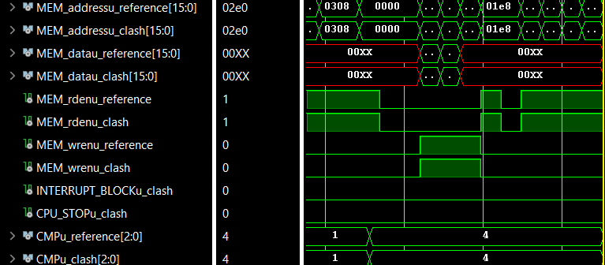
Clash
Comparison

Slide 20
Clash
Finite State Machine (FSM)
fsm ::
forall memSize regSize dom.
(KnownNat memSize, KnownNat regSize, HiddenClockResetEnable dom) =>
Signal dom (FsmInput memSize regSize) ->
Signal dom (FsmOutput memSize regSize)
fsm = mealy fsmcycle resetState
mealy
Input
FSM
cycle:: s -> i -> (s,o)
Output
Clk
State
State‘
Rst
En

Slide 21
Clash
Black Boxes
Clock Divider
IO-Buffer
Vendor Librarys
Black Boxes
Simulation
Not every behaviour can be modelled in Haskell
VHDL / Verilog

Slide 22



Clash
Memory Primitives
data RegisterRAM memSize addressSize =
Vec (addressSize*addressSize-1) (BitVector memSize)
blockRamFilePow2 ::
FilePath -- File with the initial content
-> Signal dom (Unsigned n) -- Read address
-- Size of the BRam is n^2
-> Signal dom (Maybe (Unsigned n, BitVector m))
-- (write address, value)
-> Signal dom (BitVector m) -- value requested at t-1

Slide 23
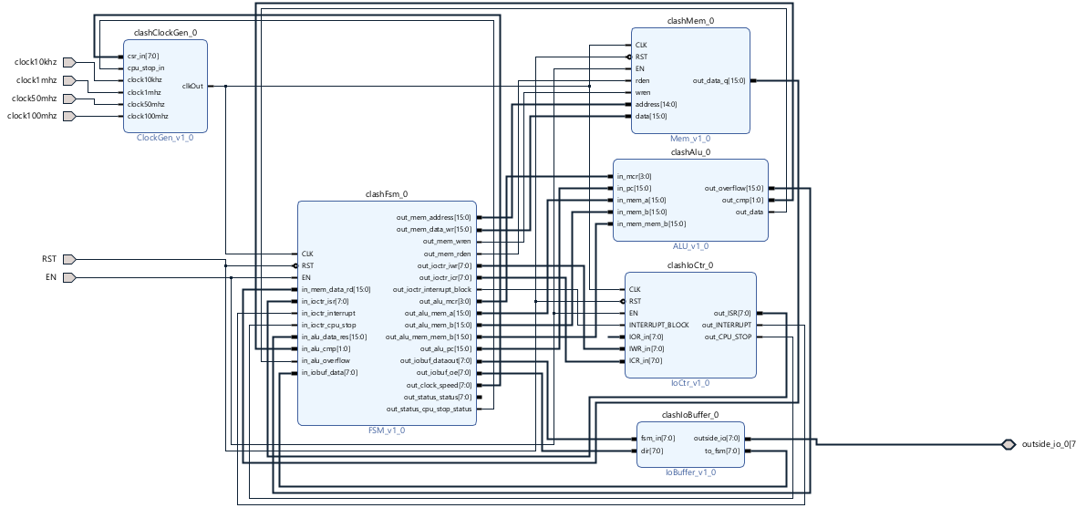
Clash
Complete mOISC in Vivado

Slide 24
Optimization and Tests

Slide 25
Optimization and Tests
State Monad – implicit State
Result
Result
Result
computation
computation
computation
Initial State
>>= >>=
type FSMm memSize regSize =
RWS
(FsmInput memSize regSize)
(FsmOutput memSize regSize)
(InternalStateNoOutputRegisters memSize regSize)
mFSM :: forall memSize regSize.
(KnownNat memSize, KnownNat regSize) =>
FSMm memSize regSize ()

Slide 26
Optimization and Tests
Lenses – Looking through Data
FETCH_MCR -> (fsmState', outputRegisters')
where
fsmState' =
fsmState
{ _cycleState = cycleState',
_outputRegisters = outputRegisters'
} outputRegisters' =
(_outputRegisters fsmState)
{ _memOutput = memOutput'
} cycleState' = FETCH_0_SAVE_MCR -- Request Instruction from Mem
memOutput' = readMemFromAddress $ _pci (_internalRegisters fsmState)
View subpart of a structure
Modify structure by changing subpart
Combine Lenses to look deeper
Combines with Monads
FETCH_MCR -> do
fetchMem =<< use (internalRegisters . pci)
cycleState .= FETCH_0_SAVE_MCR

Slide 27
Optimization and Tests
First Monoid – Undefined Signals
data Fsm2ComputerStatus regSize = Fsm2ComputerStatus
{ _status :: First (BitVector regSize),
_cpu_stop_status :: First Bool
}deriving stock (Generic, Show, Eq)
deriving anyclass NFDataX
deriving Semigroup via GenericSemigroup (Fsm2ComputerStatus regSize)
deriving Monoid via GenericMonoid (Fsm2ComputerStatus regSize)
First monoid keeps last
“Just” value
Custom datatypes composed of “First” can derive monoid properties
Initial Output should
be undefined
infix 4 .:=
(.:=) :: (MonadWriter t m, Monoid s)
=> ASetter s t a1 (First a2) -> a2 -> m ()
y .:= x = scribe y $ First $ Just x

Slide 28
Optimization and Tests
Barbies as an alternative
Barbies Library allows even more Flexibility
Even more „dark“ Template Haskell magic
Lenses are complicated enough
Error Messages are cryptic and long
Used by Gergő Érdi in „Retro Programming with Clash“
import Barbies
import Barbies.Bare
import Data.Barbie.TH
declareBareB [d| data CPUOut = CPUOut
{ _romAddr :: PC,
_inputNeeded :: Bool } |]
makeLenses ''CPUOut
type Pure b = b Bare Identity
type Partial b = b Covered First

Slide 29
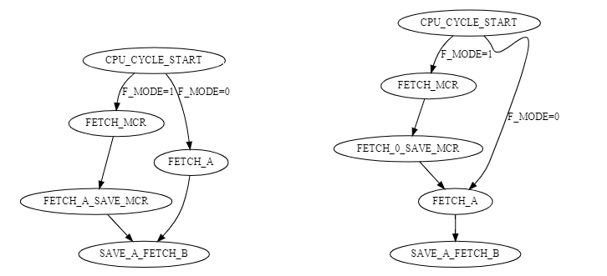
Optimization and Tests
Other optimizations – not implemented
Optimize FSM structure
Use dual port RAM
Reduce memory loading states from avg 7 States to 3
Implement a pipeline
Don’t save registers back to memory
In theory only four cycles per instruction

Slide 30
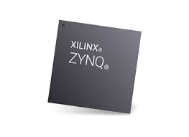


Optimization and Tests
Tests
Cyclic Accurate
Test.Tasty
Quickcheck
Testbench
Simulation
On chip
Integrated Logic Analyzer (ILA)

Slide 31
Optimization and Tests
Quickcheck
Passing generated Test
> verboseCheck testNot5
Passed:
[1,-2]
Failed:
[-4,0,-12,12,10,2,4,10,7,5]
Failed:
[2,4,10,7,5]
Failed:
[10,7,5]
Failed:
[7,5]
Failed:
[5]
Passed:
[3]
Passed:
[4]
*** Failed! Falsified (after 14 tests and 4 shrinks):
[5]
First shrink step -> halving List
Automated Testing
Proposition
Still failing -> shrink again…
> testNot5 :: (Foldable t, Eq a, Num a)
=> t a -> Bool
> let testNot5 l = all ( /= 5) l
Not failing after shrinking
[5] is the smallest counterexample

Slide 32
Optimization and Tests
Quickcheck
For Clash Datatypes Abitrary is implemented
For own datatypes Abitrary must be implemented
Test Trees implemented with Test.Tasty
-- a-b = -b - (- a)
testSubLeq :: CLP.Signed 16 -> CLP.Signed 16 -> Bool
testSubLeq a b = _data_res (test a b) == _data_res (test (negate b) (negate a))
where
test x y = alu $ Fsm2Alu {_mcr = SubLeq, _mem_a = x, _mem_b = y, _mem_mem_b = 0, _pc = 0}
instance QC.Arbitrary Instruction where
arbitrary = QC.elements [SubLeq,
MovLeq ,
…
PcS]
testDeEnCode :: Instruction -> Bool
testDeEnCode i = i == (decodeInstruction $ (encodeInstruction i :: CLP.BitVector 16))

Slide 33
Results

Slide 34
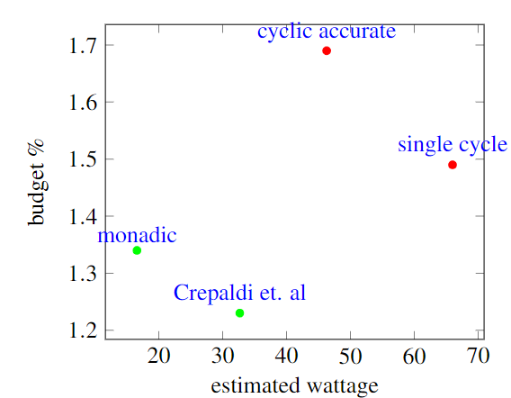
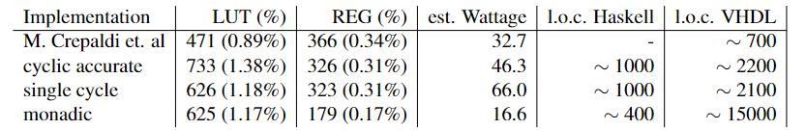
Results
Running VHDL
ALU
Non-monadic FSM
IO-Controller
Memory
Monadic FSM
Clock Gen
IO-Buffer
Complete mOISC

Slide 35
Results
Clash for hardware design
👎 Clash feels like HLS (monadic implementation)
👎 Haskell is a high entry barrier
👎 VHDL and Verilog are already high level
👎 Very little documentation and examples
👎 Small community
👍 Fast testing with QuickCheck
👍 Quick prototyping once learned
👍 Great learning experience
👍 Reusable code
👍 Usage for more specialized hardware
👍 Helpful community

Slide 36
Outlook

Slide 37
Outlook
Fixing ClockGen and IO-Buffer
Fully working Clash-mOISC
More test cases
Maybe define an Abitrary instance over C-programms?
Pipelined implementation
Pipeline
Reduced states
Dual port mem
Automated Vivado IPBlock pipeline

Slide 38

Thank you for your Attention!

