Slide 1






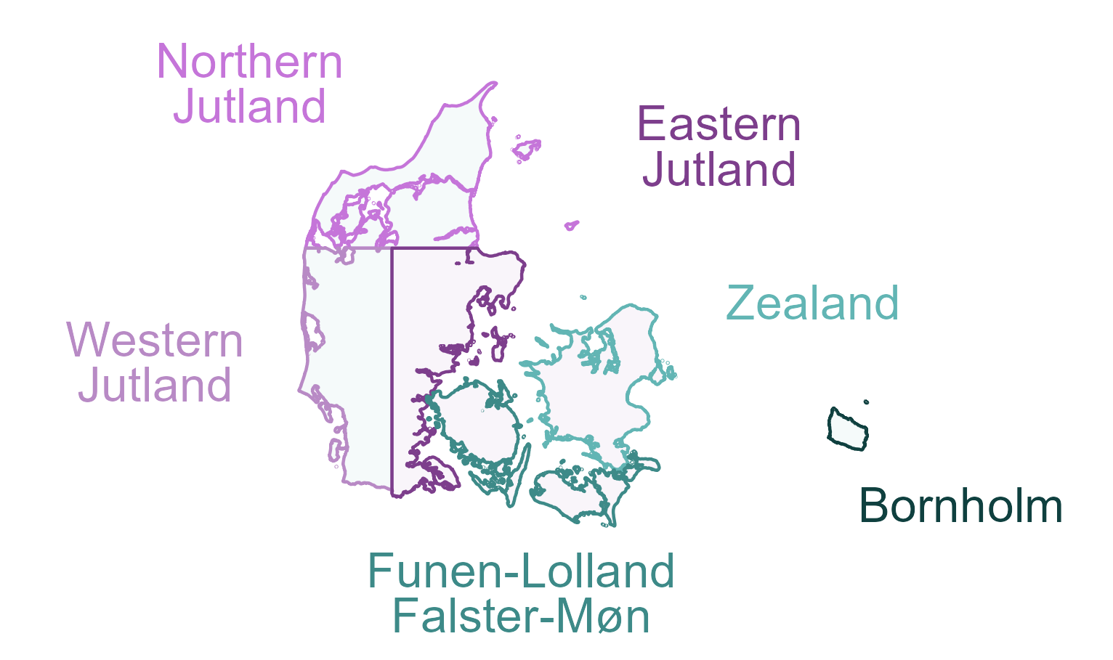

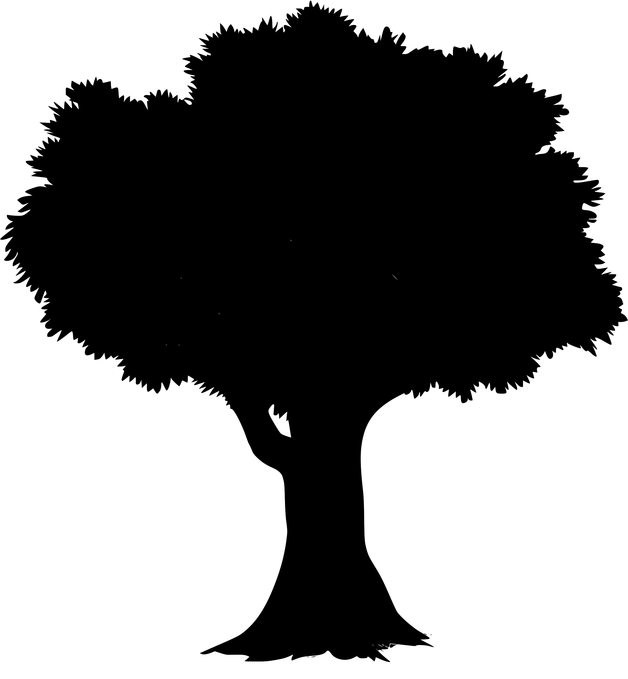

DK Forest Conservation Value Projections
80%
Model Training
- Gradient Boosting
- Random Forests
Hyperparameter Tuning
- 5-10-fold CV
Training Polygons (forest annotations)
§25 forests
§15 forests
“untouched”
High Value
Sample
(30k pixels)
Split: Geographic Stratification
Low Value
NST plantations
“not §25” forests
Sample
(30k pixels)
20%
Validation
- nationwide
- by region
Final Model
Raster Predictors [10 m]
Nationwide
Conservation Value Projections
EcoDes-DK15
Airborne Lidar
(Assman et al. 2022)
Tree Type Bjerreskov et al. 2021
Soil: Clay, Sand & Organic Matter Downsampled from 250 m (Poggio et al. 2021)
Near-surface Groundwater Koch et al. 2021

