Slide 1







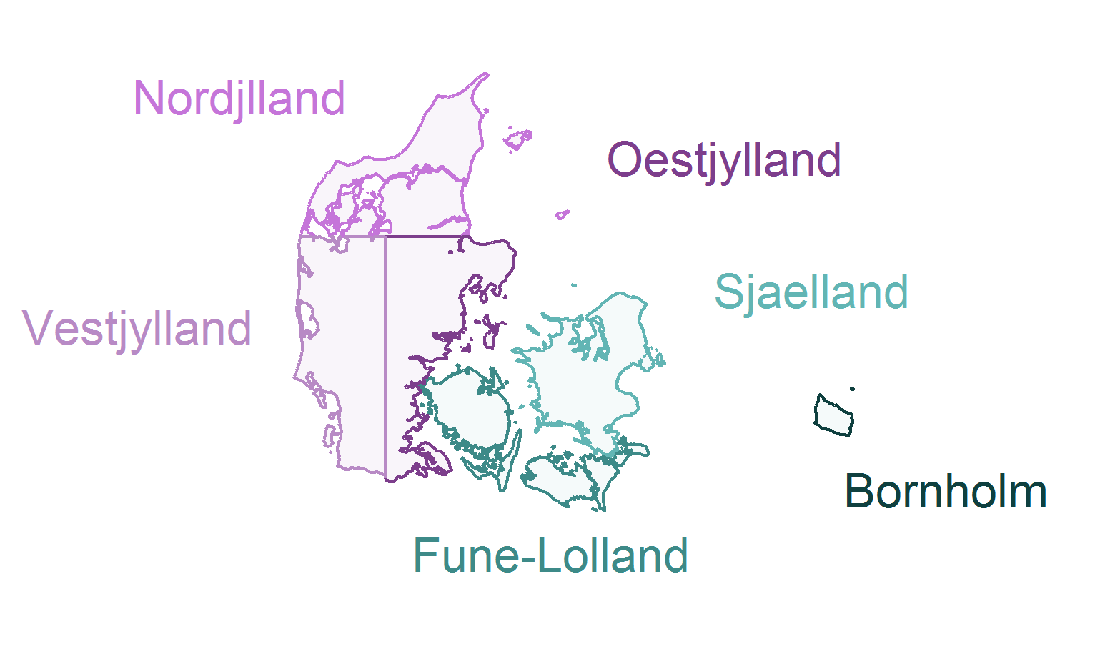


DK Forest Quality Projections Workflow
80%
Model Training
- Gradient Boosting
- Random Forests
Hyperparameter Tuning
- 5-10-fold CV
Training Polygons (forest annotations)
§25 forests
§15 forests
private old growth
High quality
Sample
(30k pixels)
Split: Geographic Stratification
Low quality
NST plantations
“ikke” §25 forests
Sample
(30k pixels)
20%
Validation
- nationwide
- by region
Final Model
Raster Predictors [10 m]
EcoDes-DK15
Airborne Lidar
(Assman et al. 2022)
Tree Type Bjerreskov et al. 2021
Nationwide Forest Quality Projections
Soil: Clay, Sand & Organic Matter Downsampled from 250 m (Poggio et al. 2021)
Near-surface Groundwater Koch et al. 2021

