Slide 1







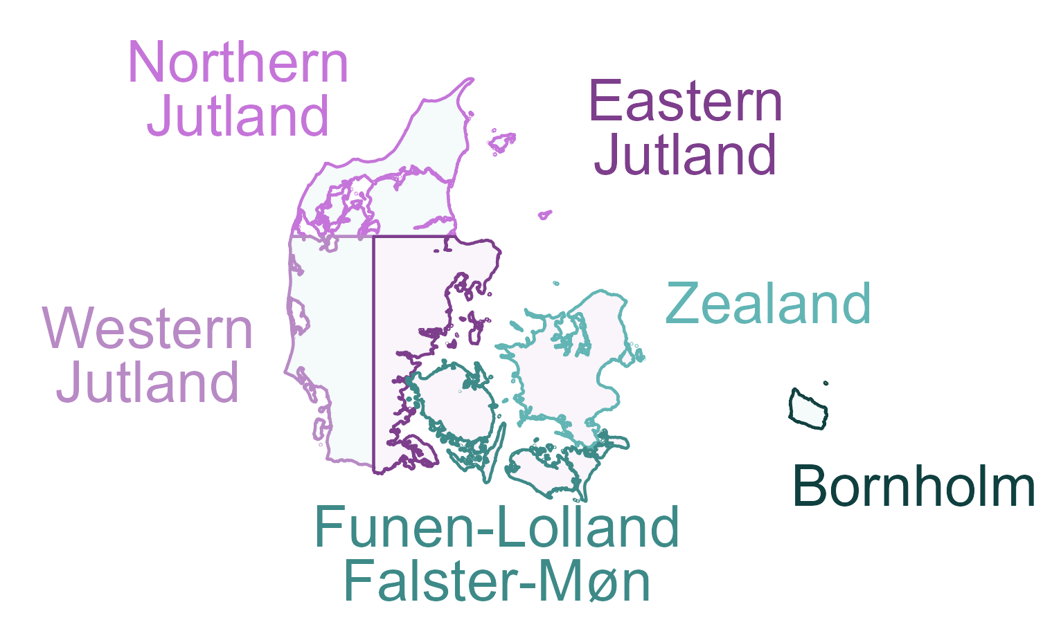
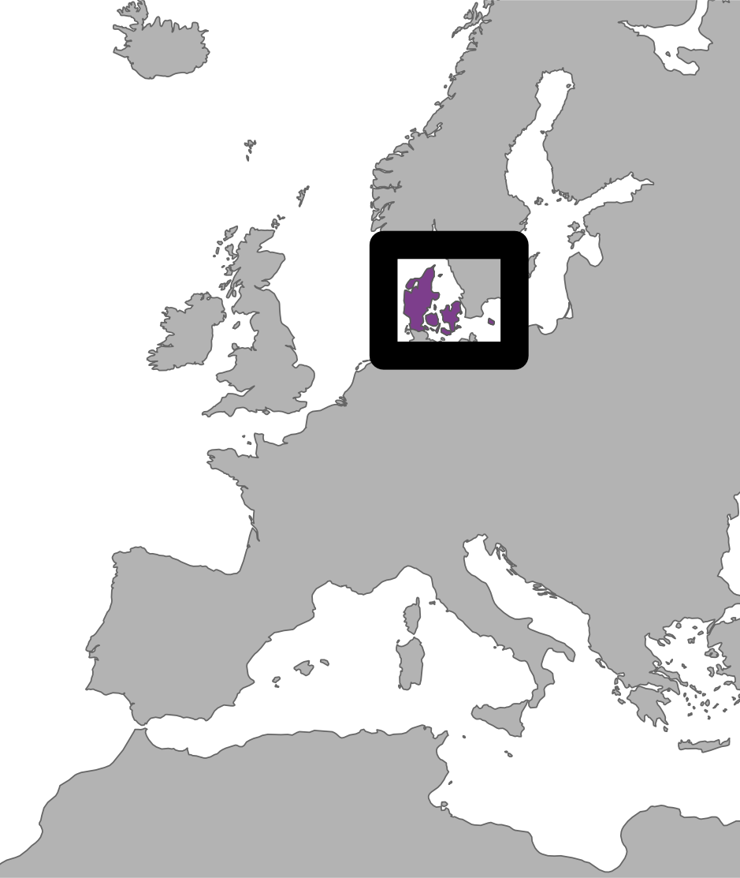
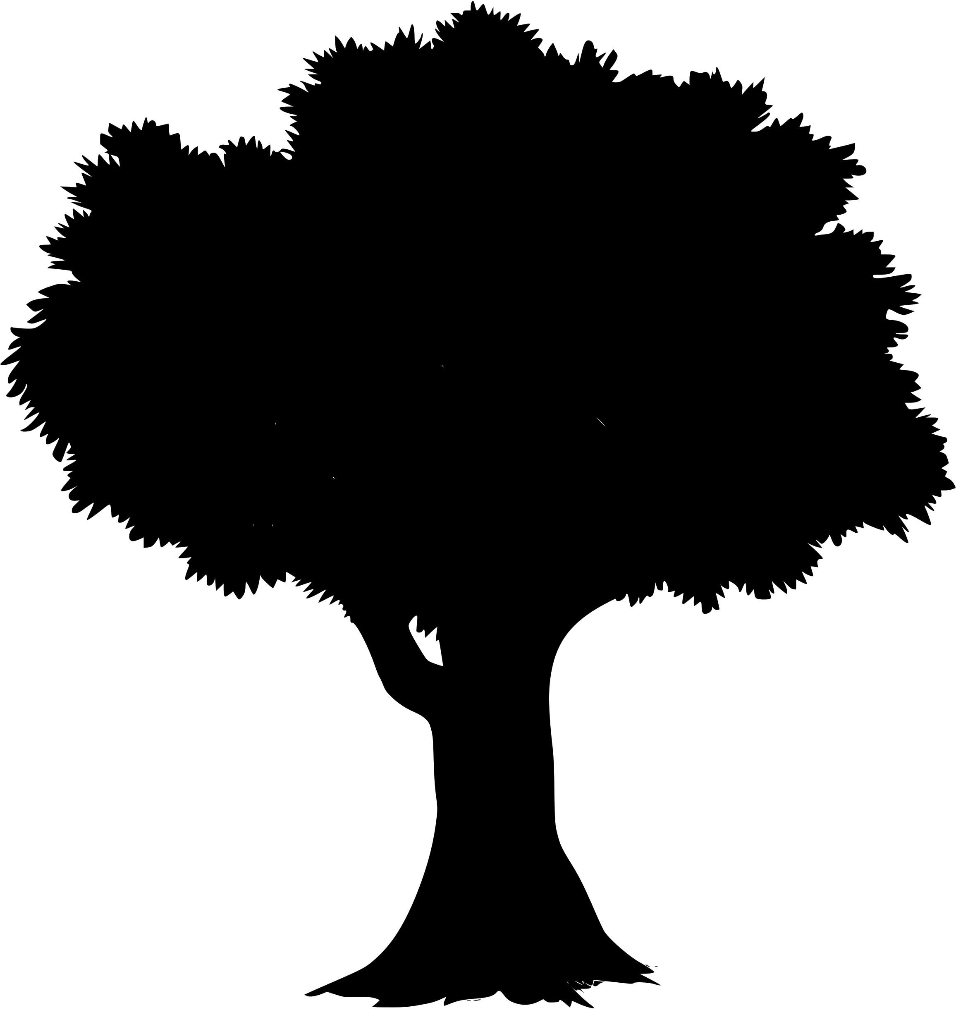

DK Forest Conservation Value Projections
Model Training
- Gradient Boosting
- Random Forests
Hyperparameter Tuning
- 5x-10x CV
Training Polygons (forest annotations)
80%
§25 forests
§15 forests
“untouched”
High Value
Sample
(30k pixels)
Split: Geographic Stratification
NST plantations
“not §25” forests
Sample
(30k pixels)
Validation
- nationwide
- by region
Low Value
20%
Final Model
Raster Predictors [10 m]
Nationwide
Conservation Value Projections
EcoDes-DK15
Airborne Lidar
(Assman et al. 2022)
Tree Type (Bjerreskov et al. 2021)
Soil: Clay, Sand & Organic Matter downsampled from 250 m (Poggio et al. 2021)
Near-surface Groundwater (Koch et al. 2021)

