Slide 1

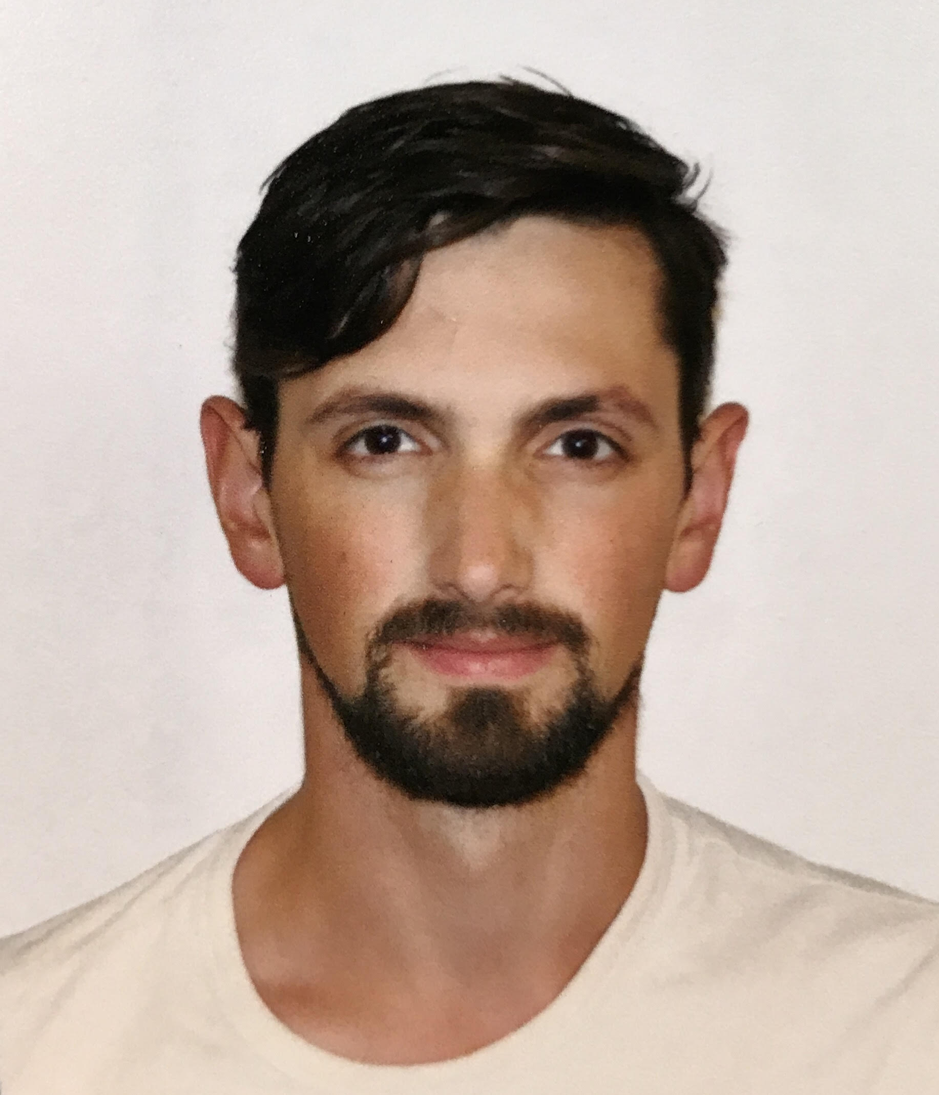



Truly Supercritical Trade-offs for Resolution, Cutting
Planes, Monotone Circuits and Weisfeiler–Leman
Jakob Nordström
University of Copenhagen & Lund University
Circuits, Communication, and Proofs
International Centre for Theoretical Sciences (ICTS)
Bengaluru, India
August 19, 2026
joint with
Susanna F. de Rezende
Noah Fleming
Duri Andrea Janett
Shuo
Pang
Notes:
Thanks.
Name
Title
Joint w/

Slide 2

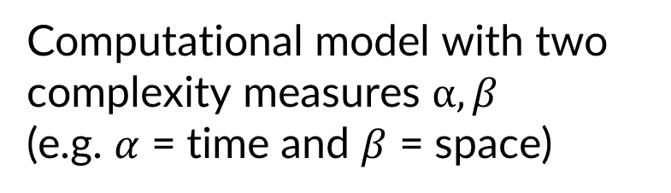





What Is a Trade-off Result?
$$α$$
$$α_{worst}$$
Computational model with two complexity measures $α, β$
(e.g. $α$ = time and $β$ = space)
$$β$$
$$β_{worst}$$
brute force algorithm can achieve worst case
can optimize $β$, but then $α$ bad
can optimize $α$, but then $β$ bad
impossible to optimize both
Notes:
Imagine comp model
Time, space,
Dashed lines: worst case upper bounds
Trivial brute force algo
Trade-off: can optimize both at the expense of the other
Impossible to optimize both: no instance for a given task in this region

Slide 3








A New Kind of Trade-off [Razborov ‘16]
$$α$$
$$α$$
Supercritical
$$α_{worst}$$
$$α_{worst}$$
$$β$$
$$β$$
$$β_{worst}$$
$$β_{worst}$$
→ Optimizing $α$ pushes $β$ way beyond brute-force worst case
Follow-up work in [Raz‘17, Raz‘18, BN‘20, FPR‘22, BN‘23, GLN‘23, BT‘24, CD‘24]
3
Notes:
In his 2016 paper, ….
Red box extends beyond dashed line
e.g. space might need to be superlinear, or even superpolynomial
Later called supercritical

Slide 4
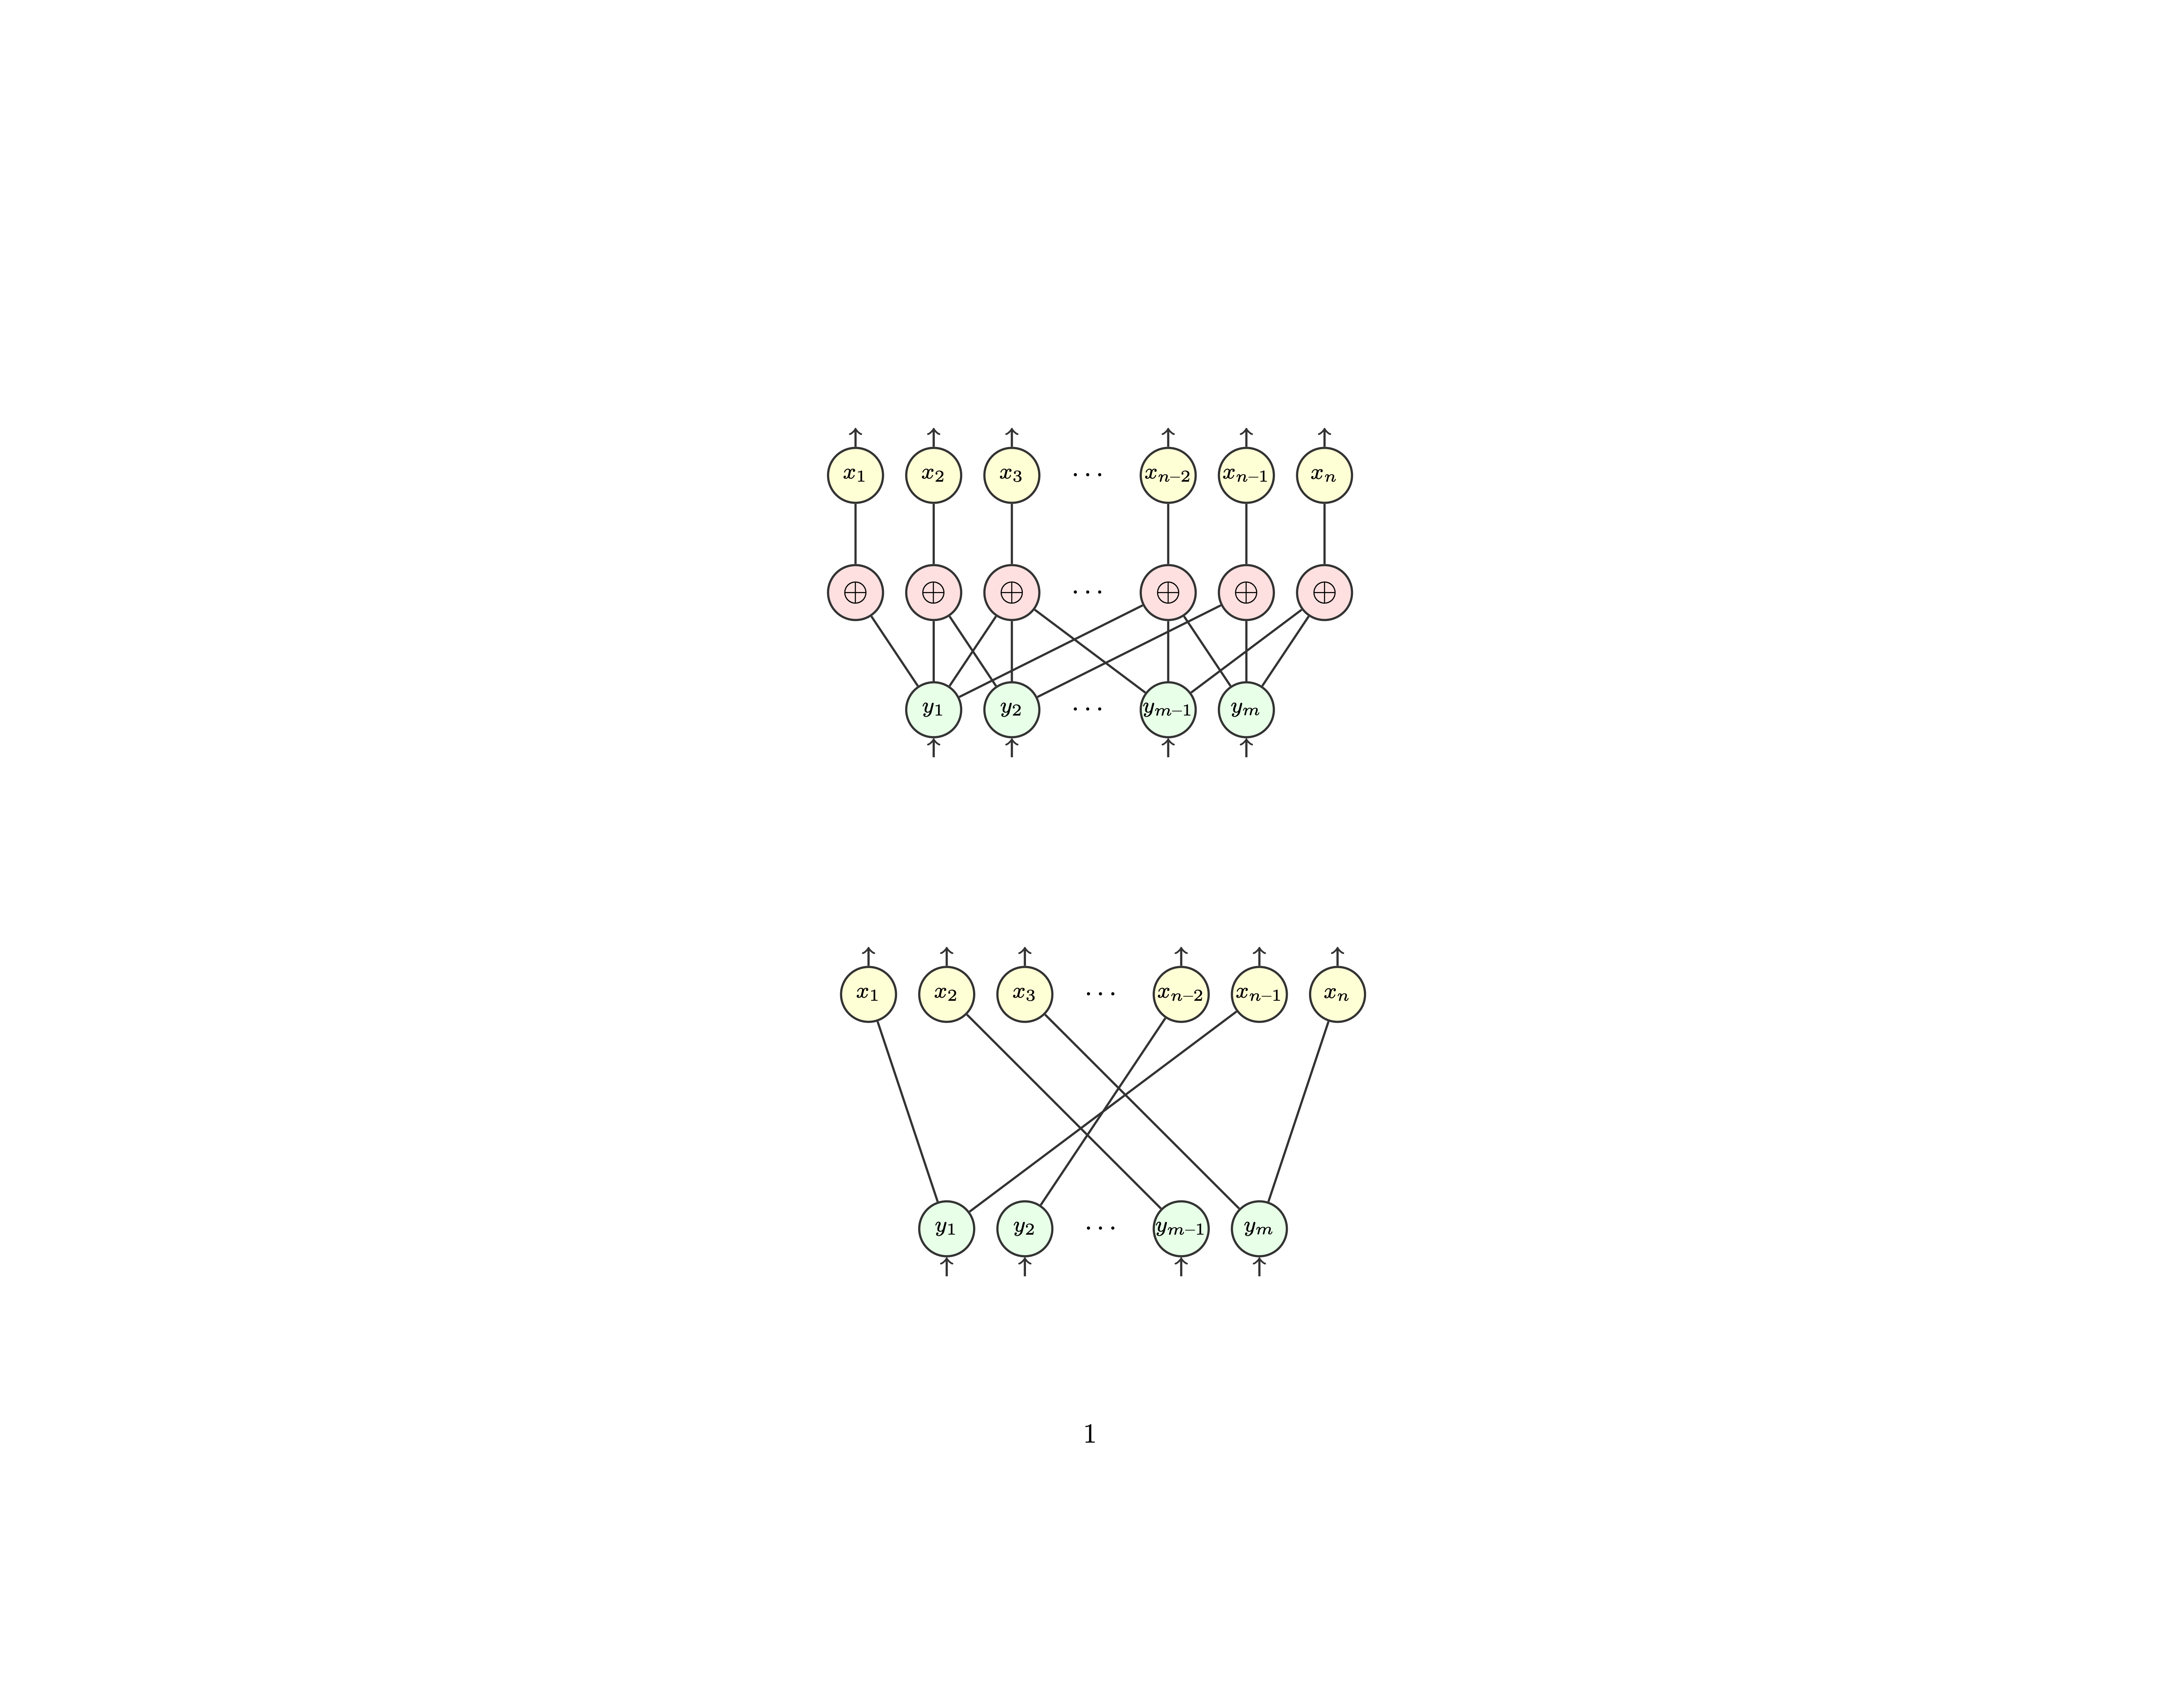
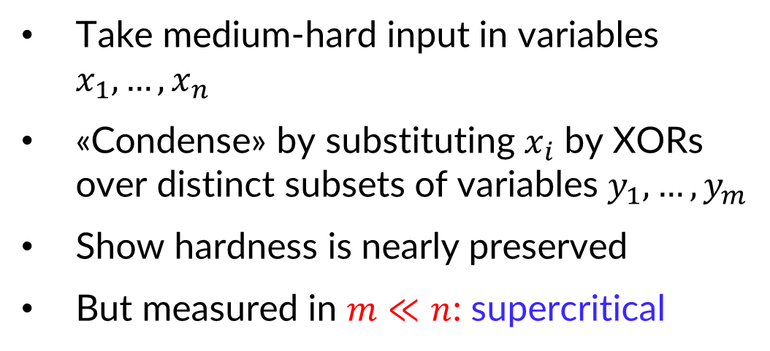
Supercritical Trade-offs Through Hardness Condensation
Take medium-hard input in variables $x_{1},…, x_{n}$
«Condense» by substituting $x_{i}$ by XORs over distinct subsets of variables $y_{1},…, y_{m}$
Show hardness is nearly preserved
But measured in $m≪n$: supercritical
Used in [Razborov ‘16, BN‘20, FPR‘22, BN‘23, GLN‘23, CD’24, …]

Slide 5





Supercritical in What?
$$α$$
$$α_{worst}$$
$$β$$
$$β_{worst}(\#Vars)$$
$$β_{worst}(size)$$
All trade-offs supercritical in # variables only,
except
[Berkholz ‘12, BBI ‘12, BNT ‘13]
→ Can we prove similar trade-offs truly supercritical in input size?
Notes:
Any questions about this?

Slide 6
Overview of Our Results (Informal)
Truly supercritical trade-offs for
depth vs width in resolution
size vs width in tree-like resolution
size vs depth in resolution and cutting planes
size vs depth for monotone circuits
dimension vs iteration number for Weisfeiler–Leman
Answering open questions in [Razborov ‘16, GGKS ‘18, FGIPRTW ‘21, FPR ‘22, GLNS ‘23]
Related concurrent work by [Göös-Maystre-Risse-Sokolov ‘25]
Next up:
More precise statement of the results
Preliminaries to make sense of statements
Notes:
ANY QUESTIONS SO FAR?
Our result is that, as long as the parameter c is below k-1, the condensed Tseitin formula is refutable in width k+3, but if you stay in width k+c world, then any proof has depth that is formula size to the k over (c+1).
Here, we can take k to be n/(2 ln n), in order for the moduli to exist.
Then, as examples, if we let c be any constant, then the depth lower bound here is subexponential in the formula size.
And c up to about 2k, the depth remains super-linear.

Slide 7
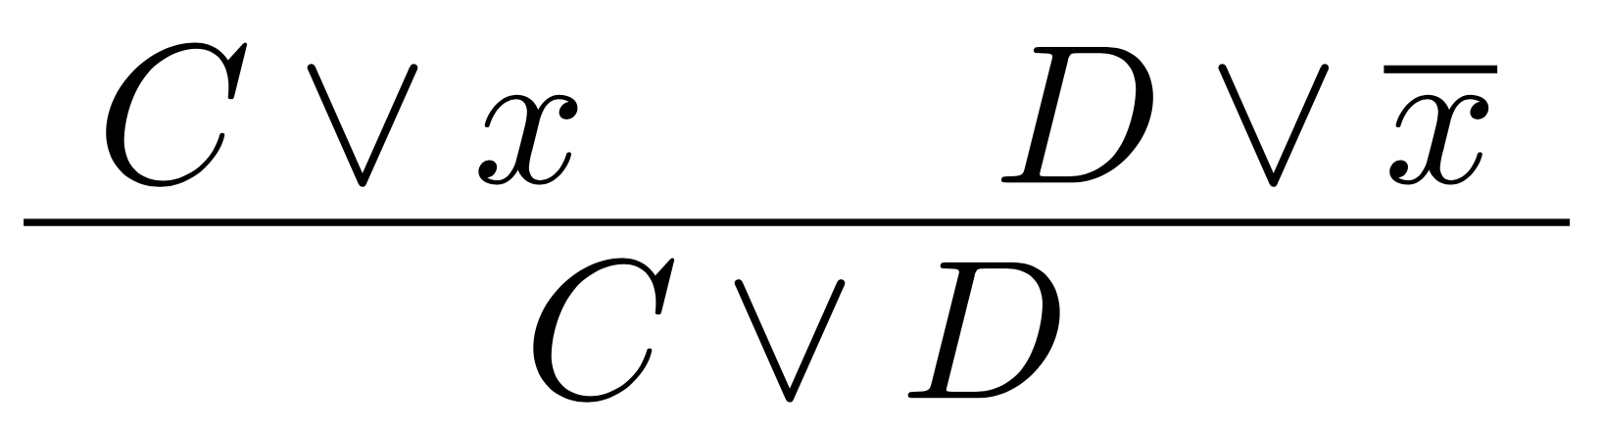







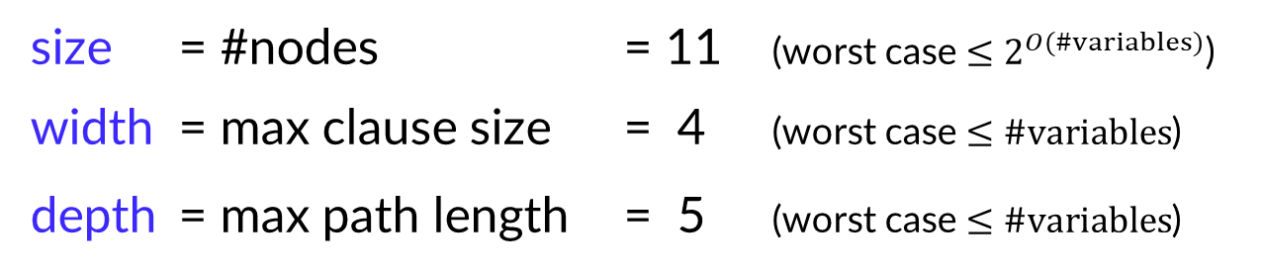









Resolution Proof System
$$u∨w∨x$$
$$\overline{x}∨y∨z$$
$$\overline{z}$$
$$\overline{y}$$
$$\overline{w}$$
$$\overline{u}$$
Goal: prove CNF formula unsatisfiable
Proof of unsatisfiability: Refutation
$$x$$
$$u∨w∨y∨z$$
Resolution rule:
$$z$$
$$u∨w∨y$$
$$y$$
$$u∨w$$
$$w$$
size = #nodes = 11 (worst case $≤2^{O(\#variables)}$)
width = max clause size = 4 (worst case $≤\#variables$)
depth = max path length = 5 (worst case $≤\#variables$)
$$u$$
$$u$$
$$⊥$$
Notes:
Soundness: Can only derive correct things (Sat assn above is sat assn below), completeness.
Depth need not be larger…
Complexity of formula: minimum over all Refs
Interested in asymptotics for families of formulas
Trivial worst case bounds: both width, depth: #vars, size. Not hard but no time.
Say what is treelike

Slide 8
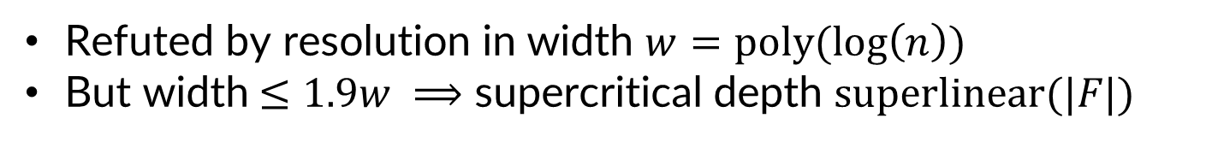
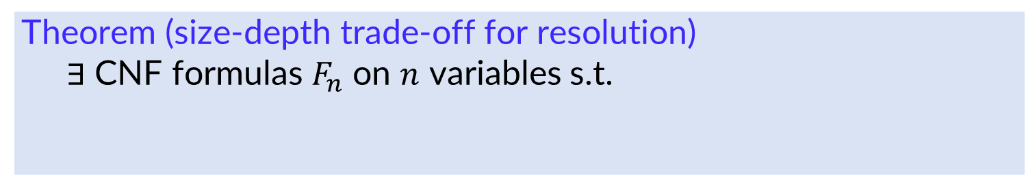
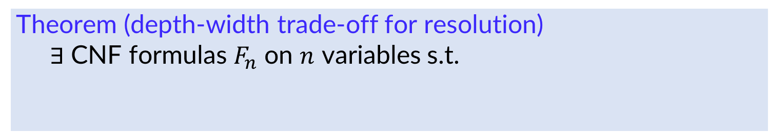
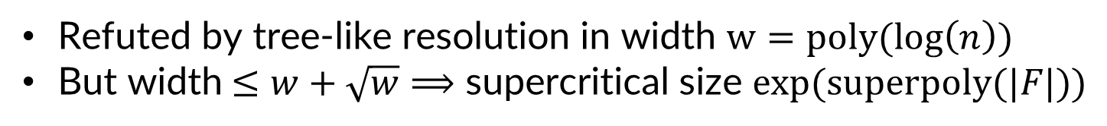
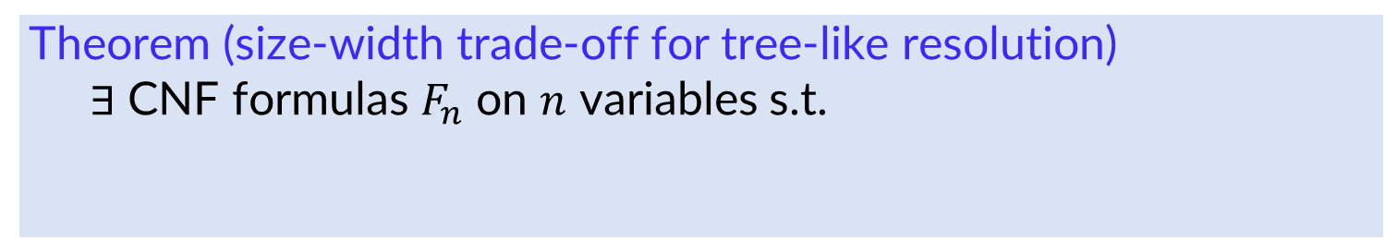
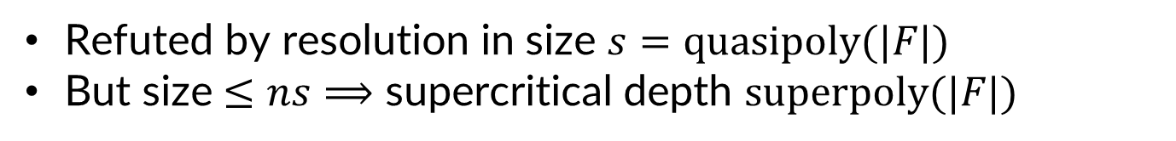
Our Results: Resolution
Theorem (depth-width trade-off for resolution)
$∃$ CNF formulas $F_{n}$ on $n$ variables s.t.
Refuted by resolution in width $w=poly(log\left(n\right))$
But width$≤1.9w ⟹$ supercritical depth $super\text{linear(|}F\text{|}\text{)}$
Theorem (size-depth trade-off for resolution)
$∃$ CNF formulas $F_{n}$ on $n$ variables s.t.
Refuted by resolution in size $s=quasipoly\text{(}\text{|}F\text{|}\text{)}$
But size $≤ns⟹$ supercritical depth $superpoly\text{(}\text{|}F\text{|}\text{)}$
All results supercritical in input size
Theorem (size-width trade-off for tree-like resolution)
$∃$ CNF formulas $F_{n}$ on $n$ variables s.t.
Refuted by tree-like resolution in width $w=poly(log\left(n\right))$
But width$≤w+\sqrt{w}⟹$ supercritical size $exp(superpoly\text{(}\text{|}F\text{|)}\text{)}$
Notes:
Depth witdth: …. Similar result for size…
Treelike
GIST: all supercritical in input size.

Slide 9



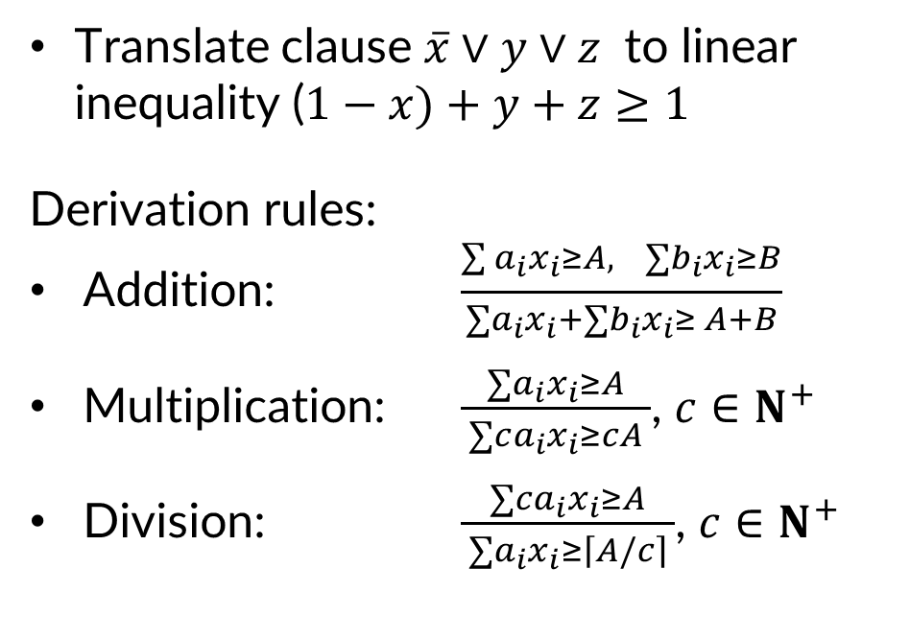




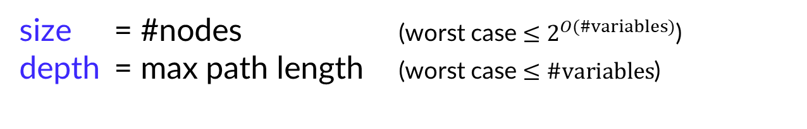














$$u∨w∨x$$
$$\overline{x}∨y∨z$$
Cutting Planes Proof System
$$\overline{z}$$
$$u+w+x≥1$$
$$−x+y+z≥0$$
$$−z≥0$$
Translate clause $\overline{x}∨y∨z$ to linear inequality ($1−x)+y+z≥1$
Derivation rules:
Addition: $\frac{\begin{aligned}\sum{a_{i}x_{i}}≥A, ∑b_{i}x_{i}≥B \\ \end{aligned}}{∑a_{i}x_{i}+∑b_{i}x_{i}≥ A+B}$
Multiplication: $\frac{∑a_{i}x_{i}≥A}{ ∑ca_{i}x_{i}≥cA }$, $c∈N^{+}$
Division: $\frac{∑ca_{i}x_{i}≥A}{ ∑a_{i}x_{i}≥\left\lceil A/\left.c\right\rceil \right. }$, $c∈N^{+}$
+
$$\overline{w}$$
$$u+w+y+z≥1$$
$$\overline{y}$$
$$−w≥0$$
$$+$$
$$u+w+y≥1$$
$$−y≥0$$
$$+$$
$$\overline{u}$$
$$u+w≥1$$
$$−u≥0$$
$$+$$
$$u≥1$$
size = #nodes (worst case $≤2^{O(\#variables)}$)
depth = max path length (worst case $≤\#variables$)
$$+$$
$$0≥1$$
Notes:
Can encode a CNF as linear inequalities,
see here the Resolution proof from before
( CP simulates Res )
Captures reasoning done
Division sound over integers

Slide 10


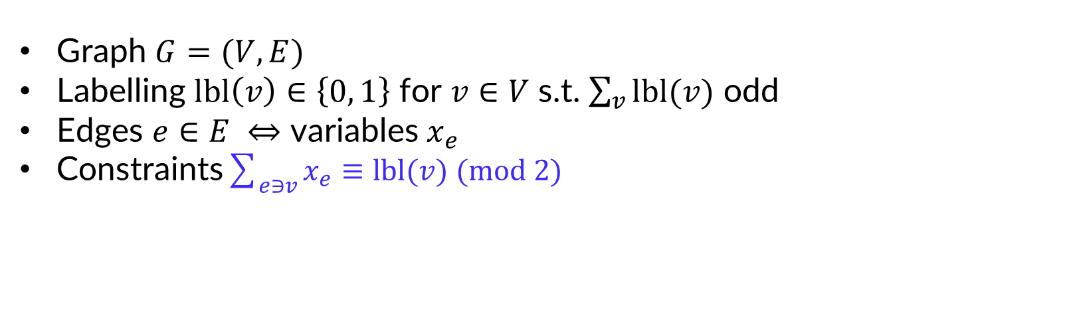











Tseitin Formulas (Handshake Lemma)
Graph $G=(V,E)$
Labelling $lbl\left(v\right)∈\left\{0, 1\right\}$ for $v∈V$ s.t. $\sum_{v}{lbl(v)}$ odd
Edges $e∈E ⇔$ variables $x_{e}$
Constraints$\sum_{e∋v}{x_{e}≡lbl(v) (mod 2)}$
$$1$$
$$0$$
$$a$$
$$x_{a}∨x_{b}$$
$$\overline{x_{a}}∨\overline{x_{b}}$$
$$\overline{x_{a}}∨\overline{x_{b}}∨\overline{x_{d}}$$
$$\overline{x_{a}}∨x_{b}∨x_{d}$$
$$x_{a}∨\overline{x_{b}}∨x_{d}$$
$$x_{a}∨x_{b}∨\overline{x_{d}}$$
$$\overline{x_{b}}∨\overline{x_{c}}∨\overline{x_{e}}$$
$$\overline{x_{b}}∨x_{c}∨x_{e}$$
$$x_{b}∨\overline{x_{c}}∨x_{e}$$
$$x_{b}∨x_{c}∨\overline{x_{e}}$$
$$x_{d}∨\overline{x_{e}}$$
$$\overline{x_{d}}∨x_{e}$$
$$b$$
$$c$$
$$d$$
$$e$$
$$0$$
$$0$$
Extensive study since [Tseitin ‘68]
Exponential resolution size lower bound [Urquhart ‘87]
Also studied for sum-of-squares (SoS), bounded-depth Frege, stabbing planes, …
Notes:
With proof systems at hand, define formula. One of main work horses in proof complexity …

Slide 11
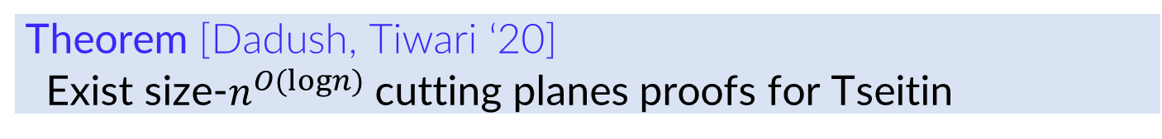
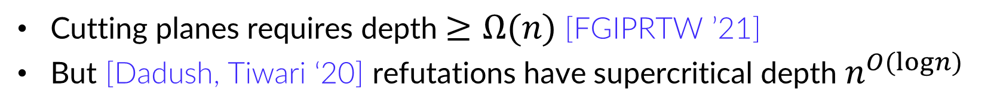
Supercritical trade-offs for Tseitin Formulas?
Long-standing conjecture: Tseitin formulas exponentially hard for cutting planes
FALSE!
Theorem [Dadush, Tiwari ‘20]
Exist size-$n^{O(logn)}$ cutting planes proofs for Tseitin
Cutting planes requires depth$≥Ω(n)$ [FGIPRTW ’21]
But [Dadush, Tiwari ‘20] refutations have supercritical depth $n^{O(logn)}$
Do Tseitin formulas yield supercritical trade-offs for size vs depth in cutting planes?
Supercritical trade-offs in # variables (though not for Tseitin) [Fleming-Pitassi-Robere ’22]

Slide 12
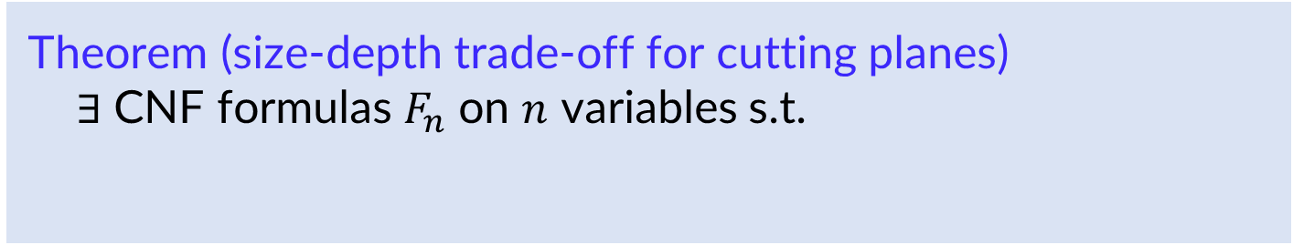
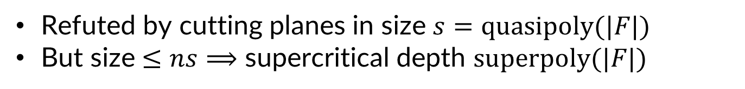
Our Result: Cutting Planes
Supercritical
in input size
Theorem (size-depth trade-off for cutting planes)
$∃$ CNF formulas $F_{n}$ on $n$ variables s.t.
Refuted by cutting planes in size $s=quasipoly\text{(}\text{|}F\text{|)}$
But size $≤ns⟹$ supercritical depth $superpoly\text{(}\text{|}F\text{|})$
Does not resolve question for Tseitin formulas
But Tseitin formulas used to construct formulas with provable trade-offs

Slide 13


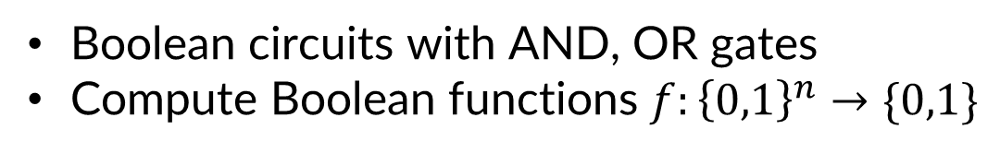

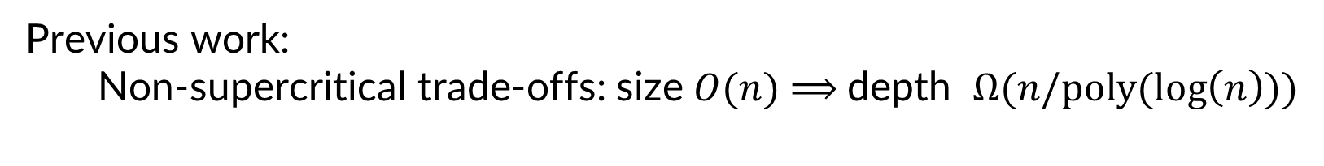



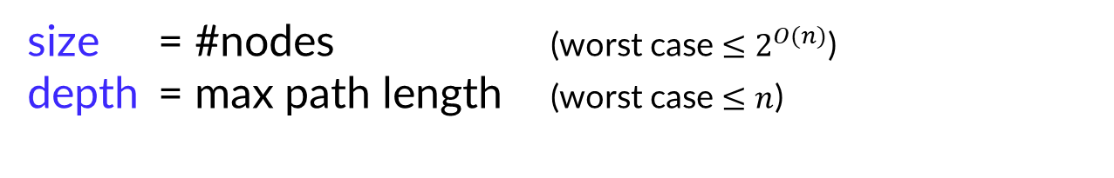




Monotone Circuits
$$∧$$
Boolean circuits with AND, OR gates
Compute Boolean functions $f:{\left\{0,1\right\}}^{n}→\{0,1\}$
$$∧$$
$$∨$$
$$∨$$
size = #nodes (worst case $≤2^{O(n)}$)
depth = max path length (worst case $≤n$)
$$∧$$
$${ x}_{5}$$
$${ x}_{1}$$
$${ x}_{2}$$
$${ x}_{3}$$
$${ x}_{4}$$
Previous work:
Non-supercritical trade-offs: size $O(n)$ $⟹$depth $Ω(n/poly(log\left(n\right)))$
[KW ’90, RM ’97, GP '14, dRMNPRV ’20]

Slide 14
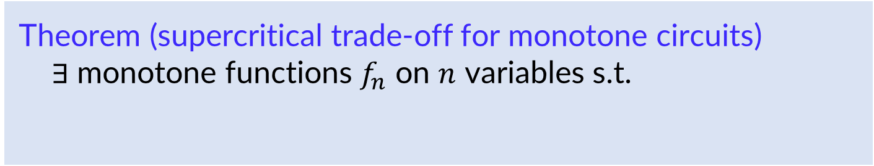
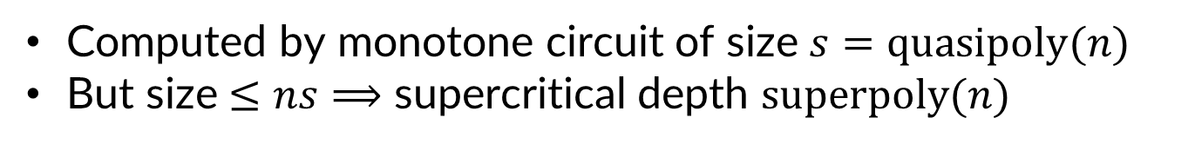
Our Result: Monotone Circuits
Theorem (supercritical trade-off for monotone circuits)
$∃$ monotone functions $f_{n}$ on $n$ variables s.t.
Computed by monotone circuit of size $s=quasipoly(n)$
But size $≤ns⟹$ supercritical depth $superpoly(n)$

Slide 15
Proof Structure
Proof in two steps:
Establish width vs depth trade-off result for resolution
Derive other proof & circuit complexity trade-off results with lifting
Notes:
Structure of our proof and paper
Little time: focus on width vs depth

Slide 16






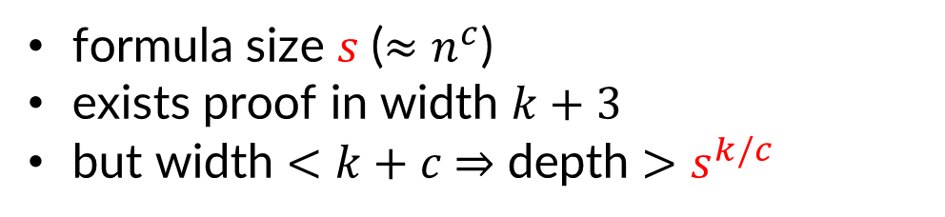

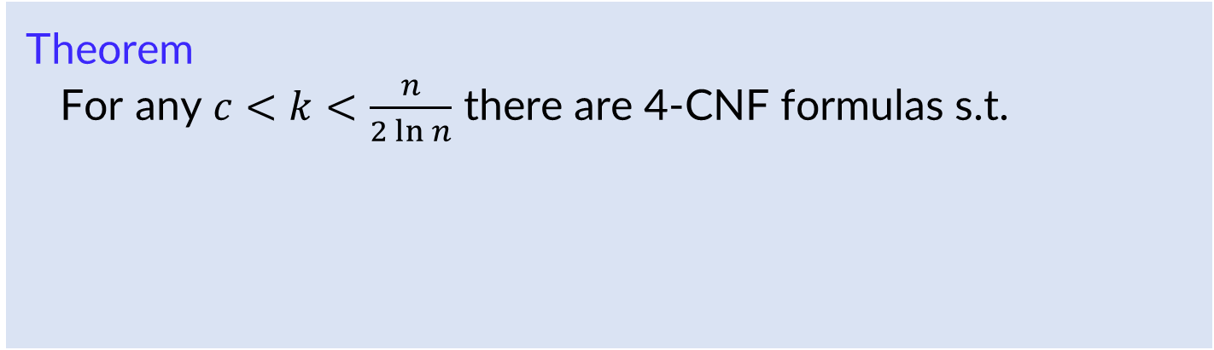
Resolution Width-Depth Trade-off
Theorem
For any $c<k<\frac{n}{2\ln{n}}$ there are 4-CNF formulas s.t.
formula size $s$ ($≈n^{c}$)
exists proof in width $k+3$
but width $<k+c$ $⇒$ depth $>s^{k/c}$
$$width$$
$$n$$
$$3w$$
$$1.9w$$
$$w$$
$$\text{|}F_{n}\text{|}$$
$$depth$$
Notes:
Soundness: Can only derive correct things (Sat assn above is sat assn below), completeness.
Depth need not be larger…
Complexity of formula: minimum over all Refs
Interested in asymptotics for families of formulas
Trivial worst case bounds: both width, depth: #vars, size. Not hard but no time.
Say what is treelike

Slide 17
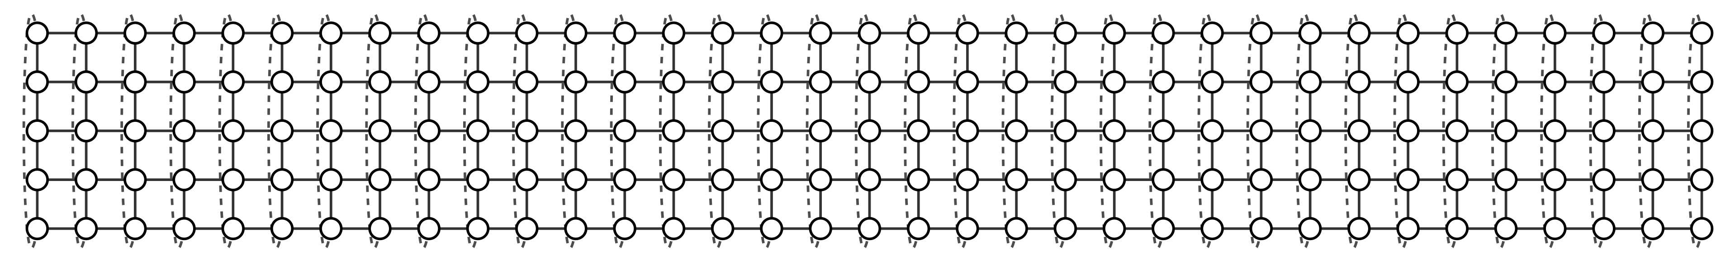

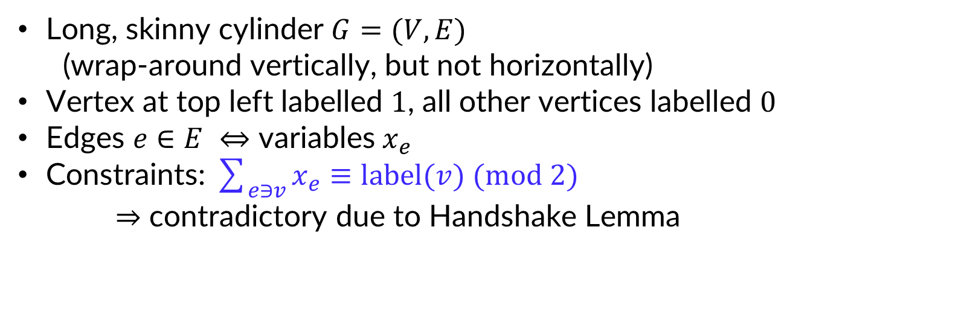

Starting Point: Tseitin Formula on Cylinder Graph
$$1$$
Long, skinny cylinder $G=(V,E)$
(wrap-around vertically, but not horizontally)
Vertex at top left labelled $1$, all other vertices labelled $0$
Edges $e∈E ⇔$ variables $x_{e}$
Constraints: $\sum_{e∋v}{x_{e}≡label(v) (mod 2)}$
$⇒$ contradictory due to Handshake Lemma
$$x_{up }∨x_{down}∨x_{right}$$
$$x_{up }∨\overline{x_{down}}∨\overline{x_{right}}$$
$$\overline{x_{up}}∨x_{down}∨\overline{x_{right}}$$
$$\overline{x_{up}}∨\overline{x_{down}}∨x_{right}$$

Slide 18




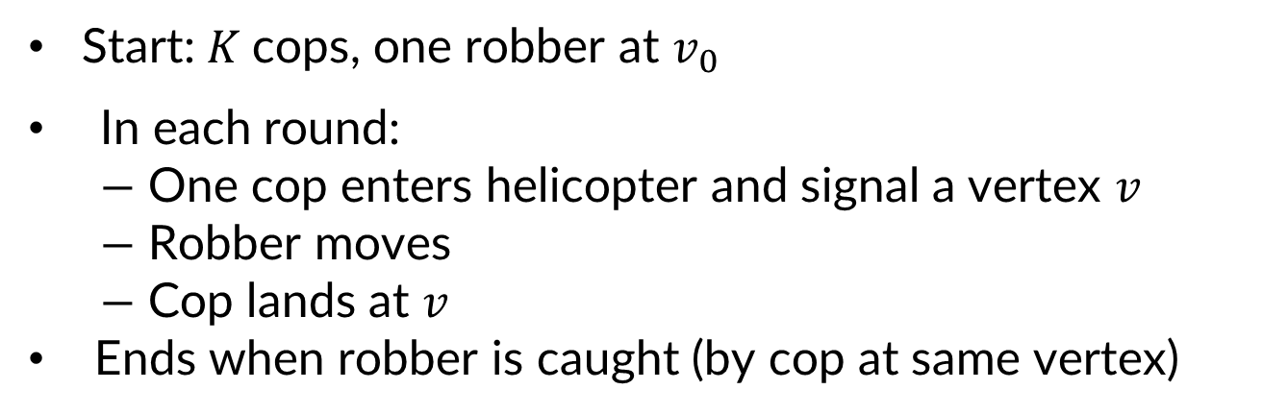
Trade-offs by Analyzing the Cop-Robber Game [Seymour-Thomas ’93]
Start:$K$cops, one robber at $v_{0}$
In each round:
$−$ One cop enters helicopter and signal a vertex $v$
$−$ Robber moves
$−$ Cop lands at $v$
Ends when robber is caught (by cop at same vertex)
width ≈ # cops
depth ≈ # rounds
[GTT ’18]

Slide 19

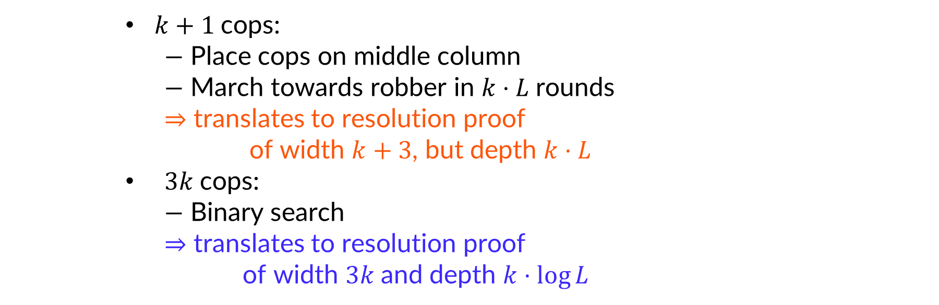

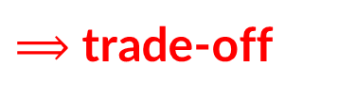





Upper Bounds: Simple Cop Strategies
$$k$$
$$L$$
$k+1$cops:
$−$ Place cops on middle column
$−$ March towards robber in $k⋅L$rounds
$⇒$ translates to resolution proof
of width $k+3$, but depth $k⋅L$
$3k$cops:
$−$ Binary search
$⇒$ translates to resolution proof
of width $3k$and depth $k⋅\log{L}$
$$width$$
$⟹$ trade-off
$$k⋅L$$
$$3k$$
$$k+3$$
$$depth$$
$$\operatorname{klog}{L}$$
$$\text{|}F_{n}\text{|}$$
Notes:
Say correspondence not exact
Say that L is the length of the cylinder, k the height
+3 is due to inexact correspondence

Slide 20
Key Idea: Variable Compression [Grohe-Lichter-Neuen-Schweitzer 2023]
Variable substitution
(with lots of collisions)
Substitution with XOR gadgets

Slide 21
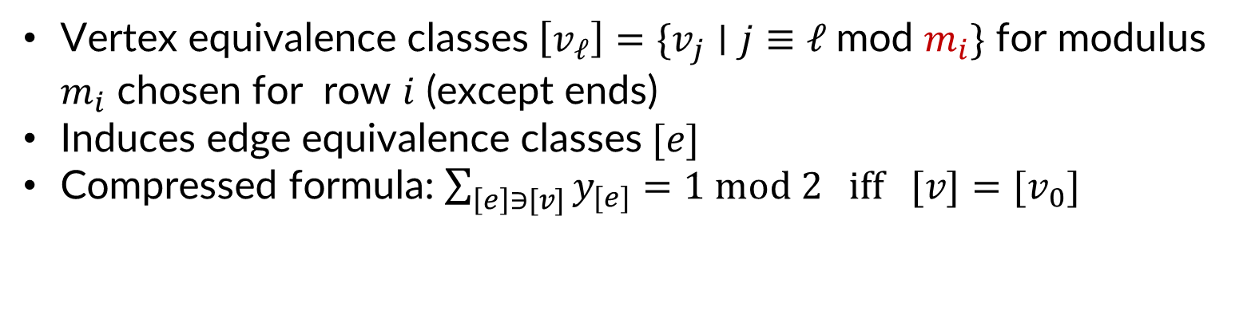
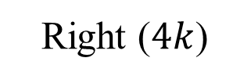
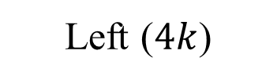

Graph and Tseitin Formula after Compression
$$v_{0}$$
Left ($4k$)
$$L≈n^{k}$$
Right ($4k$)
Vertex equivalence classes $\left[v_{ℓ}\right]=\{v_{j}∣j≡ℓ \text{mod }m_{i}\}$ for modulus $m_{i}$ chosen for row $i$ (except ends)
Induces edge equivalence classes $[e]$
Compressed formula: $\sum_{\left[e\right]∋[v]}{y_{[e]}}=1 mod 2 iff [v]={[v}_{0}]$

Slide 22
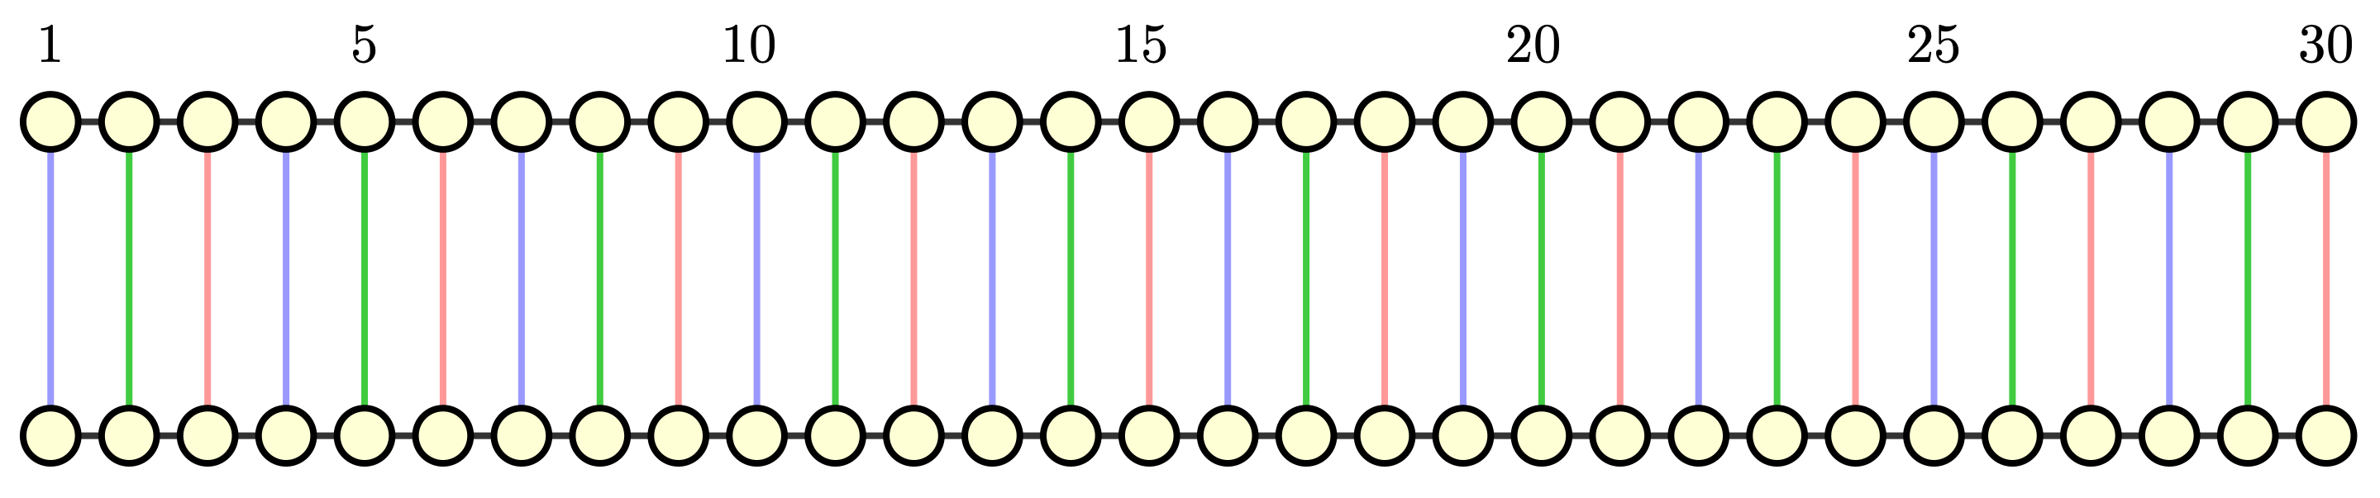
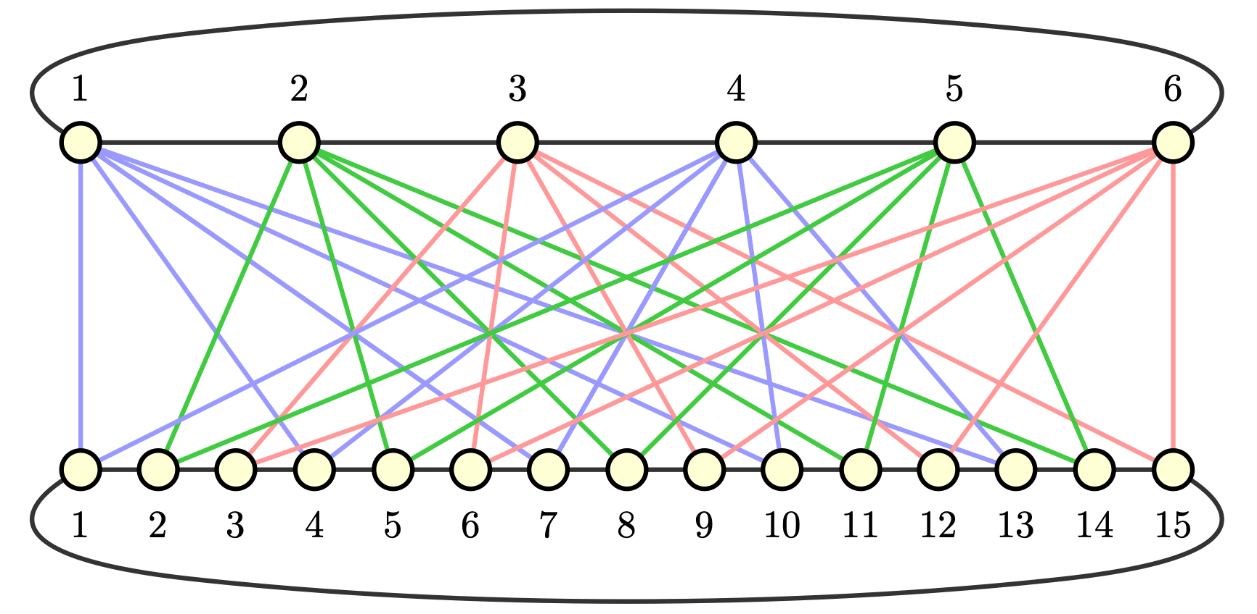
Edge Equivalence Between Two Rows ($m_{1}=6, m_{2}=15$)

Slide 23

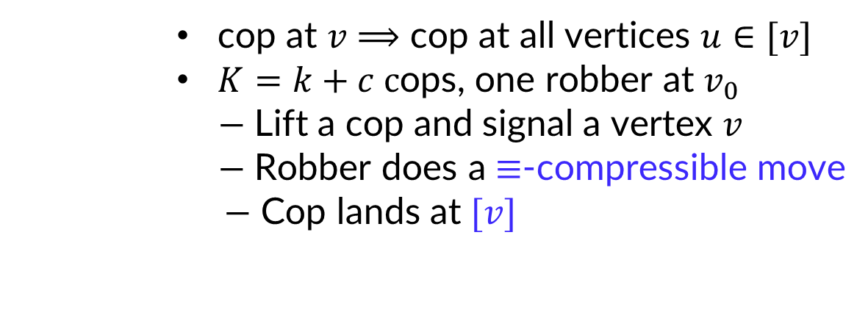
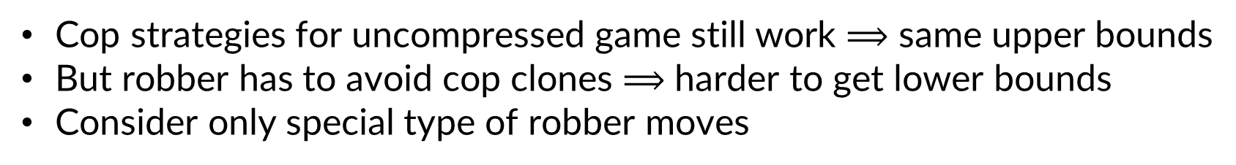
Compressed Game [GLNS ‘23]
cop at $v$ $⟹$ cop at all vertices $u∈[v]$
$K=k+c c$ops, one robber at $v_{0}$
$−$ Lift a cop and signal a vertex $v$
$−$ Robber does a $≡$-compressible move
$−$ Cop lands at $[v]$
Cop strategies for uncompressed game still work $⟹$ same upper bounds
But robber has to avoid cop clones $⟹$ harder to get lower bounds
Consider only special type of robber moves

Slide 24

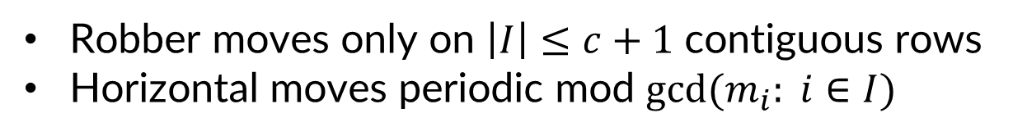
Moves Translatable to Compressed Setting
$$I$$
Robber moves only on $\left|I\right|≤c+1$ contiguous rows
Horizontal moves periodic mod $gcd(m_{i}: i∈I)$

Slide 25
Idea for Robber Strategy
Robber stays on cop-free column in left or right end
Slides between left and right end using compressible moves
Problem: (virtual) cops can form a (virtual) police cordon

Slide 26

Idea for Robber Strategy (cont.)
Plan: Keep away from (set of) virtual cordons
Allows robber to escape in time
Prove that cordons can only move slowly
Survives $n^{k}$ rounds against $k+c$ cops
Notes:
Say bullets, then
Virtual cordon: what could the cops occupy in the next move (while maintaining positions on unique rows)?
Cone shape: condition on unique rows.
Unique rows: will force to move slowly (choice of moduli)
Note that our choice of c => unique row
Induction on the rounds: Initially at least half away, little progress per round.

Slide 27
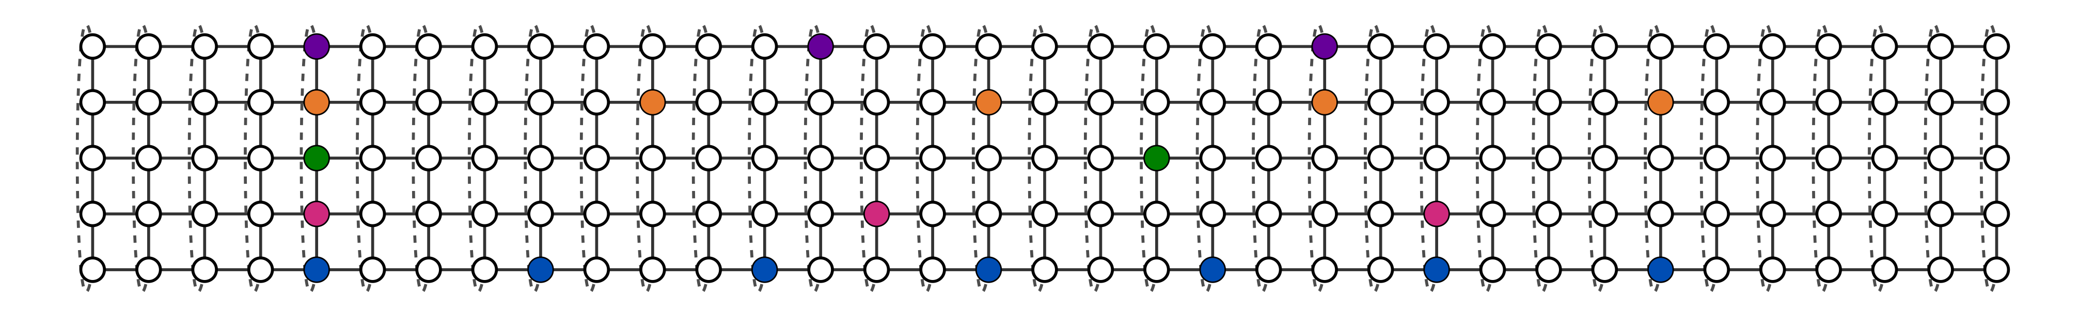

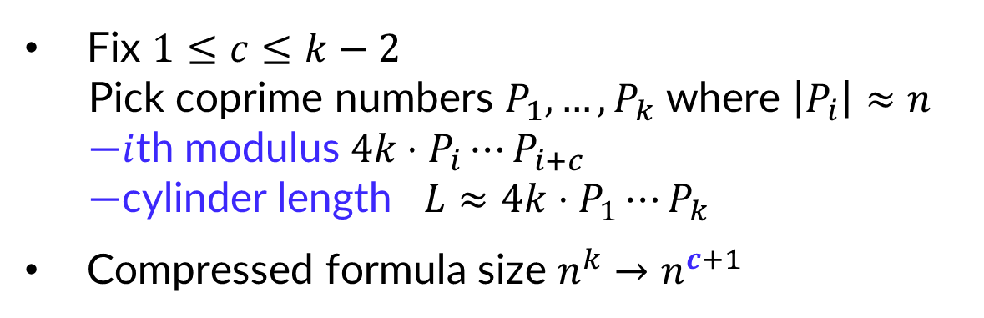






Choice of Row Moduli
$$v_{0}$$
Fix $1≤c≤k−2$
Pick coprime numbers $P_{1},…,P_{k}$ where $\left|P_{i}\right|≈n$
—$i$th modulus $4k⋅P_{i}⋯P_{i+c}$
—cylinder length $L≈4k⋅P_{1}⋯P_{k}$
Compressed formula size $n^{k}→n^{c+1}$
$$width$$
$$3k$$
$$k+3$$
$$depth$$
$$\text{|}F_{n}\text{|}$$
$$kL$$
Notes:
For “full consumer information”, no time to get into details; stay tuned for part II.

Slide 28
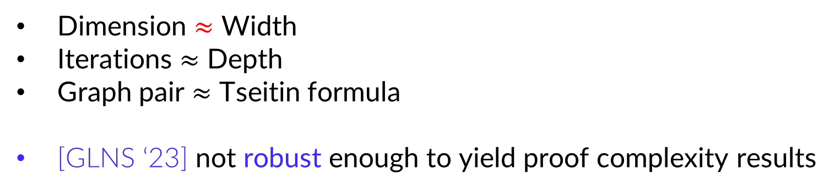
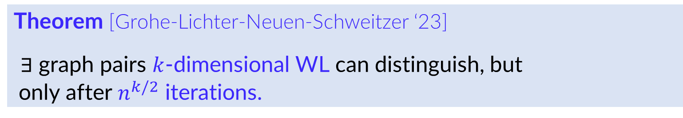
Motivation for Grohe et al: Weisfeiler-Leman (WL) algorithm
Theorem [Grohe-Lichter-Neuen-Schweitzer ‘23]
$∃$ graph pairs $k$-dimensional WL can distinguish, but
only after $n^{k/2}$ iterations.
Dimension $≈$ Width
Iterations $≈$ Depth
Graph pair $≈$ Tseitin formula
[GLNS ‘23] not robust enough to yield proof complexity results

Slide 29
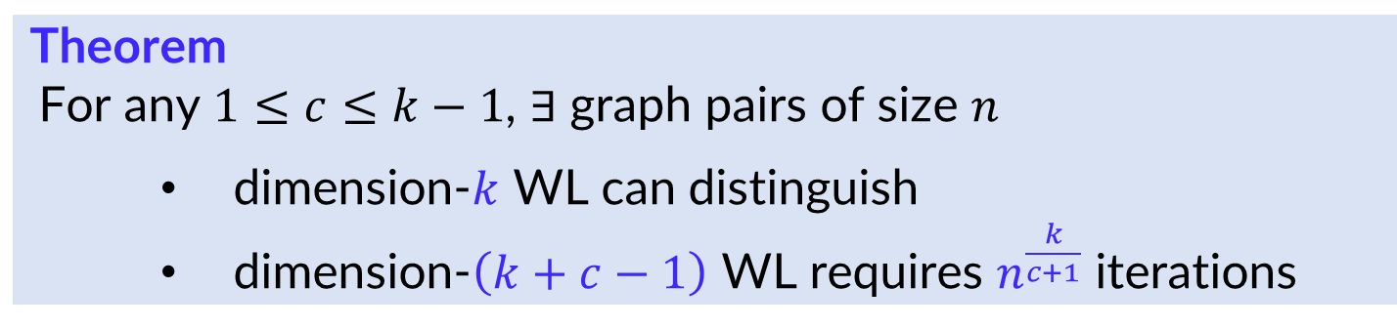
Our Result for Weisfeiler-Leman (WL)
Theorem
For any $1≤c≤k−1$, $∃$ graph pairs of size $n$
dimension-$k$ WL can distinguish
dimension-$\left(k+c−1\right)$ WL requires $n^{\frac{k}{c+1}}$ iterations

Slide 30
Proof Structure
Proof in two steps:
Establish width vs depth trade-off results for resolution
Derive proof & circuit complexity trade-off results with lifting
Notes:
Structure of our proof and paper
Little time: focus on width vs depth

Slide 31
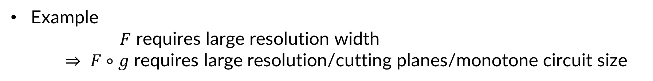
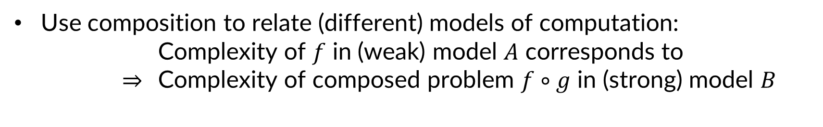
What is a Lifting Theorem?
Use composition to relate (different) models of computation:
Complexity of $f$ in (weak) model $A$ corresponds to
$⇒$ Complexity of composed problem $f∘g$ in (strong) model $B$
Example
$F$ requires large resolution width
$⇒$ $F∘g$ requires large resolution/cutting planes/monotone circuit size
31

Slide 32


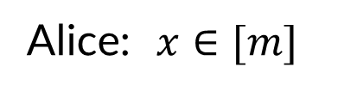
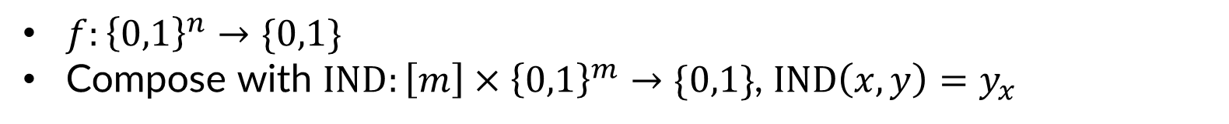

Lifting with Indexing Gadget (for Functions)
$f:{\left\{0,1\right\}}^{n}→\{0,1\}$
Compose with $IND:\left[m\right]×{\left\{0,1\right\}}^{m}→\{0,1\}$, $IND\left(x,y\right)=y_{x}$
Alice: $x∈{\left[m\right]}^{n}$
1
2
2
1
3
2
Alice: $x∈[m]$
1
3
1
0
1
0
1
0
0
1
1
1
0
Bob: ${y∈\left\{0,1\right\}}^{m}$
Bob: ${y∈\left\{0,1\right\}}^{mn}$
0
1
1
0
0
0
1
0
1
1
0
1
0
0
1
1
1
0
1
0
0
0
1
1
1
1
1
0
0
$$f∘IND\left(x,y\right)=f ($$
$$)$$
32
Notes:
Explanation for functions, can be extended to CNFs in straightforward way.
Compose with index function.
Input has two parts: … ; Alice gets ….. Bob gets …. Alice picks out a position in Bobs string.
N inputs → need to do this n times.
Get function f circ IND taking inputs from …, first compute IND for all n bits, then apply f.

Slide 33


[Garg-Göös-Kamath-Sokolov ’18]
Lifting Resolution to Monotone Circuits
Resolution width-depth trade-off $⇒$ monotone circuit size-depth trade-off
Theorem [GGKS ’18]
For CNF formula $F$ and large enough $m$, can construct function $f_{F,m}$ s.t.
size-$m^{w}$, depth-$d$ monotone circuit for $f_{F,m}$
$⇒$ width-$O(w)$, depth-$O(dw)$ resolution proof for $F$
Crucial issue: #variables of function $≈$ #clauses in formula
— Previous supercritical trade-offs do not work
— Crucial that depth-width trade-off is truly supercritical
Need tighter lifting theorem than [GGKS ’18] with better constants

Slide 34



Tight Lifting for Resolution
Theorem
size-$(m/2)^{w}$, depth-$d$ resolution refutation for $F∘IND_{m}$
$⇒$ width-$w$, depth-$d$ resolution refutation of $F$
Essentially optimal
Simple proof via random restriction
Corollary (size-depth trade-off for resolution)
$∃$ a CNF formula $F$ on $ℓ$ clauses s.t.
$∃$ resolution refutation of $F$ in size $s$
But size$≤ℓs$ $⇒$ superpolynomial (in $ℓ$) depth

Slide 35



Tight Lifting for Monotone Circuits
Theorem
size-$m^{(1−ε)w}$, depth-$d$ monotone circuit for $f_{F,m}$
$⇒$ width-$w$, depth-$wd$ resolution refutation of $F$
Also almost optimal
Applies also to cutting planes (and monotone real circuits)
Corollary (size-depth trade-off for monotone circuits)
$∃$ function $f$ on $n$ variables s.t.
$∃$ a monotone circuit for $f$ of size $s$
size $≤ns$ $⇒$ superpolynomial depth

Slide 36



Lifting for Tree-like Resolution
Theorem
size-$s$, width-$w$ tree-like resolution refutation for $F∘{\text{XOR}}_{m+1}$
$⇒$ depth-$(log s)$, width-$(w/m)$ resolution refutation of $F$
Note that width is also reduced
Corollary (size-width trade-off for tree-like resolution)
$∃$ a CNF formula $F$ on $n$ variables s.t.
$∃$ a tree-like resolution refutation of width $w=poly(log\left(n\right))$
But width$≤w+\sqrt{w}⟹$ $exp(superpoly\text{(}\text{|}F\text{|)}\text{)}$ size

Slide 37
Concurrent Work [Göös-Maystre-Risse-Sokolov ‘24]
Independently obtained supercritical size-depth trade-offs
Natural formulas formalizing interesting combinatorial principle
More robust trade-offs
Can use existing lifting theorems as black box
Our work
Different parameter regime, with trade-offs kicking in earlier
Robust supercritical trade-offs also for Weisfeiler–Leman
Formula compression technique in [GLNS ‘23] worth investigating further
Tighter lifting theorems also of independent interest

Slide 38
Some Open Problems
Further applications of compression in proof complexity
Can pebbling formulas be compressed?
Can we find other graph compressions?
Prove more supercritical trade-offs
Size vs space or similar
Unified parameter range with [GMRS ‘24]
Complexity of Tseitin formulas for cutting planes
Are there supercritical trade-offs?
38

Slide 39
Conclusion
We give truly supercritical (in terms of size) trade-offs for
— proof complexity (resolution and cutting planes)
— monotone circuits
— Weisfeiler–Leman algorithm
Proof in two steps:
— Base trade-off width vs depth for compressed Tseitin formulas
— Lifting theorems with improved parameters yield other results
Future Supercritical Research Directions
Via compression of other formulas or graphs?
Trade-offs for other measures (e.g. size vs space)?
Size-depth trade-offs for (uncompressed) Tseitin formulas?
Thanks for your attention!
Notes:
As mentioned before, here are some directions for future research.
To summarize ….. Main open problems: sc trade-offs for PM, Tseitin.

