Slide 1

YSC2239 Lecture 02

Slide 2
Today’s class
Python basics
Tables
Data types
Reading: Chapter 3, 4, 5

Slide 3
Names

Slide 4
Assignment Statements
hours_per_wk = 24*7
Name
Any expression
Statements don't have a value; they perform an action
An assignment statement changes the meaning of the name to the left of the = symbol
The name is bound to a value (not an equation)
(Demo)

Slide 5
Functions

Slide 6
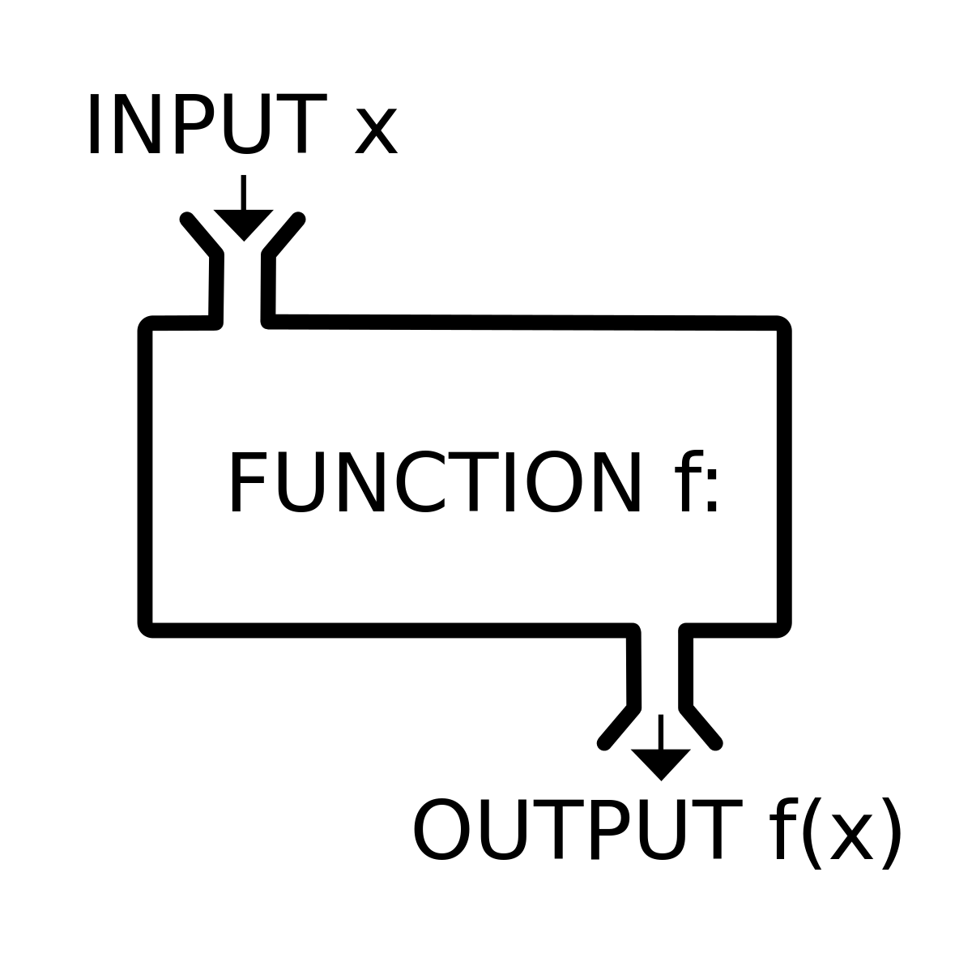
Functions

Slide 7
Anatomy of a Call Expression
What function to call
Argument/parameter/input to the function
f ( 27)
"Call f on 27."

Slide 8
Anatomy of a Call Expression
What function to call
First argument/parameter
Second argument/parameter
min ( 15 , 27 )
(Demo)

Slide 9
Tables

Slide 10
Table Structure
A Table is a sequence of labeled columns
Each row represents one individual
Data within a column represents one attribute of the individuals
Label
Name | Code | Area (m2)
California | CA | 163696
Nevada | NV | 110567
Column
(Demo)
Row

Slide 11
Some Table Operations
t.select(label) - constructs a new table with just the specified columns
t.drop(label) - constructs a new table in which the specified columns are omitted
t.sort(label) - constructs a new table with rows sorted by the specified column
t.where(label, condition) - constructs a new table with just the rows that match the condition

Slide 12
Numbers
(Demo)

Slide 13
Ints and Floats
Python has two real number types
int: an integer of any size
float: a number with an optional fractional part
An int never has a decimal point; a float always does
A float might be printed using scientific notation
Three limitations of float values:
They have limited size (but the limit is huge)
They have limited precision of 15-16 decimal places
After arithmetic, the final few decimal places can be wrong

Slide 14
Strings
(Demo)

Slide 15
Text and Strings
A string value is a snippet of text of any length
'a'
'word'
"there can be 2 sentences. Here's the second!"
Strings consisting of numbers can be converted to numbers
int('12')
float('1.2')
Any value can be converted to a string
str(5)

Slide 16
Discussion Question
Assume you have run the following statements:
x = 3
y = '4'
z = '5.6'
What's the source of the error in each example?
x + y
x + int(y + z)
str(x) + int(y)
y + float(z)

Slide 17
Types
(Demo)

Slide 18
Every value has a type
We’ve seen 5 types so far:
int: 2
float: 2.2
str: 'Red fish, blue fish'
The type function can tell you the type of a value
type(2)
type(2 + 2)
An expression’s “type” is based on its value, not how it looks
x = 2
type(x)
builtin_function_or_method: abs
Table

Slide 19
Conversions
Strings that contain numbers can be converted to numbers
int('12')
float('1.2')
float('one point two') # Not a good idea!
Any value can be converted to a string
str(5)
Numbers can be converted to other numeric types
float(1)
int(1.2) # DANGER: loses information!

Slide 20
To do
Lab 1

