Slide 1

YSC2239 Lecture 4

Slide 2
Today’s class
Census data
Charts
Histograms
Reading: Chapter 6.3, 6.4, 7

Slide 3
Census Data

Slide 4
The Decennial Census
Every ten years, the Census Bureau counts how many people there are in the U.S.
In between censuses, the Bureau estimates how many people there are each year.
Article 1, Section 2 of the Constitution:
“Representatives and direct Taxes shall be apportioned among the several States … according to their respective Numbers …”

Slide 5
Census Table Description
Values have column-dependent interpretations
The SEX column: 1 is Male, 2 is Female
The POPESTIMATE2010 column: 7/1/2010 estimate
In this table, some rows are sums of other rows
The SEX column: 0 is Total (of Male + Female)
The AGE column: 999 is Total of all ages
Numeric codes are often used for storage efficiency
Values in a column have the same type, but are not necessarily comparable (AGE 12 vs AGE 999)
http://www2.census.gov/programs-surveys/popest/datasets/2010-2015/national/asrh/nc-est2015-agesex-res.pdf

Slide 6
Analyzing Census Data
Leads to the discovery of interesting features and trends in the population
(Demo)

Slide 7
Numerical Data

Slide 8
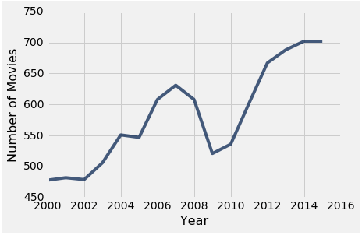
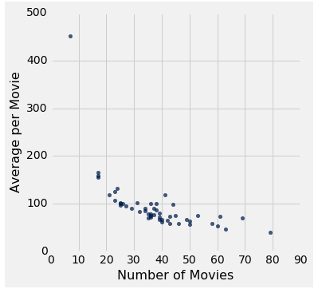
Plotting Two Numerical Variables
Line graph: plot
Scatter plot : scatter
(Demo)

Slide 9
When to use a line vs scatter plot?
Use line plots for sequential data: if...
...your x-axis has an order
...sequential differences in y values are meaningful
...there’s only one y-value for each x-value
Usually: x-axis is time or distance
Use scatter plots for non-sequential data
When you’re looking for associations

Slide 10
Categorical Data
(Demo)

Slide 11
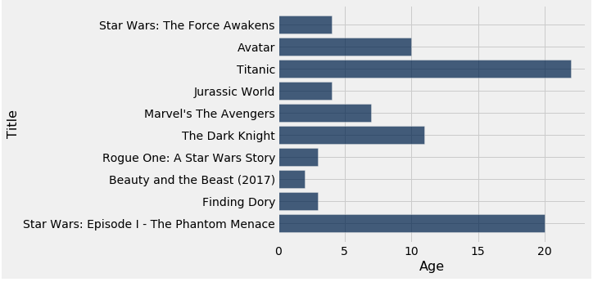
How Do You Generate This Chart?
Top 10 highest grossing movies
Number of years since release

Slide 12
Terminology
Individuals: those whose features are recorded
Variable: a feature, an attribute
A variable has different values
Values can be numerical or categorical, and of many sub-types within these
Each individual has exactly one value of the variable
Distribution: For each different value of the variable, the frequency of individuals that have that value

Slide 13
Categorical Distributions

Slide 14
Visualization
Bar charts are commonly used to visualize categorical distributions
One axis is categorical, one numerical
(Demo)

Slide 15
Displaying a Categorical Distribution
The distribution of a variable (a column, e.g. Studios) describes the frequencies of its different values
The group method counts the number of rows for each value in the column (e.g. the number of top movies released by each studio)
Bar charts can display the distribution of a categorical variable (e.g. studios):
One bar for each category
Length of bar is the count of individuals in that category
You can choose the order of the bars

Slide 16
Binning a Numerical Variable

Slide 17
Binning Numerical Values
Binning is counting the number of numerical values that lie within ranges, called bins.
Bins are defined by their lower bounds (inclusive)
The upper bound is the lower bound of the next bin
188, 170, 189, 163, 183, 171, 185, 168, 173, ...
The [185,190) bin
160
165
170
175
180
185
190

Slide 18
Area Principle

Slide 19
Area Principle
Areas should be proportional to the values they represent.
For example
If you represent 20% of a population by
Then 40% can be represented by:
But not by:

Slide 20
Drawing Histograms

Slide 21
Histogram
Chart that displays the distribution of a numerical variable
Uses bins; there is one bar corresponding to each bin
Uses the area principle:
The area of each bar is the percent of individuals in the corresponding bin
(Demo)

Slide 22
Bar Chart or Histogram?
To display a distribution:
Bar Chart
Distribution of categorical variable
Bars have arbitrary (but equal) widths and spacings
height (or length) of bars proportional to the percent of individuals
Histogram
Distribution of numerical variable
Horizontal axis is numerical: to scale, no gaps, bins can be unequal
Area of bars proportional to the percent of individuals; height measures density

Slide 23
Summary: charts
Scatter plot: relation between numerical variables
Line graph: sequential data (over time, etc.)
Bar chart: distribution of categorical data
Histogram: distribution of numerical data

Slide 24
To do
Assignment 1 due on Friday
No Lecture on next Monday (due to CNY)
No Lab next week (due to CNY)
Assignment 2 will be uploaded before this weekend and due on Next Friday

