Slide 1

YSC2239 Lecture 11

Slide 2
Recap
Center and Spread
Central Limit Theorem (CLT)
Python command: np.std, np.average

Slide 3
Today’s class
Linear regression
Method of least squares
Residuals
Reading: Chapter 15

Slide 4
Linear Regression

Slide 5
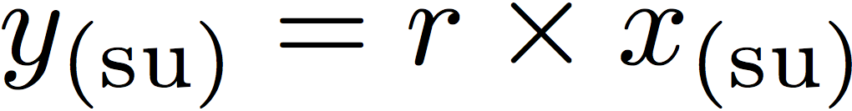
Linear Regression
A statement about x and y pairs
Measured in standard units
Describing the deviation of x from 0 (the average of x's)
And the deviation of y from 0 (the average of y's)
On average, y deviates from 0 less than x deviates from 0
Regression Line
Correlation
Not true for all points — a statement about averages

Slide 6
Slope & Intercept

Slide 7
Regression Line Equation
In original units, the regression line has this equation:
estimated y in standard units
x in standard units
Lines can be expressed by slope & intercept

Slide 8
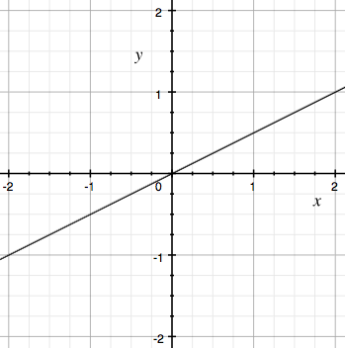
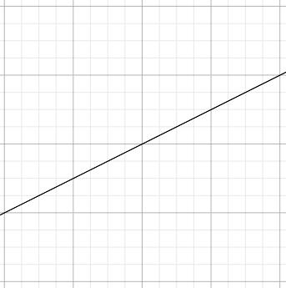
Regression Line
Standard Units
Original Units
(Average x, Average y)
(0, 0)
r
r * SD y
1
SD x

Slide 9
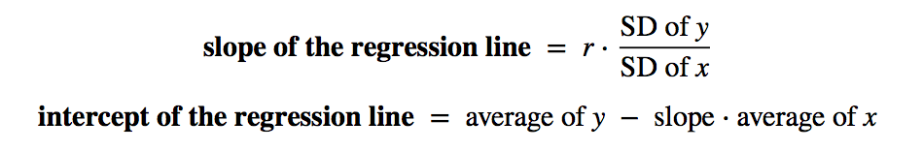
Slope and Intercept
estimate of y = slope * x + intercept
(Demo)

Slide 10
Least Squares

Slide 11
Error in Estimation
error = actual value − estimate
Typically, some errors are positive and some negative
To measure the rough size of the errors
square the errors to eliminate cancellation
take the mean of the squared errors
take the square root to fix the units
root mean square error (rmse)
(Demo)

Slide 12
Least Squares Line
Minimizes the root mean squared error (rmse) among all lines
Equivalently, minimizes the mean squared error (mse) among all lines
Names:
“Best fit” line
Least squares line
Regression line
(Demo)

Slide 13
Numerical Optimization
Numerical minimization is approximate but effective
Lots of machine learning uses numerical minimization
If the function mse(a, b)returns the mse of estimation using the line “estimate = ax + b”,
then minimize(mse)returns array [a₀, b₀]
a₀ is the slope and b₀ the intercept of the line that minimizes the mse among lines with arbitrary slope a and arbitrary intercept b (that is, among all lines)
(Demo)

Slide 14
Regression Diagnostics

Slide 15
Residuals
Error in regression estimate
One residual corresponding to each point (x, y)
residual
= observed y - regression estimate of y
= observed y - height of regression line at x
= vertical distance between the point and the best line
(Demo)

Slide 16
Residual Plot
A scatter diagram of residuals
Should look like an unassociated blob for linear relations
But will show patterns for non-linear relations
Used to check whether linear regression is appropriate
Look for curves, trends, changes in spread, outliers, or any other patterns

Slide 17
Properties of residuals
Residuals from a linear regression always have
Zero mean
(so rmse = SD of residuals)
Zero correlation with x
Zero correlation with the fitted values
These are all true no matter what the data look like
Just like deviations from mean are zero on average
(Demo)

Slide 18
A Measure of Clustering

Slide 19
Correlation, Revisited
“The correlation coefficient measures how clustered the points are about a straight line.”
We can now quantify this statement.
(Demo)

Slide 20
SD of Fitted Values
SD of fitted values
---------------------------- = |r|
SD of y
SD of fitted values = |r| * (SD of y)

Slide 21
Variance of Fitted Values
Variance = Square of the SD
= Mean Square of the Deviations
Variance has weird units, but good math properties
Variance of fitted values
--------------------------------- = r²
Variance of y

Slide 22
A Variance Decomposition
By definition,
y = fitted values + residuals
Tempting (but wrong) to think that:
SD(y) = SD(fitted values) + SD(residuals)
But it is true that:
Var(y) = Var(fitted values) + Var(residuals)
(a result of the Pythagorean theorem!)

Slide 23
A Variance Decomposition
Var(y) = Var(fitted values) + Var(residuals)
Variance of fitted values
--------------------------------- = r²
Variance of y
Variance of residuals
--------------------------------- = 1 - r²
Variance of y

Slide 24
Residual Average and SD
The average of residuals is always 0
Variance of residuals
--------------------------------- = 1 - r²
Variance of y
SD of residuals = √(1 - r²) SD of y
(Demo)

Slide 25
End of midterm coverage

Slide 26
To-do
Assignment 5

