Slide 1

YSC2239 Lecture 16

Slide 2
Today’s class
Introduction to scikit-learn
Feature engineering

Slide 3
Motivating Feature Engineering

Slide 4
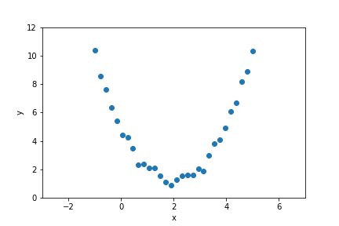
Can we fit a model to this data?

Slide 5
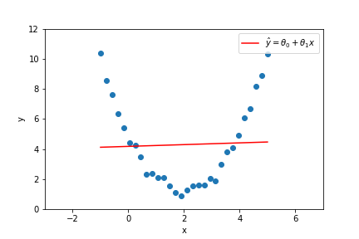
Can we fit a model to this data?
Simple Linear Regression?
No, because the data is fundamentally nonlinear

Slide 6
Can we fit a model to this data?
Multiple Linear Regression?
No, because there are no other features to add

Slide 7
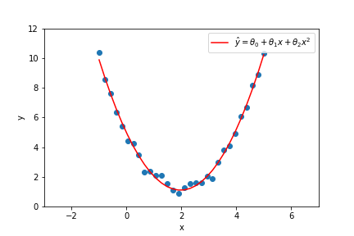
Can we fit a model to this data?
Idea: Create an extra feature to use in the model. What feature should we add?
Since the data looks like a parabola, let’s add a quadratic feature

Slide 8
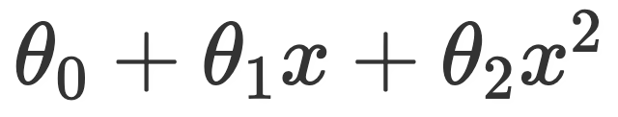
What is a feature?
A feature is an input to our model
So far, we have just used the raw data as features
We can also create new features to use an inputs to our model
The process of creating new features is called feature engineering
Example: Quadratic model
Features: x, x^2
Parameters: 𝜃₀, 𝜃₁, 𝜃₂

Slide 9
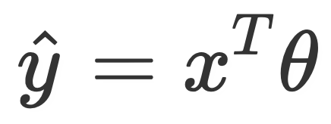
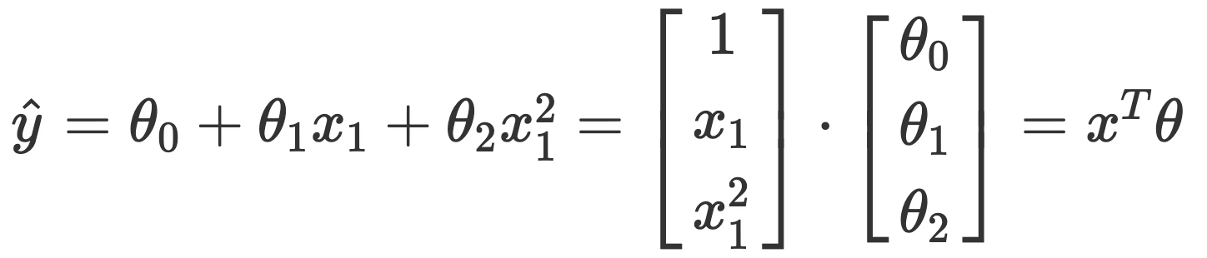
Can we really just create our own features?
Yes! (with some restrictions)
We can create any feature we want as long we can write the model in the form
This is a linear combination of the features. The features cannot depend on the parameters of the model!
Example: Adding a Quadratic Feature

Slide 10
Lecture Roadmap
We can choose/create x any way we like as long as our model follows the form
The rest of the lecture will discuss different techniques we can use to create x:
How can we create features from quantitative data?
How can we create features from categorical data?
How can we create features from text data?

Slide 11
Intro to Scikit-Learn (Demo)

Slide 12
Feature Engineering: Quantitative Data

Slide 13
Feature Engineering: Categorical Data

Slide 14
Feature Engineering: Imputation

Slide 15
Feature Engineering: Text Data

Slide 16
Bag-of-words Encoding
Generalization of one-hot-encoding for a string of text:
Encode text as a long vector of word counts (Issues?)
Typically high dimensional (millions of columns) and very sparse
Word order information is lost… (is this an issue?)
What happens when you see a word not in the dictionary?
A bag is another term for a multiset: an unordered collection which may contain multiple instances of each element.
Stop words: words that do not contain significant information
Examples: the, in, at, or, on, a, an, and …
Typically removed
“Learning about machine learning is fun.”
aardwolf
learning
machine
aardvark
zyzzyva
fun
Vector
0
0
…
1
…
2
…
1
…
0

Slide 17
N-Gram Encoding
Sometimes word order matters:
How do we capture word order in a “vector” model?
N-Gram: “Bag-of- sequences-of-words”
The book was not well written but I did enjoy it.
The book was well written but I did not enjoy it.

Slide 18
2-Gram Encoding
The book was well written ...
the book
book was
was well
well written
book was
well written
aardvark is
the book
was well
apple shines
zebra ran
Vector
0
0
…
1
…
1
…
1
…
1
…
0

Slide 19
N-Gram Encoding
Sometimes word order matters:
How do we capture word order in a “vector” model?
N-Gram: “Bag-of- sequences-of-words”
Issue:
Can be very sparse (many combinations occur only once)
The book was not well written but I did enjoy it.
The book was well written but I did not enjoy it.

Slide 20
Mathematical Implications of Feature Engineering

Slide 21
One-Hot Encoding and Linear Dependence
Notice that co_appl + co_sam = bias! This means the columns are linearly dependent
Solution: Drop one of the one-hot encoded columns per variable
bias | ... | co
1 | ... | Apple
1 | ... | Samsung
1 | ... | Apple
bias | ... | co_appl | co_sam
1 | ... | 1 | 0
1 | ... | 0 | 1
1 | ... | 1 | 0
Notes:
Note (out of scope): You don’t always have to drop one of the one-hot encoded columns, see this blog post

Slide 22
Too Many Features
If you add too many features, the normal equations will have infinite solutions
The normal equations can be thought of as a system of equations with N equations and P unknown quantities to solve for
N: # of data points
P: # of parameters
If P > N, you have more unknowns than equations so there can be no unique solution
Additionally, too many features can cause overfitting, which will be covered in future lectures

Slide 23
Summary

Slide 24
Feature Engineering Summary
Feature engineering is the process of creating new useful features from your data to build more sophisticated models
Feature engineering allows you to utilize non-numerical data
One-hot encoding is a widely used technique
Need to be careful in choosing how many and which features to create
Linearly dependent features
Too many features
Feature engineering is as much an art as it is a skill
Neural networks try to automatically do feature engineering

