Slide 1

YSC2239 Lecture 7

Slide 2
Recap on previous class
Chance / Probability: Multiplication Rule and Addition Rule
Python:
Join tables
Booleans: True or False, comparison operators
Control statements (if else/ for)
Append array: np.append
Random choice: np.random.choice

Slide 3
Today’s class
Sampling
Assessing Models
Comparing Distributions
Reading: Chapter 10, 11

Slide 4
Sampling

Slide 5
Probability Samples
Deterministic sample:
Sampling scheme doesn’t involve chance
Probability sample:
Before the sample is drawn, you have to know the selection probability of every group of people in the population
Not all individuals have to have equal chance of being selected

Slide 6
Sample of Convenience
Example: sample consists of whoever walks by
Just because you think you’re sampling “at random”, doesn’t mean you are.
If you can’t figure out ahead of time
what’s the population
what’s the chance of selection, for each group in the population
then you don’t have a random sample
(Demo)

Slide 7
Distributions

Slide 8
Probability Distribution
Random quantity with various possible values
“Probability distribution”:
All the possible values of the quantity
The probability of each of those values
If you can do the math, you can work out the probability distribution can without ever simulating the random quantity

Slide 9
Empirical Distribution
“Empirical”: based on observations
Observations can be from repetitions of an experiment
“Empirical Distribution”
All observed values
The proportion of times each value appears
(Demo)

Slide 10
Large Random Samples

Slide 11
Law of Averages
If a chance experiment is repeated many times,
independently and under the same conditions,
then the proportion of times that an event occurs
gets closer to the theoretical probability of the event
As you increase the number of rolls of a die, the proportion of times you see the face with five spots gets closer to 1/6
(Demo)

Slide 12
Empirical Distribution of a Sample
If the sample size is large,
then the empirical distribution of a uniform random sample
resembles the distribution of the population,
with high probability

Slide 13
A Statistic

Slide 14
Terminology
Parameter
A number associated with the population
Statistic
A number calculated from the sample
A statistic can be used as an estimate of a parameter, or to test hypotheses about how the data were generated
(Demo)

Slide 15
Inference
Statistical Inference:
Making conclusions based on data in random samples
fixed
Example:
Use the data to guess the value of an unknown number
depends on the random sample
Create an estimate of the unknown quantity

Slide 16
Probability Distribution of a Statistic
Values of a statistic vary because random samples vary
“Sampling distribution” or “probability distribution” of the statistic:
All possible values of the statistic,
and all the corresponding probabilities
Can be hard to calculate
Either have to do the math
Or have to generate all possible samples and calculate the statistic based on each sample

Slide 17
Empirical Distribution of a Statistic
Empirical distribution of the statistic:
Based on simulated values of the statistic
Consists of all the observed values of the statistic,
and the proportion of times each value appeared
Good approximation to the probability distribution of the statistic
if the number of repetitions in the simulation is large

Slide 18
Assessing Models

Slide 19
Models
A model is a set of assumptions about the data

Slide 20
Models
A model is a set of assumptions about the data
In data science, many models involve assumptions about processes that involve randomness
“Chance models”

Slide 21
Jury Selection

Slide 22
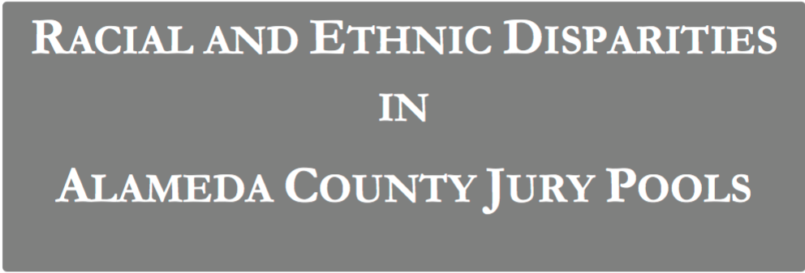
Jury Selection in Alameda County

Slide 23
Jury Panels
Eligible jurors in a County
List of eligible residents
Jury panel
Jury
Section 197 of California's Code of Civil Procedure says, "All persons selected for jury service shall be selected at random, from a source or sources inclusive of a representative cross section of the population of the area served by the court."
(Demo)

Slide 24
Two Viewpoints

Slide 25
Model and Alternative
Model:
The people on the jury panels were selected at random from the eligible population
Alternative viewpoint:
No, they weren’t

Slide 26
A New Statistic

Slide 27
Distance Between Distributions
People on the panels are of multiple ethnicities
Distribution of ethnicities is categorical
To see whether the the distribution of ethnicities of the panels is close to that of the eligible jurors, we have to measure the distance between two categorical distributions
(Demo)

Slide 28
Total Variation Distance
Every distance has a computational recipe
Total Variation Distance (TVD):
For each category, compute the difference in proportions between two distributions
Take the absolute value of each difference
Sum, and then divide the sum by 2
(Demo)

Slide 29
Summary

Slide 30
Summary of the Method
To assess whether a sample was drawn randomly from a known categorical distribution:
Use TVD as the statistic because it measures the distance between categorical distributions
Sample at random from the population and compute the TVD from the random sample; repeat numerous times
Compare:
Empirical distribution of simulated TVDs
Actual TVD from the sample in the study

Slide 31
Reminders
Assignment 3

