Slide 1
Untapping Analytical Synergies in Industrial SME Ecosystems: An Empirical Evaluation of Federated Machine Learning
Anna Hensel, master’s thesis

Slide 2

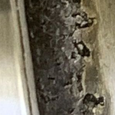




SMEs* often have related machine learning use cases, each facing several problems concerning classical ML
[7]
* SME: small medium-sized enterprise (dt. KMU)

Slide 3
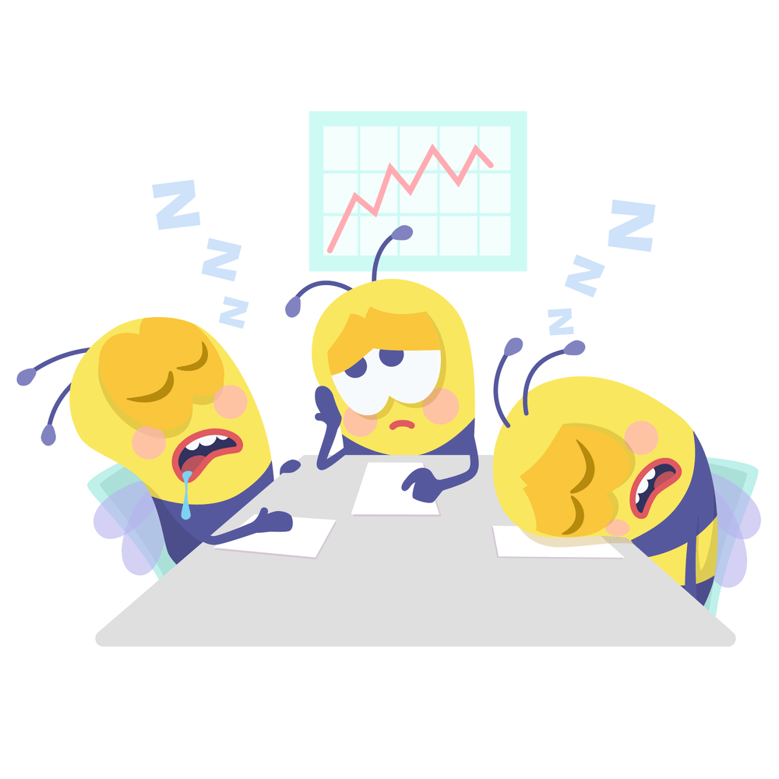
SMEs* often have related machine learning use cases, each facing several problems concerning classical ML
[7]
Problems: too little data, lack of experience [10, 11]
→ poor performance
* SME: small medium-sized enterprise (dt. KMU)

Slide 4




SMEs* often have related machine learning use cases, each facing several problems concerning classical ML
[7]
One model per company
Problems: too little data, lack of experience [10, 11]
→ poor performance
* SME: small medium-sized enterprise (dt. KMU)

Slide 5

SMEs* often have related machine learning use cases, each facing several problems concerning classical ML
All data model
[7]
One model per company
Problems: too little data, lack of experience [10, 11]
→ poor performance
* SME: small medium-sized enterprise (dt. KMU)

Slide 6


SMEs* often have related machine learning use cases, each facing several problems concerning classical ML
All data model
Huge privacy problem as companies data is sent to a central node
[7]
One model per company
Problems: too little data, lack of experience [10, 11]
→ poor performance
* SME: small medium-sized enterprise (dt. KMU)

Slide 7
Federated machine learning (FML) allows for decentralized machine learning potentially mitigating privacy issues
Federated learning model
[2]

Slide 8

Federated machine learning (FML) allows for decentralized machine learning potentially mitigating privacy issues
Federated learning model
[2]

Slide 9



Federated machine learning (FML) allows for decentralized machine learning potentially mitigating privacy issues
Federated learning model
[2]

Slide 10



Federated machine learning (FML) allows for decentralized machine learning potentially mitigating privacy issues
Federated learning model
avg( , , ) =
[2]

Slide 11

Federated machine learning (FML) allows for decentralized machine learning potentially mitigating privacy issues
Federated learning model
avg( , , ) =
[2]

Slide 12


Federated machine learning (FML) allows for decentralized machine learning potentially mitigating privacy issues
Federated learning model
Local training and model sharing preserves privacy
Enables joint use of data of several companies → unlocks performance potential
Complexity due to model sharing and update communication
avg( , , ) =
[2]

Slide 13
Agenda
Motivation
Evaluation dimensions
Privacy analysis in the SME context
Complexity analysis in the SME context
Performance analysis in the SME context
Conclusion and outlook

Slide 14
Privacy, complexity and performance are important dimensions for the evaluation of federated learning use cases for SMEs
Federated Learning Literature [2, 4, 5, 6, 8, 12, 13]
SME Perspective [10, 11]

Slide 15
Privacy, complexity and performance are important dimensions for the evaluation of federated learning use cases for SMEs
Federated Learning Literature [2, 4, 5, 6, 8, 12, 13]
Privacy
Privacy
SME Perspective [10, 11]

Slide 16
Privacy, complexity and performance are important dimensions for the evaluation of federated learning use cases for SMEs
Federated Learning Literature [2, 4, 5, 6, 8, 12, 13]
Privacy
How and to what extent can private information from a specific client be reconstructed or inferred through adversarial attacks?
Protection mechanisms
Privacy
SME Perspective [10, 11]

Slide 17
Privacy, complexity and performance are important dimensions for the evaluation of federated learning use cases for SMEs
Federated Learning Literature [2, 4, 5, 6, 8, 12, 13]
Privacy
How and to what extent can private information from a specific client be reconstructed or inferred through adversarial attacks?
Protection mechanisms
Privacy
Does my data stay private?
How can I protect my data?
Who in the federation can be a threat?
SME Perspective [10, 11]

Slide 18
Privacy, complexity and performance are important dimensions for the evaluation of federated learning use cases for SMEs
Federated Learning Literature [2, 4, 5, 6, 8, 12, 13]
Privacy
How and to what extent can private information from a specific client be reconstructed or inferred through adversarial attacks?
Protection mechanisms
Privacy
Does my data stay private?
How can I protect my data?
Who in the federation can be a threat?
SME Perspective [10, 11]
Complexity
Complexity

Slide 19
Privacy, complexity and performance are important dimensions for the evaluation of federated learning use cases for SMEs
Federated Learning Literature [2, 4, 5, 6, 8, 12, 13]
Privacy
How and to what extent can private information from a specific client be reconstructed or inferred through adversarial attacks?
Protection mechanisms
Privacy
Does my data stay private?
How can I protect my data?
Who in the federation can be a threat?
SME Perspective [10, 11]
Complexity
Computational complexity
Time, until specific performance is met
Potential bottlenecks
Speed up computation and communication
Complexity

Slide 20
Privacy, complexity and performance are important dimensions for the evaluation of federated learning use cases for SMEs
Federated Learning Literature [2, 4, 5, 6, 8, 12, 13]
Privacy
How and to what extent can private information from a specific client be reconstructed or inferred through adversarial attacks?
Protection mechanisms
Privacy
Does my data stay private?
How can I protect my data?
Who in the federation can be a threat?
SME Perspective [10, 11]
Complexity
Computational complexity
Time, until specific performance is met
Potential bottlenecks
Speed up computation and communication
Complexity
Do I have the required expertise?
How much effort is needed for organizational aspects?
Contracts, cost sharing, 3rd parties

Slide 21
Privacy, complexity and performance are important dimensions for the evaluation of federated learning use cases for SMEs
Federated Learning Literature [2, 4, 5, 6, 8, 12, 13]
Privacy
How and to what extent can private information from a specific client be reconstructed or inferred through adversarial attacks?
Protection mechanisms
Privacy
Does my data stay private?
How can I protect my data?
Who in the federation can be a threat?
SME Perspective [10, 11]
Complexity
Computational complexity
Time, until specific performance is met
Potential bottlenecks
Speed up computation and communication
Complexity
Do I have the required expertise?
How much effort is needed for organizational aspects?
Contracts, cost sharing, 3rd parties
Performance
Performance

Slide 22
Privacy, complexity and performance are important dimensions for the evaluation of federated learning use cases for SMEs
Federated Learning Literature [2, 4, 5, 6, 8, 12, 13]
Privacy
How and to what extent can private information from a specific client be reconstructed or inferred through adversarial attacks?
Protection mechanisms
Privacy
Does my data stay private?
How can I protect my data?
Who in the federation can be a threat?
SME Perspective [10, 11]
Complexity
Computational complexity
Time, until specific performance is met
Potential bottlenecks
Speed up computation and communication
Complexity
Do I have the required expertise?
How much effort is needed for organizational aspects?
Contracts, cost sharing, 3rd parties
Performance
E.g., accuracy over time / epochs
Which FL architecture / setup performs best?
Performance

Slide 23
Privacy, complexity and performance are important dimensions for the evaluation of federated learning use cases for SMEs
Federated Learning Literature [2, 4, 5, 6, 8, 12, 13]
Privacy
How and to what extent can private information from a specific client be reconstructed or inferred through adversarial attacks?
Protection mechanisms
Privacy
Does my data stay private?
How can I protect my data?
Who in the federation can be a threat?
SME Perspective [10, 11]
Complexity
Computational complexity
Time, until specific performance is met
Potential bottlenecks
Speed up computation and communication
Complexity
Do I have the required expertise?
How much effort is needed for organizational aspects?
Contracts, cost sharing, 3rd parties
Performance
E.g., accuracy over time / epochs
Which FL architecture / setup performs best?
Performance
Is it worth it?

Slide 24



Privacy, complexity and performance are important dimensions for the evaluation of federated learning use cases for SMEs
Federated Learning Literature [2, 4, 5, 6, 8, 12, 13]
Privacy
How and to what extent can private information from a specific client be reconstructed or inferred through adversarial attacks?
Protection mechanisms
Privacy
Does my data stay private?
How can I protect my data?
Who in the federation can be a threat?
SME Perspective [10, 11]
Complexity
Computational complexity
Time, until specific performance is met
Potential bottlenecks
Speed up computation and communication
Complexity
Do I have the required expertise?
How much effort is needed for organizational aspects?
Contracts, cost sharing, 3rd parties
Performance
E.g., accuracy over time / epochs
Which FL architecture / setup performs best?
Performance
Is it worth it?

Slide 25
Research Questions and Contributions
What do SMEs need to consider when evaluating FML in terms of
privacy,
complexity,
and performance?
How does FML compare to one model per company and all data model?
In summary, under which conditions is FML (not) useful for SMEs in an industrial context?
Can the knowledge and data problems be overcome using FML?
Implementation of a simulation pipeline to empirically investigate and evaluate FML in relation to one model per company and all data model.

Slide 26


FL aims on ensuring privacy, but there are potential privacy threats that have to be kept in mind by SMEs
Privacy
Critical aspects:
Company sends weights to central node [2]
Weights reflect company data

Slide 27
FL aims on ensuring privacy, but there are potential privacy threats that have to be kept in mind by SMEs
Privacy
Critical aspects:
Company sends weights to central node [2]
Weights reflect company data
Adversarial attacks from “malicious client” or “malicious server” possible [8]
Sample reconstruction
Information inference
Model corruption
Runtime misclassification

Slide 28

FL aims on ensuring privacy, but there are potential privacy threats that have to be kept in mind by SMEs
Privacy
Critical aspects:
Company sends weights to central node [2]
Weights reflect company data
Adversarial attacks from “malicious client” or “malicious server” possible [8]
Sample reconstruction
Information inference
Model corruption
Runtime misclassification
Sample Reconstruction
Loss-Function/ReLu Exploitation
First Dense Layer Attack
DLG/iDGL (Deep Leakage from Gradients)
Not realistic / viable if:
Clients‘ datasets sufficiently large enough
Basic counter measures such as dropout or artificial noise
[8]

Slide 29
FL aims on ensuring privacy, but there are potential privacy threats that have to be kept in mind by SMEs
Privacy
Critical aspects:
Company sends weights to central node [2]
Weights reflect company data
Adversarial attacks from “malicious client” or “malicious server” possible [8]
Sample reconstruction
Information inference
Model corruption
Runtime misclassification
Sample Reconstruction
Loss-Function/ReLu Exploitation
First Dense Layer Attack
DLG/iDGL (Deep Leakage from Gradients)
Not realistic / viable if:
Clients‘ datasets sufficiently large enough
Basic counter measures such as dropout or artificial noise
[8]
Information Inference
Model Inversion Attacks
mGAN-AI [14]
GAN
Not realistic / viable if:
Input spaces sufficiently large
Sufficient number of clients
Non-linear models
Heterogenous client data
[8]

Slide 30


FL aims on ensuring privacy, but there are potential privacy threats that have to be kept in mind by SMEs
Privacy
Critical aspects:
Company sends weights to central node [2]
Weights reflect company data
Adversarial attacks from “malicious client” or “malicious server” possible [8]
Sample reconstruction
Information inference
Model corruption
Runtime misclassification
Sample Reconstruction
Loss-Function/ReLu Exploitation
First Dense Layer Attack
DLG/iDGL (Deep Leakage from Gradients)
Not realistic / viable if:
Clients‘ datasets sufficiently large enough
Basic counter measures such as dropout or artificial noise
[8]
Information Inference
Model Inversion Attacks
mGAN-AI [14]
GAN
Not realistic / viable if:
Input spaces sufficiently large
Sufficient number of clients
Non-linear models
Heterogenous client data
[8]
Implications for SMEs
mGAN-AI (server-side attack) as only realistic threat
→ Server has to be trustworthy
Maybe employ 3rd party to run server / implement audits
One model per company
Federated learning
All data model

Slide 31
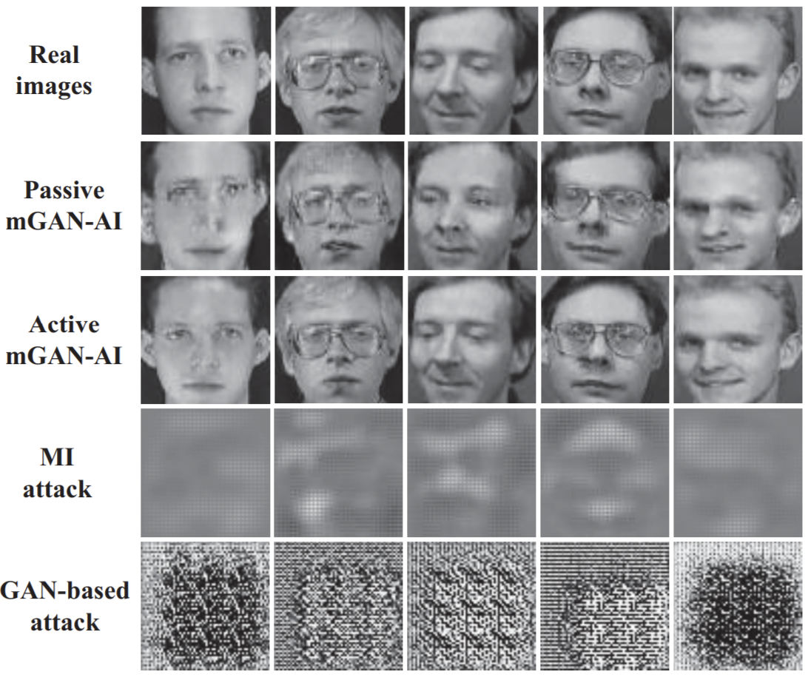
FL aims on ensuring privacy, but there are potential privacy threats that have to be kept in mind by SMEs
Privacy
Critical aspects:
Company sends weights to central node [2]
Weights reflect company data
Adversarial attacks from “malicious client” or “malicious server” possible [8]
Sample reconstruction
Information inference
Model corruption
Runtime misclassification
Sample Reconstruction
Loss-Function/ReLu Exploitation
First Dense Layer Attack
DLG/iDGL (Deep Leakage from Gradients)
Not realistic / viable if:
Clients‘ datasets sufficiently large enough
Basic counter measures such as dropout or artificial noise
[8]
Information Inference
Model Inversion Attacks
mGAN-AI [14]
GAN
Not realistic / viable if:
Input spaces sufficiently large
Sufficient number of clients
Non-linear models
Heterogenous client data
[8]
Implications for SMEs
mGAN-AI (server-side attack) as only realistic threat
→ Server has to be trustworthy
Maybe employ 3rd party to run server / implement audits
One model per company
Federated learning
All data model

Slide 32
Complexity can be decomposed into three components which are key for evaluating federated learning in the SME context

Slide 33
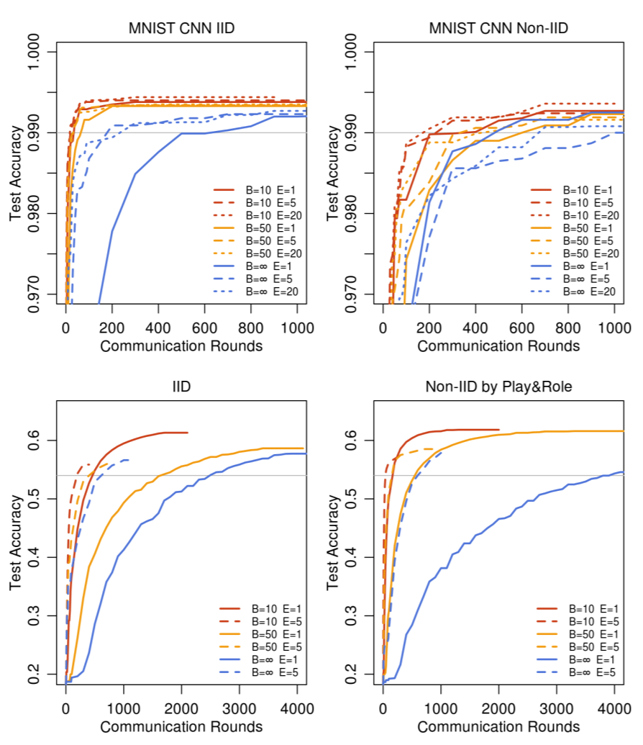
Complexity can be decomposed into three components which are key for evaluating federated learning in the SME context
Computational Complexity
Number of communication rounds [2] / iterations / communicated bits until a certain target accuracy is reached [5]

Slide 34
Complexity can be decomposed into three components which are key for evaluating federated learning in the SME context
Computational Complexity
Number of communication rounds [2] / iterations / communicated bits until a certain target accuracy is reached [5]
In contrast to in classical federated learning use cases computational complexity is not a dominating factor for SMEs

Slide 35



Complexity can be decomposed into three components which are key for evaluating federated learning in the SME context
Computational Complexity
Number of communication rounds [2] / iterations / communicated bits until a certain target accuracy is reached [5]
In contrast to in classical federated learning use cases computational complexity is not a dominating factor for SMEs
Organizational Complexity
Complexity that arises from organizing and facilitating federated learning and the other settings, especially relating to second and third parties

Slide 36
Complexity can be decomposed into three components which are key for evaluating federated learning in the SME context
Computational Complexity
Number of communication rounds [2] / iterations / communicated bits until a certain target accuracy is reached [5]
In contrast to in classical federated learning use cases computational complexity is not a dominating factor for SMEs
Organizational Complexity
Complexity that arises from organizing and facilitating federated learning and the other settings, especially relating to second and third parties
Organizational complexity, especially related to privacy, is key driver of complexity in facilitating federated learning in the SME context

Slide 37
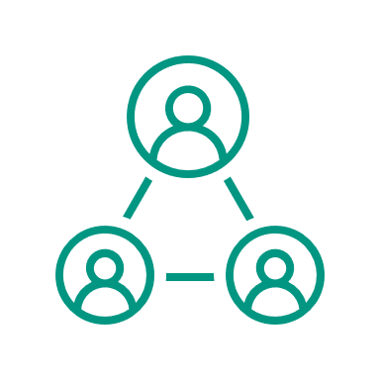

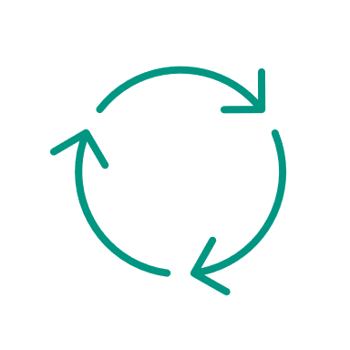
Complexity can be decomposed into three components which are key for evaluating federated learning in the SME context
Computational Complexity
Number of communication rounds [2] / iterations / communicated bits until a certain target accuracy is reached [5]
In contrast to in classical federated learning use cases computational complexity is not a dominating factor for SMEs
Organizational Complexity
Complexity that arises from organizing and facilitating federated learning and the other settings, especially relating to second and third parties
Organizational complexity, especially related to privacy, is key driver of complexity in facilitating federated learning in the SME context
Implementation Complexity
Modelling and deployment complexity SMEs have to deal with when training ML models in the three settings

Slide 38
Complexity can be decomposed into three components which are key for evaluating federated learning in the SME context
Computational Complexity
Number of communication rounds [2] / iterations / communicated bits until a certain target accuracy is reached [5]
In contrast to in classical federated learning use cases computational complexity is not a dominating factor for SMEs
Organizational Complexity
Complexity that arises from organizing and facilitating federated learning and the other settings, especially relating to second and third parties
Organizational complexity, especially related to privacy, is key driver of complexity in facilitating federated learning in the SME context
Implementation Complexity
Modelling and deployment complexity SMEs have to deal with when training ML models in the three settings
The implementation complexity for each SME in FML can be expected to be lower than in the one model per SME setting due to shared efforts

Slide 39
For analyzing the performance dimension, we implement a flexible pipeline that allows us to simulate all three settings with various parameter combinations.

Slide 40
For analyzing the performance dimension, we implement a flexible pipeline that allows us to simulate all three settings with various parameter combinations.
Dataset
Requirements:
real-world, industry
publicly available
sufficiently large
labels / supervised
[7] published in June
2021 at KIT
~22.000 images
Parts of spindles
worn („pitting“) and unworn („no pitting“)

Slide 41
For analyzing the performance dimension, we implement a flexible pipeline that allows us to simulate all three settings with various parameter combinations.
Dataset
Requirements:
real-world, industry
publicly available
sufficiently large
labels / supervised
[7] published in June
2021 at KIT
Algorithm
CNN
For comparability: same network architecture, optimizer, and parameters for all settings
Early stopping routine to prevent overfitting
Federated Averaging using TensorFlow Federated (TFF)
~22.000 images
Parts of spindles
worn („pitting“) and unworn („no pitting“)

Slide 42
For analyzing the performance dimension, we implement a flexible pipeline that allows us to simulate all three settings with various parameter combinations.
Dataset
Requirements:
real-world, industry
publicly available
sufficiently large
labels / supervised
[7] published in June
2021 at KIT
Algorithm
CNN
For comparability: same network architecture, optimizer, and parameters for all settings
Early stopping routine to prevent overfitting
Federated Averaging using TensorFlow Federated (TFF)
~22.000 images
Parts of spindles
worn („pitting“) and unworn („no pitting“)
Performance measure to enable comparability between and within SMEs
Accuracy [2, 6]
Threshold needed
Unbalancedness
AUC [9] (area under the ROC curve)
Abstracts from balancedness
Quality of score (no threshold needed)
Interpretation: “probability of correctly ranking a (normal, abnormal) pair” [9]

Slide 43
For analyzing the performance dimension, we implement a flexible pipeline that allows us to simulate all three settings with various parameter combinations.
Dataset
Requirements:
real-world, industry
publicly available
sufficiently large
labels / supervised
[7] published in June
2021 at KIT
Algorithm
CNN
For comparability: same network architecture, optimizer, and parameters for all settings
Early stopping routine to prevent overfitting
Federated Averaging using TensorFlow Federated (TFF)
~22.000 images
Parts of spindles
worn („pitting“) and unworn („no pitting“)
Performance measure to enable comparability between and within SMEs
Accuracy [2, 6]
Threshold needed
Unbalancedness
AUC [9] (area under the ROC curve)
Abstracts from balancedness
Quality of score (no threshold needed)
Interpretation: “probability of correctly ranking a (normal, abnormal) pair” [9]
Factorial design
One model per client and all data model setting to set the FL model into perspective
Scenarios:
Vary number of clients for each scenario
Data distribution / label distribution | Balanced | Unbalanced
Balanced | Scenario 1 | Scenario 2
Unbalanced | Scenario 3 | Scenario 4

Slide 44
Scenario 1 – balanced data distribution – balanced label distribution
Data distribution / label distribution | Balanced | Unbalanced
Balanced | Scenario 1 | Scenario 2
Unbalanced | Scenario 3 | Scenario 4
Scenario setup and resulting performance gains
Performance (AUC) for all settings and clients
client | 1 | 2 | 3 | 4 | 5
weight | 1 | 1 | 1 | 1 | 1
pitting share | 0.5 | 0.5 | 0.5 | 0.5 | 0.5
no pitting share | 0.5 | 0.5 | 0.5 | 0.5 | 0.5

Slide 45
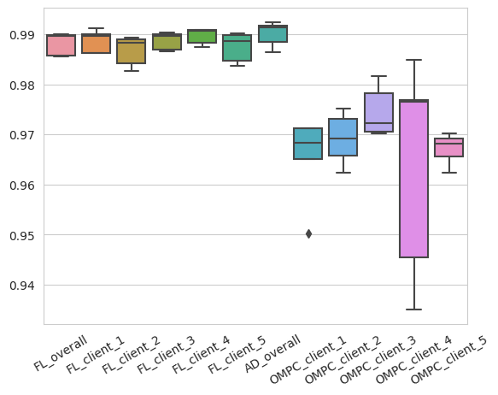
Scenario 1 – balanced data distribution – balanced label distribution
Data distribution / label distribution | Balanced | Unbalanced
Balanced | Scenario 1 | Scenario 2
Unbalanced | Scenario 3 | Scenario 4
Scenario setup and resulting performance gains
Performance (AUC) for all settings and clients
client | 1 | 2 | 3 | 4 | 5
weight | 1 | 1 | 1 | 1 | 1
pitting share | 0.5 | 0.5 | 0.5 | 0.5 | 0.5
no pitting share | 0.5 | 0.5 | 0.5 | 0.5 | 0.5

Slide 46
Scenario 1 – balanced data distribution – balanced label distribution
Data distribution / label distribution | Balanced | Unbalanced
Balanced | Scenario 1 | Scenario 2
Unbalanced | Scenario 3 | Scenario 4
Scenario setup and resulting performance gains
Performance (AUC) for all settings and clients
client | 1 | 2 | 3 | 4 | 5
weight | 1 | 1 | 1 | 1 | 1
pitting share | 0.5 | 0.5 | 0.5 | 0.5 | 0.5
no pitting share | 0.5 | 0.5 | 0.5 | 0.5 | 0.5

Slide 47
Scenario 1 – balanced data distribution – balanced label distribution
Data distribution / label distribution | Balanced | Unbalanced
Balanced | Scenario 1 | Scenario 2
Unbalanced | Scenario 3 | Scenario 4
Scenario setup and resulting performance gains
Performance (AUC) for all settings and clients
client | 1 | 2 | 3 | 4 | 5
weight | 1 | 1 | 1 | 1 | 1
pitting share | 0.5 | 0.5 | 0.5 | 0.5 | 0.5
no pitting share | 0.5 | 0.5 | 0.5 | 0.5 | 0.5

Slide 48
Scenario 1 – balanced data distribution – balanced label distribution
Data distribution / label distribution | Balanced | Unbalanced
Balanced | Scenario 1 | Scenario 2
Unbalanced | Scenario 3 | Scenario 4
Scenario setup and resulting performance gains
Performance (AUC) for all settings and clients
client | 1 | 2 | 3 | 4 | 5
weight | 1 | 1 | 1 | 1 | 1
pitting share | 0.5 | 0.5 | 0.5 | 0.5 | 0.5
no pitting share | 0.5 | 0.5 | 0.5 | 0.5 | 0.5

Slide 49
Scenario 1 – balanced data distribution – balanced label distribution
Data distribution / label distribution | Balanced | Unbalanced
Balanced | Scenario 1 | Scenario 2
Unbalanced | Scenario 3 | Scenario 4
Scenario setup and resulting performance gains
Performance (AUC) for all settings and clients
client | 1 | 2 | 3 | 4 | 5
weight | 1 | 1 | 1 | 1 | 1
pitting share | 0.5 | 0.5 | 0.5 | 0.5 | 0.5
no pitting share | 0.5 | 0.5 | 0.5 | 0.5 | 0.5
client | 1 | 2 | 3 | 4 | 5
performance gain | 2.37% | 1.97% | 1.40% | 2.53% | 2.18%
average performance gain: 2.09%

Slide 50
Scenario 2 – unbalanced data distribution – balanced label distribution
Data distribution / label distribution | Balanced | Unbalanced
Balanced | Scenario 1 | Scenario 2
Unbalanced | Scenario 3 | Scenario 4
Scenario setup and resulting performance gains
Performance (AUC) for all settings and clients
client | 1 | 2 | 3 | 4 | 5
weight | 8 | 8 | 2 | 2 | 2
pitting share | 0.5 | 0.5 | 0.5 | 0.5 | 0.5
no pitting share | 0.5 | 0.5 | 0.5 | 0.5 | 0.5

Slide 51
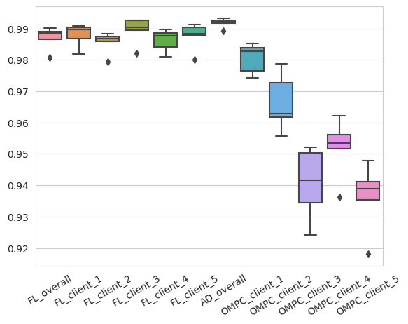
Scenario 2 – unbalanced data distribution – balanced label distribution
Data distribution / label distribution | Balanced | Unbalanced
Balanced | Scenario 1 | Scenario 2
Unbalanced | Scenario 3 | Scenario 4
Scenario setup and resulting performance gains
Performance (AUC) for all settings and clients
client | 1 | 2 | 3 | 4 | 5
weight | 8 | 8 | 2 | 2 | 2
pitting share | 0.5 | 0.5 | 0.5 | 0.5 | 0.5
no pitting share | 0.5 | 0.5 | 0.5 | 0.5 | 0.5

Slide 52
Scenario 2 – unbalanced data distribution – balanced label distribution
Data distribution / label distribution | Balanced | Unbalanced
Balanced | Scenario 1 | Scenario 2
Unbalanced | Scenario 3 | Scenario 4
Scenario setup and resulting performance gains
Performance (AUC) for all settings and clients
client | 1 | 2 | 3 | 4 | 5
weight | 8 | 8 | 2 | 2 | 2
pitting share | 0.5 | 0.5 | 0.5 | 0.5 | 0.5
no pitting share | 0.5 | 0.5 | 0.5 | 0.5 | 0.5
client | 1 | 2 | 3 | 4 | 5
performance gain | 0.66% | 2.13% | 4.94% | 3.69% | 5.42%
average performance gain: 3.37%

Slide 53
Scenario 3 – balanced data distribution – unbalanced label distribution
Data distribution / label distribution | Balanced | Unbalanced
Balanced | Scenario 1 | Scenario 2
Unbalanced | Scenario 3 | Scenario 4
Scenario setup and resulting performance gains
Performance (AUC) for all settings and clients
client | 1 | 2 | 3 | 4 | 5
weight | 1 | 1 | 1 | 1 | 1
pitting share | 0.8 | 0.2 | 0.8 | 0.2 | 0.8
no pitting share | 0.2 | 0.8 | 0.2 | 0.8 | 0.2

Slide 54
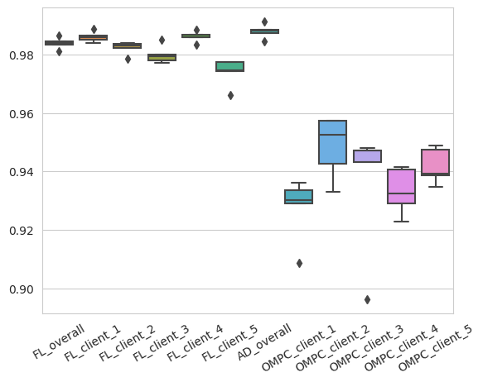
Scenario 3 – balanced data distribution – unbalanced label distribution
Data distribution / label distribution | Balanced | Unbalanced
Balanced | Scenario 1 | Scenario 2
Unbalanced | Scenario 3 | Scenario 4
Scenario setup and resulting performance gains
Performance (AUC) for all settings and clients
client | 1 | 2 | 3 | 4 | 5
weight | 1 | 1 | 1 | 1 | 1
pitting share | 0.8 | 0.2 | 0.8 | 0.2 | 0.8
no pitting share | 0.2 | 0.8 | 0.2 | 0.8 | 0.2

Slide 55
Scenario 3 – balanced data distribution – unbalanced label distribution
Data distribution / label distribution | Balanced | Unbalanced
Balanced | Scenario 1 | Scenario 2
Unbalanced | Scenario 3 | Scenario 4
Scenario setup and resulting performance gains
Performance (AUC) for all settings and clients
client | 1 | 2 | 3 | 4 | 5
weight | 1 | 1 | 1 | 1 | 1
pitting share | 0.8 | 0.2 | 0.8 | 0.2 | 0.8
no pitting share | 0.2 | 0.8 | 0.2 | 0.8 | 0.2
client | 1 | 2 | 3 | 4 | 5
performance gain | 6.09% | 3.72% | 5.09% | 5.43% | 4.48%
average performance gain: 4.96%

Slide 56
Scenario 4 – unbalanced data distribution – unbalanced label distribution
Data distribution / label distribution | Balanced | Unbalanced
Balanced | Scenario 1 | Scenario 2
Unbalanced | Scenario 3 | Scenario 4
Scenario setup and resulting performance gains
Performance (AUC) for all settings and clients
client | 1 | 2 | 3 | 4 | 5
weight | 4 | 4 | 1 | 1 | 1
pitting share | 0.8 | 0.2 | 0.8 | 0.2 | 0.8
no pitting share | 0.2 | 0.8 | 0.2 | 0.8 | 0.2

Slide 57
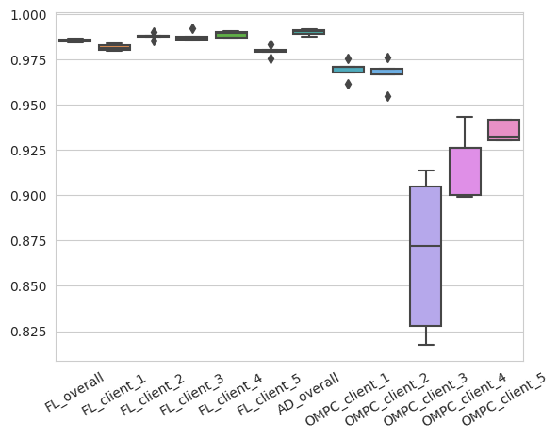
Scenario 4 – unbalanced data distribution – unbalanced label distribution
Data distribution / label distribution | Balanced | Unbalanced
Balanced | Scenario 1 | Scenario 2
Unbalanced | Scenario 3 | Scenario 4
Scenario setup and resulting performance gains
Performance (AUC) for all settings and clients
client | 1 | 2 | 3 | 4 | 5
weight | 4 | 4 | 1 | 1 | 1
pitting share | 0.8 | 0.2 | 0.8 | 0.2 | 0.8
no pitting share | 0.2 | 0.8 | 0.2 | 0.8 | 0.2

Slide 58
Scenario 4 – unbalanced data distribution – unbalanced label distribution
Data distribution / label distribution | Balanced | Unbalanced
Balanced | Scenario 1 | Scenario 2
Unbalanced | Scenario 3 | Scenario 4
Scenario setup and resulting performance gains
Performance (AUC) for all settings and clients
client | 1 | 2 | 3 | 4 | 5
weight | 4 | 4 | 1 | 1 | 1
pitting share | 0.8 | 0.2 | 0.8 | 0.2 | 0.8
no pitting share | 0.2 | 0.8 | 0.2 | 0.8 | 0.2

Slide 59
Scenario 4 – unbalanced data distribution – unbalanced label distribution
Data distribution / label distribution | Balanced | Unbalanced
Balanced | Scenario 1 | Scenario 2
Unbalanced | Scenario 3 | Scenario 4
Scenario setup and resulting performance gains
Performance (AUC) for all settings and clients
client | 1 | 2 | 3 | 4 | 5
weight | 4 | 4 | 1 | 1 | 1
pitting share | 0.8 | 0.2 | 0.8 | 0.2 | 0.8
no pitting share | 0.2 | 0.8 | 0.2 | 0.8 | 0.2
client | 1 | 2 | 3 | 4 | 5
performance gain | 1.67% | 1.94% | 13.66% | 7.24% | 5.37%
average performance gain: 5.97%

Slide 60
Scenario 4 – unbalanced data distribution – unbalanced label distribution
Data distribution / label distribution | Balanced | Unbalanced
Balanced | Scenario 1 | Scenario 2
Unbalanced | Scenario 3 | Scenario 4
Scenario setup and resulting performance gains
Performance (AUC) for all settings and clients
client | 1 | 2 | 3 | 4 | 5
weight | 4 | 4 | 1 | 1 | 1
pitting share | 0.8 | 0.2 | 0.8 | 0.2 | 0.8
no pitting share | 0.2 | 0.8 | 0.2 | 0.8 | 0.2
client | 1 | 2 | 3 | 4 | 5
performance gain | 1.67% | 1.94% | 13.66% | 7.24% | 5.37%
average performance gain: 5.97%

Slide 61
Scenario 4 – unbalanced data distribution – unbalanced label distribution
Data distribution / label distribution | Balanced | Unbalanced
Balanced | Scenario 1 | Scenario 2
Unbalanced | Scenario 3 | Scenario 4
Scenario setup and resulting performance gains
Performance (AUC) for all settings and clients
client | 1 | 2 | 3 | 4 | 5
weight | 4 | 4 | 1 | 1 | 1
pitting share | 0.8 | 0.2 | 0.8 | 0.2 | 0.8
no pitting share | 0.2 | 0.8 | 0.2 | 0.8 | 0.2
client | 1 | 2 | 3 | 4 | 5
performance gain | 1.67% | 1.94% | 13.66% | 7.24% | 5.37%
average performance gain: 5.97%

Slide 62
There is a clear incentive for SMEs towards taking part in federated learning from a performance perspective
Scenario 1
Scenario 2
Scenario 3
Scenario 4

Slide 63
There is a clear incentive for SMEs towards taking part in federated learning from a performance perspective
SME profits more from taking part in FL setting (measured in AUC),
the fewer data it has and
the more unbalanced the label distribution of the SME’s data is
Scenario 1
Scenario 2
Scenario 3
Scenario 4

Slide 64
There is a clear incentive for SMEs towards taking part in federated learning from a performance perspective
SME profits more from taking part in FL setting (measured in AUC),
the fewer data it has and
the more unbalanced the label distribution of the SME’s data is
Performance gains of SMEs in vast majority of simulations positive → no disadvantage from taking part in FL setting even for strong SMEs
Scenario 1
Scenario 2
Scenario 3
Scenario 4

Slide 65
There is a clear incentive for SMEs towards taking part in federated learning from a performance perspective
SME profits more from taking part in FL setting (measured in AUC),
the fewer data it has and
the more unbalanced the label distribution of the SME’s data is
Performance gains of SMEs in vast majority of simulations positive → no disadvantage from taking part in FL setting even for strong SMEs
AUC of FL models in all four scenarios at a similarly high level, even in scenarios where all SMEs face a challenging data situation
Clear incentive towards taking part in FL from a performance perspective
Scenario 1
Scenario 2
Scenario 3
Scenario 4

Slide 66
SMEs would consider taking part in FL if privacy is met, and the performance advantages outweigh the complexity disadvantages
Summary
Privacy: relatively high level of privacy achievable, but can be problematic in highly sensitive settings
Complexity: organizational complexity as key driver with the need for a cost sharing model that guarantees adequate incentives
Performance: SME with most challenging data situation profits the most from FL which again leads to the need for an adequate incentive structure

Slide 67
SMEs would consider taking part in FL if privacy is met, and the performance advantages outweigh the complexity disadvantages
Summary
Privacy: relatively high level of privacy achievable, but can be problematic in highly sensitive settings
Complexity: organizational complexity as key driver with the need for a cost sharing model that guarantees adequate incentives
Performance: SME with most challenging data situation profits the most from FL which again leads to the need for an adequate incentive structure
Outlook / Limitations
Develop organizational framework
Develop cost sharing model
Deep dive into knowledge and needs of SMEs

Slide 68
SMEs would consider taking part in FL if privacy is met, and the performance advantages outweigh the complexity disadvantages
Summary
Privacy: relatively high level of privacy achievable, but can be problematic in highly sensitive settings
Complexity: organizational complexity as key driver with the need for a cost sharing model that guarantees adequate incentives
Performance: SME with most challenging data situation profits the most from FL which again leads to the need for an adequate incentive structure
Outlook / Limitations
Contributions
Develop organizational framework
Develop cost sharing model
Deep dive into knowledge and needs of SMEs
Evaluation of FL in an industrial SME ecosystem
Provide guidance from a neutral point of view how the knowledge and data problems can be tackled using FL
Simulation pipeline for Service-Meister project to demonstrate benefits of FL in various settings

Slide 69
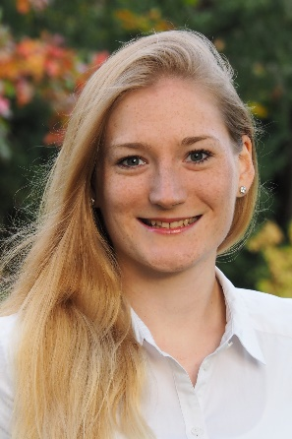
Thank you for your attention!
anna.hensel@student.kit.edu

Slide 70
Sources
Bonawitz et al. 2019
McMahan et al. 2017
Murakonda et al. 2020
Konečný et al. 2016
Sattler et al. 2021
Yang et al. 2019
Schlagenhauf 2021
Enthoven and Al-Ars 2021
Hanley and McNeil 1982
https://hbr.org/2021/09/how-midsize-companies-can-compete-in-ai
https://www.eco.de/news/technischer-service-4-0-der-service-der-zukunft/
Li et al. 2020
Sun et al.
Wang et al. 2019

Slide 71
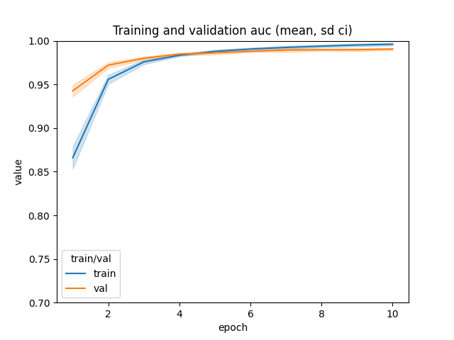
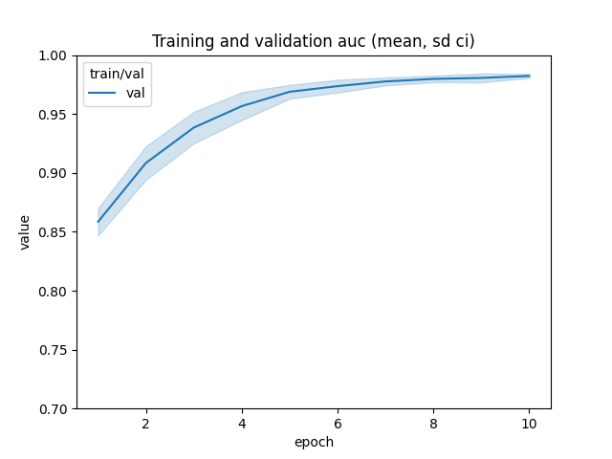
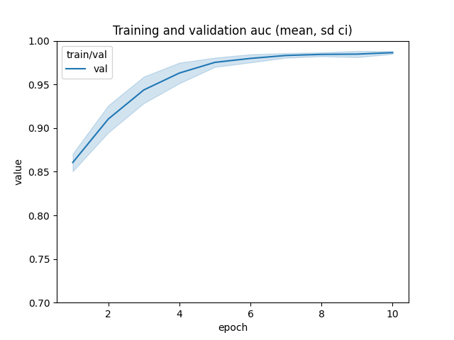
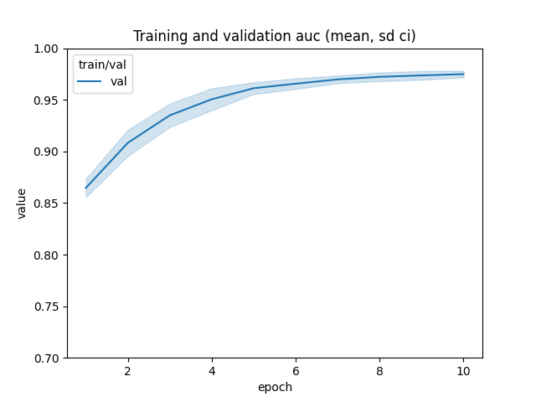
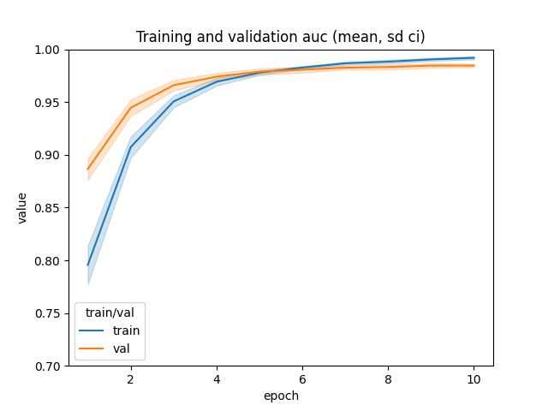
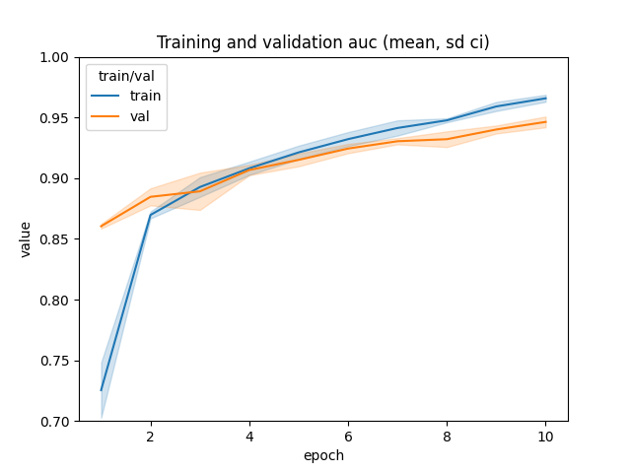
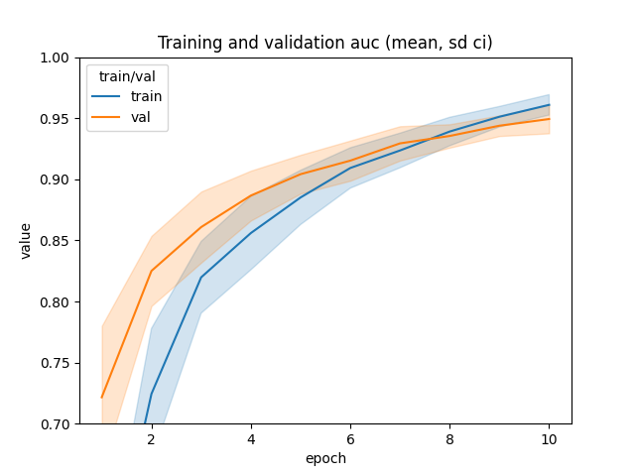
All data model
The all data model can be seen as an upper bound
One model per company can be seen as a lower bound
Companies with insufficient data profit more from the federated model
For companies with sufficient data there is little incentive to take part in FL setting
AUC = 0.991
FL model per company
AUC = 0.982
AUC = 0.986
AUC = 0.975
One model per company
AUC = 0.985
AUC = 0.946
AUC = 0.949
Company 1
50% of all data, balanced
Company 2
25% of all data, unbalanced
Company 3
25% of all data, unbalanced

Slide 72
In contrast to in classical federated learning use cases computational complexity is not a dominating factor for SMEs
Computational Complexity
Number of communication rounds [2] / iterations / communicated bits until a certain target accuracy is reached [5]
Characteristics of computational complexity per setting
Federated learning
All data model
One model per client

Slide 73
In contrast to in classical federated learning use cases computational complexity is not a dominating factor for SMEs
Computational Complexity
Number of communication rounds [2] / iterations / communicated bits until a certain target accuracy is reached [5]
Characteristics of computational complexity per setting
Federated learning | Cannot make ideal use of optimizers → potentially comparably slow convergence Communication rounds can slow down training
All data model | No restriction concerning optimizers → potentially better convergence behavior No communication except initial data gathering and distribution of final model
One model per client | No restriction concerning optimizers → potentially better convergence behavior No communication

Slide 74
In contrast to in classical federated learning use cases computational complexity is not a dominating factor for SMEs
Computational Complexity
Number of communication rounds [2] / iterations / communicated bits until a certain target accuracy is reached [5]
Characteristics of computational complexity per setting
Federated learning | Cannot make ideal use of optimizers → potentially comparably slow convergence Communication rounds can slow down training
All data model | No restriction concerning optimizers → potentially better convergence behavior No communication except initial data gathering and distribution of final model
One model per client | No restriction concerning optimizers → potentially better convergence behavior No communication
Implications for SMEs
Computational complexity not as relevant as in other use cases such as the mobile device setting → computations are not restricted to be executed on mobile devices or other specific devices with relatively low computational power and limited bandwidth and availability → manageable and not a major issue for SMEs

Slide 75
Organizational complexity, especially related to privacy, is key driver of complexity in facilitating federated learning in the SME context
Organizational Complexity
Complexity that arises from organizing and facilitating federated learning and the other settings, especially relating to second and third parties
Characteristics of organizational complexity per setting
Federated learning
All data model
One model per client

Slide 76
Organizational complexity, especially related to privacy, is key driver of complexity in facilitating federated learning in the SME context
Organizational Complexity
Complexity that arises from organizing and facilitating federated learning and the other settings, especially relating to second and third parties
Characteristics of organizational complexity per setting
Federated learning | Alignment of data, use case, problem formulation Federation setup Contract-related and legal issues Cost-sharing model Privacy; potential engagement of third parties for audits and a trustworthy server
All data model | Alignment of data, use case, problem formulation Contract-related and legal issues Cost-sharing model
One model per client | No organizational complexity relating to external entities

Slide 77
Organizational complexity, especially related to privacy, is key driver of complexity in facilitating federated learning in the SME context
Organizational Complexity
Complexity that arises from organizing and facilitating federated learning and the other settings, especially relating to second and third parties
Characteristics of organizational complexity per setting
Federated learning | Alignment of data, use case, problem formulation Federation setup Contract-related and legal issues Cost-sharing model Privacy; potential engagement of third parties for audits and a trustworthy server
All data model | Alignment of data, use case, problem formulation Contract-related and legal issues Cost-sharing model
One model per client | No organizational complexity relating to external entities
Implications for SMEs
Being pat of a FL settings comes with lots of organizational issues compared to the one model per client setting → key driver of complexity, especially related to privacy, in facilitating FL in the SME context

Slide 78
The implementation complexity for each SME can be expected to be lower in federated learning than in the one model per SME setting due to shared efforts
Implementation Complexity
Modelling and deployment complexity SMEs have to deal with when training ML models in the three settings
Characteristics of implemention complexity per setting
Federated learning
All data model
One model per client

Slide 79
The implementation complexity for each SME can be expected to be lower in federated learning than in the one model per SME setting due to shared efforts
Implementation Complexity
Modelling and deployment complexity SMEs have to deal with when training ML models in the three settings
Characteristics of implemention complexity per setting
Federated learning | Limited additional complexity for facilitating federated learning Possibility to share implementation complexity
All data model | Possibility to share implementation complexity
One model per client | Each SME faces full implementation complexity

Slide 80
The implementation complexity for each SME can be expected to be lower in federated learning than in the one model per SME setting due to shared efforts
Implementation Complexity
Modelling and deployment complexity SMEs have to deal with when training ML models in the three settings
Characteristics of implemention complexity per setting
Federated learning | Limited additional complexity for facilitating federated learning Possibility to share implementation complexity
All data model | Possibility to share implementation complexity
One model per client | Each SME faces full implementation complexity
Implications for SMEs
Effort, resources, and knowledge for creating a high-quality ML model could be shared.
FL frameworks such as Flower limit the additional implementation complexity due to the FL setting.
The SMEs could form a joint data science team and potentially engage a third party for support → lack of resources and knowledge could be overcome and implementation complexity could be expected to be lower in FL than in the one model per client setting.

