Slide 1
Event
Public
Health
problem
collection
data
information
action
classification
interpretation
politics

Slide 2
public health
inidvidual health
{

local public
health agency


general
practitioner
{





state
public
health
agency
{

{
local public
health agency



medical
specialist
national
public
health
agency

{
{

local public
health agency

state
public
health
agency
hospitals



Slide 3
Local
public
health
Labs
Physicians
Ministry of
health
Population
State
Ministry of
health
State
public
health
National
public
health

Slide 4
Population
with acute respiratory
infections
disease
absenteeism
respiratory
specimens
of sick patients
selected
Kindergartens
selected
physicians
weekly
newsletter
recipients
Local
public
health
State
public-health
lab
State
public
health

Slide 5
international
institutions
population
ministry
any important
public health event
State
public
health
National
public
health
companies
national
institutions
physicians
state/local
institutions

Slide 6
participating
clinic
National
public
health
HIV to AIDS conversion
Not-treated HIV patients
Treatment effect
Public health
institutions
Hiv-patient

Slide 7
Visits disease
page
Wikipedia
IP adress
Infectious
disease
patient
Public health
Software
algorithm
Targeted public health advice via google advertisment

Slide 8

jakiva.de/presentations

Slide 9
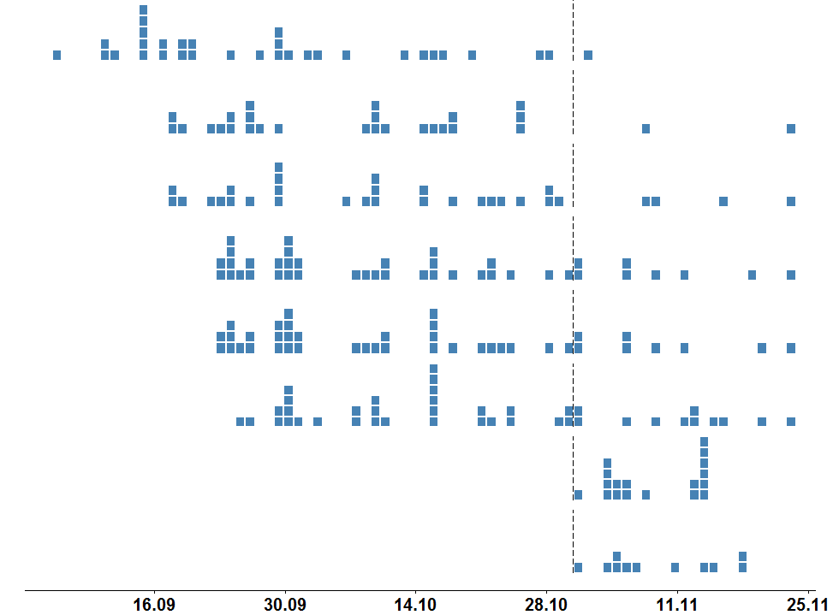
Disease onset
Start investigation
Lab test
Local level
State level
National level
Subtype available
Phone number available
Interview with case
Weeks
2
4
6
8
12

