Slide 1
Validating Scintillation in CHIME/FRB Data
Conditions, evidence, and open issues for the method ratification (wayfinder ticket 02)
Ground truth: analysis/window-tuning-campaign-2026-07-17/ at FLITS main 666306d1 · staged for Faber2026 by PR #140
Faber2026 · CHIME/FRB x DSA-110 co-detections

Slide 2
Why CHIME-band scintillation is hard
Upchannelized baseband
Δν_d sits near/below the native resolution; measurements ride the upchannelization chain, not raw channels.
Coarse-channel bandpass
Multiplicative common-mode structure within each 390.625 kHz coarse channel — shown to live upstream in the baseband (windowing left its amplitude unchanged, 0.586 → 0.62–0.68).
Data lineage
A gen-1 de-chirp defect contaminated early upchannelized products; every input must be gen-2+, checksum-provenanced.
Scattering-tail chromatics
The tail carries broad spectral structure distinct from the narrow core scintle — window choice alone can inflate γ by 2.6–3.6×.
A frequency ACF cannot tell these apart unaided
Every failed route below died on one of these confounds — the validation conditions exist to force the separation.
wf-02 ratification review · window-tuning campaign @ FLITS 666306d1 · 2026-07-18
2

Slide 3
The route graveyard — and what each failure bought
Route
Predeclared gate
Outcome
Lesson
Cross-fitted all-pairs estimator (C1)
Low-modulation calibration cells + family-wise null
0/8 cells passed; nulls failed
Estimator-level cleverness cannot beat the common mode
Windowed fine-channelization (P1)
10× common-mode suppression, 5 predeclared variants
0/5; amplitude unchanged → structure is upstream in baseband
Located the confound; killed re-channelization fixes
Ratio statistic, Route B (P2)
Cancellation (G2) + sensitivity (G1)
G2 PASS ~100×; G1 FAIL
Cancelling the mode also cancels the signal
Delay-domain optimal estimator (P3)
≥3σ forecast; frozen gates; one-shot unblinding
Calibrated; unblinded structure declined as intrinsic envelope
A calibrated estimator exists; attribution is the bottleneck
Envelope modeling (P4)
Predeclared grids + surrogate certification
DOCUMENTED-FAIL: 13/14 operating points fail mismatch control
Intrinsic envelope not separable post hoc — must be handled in-window
wf-02 ratification review · window-tuning campaign @ FLITS 666306d1 · 2026-07-18
3

Slide 4
Design requirements the failures forced
Predeclare, then look
Null-first
Gates, thresholds, and status rules frozen before burst data is inspected — every route above did this; the survivor must too.
An off-pulse null distribution accompanies every measurement; a detection must beat its own null, not a theory curve.
Carry the window systematic
Decide by injection, not assertion
Estimator variants are reported, not hidden — the window-choice spread (γ_win_sys) rides every quoted γ.
Estimator and model-selection thresholds chosen by known-truth injections with measured false-positive rates.
Mechanical status vocabulary
Two-band consistency as the external check
detection / diagnostic_only / non_detection assigned by rule, with the basis string stored next to the number.
CHIME γ(ν) scaling must cohere with the DSA band — the cross-check no single-band route could offer.
wf-02 ratification review · window-tuning campaign @ FLITS 666306d1 · 2026-07-18
4

Slide 5
The candidate method — windowed refit, two-band scaling
1
Coherently dedispersed, de-scalloped dynamic spectrum (gen-2+, checksummed)
Key choices are injection-decided
2
Window selection: matched-significance burst core + pre-burst off-window
Core-boxcar window: on clean truth all three estimators agree to ~2%; with tail chromatics, tail-expanded inflates γ 2.6–3.6×, matched-weight 1.3–1.9× — core stays unbiased.
Pre-burst off-window: post-burst windows sit in the scattering tail and corrupt per-channel gains. For chromatica this is the difference between a 4-subband detection and a railed 2-subband collapse.
Grid regularization ON — fitted grids uniform, absolute γ quotable.
3
Per-subband frequency ACF (4 subbands)
4
2-Lorentzian vs 1-Lorentzian model selection (ΔBIC ≥ 6)
5
γ(ν) per resolved subband, with scintle + window error terms
6
Scaling index α across resolved subbands; mechanical status rule
wf-02 ratification review · window-tuning campaign @ FLITS 666306d1 · 2026-07-18
5

Slide 6
Calibration: the fitter earns its thresholds
9/9
0.02–3 MHz
injection-recovery grid PASS — γ and inner components inside 90% CIs on known truth
range over which the 2-component model recovers γ unbiased; the single Lorentzian fails a narrow scintle under a broad envelope
0/150 + 0/150
γ_win_sys, γ_tail
false-positive rate of the ΔBIC ≥ 6 two-component gate on envelope-only and pure-noise truth sets
retained estimator variants keep the window systematic visible in every record, per subband
wf-02 ratification review · window-tuning campaign @ FLITS 666306d1 · 2026-07-18
6

Slide 7
The predeclared validation conditions (verbatim from the records)
detection
n_resolved_physical ≥ 3 AND α ∈ (1.5, 6.0) open interval AND off-pulse null not majority-fail
diagnostic_only
subbands resolve but the slope is unphysical — e.g. hamilton: n=2 resolved, α = +8.94 outside (1.5, 6.0)
non_detection
n_resolved_physical < 2 — no measurable slope; no α is quoted at all
Per-subband ‘resolved’ is itself gated: amplitude S/N, shape check, and the ΔBIC line test must all pass; every γ carries fit, scintle, and window-systematic error terms. The basis string is stored beside every verdict — the rule is auditable per burst.
Open question for ratification: the (1.5, 6.0) window — thin-screen Kolmogorov expects α ≈ 4.4; the permissive lower bound admits shallow scalings. Predeclared, but is it the interval you want to defend to a referee?
wf-02 ratification review · window-tuning campaign @ FLITS 666306d1 · 2026-07-18
7

Slide 8
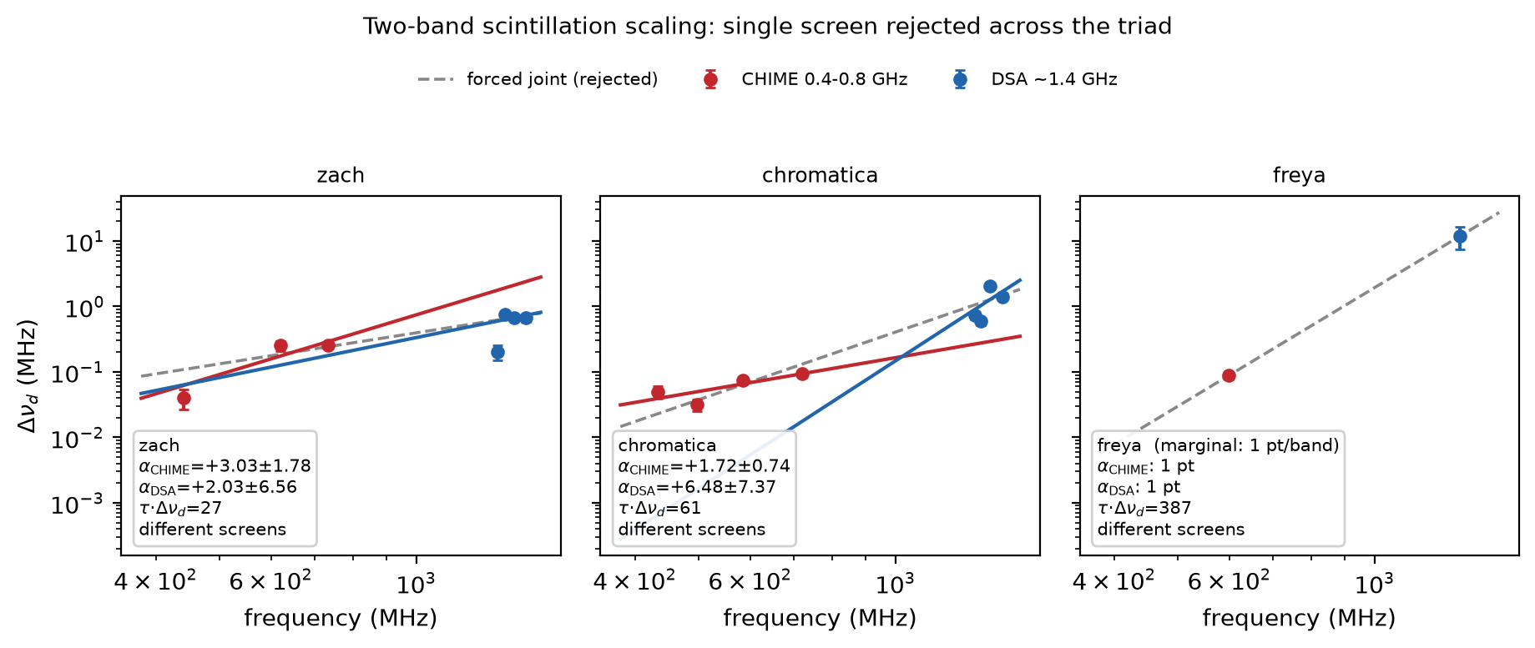
The 12-burst campaign outcome
chromatica
α = +1.72 ± 0.40 (n = 4)
zach
α = +3.03 ± 0.65 (n = 3)
hamilton
α = +8.94 ± 3.22 — unphysical slope, correctly quarantined
casey, freya, phineas, wilhelm
1 resolved subband each — below the 2-subband floor
Two-band scaling summary (staged for the manuscript in PR #140)
isha, johndoeII, mahi, oran, whitney
0 resolved subbands
Full CHIME sample coverage: this campaign already ran all twelve co-detections — ratification does not ‘unblock’ a future CHIME run; it decides whether THIS one is citable.
wf-02 ratification review · window-tuning campaign @ FLITS 666306d1 · 2026-07-18
8

Slide 9
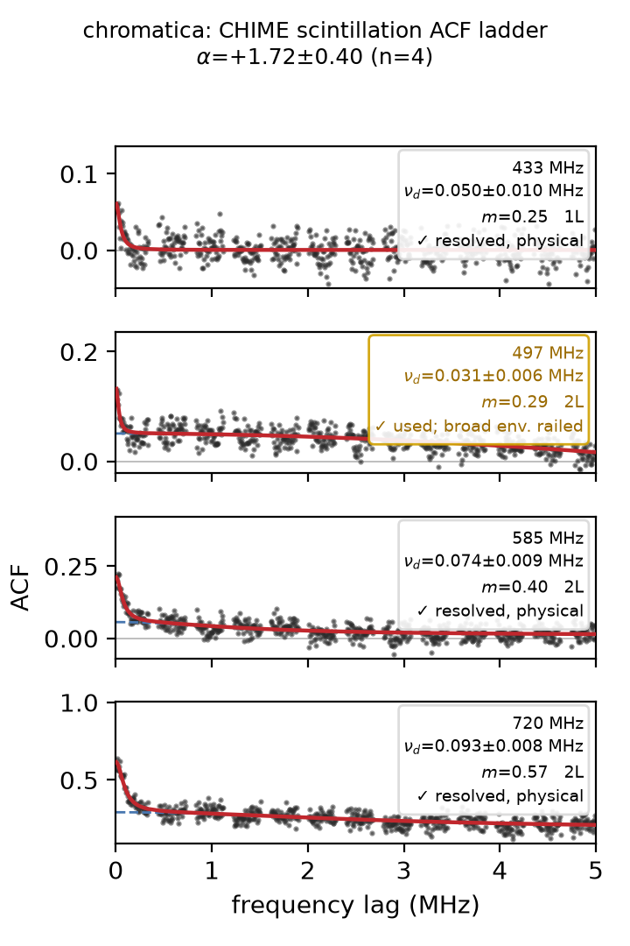
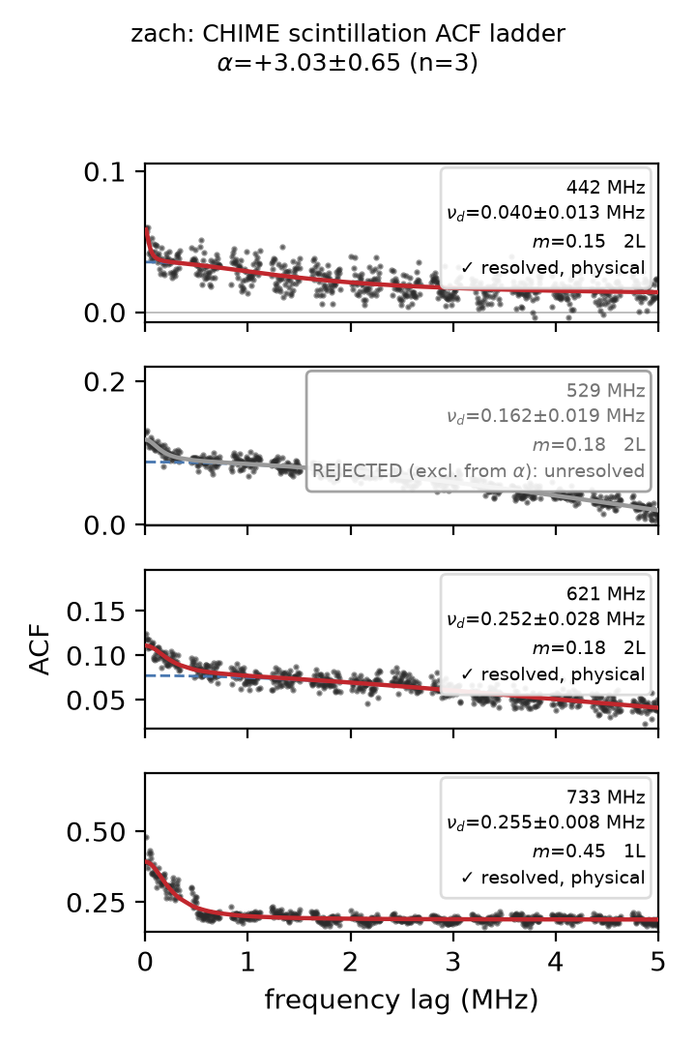
The two detections
chromatica — 4 resolved subbands, pre-burst window; α = +1.72 ± 0.40
zach — 3 resolved subbands; α = +3.03 ± 0.65
wf-02 ratification review · window-tuning campaign @ FLITS 666306d1 · 2026-07-18
9

Slide 10
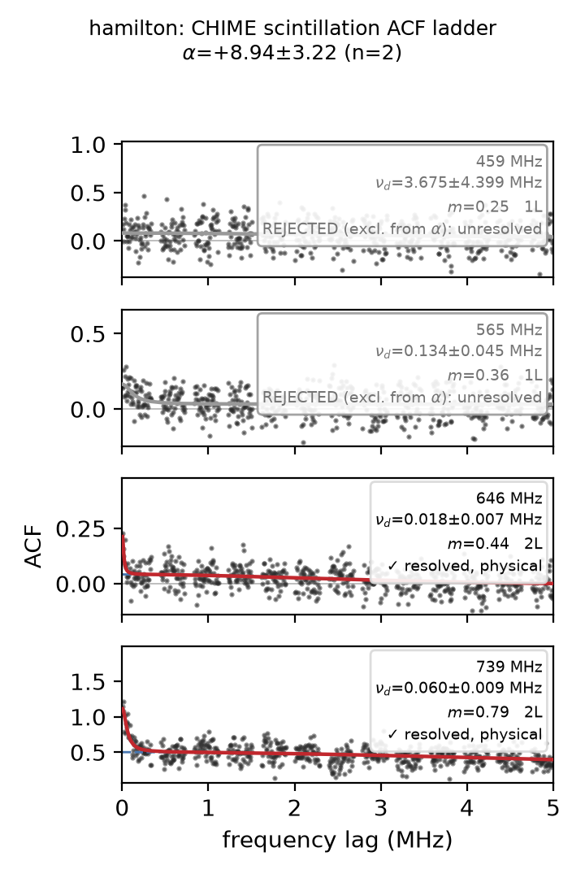
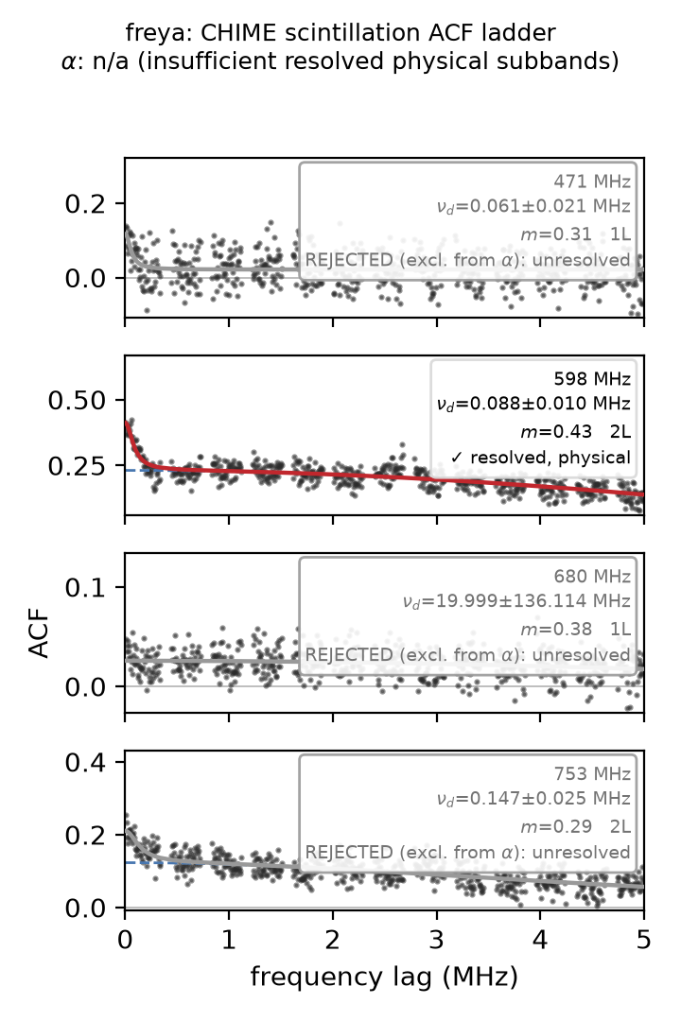
The rules rejecting what should be rejected
hamilton — 2 subbands resolve but α = +8.94 is unphysical → diagnostic_only, no science claim
freya — the burst that failed four qualification routes lands as non_detection here (1 resolved subband): the new method agrees with the graveyard rather than contradicting it
wf-02 ratification review · window-tuning campaign @ FLITS 666306d1 · 2026-07-18
10

Slide 11
What this ratification must NOT cover: τ·Δν_d
The two-screen products (τ·Δν_d = 26.7 / 61.0 / 386.7 / 1.3) are composite: Δν_d from this campaign, τ from the scattering mass-refit — which is still pre-ratification (leakage-injection verdict, count adoption, and validation all pending).
Ratifying τ·Δν_d now would smuggle unratified τ values into citability through a product.
Recommendation: Δν_d side citable with this ratification; τ·Δν_d and every screen-placement inference stay pending until the scattering side ratifies (free-α reporting + count remediation tickets).
The scint-to-scattering coupling design (constraint layer, prior-odds geometry) consumes these as frozen posterior/limit products once both sides are trusted — sequencing is already on the map.
wf-02 ratification review · window-tuning campaign @ FLITS 666306d1 · 2026-07-18
11

Slide 12
Open issue found in this review: the closure record is stale
validation.json (campaign closure)
campaign_results.jsonl (beside it)
#192-era: status=closed, 24 records (with _hi variants), n_measurements = 1 (chromatica_hi), figure_gate = FAIL, long artifact-failure list
R5/R6: 12 records, TWO detections, different status vocabulary (detection vs measurement)
The campaign’s own finalization machinery (finalize_campaign.py: artifact validation + figure-review gates → promotion) has not been rerun over the R5/R6 records.
The five staged manuscript figures (PR #140) have not passed the hash-bound review the figure gate encodes.
The manuscript-side loader/tests still encode the #192 contract — the pin bump fails CI until the sync (diagnosed on PR #140).
The staged two-band figure quotes larger alpha errors than the records (zach ±1.78 vs ±0.65; chromatica ±0.74 vs ±0.40) — presumably a systematics-inflated convention; the convention must be named and made consistent before either number is quoted.
Ratification should therefore carry CONDITIONS PRECEDENT: rerun closure + figure review over R5/R6; regenerate validation.json; reconcile the error conventions; then the manuscript contract sync.
wf-02 ratification review · window-tuning campaign @ FLITS 666306d1 · 2026-07-18
12

Slide 13
Mapping to the five-term re-trust contract (per decision (a))
(i) Verified input lineage
MET (conditional)
gen-2+ inputs, checksummed; confirm per-burst lineage table at closure rerun
(ii) Injection recovery of known truth
MET
recover + discriminate harnesses; 9/9 grid; estimator chosen by injection
(iii) Rail = rejection, never a limit
MET by construction
γ rails → subband unresolved → excluded from α; no railed value is quoted
(iv) Posterior-predictive / adequacy check
PARTIAL
ΔBIC + shape gates play this role; no explicit PPC on the ACF fits — note for wf-13
(v) Independent cross-check, re-derived
PARTIAL
two-band consistency is the check; DSA-band re-runs under the contract still owed
Two PARTIALs are the honest gaps wf-13 inherits — they are recorded, not hidden, and neither invalidates the predeclared-gate basis chosen for this ratification.
wf-02 ratification review · window-tuning campaign @ FLITS 666306d1 · 2026-07-18
13

Slide 14
The decision on the table
RATIFY — the method
Windowed refit + core-boxcar + pre-burst off-window + ΔBIC model selection + mechanical status rules, as the qualifying CHIME-band route.
RATIFY — the verdicts
The 12-burst status set and the two α scalings (chromatica +1.72±0.40, zach +3.03±0.65), citable once the conditions precedent clear.
EXCLUDE — τ·Δν_d
Composite with unratified τ; stays pending behind the scattering-side ratification.
CONDITIONS PRECEDENT
Rerun campaign closure + hash-bound figure review over R5/R6; regenerate validation.json; manuscript contract sync (turns PR #140 green). Decide the α-interval defense (1.5, 6.0).
Everything above is grounded in the pinned artifacts at FLITS 666306d1; nothing depends on this session’s summary being right.

