Slide 1
Representative ACF outputs
Freya and Casey DSA diagnostics, plus the Freya CHIME instrumental-control overview
Faber2026 · scintillation revalidation · DIAGNOSTIC ONLY

Slide 2
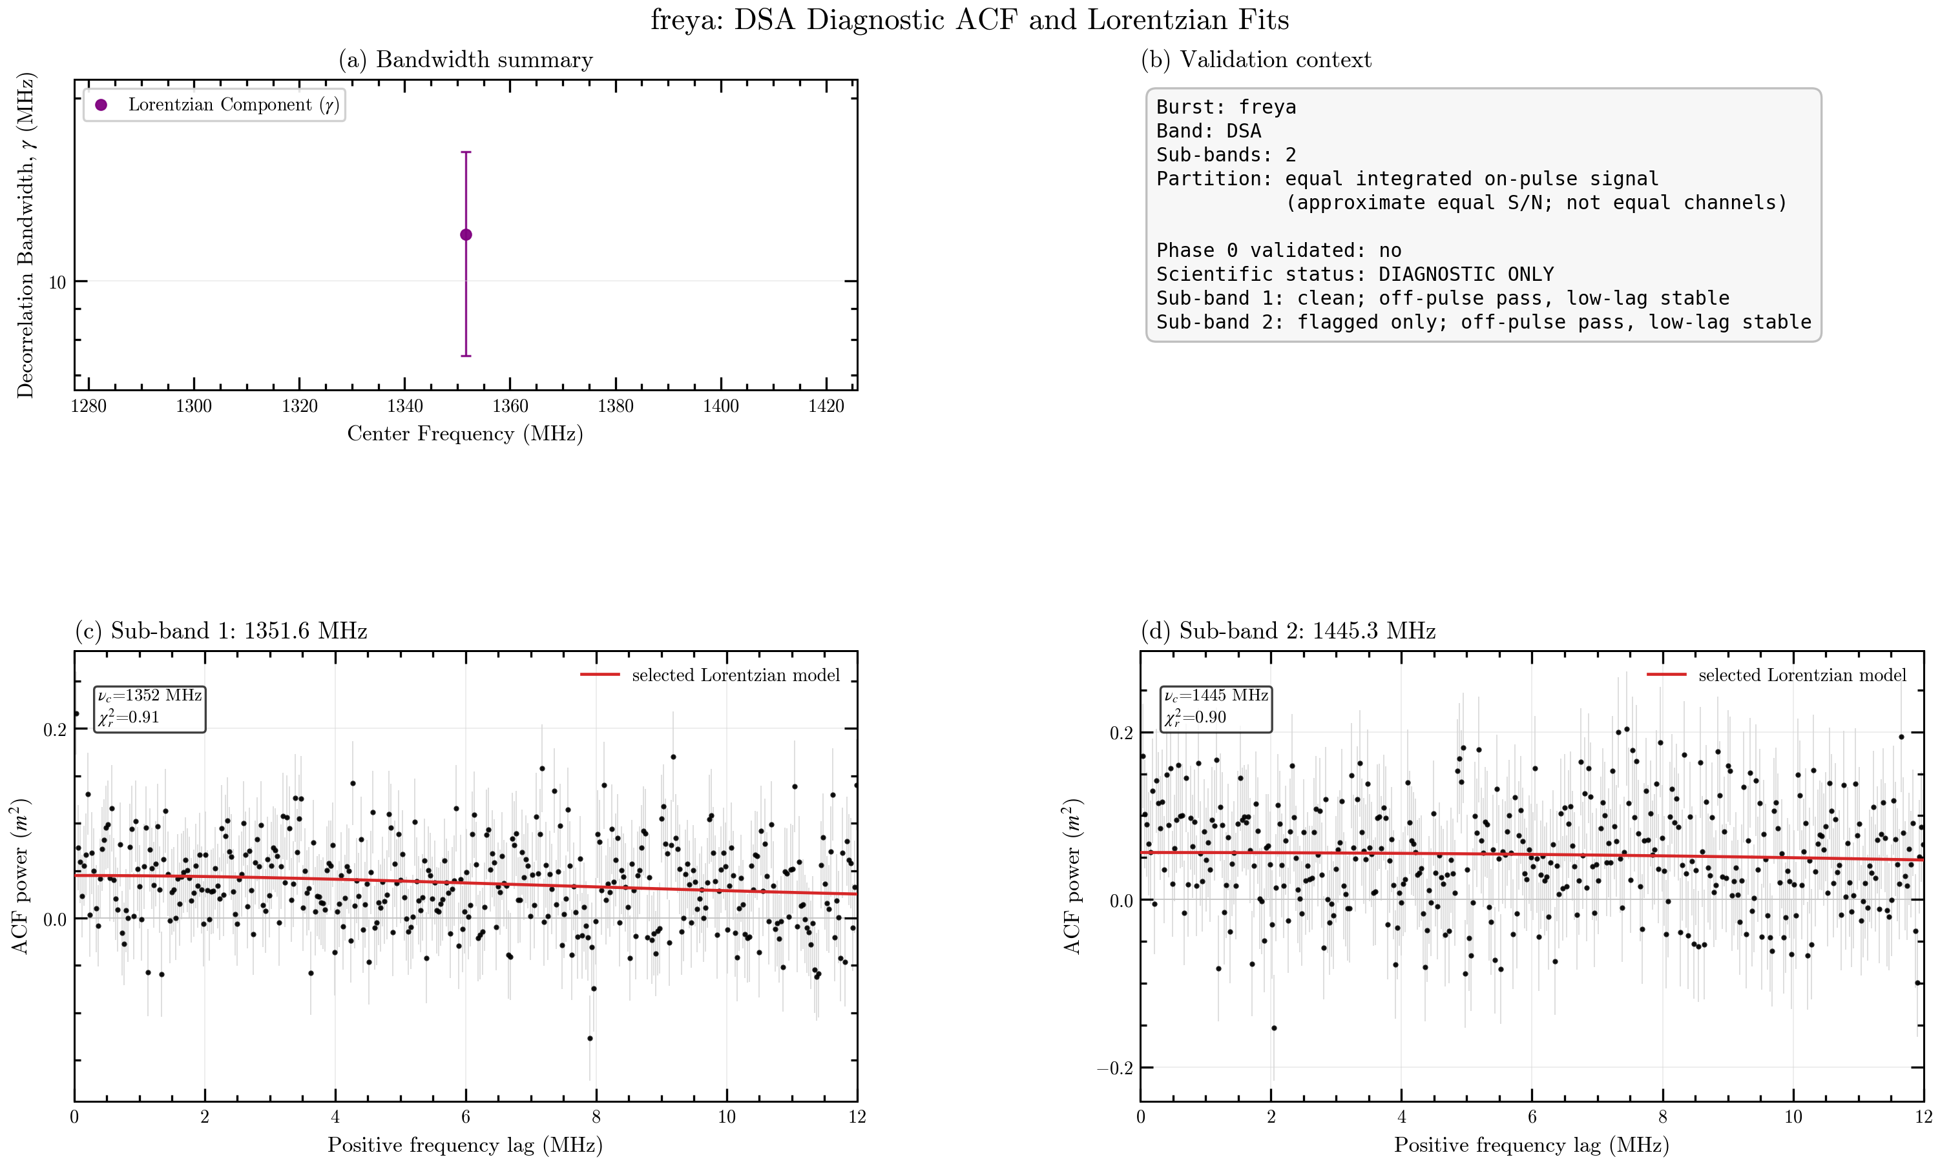
Freya — DSA diagnostic ACF
Two sub-bands partitioned by equal integrated on-pulse signal (approximately equal S/N)
2 / 4

Slide 3
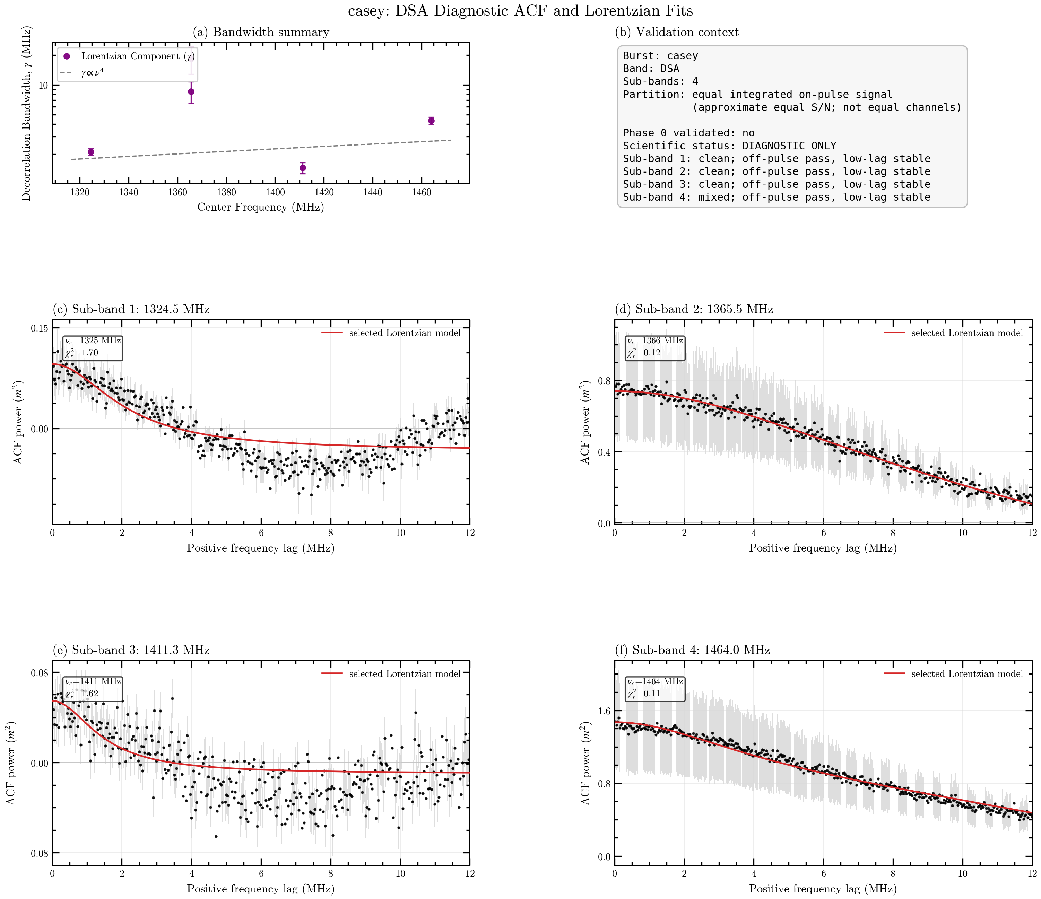
Casey — DSA diagnostic ACF
Four sub-bands partitioned by equal integrated on-pulse signal (approximately equal S/N)
3 / 4

Slide 4
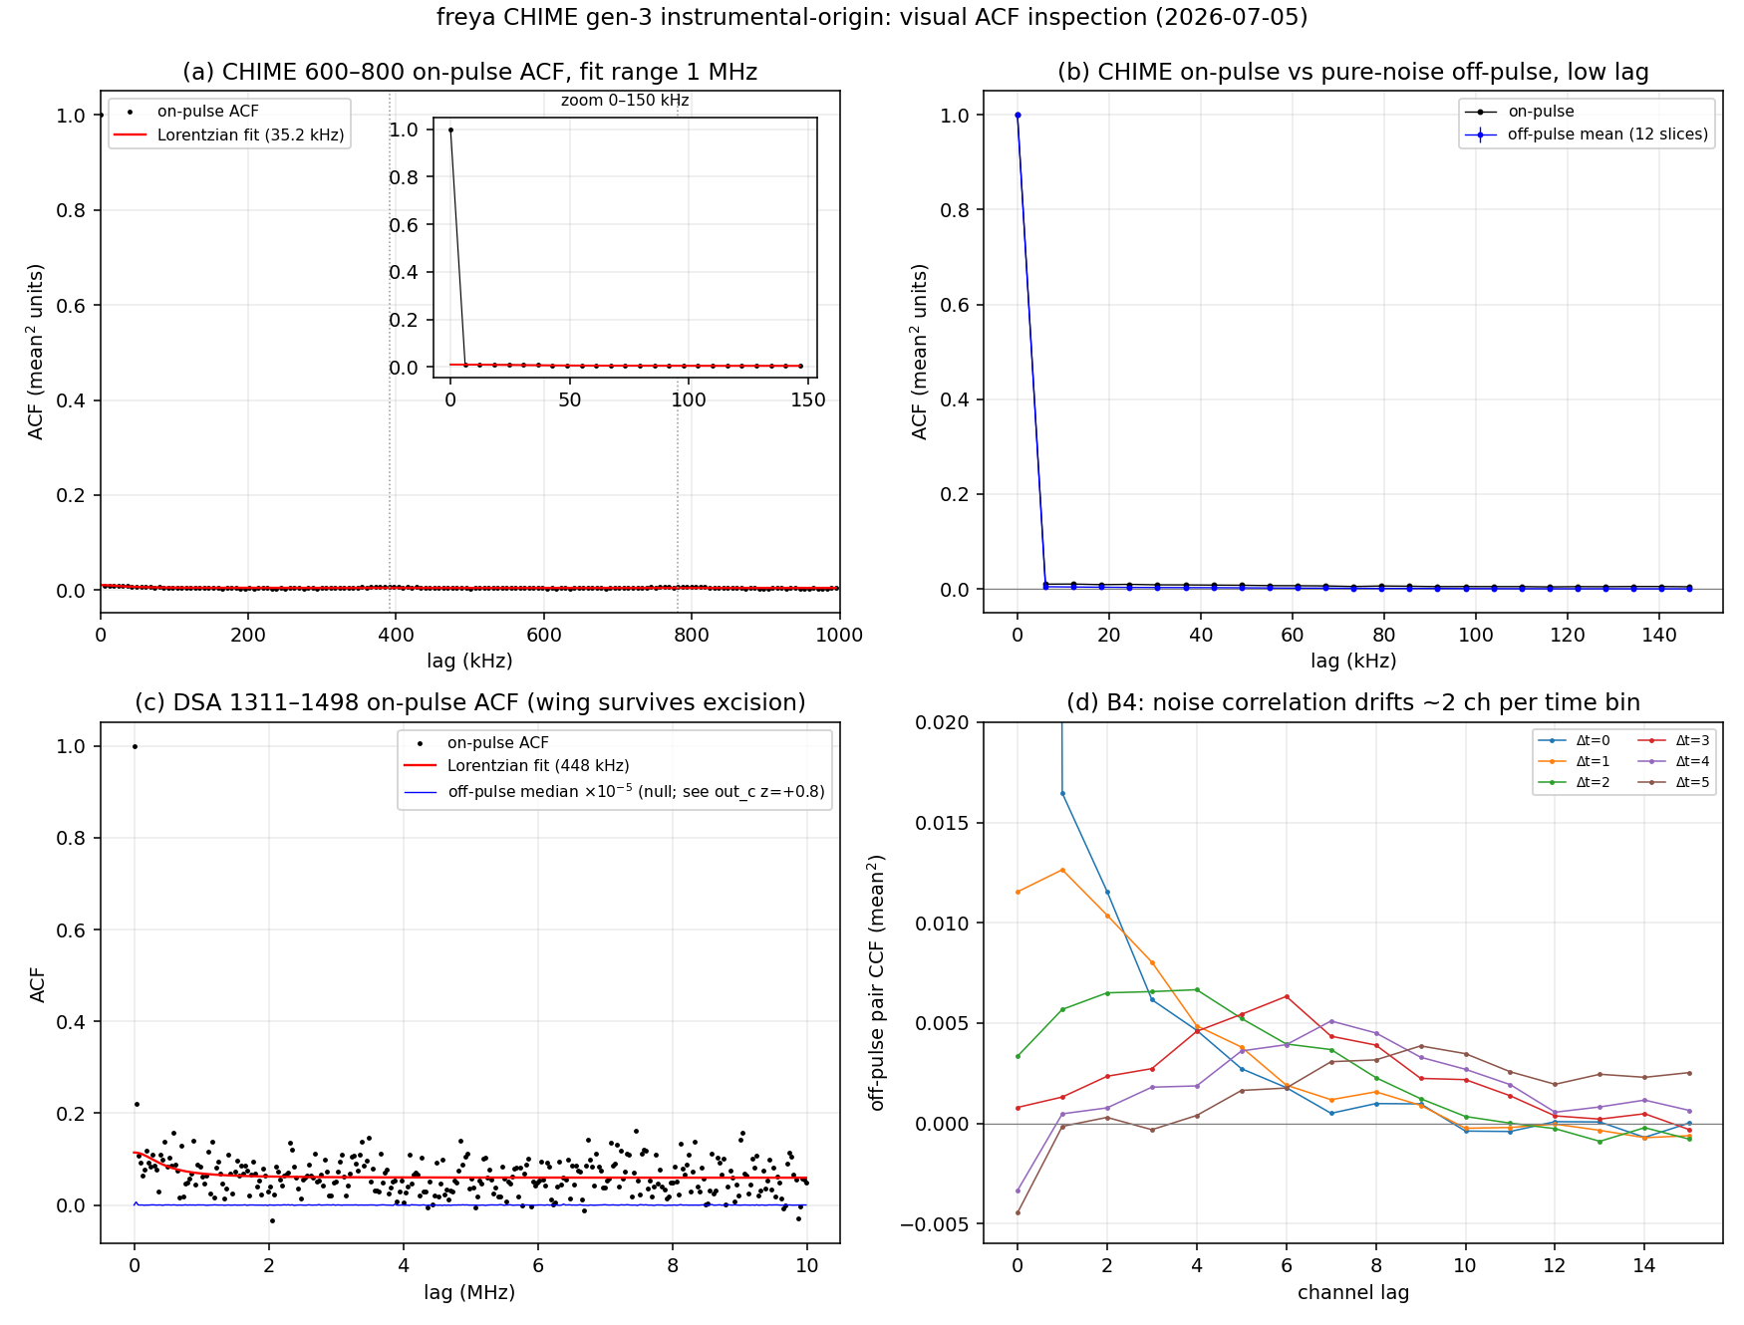
Freya — CHIME instrumental-origin control
Original 2026-07-05 overview retained for direct comparison
4 / 4

