Slide 1

Unit Testing

Slide 2
Context
Unit tests are one of the ways used to test individual units of a source code.
Methods Classes Features Modules …
This ensure us that code meets its design and behave as intended.

Slide 3
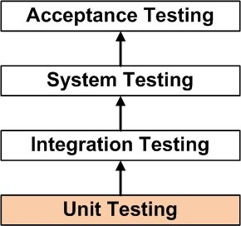
Context
Unit tests are a component of Test Driven Development, a pragmatic methodology which presents an approach in the creation of products through continuous tests and revisions. TDD requires that developers first write unit tests and that they fail. After that they write the code and refactor the application until pass those tests.
Unit Testing is the first level of testing and is performed prior to Integration Testing.

Slide 4
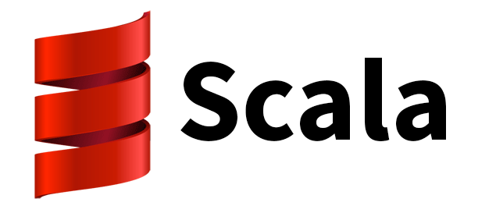
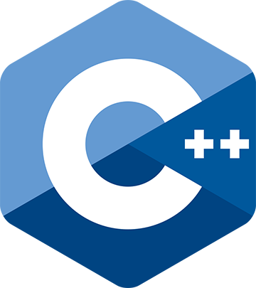

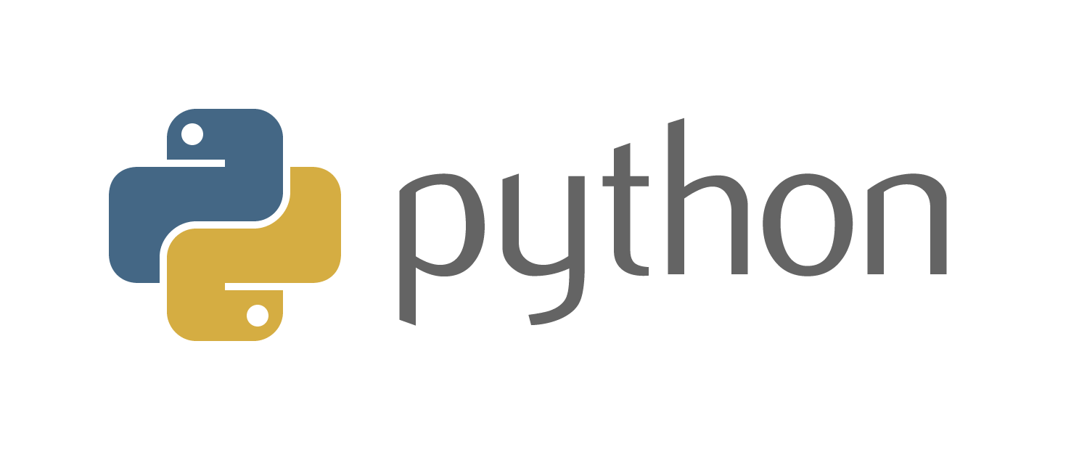

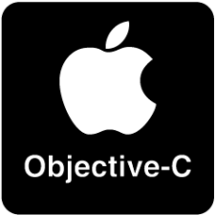

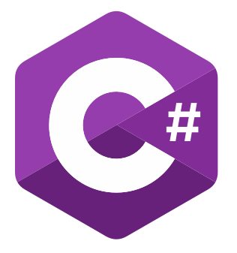


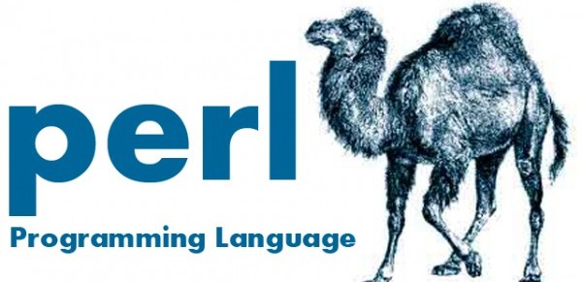

Context
xUnit

Slide 5



Java Tools
Junit | TestNG | Jtest
Simplest framework | Influenced by JUnit w/ concurret annotation support | Comercial
Supported by almost all the IDE’s. | Supports a lot of test types | Supports static code analysis
Has a lot extensions | Effective with powerful execution model and flexible test configuration | Performs regression testing, end-to-end functional and load testing for complex application
It’s easy to find solutions to your problems.
Standard library for unit testing in Java |  | Capture actual code behavior and generates JUnit tests for coverage analysis
Junit | TestNG | Jtest
Simplest framework | Influenced by JUnit w/ concurret annotation support | Comercial
Supported by almost all the IDE’s. | Supports a lot of test types | Supports static code analysis
Has a lot extensions | Effective with powerful execution model and flexible test configuration | Performs regression testing, end-to-end functional and load testing for complex application
It’s easy to find solutions to your problems.
Standard library for unit testing in Java |  | Capture actual code behavior and generates JUnit tests for coverage analysis

Slide 6



JavaScript Tools
Karma | Jasmine | Mocha
Easily extensible | Behaviour Driven Development focused | Supports different assertion libraries
Provides both Browser based testing as well as headless tests | Includes assertions and mocking. | Allows developers to choose their development process.
Provides the option of running client/servers either separately or on the Development computer. | Has a very readable and user-friendly syntax. | Makes Asynchronous testing extremely easy
 | Allows both DOM-less as well as Asynchronous testing | Integrates really well with NodeJS
You can test your code in cross browser environments |  | Mocha has a browser build as well as a node command line program
Karma | Jasmine | Mocha
No support for NodeJS | Not much room for flexibility | No atomic tests – cannot be run in random order
No plugin for Eclipse |  | Can be intimidating for beginners – requires developers to select and set up assertion libraries
Karma | Jasmine | Mocha
No support for NodeJS | Not much room for flexibility | No atomic tests – cannot be run in random order
No plugin for Eclipse |  | Can be intimidating for beginners – requires developers to select and set up assertion libraries

Slide 7



C/C++ Tools
Catch (only C++) | Googletest | Parasoft
Really easy to get started. | Portable. | Commercial
No external dependencies. | Automatically detects your tests and doesn't require you to enumerate them in order to run them. | Automated unit/component test generation and execution on host or embedded systems with code coverage and runtime error detection.
Header only
Auto-registration | XML test report generation
TDD and BDD features | A rich set of assertions | Provides static analysis and peer code review.
Catch (only C++) | Googletest | Parasoft
Really easy to get started. | Portable. | Commercial
No external dependencies. | Automatically detects your tests and doesn't require you to enumerate them in order to run them. | Automated unit/component test generation and execution on host or embedded systems with code coverage and runtime error detection.
Header only
Auto-registration | XML test report generation
TDD and BDD features | A rich set of assertions | Provides static analysis and peer code review.

Slide 8
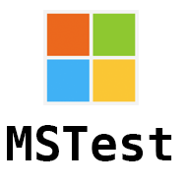


C# Tools
NUnit | xUnit.net | MSTest
Doesn’t integrate with Visual Studio | Lack of documentation | Experience can be sluggish
 | Small but loyal core of users | Struggle with interoperability
NUnit | xUnit.net | MSTest
Doesn’t integrate with Visual Studio | Lack of documentation | Experience can be sluggish
 | Small but loyal core of users | Struggle with interoperability
NUnit | xUnit.net | MSTest
Started out as a port from Java’s Junit. | Extremely intuitive terminology and ways to reason about the language of tests. | Ships with Visual Studio.
Interoperates nicely with other tools. | Excellent extensibility. | You can also see code coverage without installing any other tools.
Fast testing running. | Great community & active development. | AutoGenerate unit test.
Test annotations allows easy specification of multiple inputs to a given test. | Is already compatible with Xamarin, DNX, … | Easy to get started
 | Just need a basic class Library with a reference to the official Nuget.

Slide 9
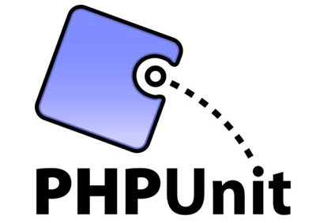
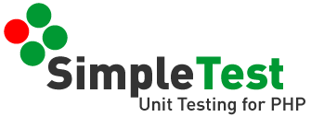


PHP Tools
SimpleTest | PHPUnit | Codeception | Behat
Not has well documented | Mock objects not fluent | Better for other test types
Can not run directly via a web browser | Can not run directly via a web browser
SimpleTest | PHPUnit | Codeception | Behat
Not has well documented | Mock objects not fluent | Better for other test types
Can not run directly via a web browser | Can not run directly via a web browser
SimpleTest | PHPUnit | Codeception | Behat
Can be used with PHPUnit. | Loads of example on-line. | A lot of features available for different type of testing | Test cases are very human friendly.
Can custom output. | Able to test controllers with no further extending. | It have separate modules for many PHP frameworks. | A lot of features available for different type of testing
Can be run via both command line and browser. | Can create various type of reports. | It provides support for different other testing frameworks | Test cases are cleaner and maintenance of tests is easier;
Customisable tests results. | Is integrated in every PHP IDE. | Its Test Cases are written in PHP.
Can test both state, behaviour & front end functionality. | allows developers to use pre-written assertion methods to assert that the app behaves a certain way.
Not as well documented as PHPUnit

Slide 10

JUnit
Annotation | Description
@Test | Denotes that a method is a test method. Unlike JUnit 4’s @Test annotation, this annotation does not declare any attributes.
@ParameterizedTest | Denotes that a method is a parameterized test.
@RepeatedTest | Denotes that a method is a test template for a repeated test.
@TestFactory | Denotes that a method is a test factory for dynamic tests.
@TestInstance | Used to configure the test instance lifecycle for the annotated test class.
@TestTemplate | Denotes that a method is a template for test cases designed to be invoked multiple times depending on the number of invocation contexts returned by the registered providers.
@DisplayName | Declares a custom display name for the test class or test method.
@Tag | Used to declare tags for filtering tests, either at the class or method level.
@BeforeEach, @AfterEach, @BeforeAll, @AfterAll, @Nested, @Disabled, @ExtendWith

Slide 11

Mockito
Annotation | Description
@Mock/mock() | Create mock - optionally specify how it should behave via Answer/ReturnValues/MockSettings - when()/given() to specify how a mock should behave - If the provided answers don’t fit your needs, write one yourself extending the Answerinterface
@Spy/Spy() | Partial mocking, real methods are invoked but still can be verified and stubbed
@InjectMocks | Automatically inject mocks/spies fields annotated with @Spy or @Mock
Verify() | To check methods were called with given arguments - can use flexible argument matching, for example any expression via the any() - or capture what arguments were called using @Captor instead

Slide 12

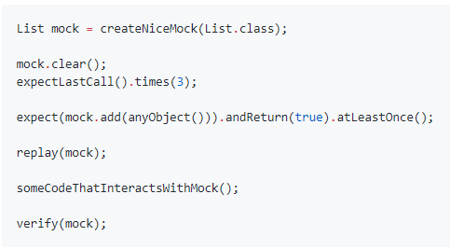
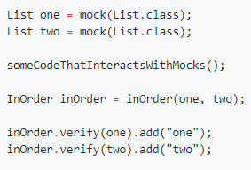
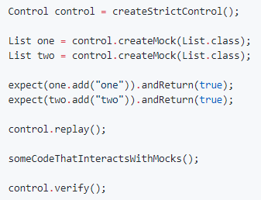
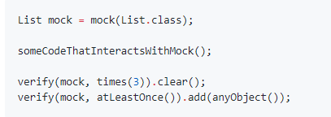
Mockito

