Slide 1
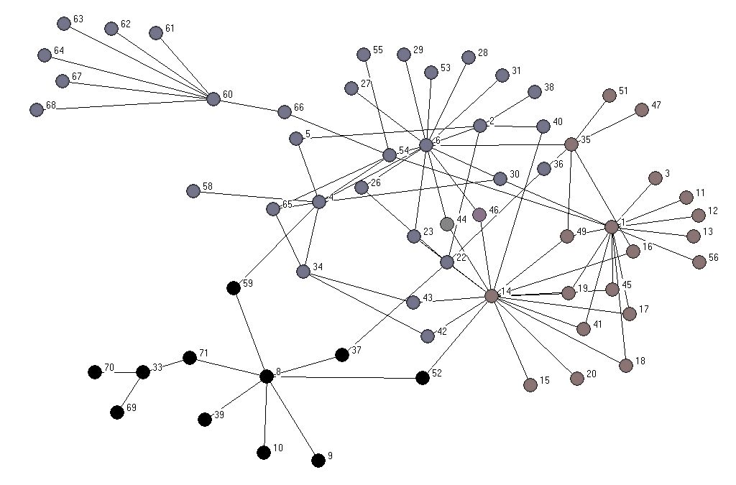
MDVRP
by
Baran Kizbaz
Jacob Isaacs

Slide 2
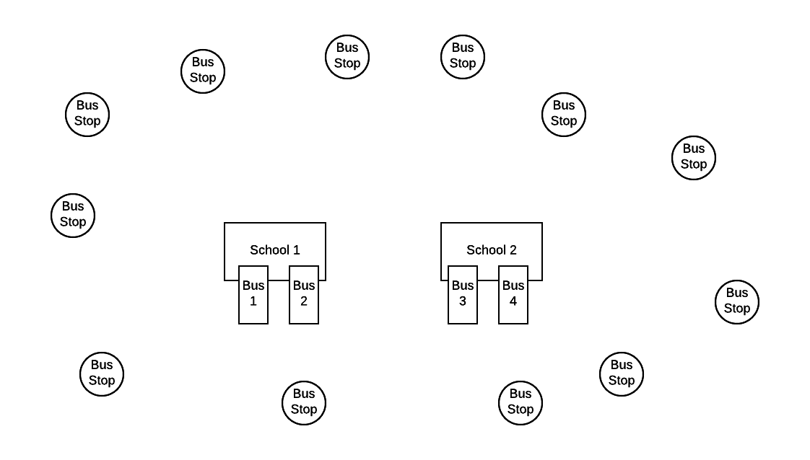
What is an MDVRP?
MDVRP
stands for multi depot vehicle routing problem
THE GOAL
is to optimally route vehicles from the depots to all customers who need service.​
APPLICATIONS:
School bus routing systems
Military routing systems
UPS Delivering Packages
Pet Sitter Business
EXAMPLE DIAGRAM
School bus routing system is viewed to the right

Slide 3
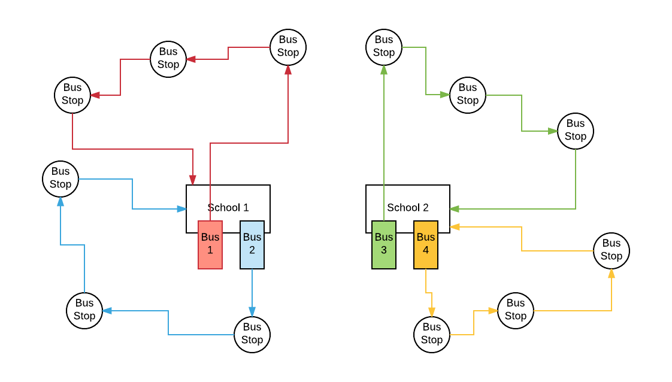
What might a solution look like?
Every Bus Stop must be reached by a Bus
Multiple buses might need to be used
A route for a bus must leave the depot and return to the depot
Kids must be picked up at each bus stop
The distance / time traveled for the entire system must be minimized

Slide 4
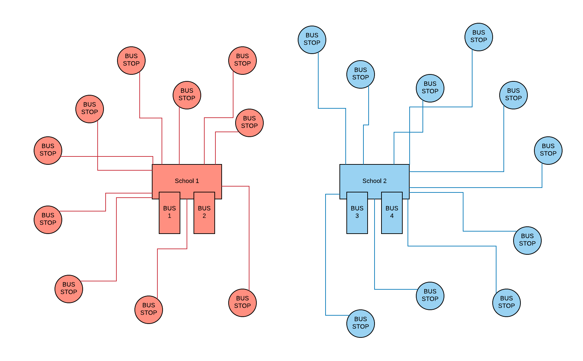
A Solution Method
Match First, Route Later
STEP 1: Solve an Optimal Matching Algorithm
Match Bus Stops to Schools
STEP 2: SOLVE Sub-VRP Problems
Route Buses to Bus Stops

Slide 5
THE MATCH
Match Method 1
Match Bus Stop To Closest School
1
Match Method 2
Split Bus Stops Evenly Among All Schools
2
Match Method 3
Specify The Maximum Bus Stops For Each School
3

Slide 6
THE DATA
THE SITE NAMES
siteNames = [“Fox Elementary", “Carver Elementary", “Stop 1", "Stop 2",“Stop 3", “Stop 4", “Stop 5", “Stop 6"]
THE SCHOOL LOCATIONS
depot_list = [“Fox Elementary", “Carver Elementary"]
THE CAPACITY OF ALL BUSES
capacity = 35
THE NUMBER OF KIDS AT EACH SITE
demand = [ 0, 0, 20, 16, 14, 10, 11, 17]
THE DISTANCE MATRIX
dist = [[0, 59.3, 31.6, 47.8, 34.2, 47.1, 36.1, 31.9], #Fox Elementary
[62.2, 0, 27.9, 21.0, 77.5, 30.0, 27.1, 44.7], #Carver Elementary
[32.2, 27.7, 0, 16.2, 50.0, 39.4, 24.9, 42.6], #Stop 1
[50.7, 21.0, 16.4, 0, 66.1, 49.7, 35.2, 52.9], #Stop 2
[34.4, 77.4, 49.6, 65.9, 0, 80.8, 67.1, 65.5], #Stop 3
[46.9, 30.1, 39.6, 49.7, 80.5, 0, 14.4, 15.0], #Stop 4
[36.9, 27.1, 25.2, 35.2, 67.1, 14.4, 0, 17.6], #Stop 5
[31.9, 44.7, 62.8, 52.8, 65.6, 15.0, 17.6, 0]] #Stop 6

Slide 7
Sneak Peek Solution

Slide 8
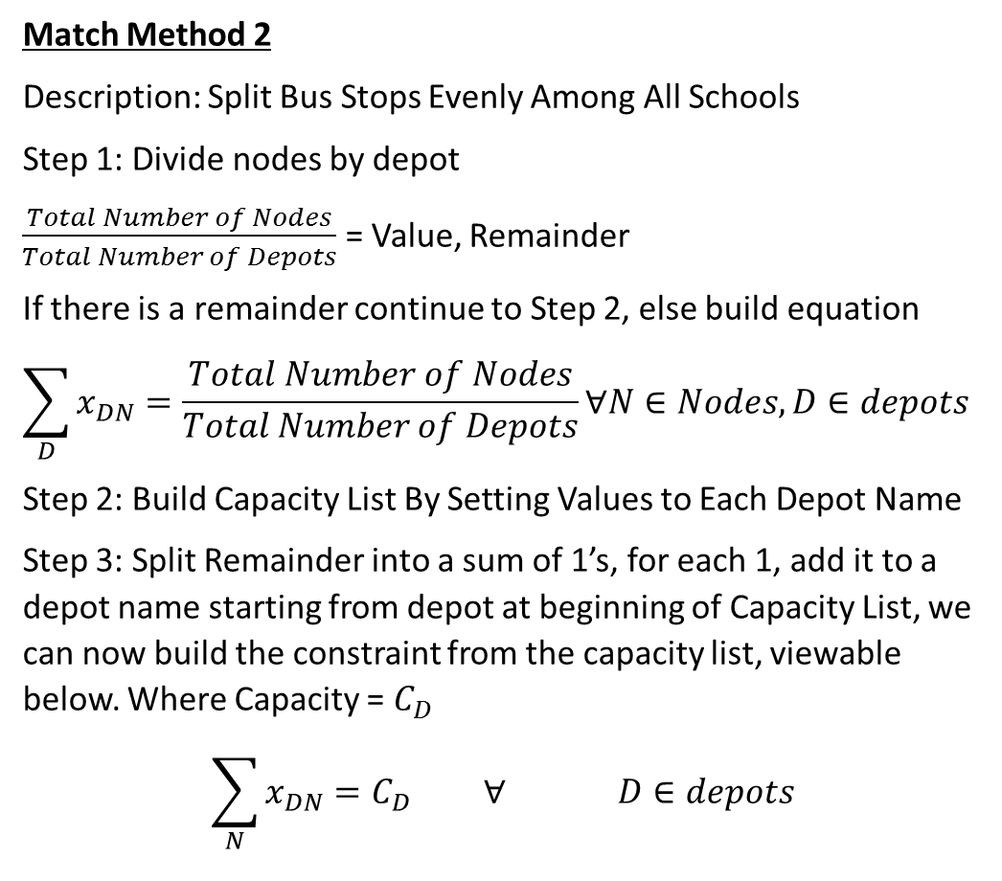
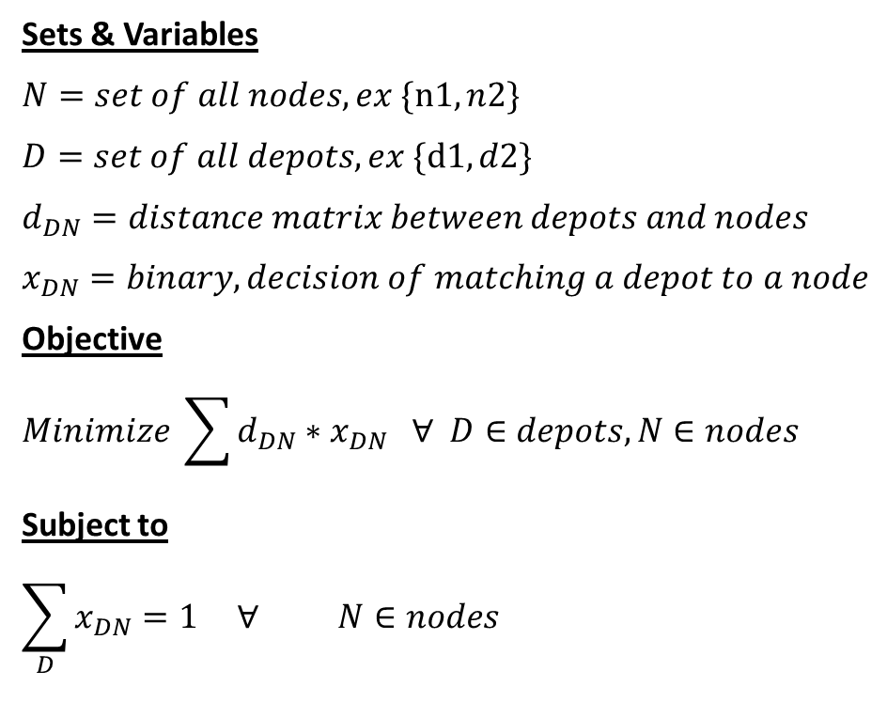
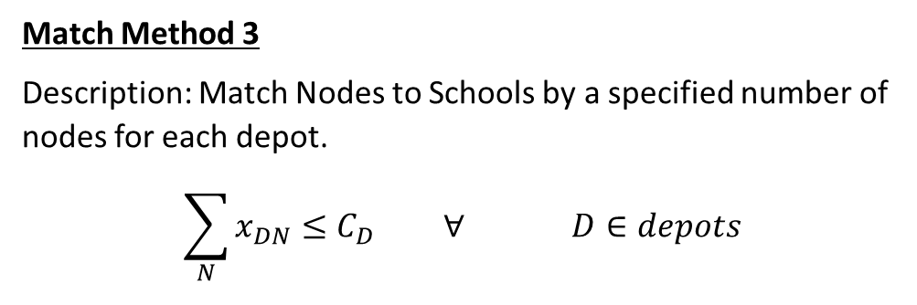
Match Algorithm
Match Method 2
Description: Split Bus Stops Evenly Among All Schools
Step 1: Divide nodes by depot
$\frac{Total Number of Nodes}{Total Number of Depots}$ = Value, Remainder
If there is a remainder continue to Step 2, else build equation
$$\sum_{D}{x_{DN}}=\frac{Total Number of Nodes}{Total Number of Depots}∀N∈Nodes,D∈depots$$
Step 2: Build Capacity List By Setting Values to Each Depot Name
Step 3: Split Remainder into a sum of 1’s, for each 1, add it to a depot name starting from depot at beginning of Capacity List, we can now build the constraint from the capacity list, viewable below. Where Capacity = $C_{D}$
$$\sum_{N}{x_{DN}}=C_{D} ∀ D∈depots$$
Sets & Variables
$$N=set of all nodes, ex \{\text{n}\text{1},n2\}$$
$$D=set of all depots, ex \{\text{d}\text{1},d2\}$$
$$d_{DN}=distance matrix between depots and nodes$$
$$x_{DN}=binary, decision of matching a depot to a node$$
Objective
$$Minimize \sum{{d_{DN}∗x}_{DN} ∀ D∈depots, N∈nodes}$$
Subject to
$$\sum_{D}{x_{DN}}=1 ∀ N∈nodes$$
Match Method 3
Description: Match Nodes to Schools by a specified number of nodes for each depot.
$$\sum_{N}{x_{DN}}≤C_{D} ∀ D∈depots$$
Match Method 1
Description: Match School to Closest Bus Stop
Add no additional constraints

Slide 9


Slide 10
The Depot Distance Matrix
(As a Sub Matrix of the Master Distance Matrix)
from gurobipy import *
depot_list = ["Reno","South Lake Tahoe"]
#"Reno", "South Lake Tahoe", "Carson City", "Garnerville", "Fernerly", "Tahoe City", "Incline Village", "Truckee"
dist = [[0, 59.3, 31.6, 47.8, 34.2, 47.1, 36.1, 31.9], #Reno
[62.2, 0, 27.9, 21.0, 77.5, 30.0, 27.1, 44.7], #South Lake Tahoe
[32.2, 27.7, 0, 16.2, 50.0, 39.4, 24.9, 42.6], #Carson City
[50.7, 21.0, 16.4, 0, 66.1, 49.7, 35.2, 52.9], #Garnerville
[34.4, 77.4, 49.6, 65.9, 0, 80.8, 67.1, 65.5], #Fernerly
[46.9, 30.1, 39.6, 49.7, 80.5, 0, 14.4, 15.0], #Tahoe City
[36.9, 27.1, 25.2, 35.2, 67.1, 14.4, 0, 17.6], #Incline Village
[31.9, 44.7, 62.8, 52.8, 65.6, 15.0, 17.6, 0]] #Truckee
The Depot List is highlighted in Green
Dist is the master distance matrix from all nodes to everywhere
The Sub Distance Depot to Node list is highlighted in Green
The Red cities is the part of the distance matrix that will not be used in the matching algorithm code

Slide 11
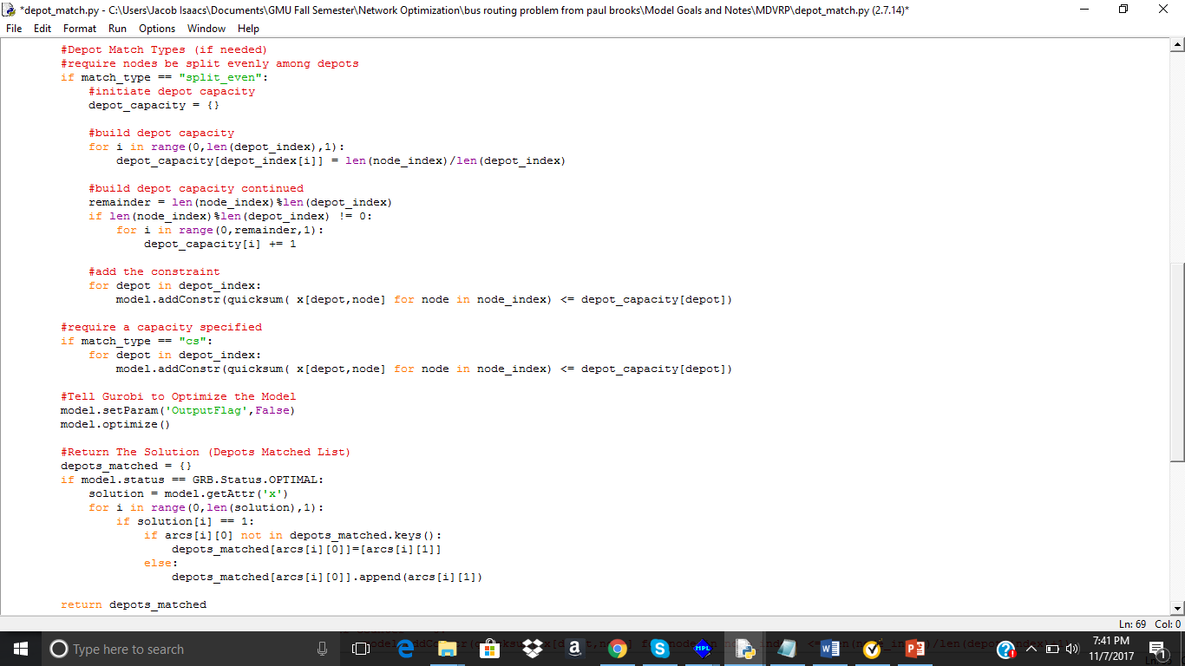
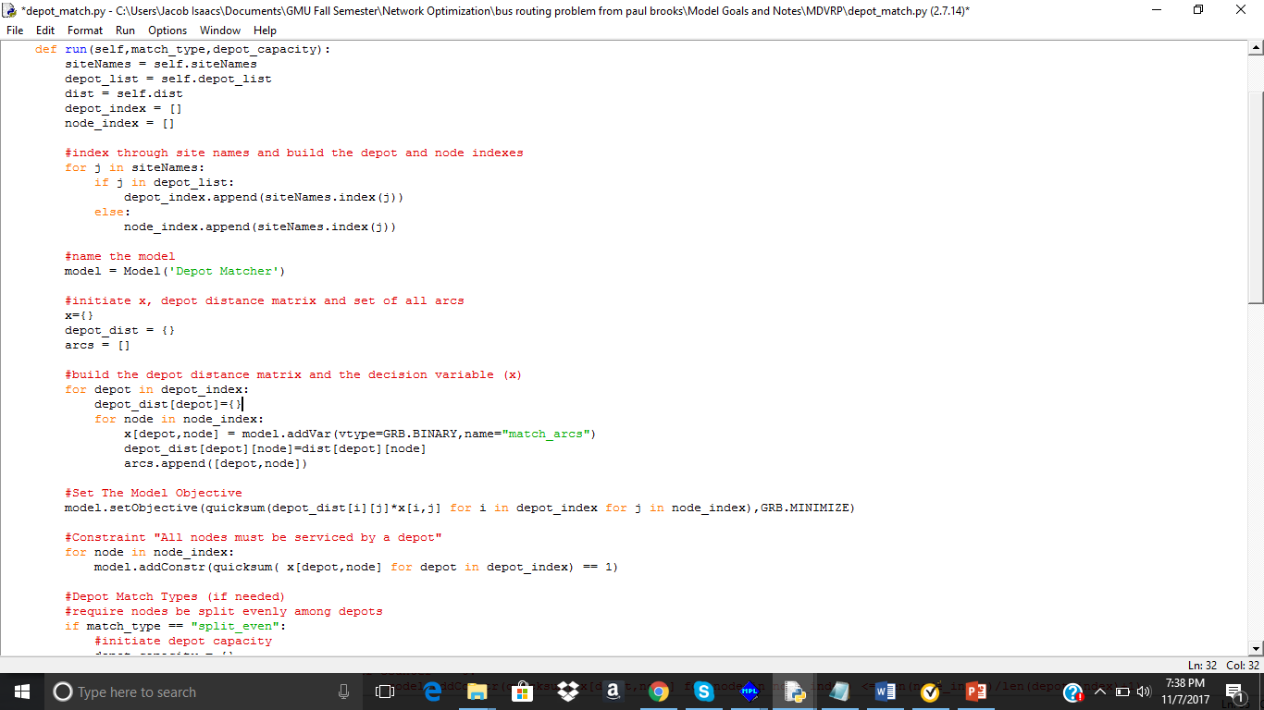
Match Algorithm Code

Slide 12
Solve Sub-VRP Problem
depot_list = ["Reno","South Lake Tahoe"]
#"Reno", "South Lake Tahoe", "Carson City", "Garnerville", "Fernerly", "Tahoe City", "Incline Village", "Truckee"
dist = [[0, 59.3, 31.6, 47.8, 34.2, 47.1, 36.1, 31.9], #Reno
[62.2, 0, 27.9, 21.0, 77.5, 30.0, 27.1, 44.7], #South Lake Tahoe
[32.2, 27.7, 0, 16.2, 50.0, 39.4, 24.9, 42.6], #Carson City
[50.7, 21.0, 16.4, 0, 66.1, 49.7, 35.2, 52.9], #Garnerville
[34.4, 77.4, 49.6, 65.9, 0, 80.8, 67.1, 65.5], #Fernerly
[46.9, 30.1, 39.6, 49.7, 80.5, 0, 14.4, 15.0], #Tahoe City
[36.9, 27.1, 25.2, 35.2, 67.1, 14.4, 0, 17.6], #Incline Village
[31.9, 44.7, 62.8, 52.8, 65.6, 15.0, 17.6, 0]] #Truckee
Sub 1 is in blue for Reno as the depot
Sub 2 is in red for South Lake Tahoe as the depot
This match was done via Method 1, closest node matches to depot
MATCH -> {0: [4, 7], 1: [2, 3, 5, 6]}

Slide 13
Sub Matrices Continued
VRP 1
Reno, Fenerly, Truckee
[[0, 34.2, 31.9], RENO
[34.4, 0, 65.5], Fenerly
[31.9, 65.6, 0]] Truckee
VRP 2
"South Lake Tahoe", "Carson City", "Garnerville", "Tahoe City", "Incline Village"
[[0, 27.9, 21.0, 30.0, 27.1], South lake
[27.7, 0, 16.2, 39.4, 24.9], Carson
[21.0, 16.4, 0, 49.7, 35.2], Garnerville
[30.1, 39.6, 49.7, 0, 14.4], Tahoe City
[27.1, 25.2, 35.2, 14.4, 0]] Incline Village

