Slide 1
Deep Learning for Intelligent Video Analytics

Slide 2
Course Perspective
Introduction to Intelligent Video Analytics
NVIDIA Endeavor Parking-Lot Case Study
TensorFlow Framework
Inference – Frame By Frame Detection
Performance Analysis
Data Preprocessing For Training
AGENDA
Notes:
I’ll start off by covering some of the popular use cases for intelligent video analytics and then go into the typical flow for building out these applications.
-Overvciew of the course

Slide 3
Course perspective

Slide 4
What this course is
✔
Discussion/demonstration of foundational elements of Intelligent Video Analytics (IVA) by acquiring deep learning models and algorithms and integrating them into a ready-to-use NVIDIA DeepStream pipeline.
In-depth discussions of data normalization, annotation, and metadata formatting in IVA applications.
Hands-on exercises using TensorFlow, Python and C for Deep Learning models and evaluation of object detection and tracking models for a parking lot management case study.
✔
✔

Slide 5
What this course is NOT
x
Not an intro to machine learning from the first principles
Not a rigorous mathematical formalism of deep neural networks
Not a survey of all the features and options of TensorFlow or DeepStream
x
x

Slide 6
What we hope you take away
You can format IVA data and associated annotations for the TensorFlow Object Detection API
Learn how to setup your own video object detection/tracking pipeline in TensorFlow and adapt it to your use-case more info.
Have an appreciation of what we can achieve by taking advantage of temporal video information using recurrent networks
You can assess the output in a rigorous quantitative manner
Learn how to accelerate the development of IVA applications by using the DeepStream framework

Slide 7
Course outline
1
Object Detection for
Intelligent Video
Analytics (IVA)
(150 minutes)
Learn the fundamentals of object detection methods in IVA applications, as well as preliminaries of raw data processing and metadata formatting. Get hands-on experience with the Object Detection API and learn how to measure accuracy and performance of he models using IoU metrics.
2
Using Transfer Learning
and Object Tracking Techniques in
IVA
(120 minutes)
Get familiar with the nuances of fine tuning an IVA application and learn about the implications of modeling. Understand how object detectors can be bootstrapped into your IVA application.
3
Deploying the Application Using NVIDIA
DeepStream
(150 minutes)
Learn to deploy the video analytics models into a ready-to-use video processing pipeline using DeepStream and understand the fundamentals of creating robust smart city applications. Learn about various plugins to embed into your pipeline, as well as NVIDIA’s dedicated video codec plugins.

Slide 8
Introduction To Intelligent Video Analytics

Slide 9
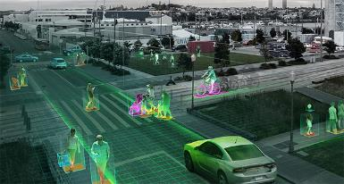
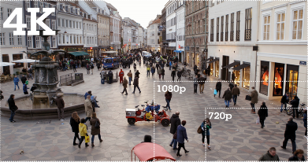
Why Intelligent Video Analytics?
One can get caught on cameras more than 75 times per day, resulting in 4 billion hours of video footage per week in the United States, which demands extremely efficient models for generating real-time actionable insights!
With increased pixel resolution, our photos are clearer than ever exposing details we never knew existed, but also resulting in increased data rates, larger image sizes, and bigger pixel counts
Classic video processing models can neither handle the load, nor the required accuracy of online video stream processing
Deep Learning has proven to provide the most efficient and accurate video analytics results

Slide 10
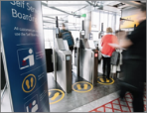
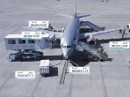
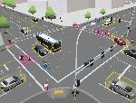
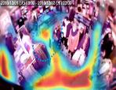
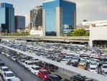
Examples of IVA Applications
Frictionless Access Control
Faster boarding for airplanes and trains and determining the occupancy of transportation carriages
Logistics and Cargo Companies
Keep better track of metrics such as how long it takes to load cargo onto an airplane and identify areas of inefficiency
Traffic Flow Management
Understanding the flow of traffic through intersections to better design roadways and reduce traffic congestion
Retail and Merchandising
Optimization
Understand customer behavior to provide richer experiences and optimize store layouts
Parking Lot Management
Making parking management more efficient by minimizing the search for an open spot and more accurately determining the duration that a space is occupied
Notes:
Meaningful insight can be gleaned from the video and we are starting to see several interesting use cases that can benefit such as:

Slide 11
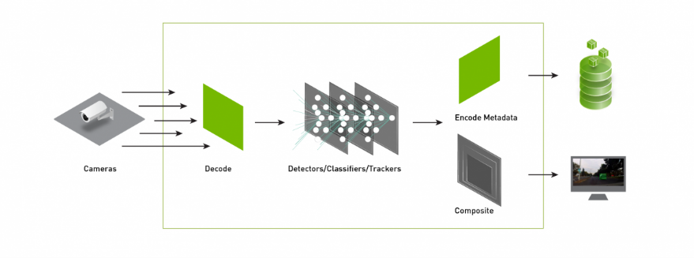
Typical IVA pipeline
Deep Learning models for extracting actionable insights such as number of cars in the scene, heatmap of a store or spare parking spots
Display/store the inferred metadata to turn the generated insights into proper actions!
Input source could be one or multiple online/camera streams or stored video files
Video streams and the generated meta-data (e.g. count of cars) need to be combined and sent for further actions. If displayed on the screen, we need to encode the streams back to a playable format (e.g. h264)
Cameras and video files are encoded binary data that require decoding before getting passed into DL models (DL models usually require uncompressed YUV/RGB inputs)
Notes:
Modern Artificial Intelligence techniques like deep learning can help transform video into meaningful insights at scale.
Deep Learning allows solutions to be deployed across a variety of difficult conditions like rain, snow and dynamic lighting conditions.We’ve come to understand that all of these applications utilize a common architecture and basic building blocks.
This includes
:collecting video and image data from various sources
decoding bitstreams
pre-processing like resolution scaling or colorspace conversion
running many neural networks for extracting insightse
ncoding and visualizing the data.

Slide 12
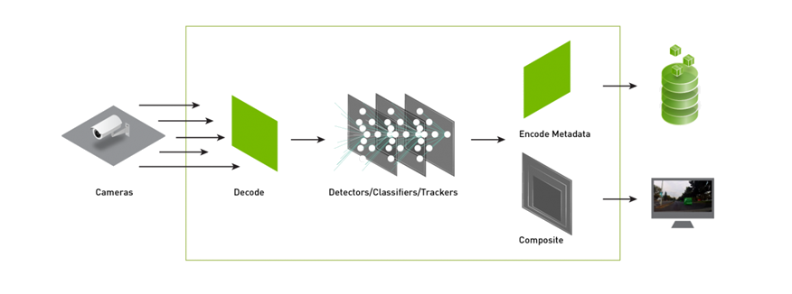
Typical IVA pipeline
The first and second parts of this course focus on utilizing and training deep learning models for video object detection and tracking purposes

Slide 13

Typical IVA pipeline
In the third section of this course, you will learn how to create a full end-to-end pipeline using the NVIDIA DeepStream SDK

Slide 14
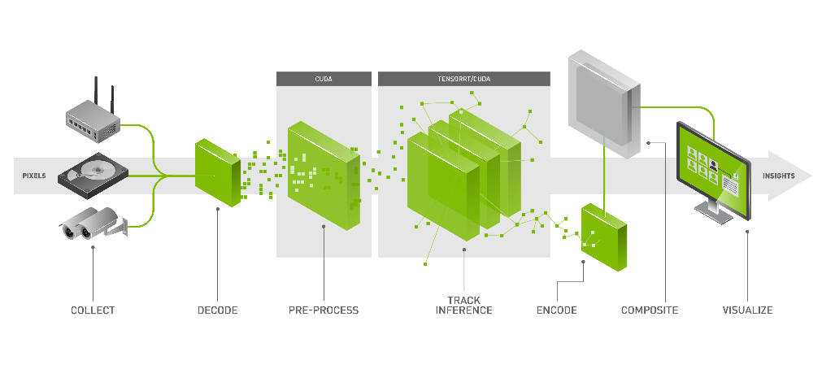
Accelerated Elements of the IVA pipeline powered by NVIDIA

Slide 15
NVIDIA Endeavor Parking Lot Case-study

Slide 16
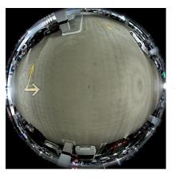
Dataset and application
NVIDIA Endeavor Parking Dataset
In this course, we use 360-degree fish-eye camera feeds mounted on the ceiling of NVIDIA headquarter in order to detect and track traffic flow at the entrances and exits of the parking lot.
The video files are recorded using omnidirectional cameras. These raw video streams are not useful for our video processing task, since all the straight lines are curved, and the video files are required to be unwarped.

Slide 17
Dataset and application
NVIDIA Endeavor Parking Dataset
Within the first two sections of this course, we work on the unwarped video streams (already preprocessed). In section 3, we learn how to unwarp the 360 video streams using the DeepStream SDK to build an end-to-end IVA pipeline.

Slide 18
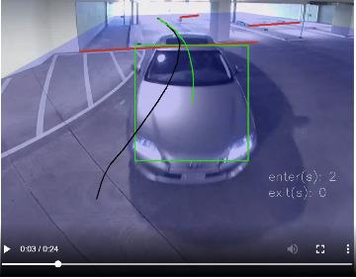
Dataset and application
NVIDIA Endeavor Parking Dataset
Due to environmental conditions like parking-lot illumination, occlusion of the cars and camera positioning on the ceiling, even the unwarped video streams are difficult to process.
In this course, we will learn how to choose a deep learning model, and apply “Transfer Learning” to improve the quality of inference.
Throughout this course, we create an application to track and tag cars at entrances and exits of the parking garage.

Slide 19
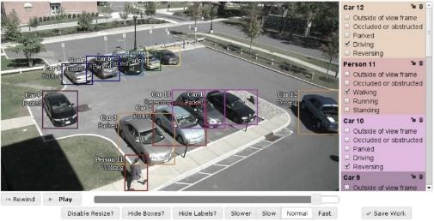
Dataset and application
Data Annotation
In addition to video feeds, we need labels to evaluate the inference results (compare the actual objects to those detected by our deep learning models), and also to expand the ground truth data for training purposes(discussed in section two).
There are several proprietary and open source image mark-up tools. All videos used in this course are annotated using Vatic.

Slide 20
Dataset and application
Data Annotation Sample

Slide 21
TensorFlow

Slide 22
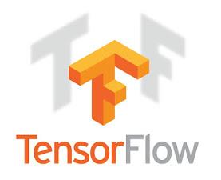
TensorFLOW, a brief review
Created by Google, tensorflow.org
Throughout this course, we use TensorFlow for inference, training and some visualization. Our choice of deep learning framework is based on the following properties of TensorFlow:
Generic: express computation as a data flow graph.
Flexible: very few limitations; if you can express computation as data flow graph then it can be computed in TF.
Portability: CPUs and GPUs, workstation, server, mobile.
Language options: Python and C++
Performance: Tuned for performance on CPUs and GPUs. Assign tasks to different hardware devices. Uses CUDNN
TensorFlow, the TensorFlow logo and any related marks are trademarks of Google Inc.

Slide 23
TensorFlow, a brief review
Construct a graph: this happens before any real computation happens. Specify your neural network as a graph with the following elements:
Variables: characteristics of the graph that can change over time, i.e., learned weights.
Operations—computations that combine the variables and the data, e.g., convolution, activation, matrix multiply, etc.
Launch a session. This is TF verbiage for executing a graph. That is, binding data with a graph computation.

Slide 24
TensorBoard
TF has a UI tool for visualize training progress. Plots of loss, learning rate, accuracy; visualize computation graph.
TensorBoard is extremely useful to aggregate training and evaluation statistics for clear analysis of the model behavior.

Slide 25
Inference – Frame By Frame Detection

Slide 26
TensorFlow object detection aPi
Detection Model Zoo
The TensorFlow Object Detection API is an open source framework built on top of TensorFlow that makes it easy to construct, train and deploy object detection models
Open source framework
Built on top of TensorFlow
Enables the ability to construct, train and deploy object detection models
Contains several object detection models
We will focus on:
Single Shot Detection (SSD) with Inception V2
Faster R-CNN ResNet 101
Faster R-CNN NasNet `

Slide 27
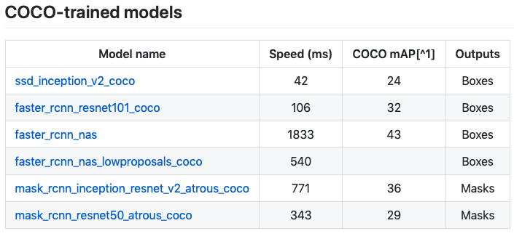
TensorFlow object detection aPi
Detection Model Zoo
Notes:
COCO is a large-scale object detection, segmentation, and captioning dataset. COCO has several features:
Object segmentation
Recognition in context
Superpixel stuff segmentation
330K images (>200K labeled)
1.5 million object instances
80 object categories
91 stuff categories
5 captions per image
250,000 people with keypoints

Slide 28
Faster r-cnn resnet 101
Faster-RCNN has a more complex architecture since it has more moving parts and separate pieces compared to SSDs.
Unlike the SSD network, In Faster-RCNN, localization and classification tasks are performed in different networks.

Slide 29
Single shot detection (ssd)
Single-Shot Multibox Detector networks (SSD), combine the bounding-box localization and classification task in a single forward pass of the network.
SSDs are built on top of their predecessor, the VGG-16 architecture, where the fully connected layers are replaced by a series of new convolutional feature extraction layers, each outputting a series of k* bounding boxes (based on *prior information) and their respective bounding boxes coordinates.
Notes:
Single Shot: this means that the tasks of object localization and classification are done in a single forward pass of the network
MultiBox: this is the name of a technique for bounding box regression developed by Szegedy et al.
Detector: The network is an object detector that also classifies those detected objects

Slide 30
Faster-RCNN with Nasnet
One of the most accurate models build so far achieving 82.7% on ImageNet validation set above all previous Inception models.
NasNet use an approach called AutoML to find the best layers that work well with the underlying dataset. In the case of NanNet, the results of applying AutoML to COCO and ImageNet are combined to form the NasNet Architecture
Notes:
892.7 is top 1 accuracy

Slide 31
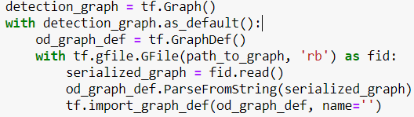

Detection Code walk-though
1
import a serialized TensorFlow GraphDef protocol buffer, and extract individual objects in the GraphDef as tf.Tensor and tf.Operation objects.
2
Use OpenCV to read image data
3
Why expanding input dimensions?
Notes:
Provides precision, recall and accuracy; however, not comprehensive enough for tracking purposes. Kalman filter and CLEAR MOT will address the short comings of IoU.

Slide 32
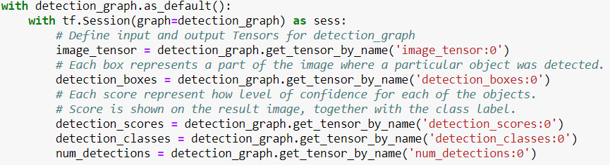
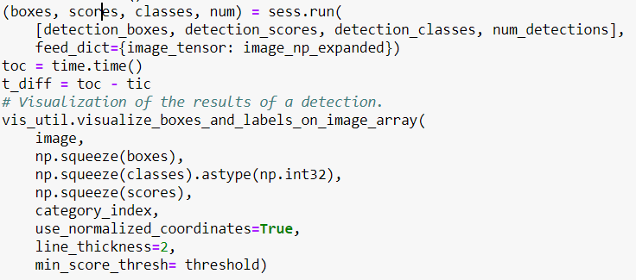
Detection Code walk-though
4
Specify output tensor names
5
Run the session and get results
Notes:
Provides precision, recall and accuracy; however, not comprehensive enough for tracking purposes. Kalman filter and CLEAR MOT will address the short comings of IoU.

Slide 33
Performance Analysis

Slide 34
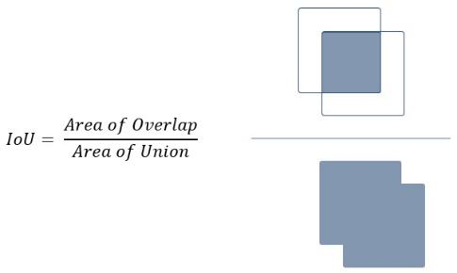
Detection metrics
Intersection over Union
Ground Truth
In order to determine how the model has performed quantitatively, we must consider the IoU (Intersection over Union) calculations.
For object detection, it is wise to calculate IoU when the detection score is above a fixed threshold. Otherwise, in this case, every box from the proposals will be considered.
Detection
Notes:
Provides precision, recall and accuracy; however, not comprehensive enough for tracking purposes. Kalman filter and CLEAR MOT will address the short comings of IoU.

Slide 35
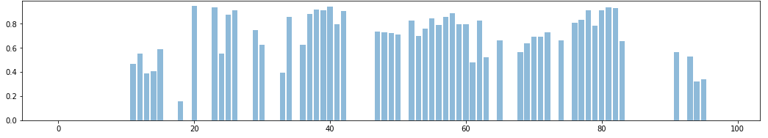
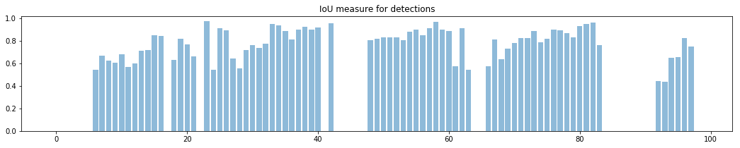
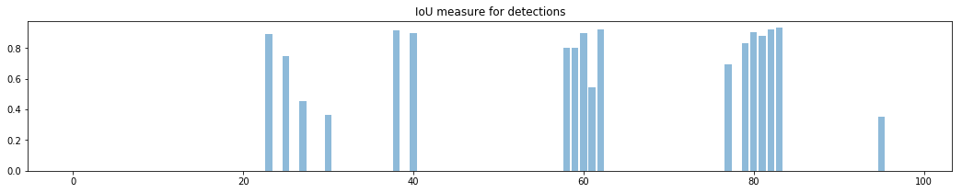
IoU results over 100 frames for the three Models
RCNN-ResNet
RCNN-NasNet
SSD-INCEPTION V2
Notes:
Provides precision, recall and accuracy; however, not comprehensive enough for tracking purposes. Kalman filter and CLEAR MOT will address the short comings of IoU.

Slide 36
Data Preprocessing For Training

Slide 37
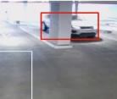
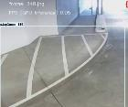
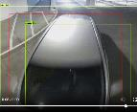
FINE-TUNING / Retraining THE NETWORK
The RCNN-ResNet seems to make good balance between throughput and accuracy, but:
The occluded cars are not detected accurately
There are other detected classes (Aeroplan!?) that we are not interested in detecting.
When approaching the bottom of the screen, the RCNN model fails to detect the cars
In addition, can we improve the IoU values?

Slide 38
FINE-TUNING / Retraining THE NETWORK
To improve the detection quality, we are going to examine re-training / fine-tuning detection models in the next lab.
But, first, we need to prepare the annotated data for model ingestion during training.
The current labels are raw and include a lot of “noisy” bounding boxes
They do not have the correct aspect ratios
Many of the frames are redundant
The raw image format is not efficient for training Neural Nets in TensorFlow. We should consider changing them into “TFRecords”

Slide 39
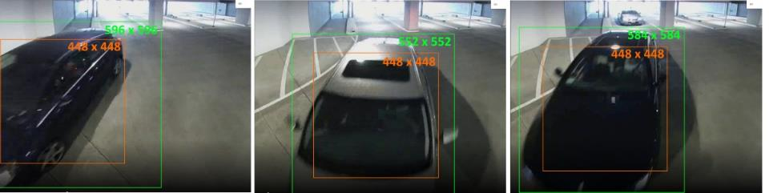
Crop and Normalize the Annotations
The model we are using, requires a fixed width input of 448 x 448 pixels
The object dimensions are sometimes larger than crop size and need to be normalized

Slide 40
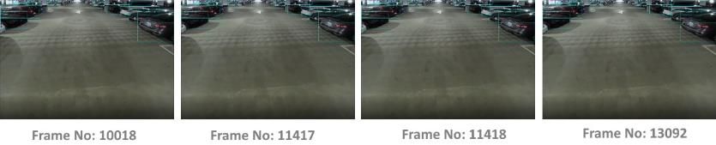
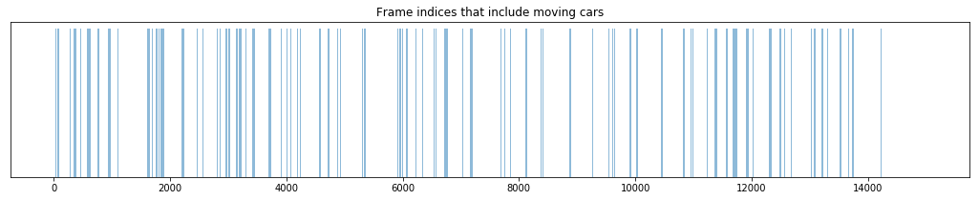
Data preprocessing
Many of the frames include no moving vehicles, and are identical
What problems may this cause?

Slide 41
Convert Data into TFRecords
TFRecord is binary format for storing TensorFlow datasets in binary formats. This allows a compact representation of the data as well as increased performance for data retrieval and memory management.
Since TFRecords store data in binary format, we need to provide data in structured format.
We are going to create two sets of training and validation TFRecords
The number of output classes is reduced to a single vehicle class

Slide 42
STARTING the lab

Slide 43
Challenges of the dataset
Methods to increase performance
IoU measure remarks
Break 1

Slide 44
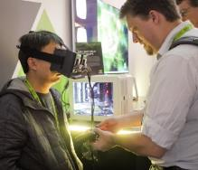
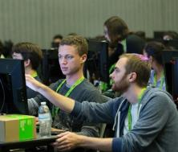
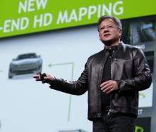
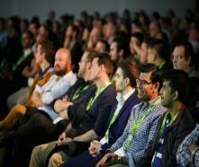
www.gputechconf.com
ADVANCE YOUR DEEP LEARNING TRAINING AT GTC
Don’t miss the world’s most important event for GPU developers
DFSFSD
Notes:
One of the best ways to quickly master deep learning is to attend the GPU Technology Conference, or “GTC”.
This year we’re hosting GTC the 2nd week in May, here in Silicon Valley, and I hope you’ll join us.
Over 300 of the 500 sessions this year will be focused on AI and Deep Learning. At the conference, you will hear from experts across a wide range of industries as well as academic and government organizations sharing their work on applications in Healthcare, Automotive, Finance, Aerospace, Defense, Retail, Manufacturing, and more.
You can also be among the first to experience more than 20 brand new hands-on training labs presented by the Deep Learning Institute and leading framework developers including Cafe2, Chainer, CNTK, MATLAB, MXNET, TensorFlow, and Theano.
Key speakers are coming from NVIDIA, Google, Amazon, Microsoft, Walmart, Facebook, IBM Watson, Salesforce, Boeing, Ford, Baidu, Alibaba, Tencent, OpenAI, Stanford, MIT, Oxford, University of Toronto, several national labs and, well, I’ll stop there but the list goes on. GTC is really the only place where you can connect 1:1 with so many experts across so many industries.
Register today using the code you see on the screen to save 20% and check out the web site for special education, government and nonprofit rates.

