Slide 1
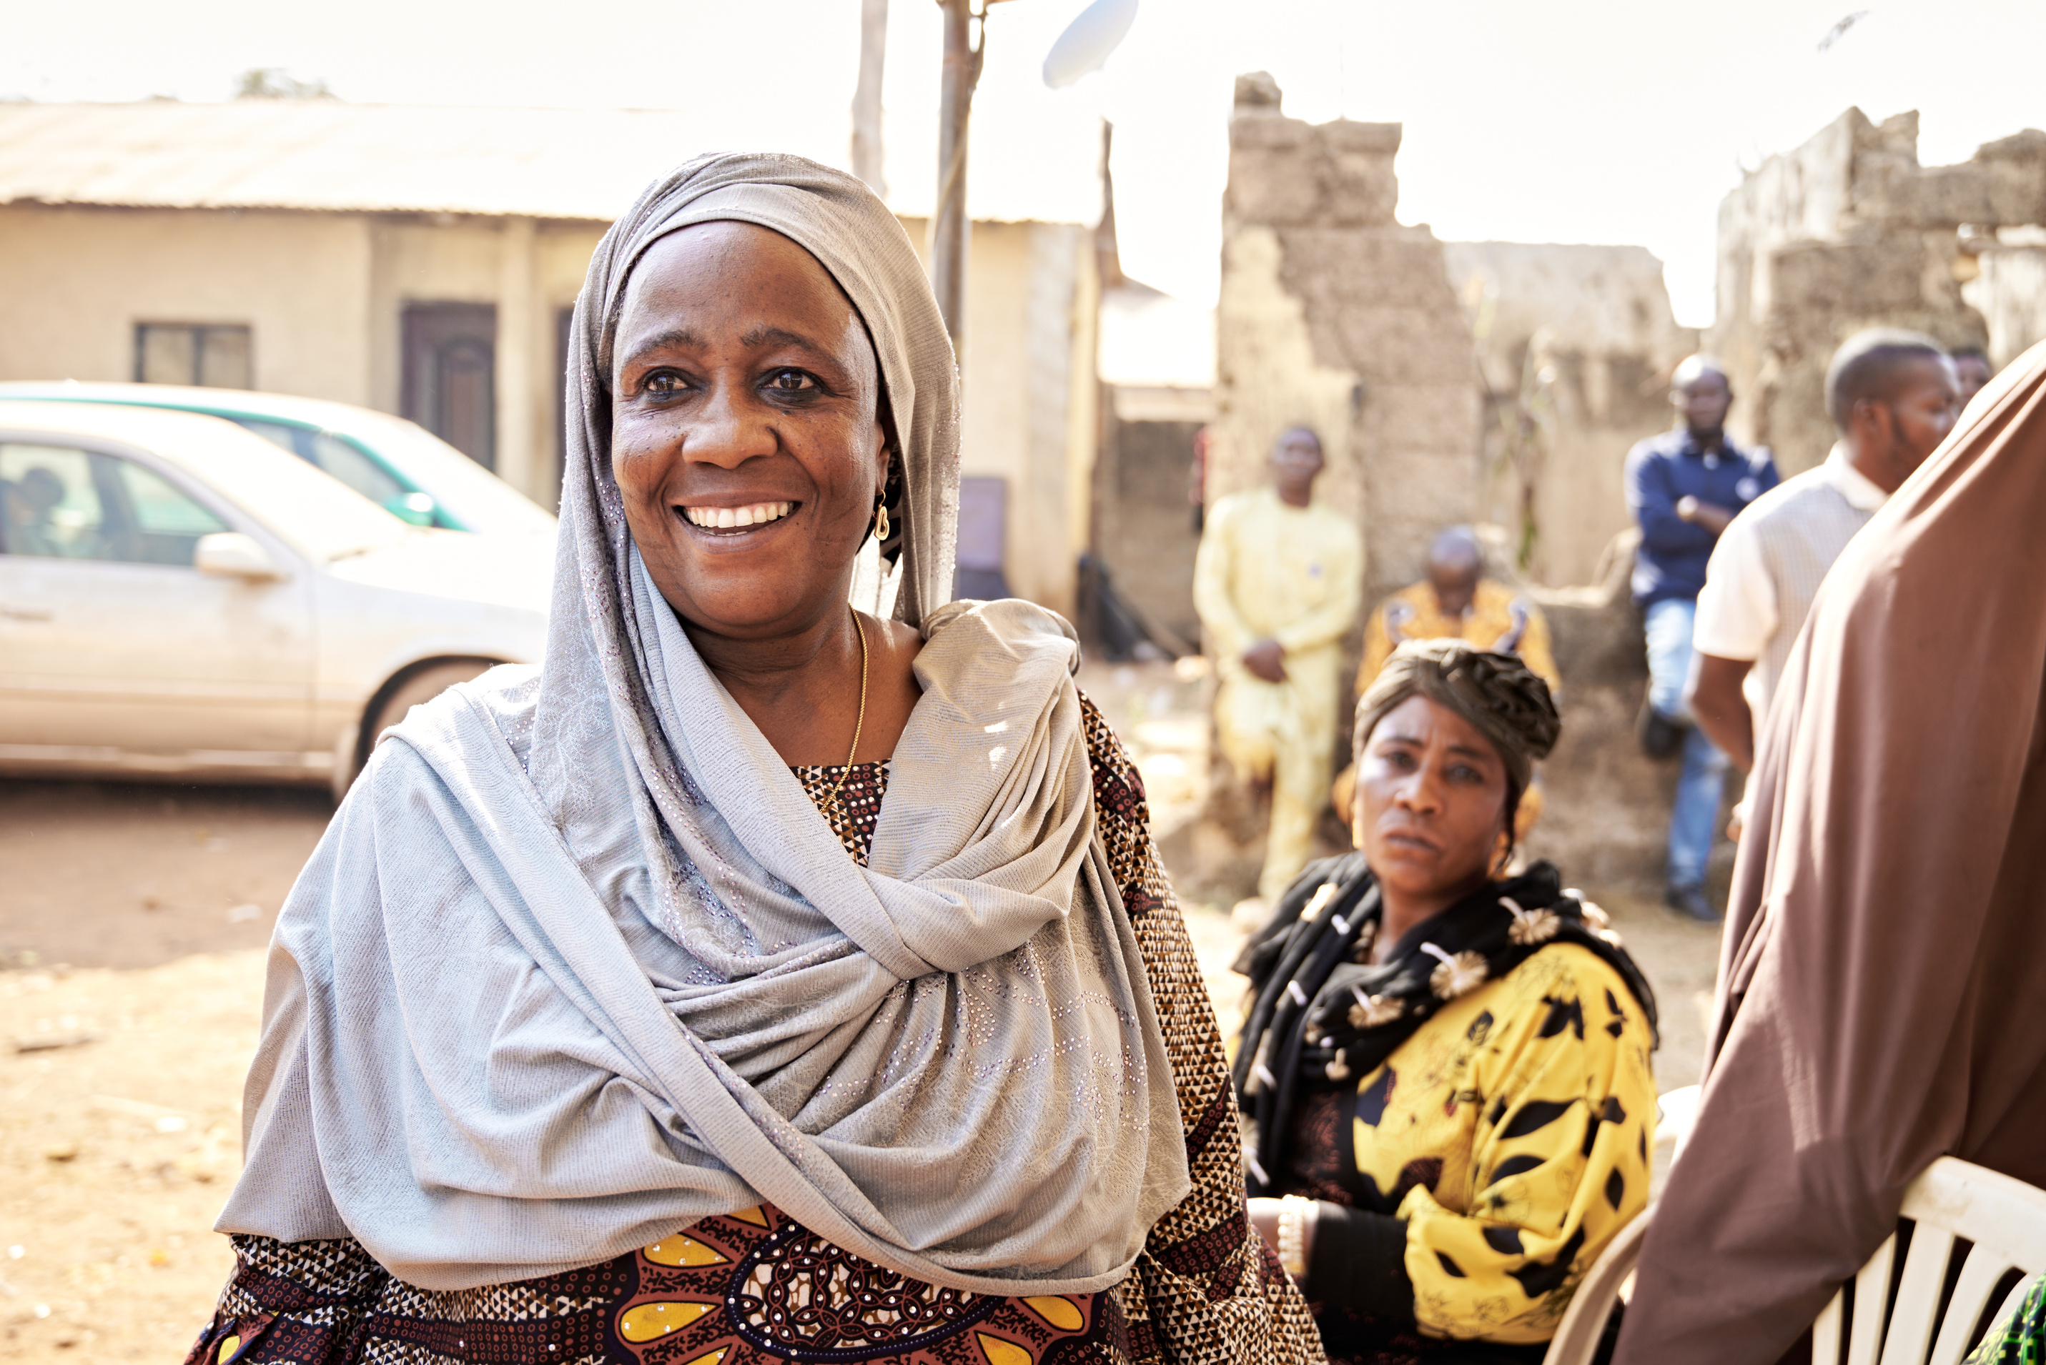

Partners Worldwide in Nigeria
From the Network to Homerun Industries: a briefing for our prospective Business Affiliate team
Jeremiah Akoyere · Partnership Manager

Slide 2

Where We're Headed
Three acts: the network, the spotlight, and your part in it
01
02
03
PW in Nigeria
Spotlight: Homerun Industries
Your Role as a BA
Who we are, our model, and the six Local Community Institutions (LCIs) already active across the country.
A renewable-energy agro-processing cluster: the opportunity, the progress so far, and what it still needs.
What a Business Affiliate does, and what that could look like for a team walking alongside Homerun.

Slide 3
ACT 1 -- PW IN NIGERIA
Who We Are
Partners Worldwide, in our own words
“
We aspire to end poverty, so that all may have life and have it abundantly.
VISION
We mobilize long term, hands-on global relationships to form a powerful Christian network that uses business as the way to create flourishing economic environments in all parts of the world.
MISSION
Poverty is not God's design
God desires everyone to flourish
Business is a holy, spiritual calling
Business is essential to ending poverty
God works through partnership
Business should be redemptive

Slide 4
ACT 1 -- PW IN NIGERIA
Our Model
Three roles, one partnership
Local Community
Institution (LCI)
Business Affiliate
(BA)
Partners Worldwide
(PW)
Our term for our local partners: independent, locally-owned and led organizations working to end poverty through business in their own communities.
Passionate individuals and groups of volunteers who collaborate with LCIs to develop concrete plans, share expertise, and provide financial support and spiritual encouragement.
Our global team is the catalyst for our network: we identify new LCIs, orient and equip BAs, facilitate partnerships, and grow the network.

Slide 5
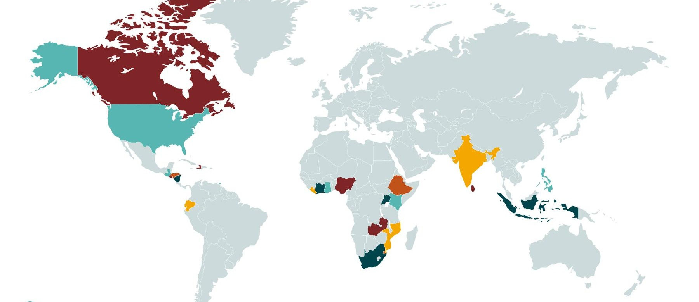
ACT 1 -- PW IN NIGERIA
A Global Network
Fiscal year 2024/25, as of June 30, 2025
47,844
Jobs created
707,666
Jobs sustained
289,562
Client businesses / farms
23,005
Graduates of business
& agricultural training
As of June 30, 2025, PW created 61% more jobs globally than in June 2024.

Slide 6
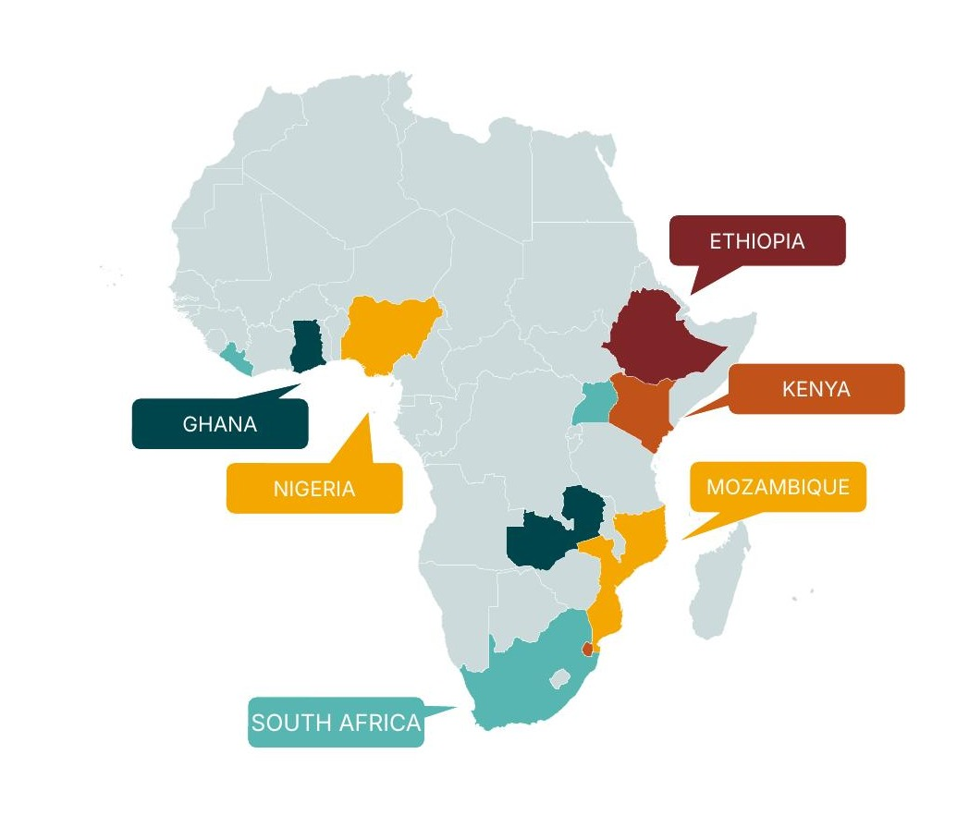
ACT 1 -- PW IN NIGERIA
Nigeria: The Context
A large population and economy, with real room to grow inclusively
228M
$363B
15.3%
40%
Population
GDP
Unemployment rate
Poverty rate
Nigeria is Africa's largest economy and most populous country -- but unemployment and poverty remain high. That combination is exactly where PW's model works best: using business, not aid, to build durable pathways out of poverty.
Macroeconomic indicators per PW Nigeria country materials.

Slide 7
ACT 1 -- PW IN NIGERIA
PW in Nigeria, By the Numbers
Seven LCIs. One growing network.
7
90,000
124,000
Local Community
Institutions (LCIs)
Businesses reached
Jobs
+2,500
3
3
People trained
LCIs with an active
BA team
BA teams
Only 3 of our 7 Nigeria LCIs currently have a Business Affiliate team walking with them. Homerun's prospective BA team would be the fourth.

Slide 8
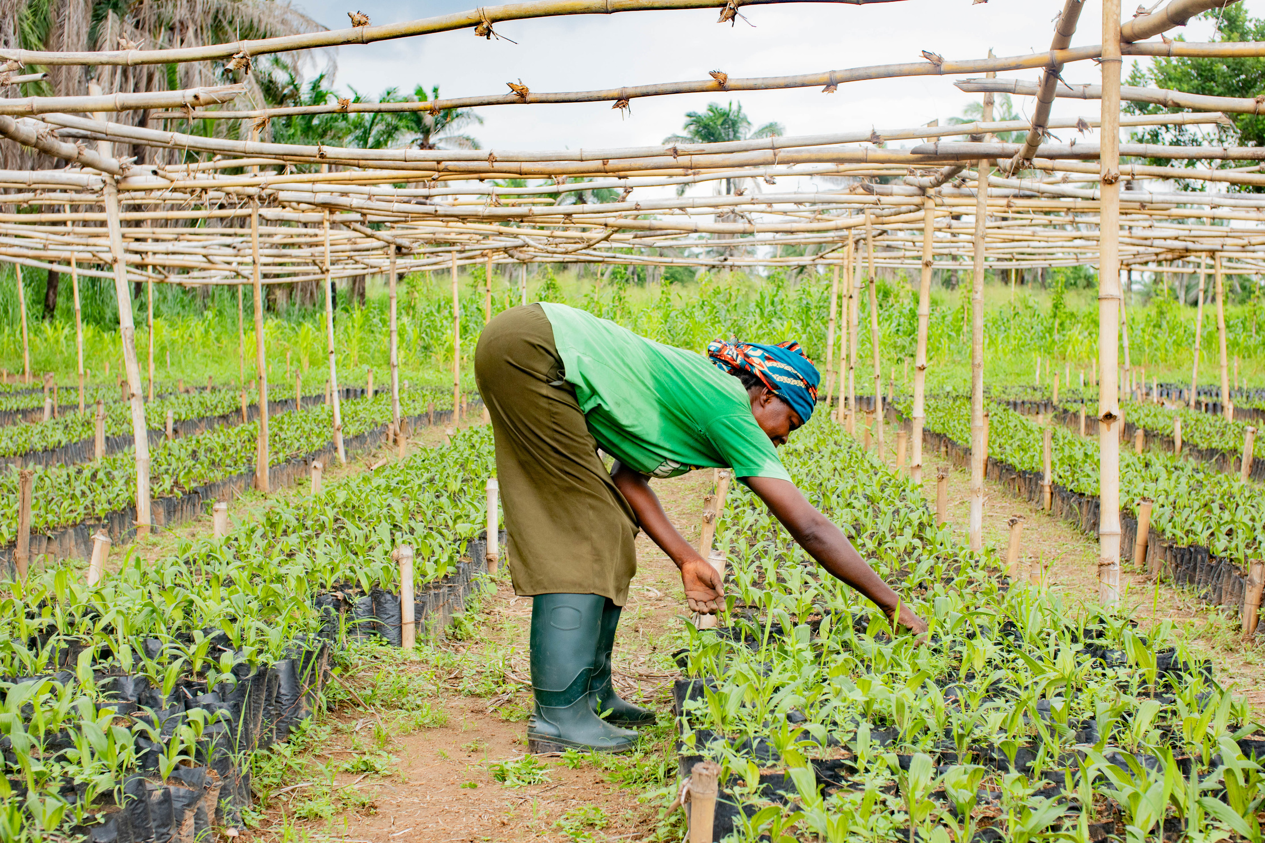
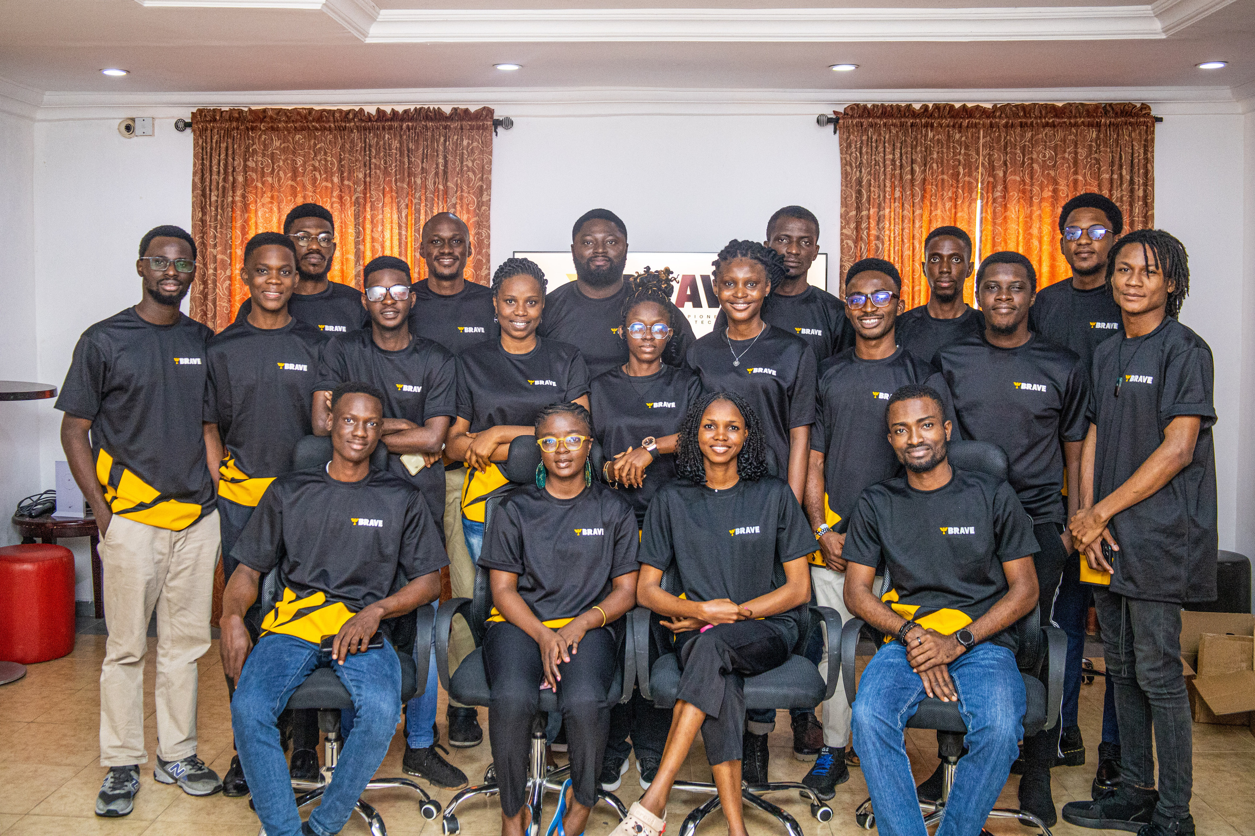
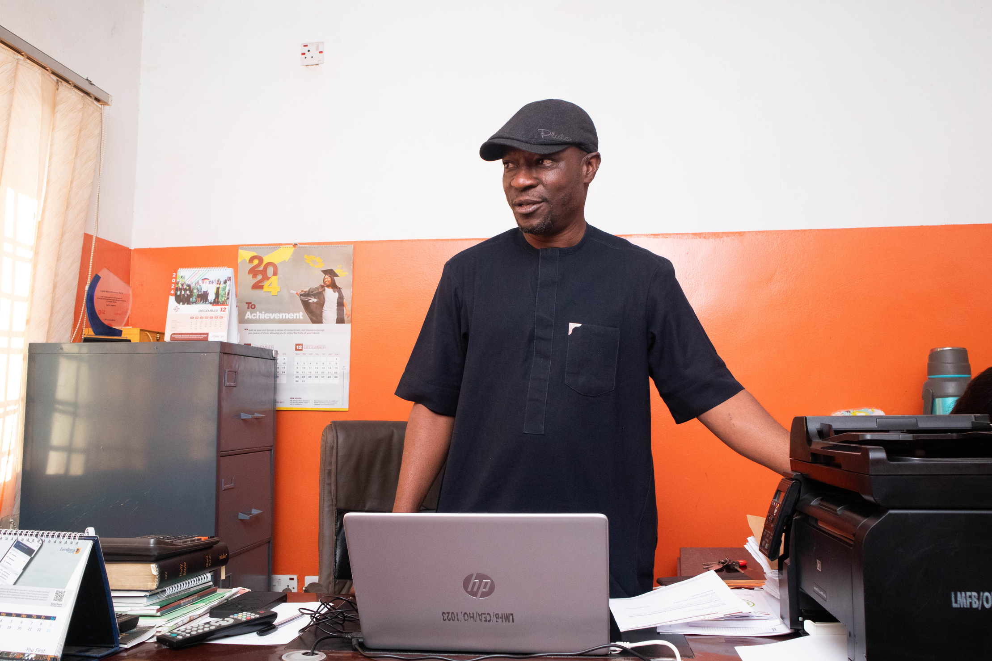
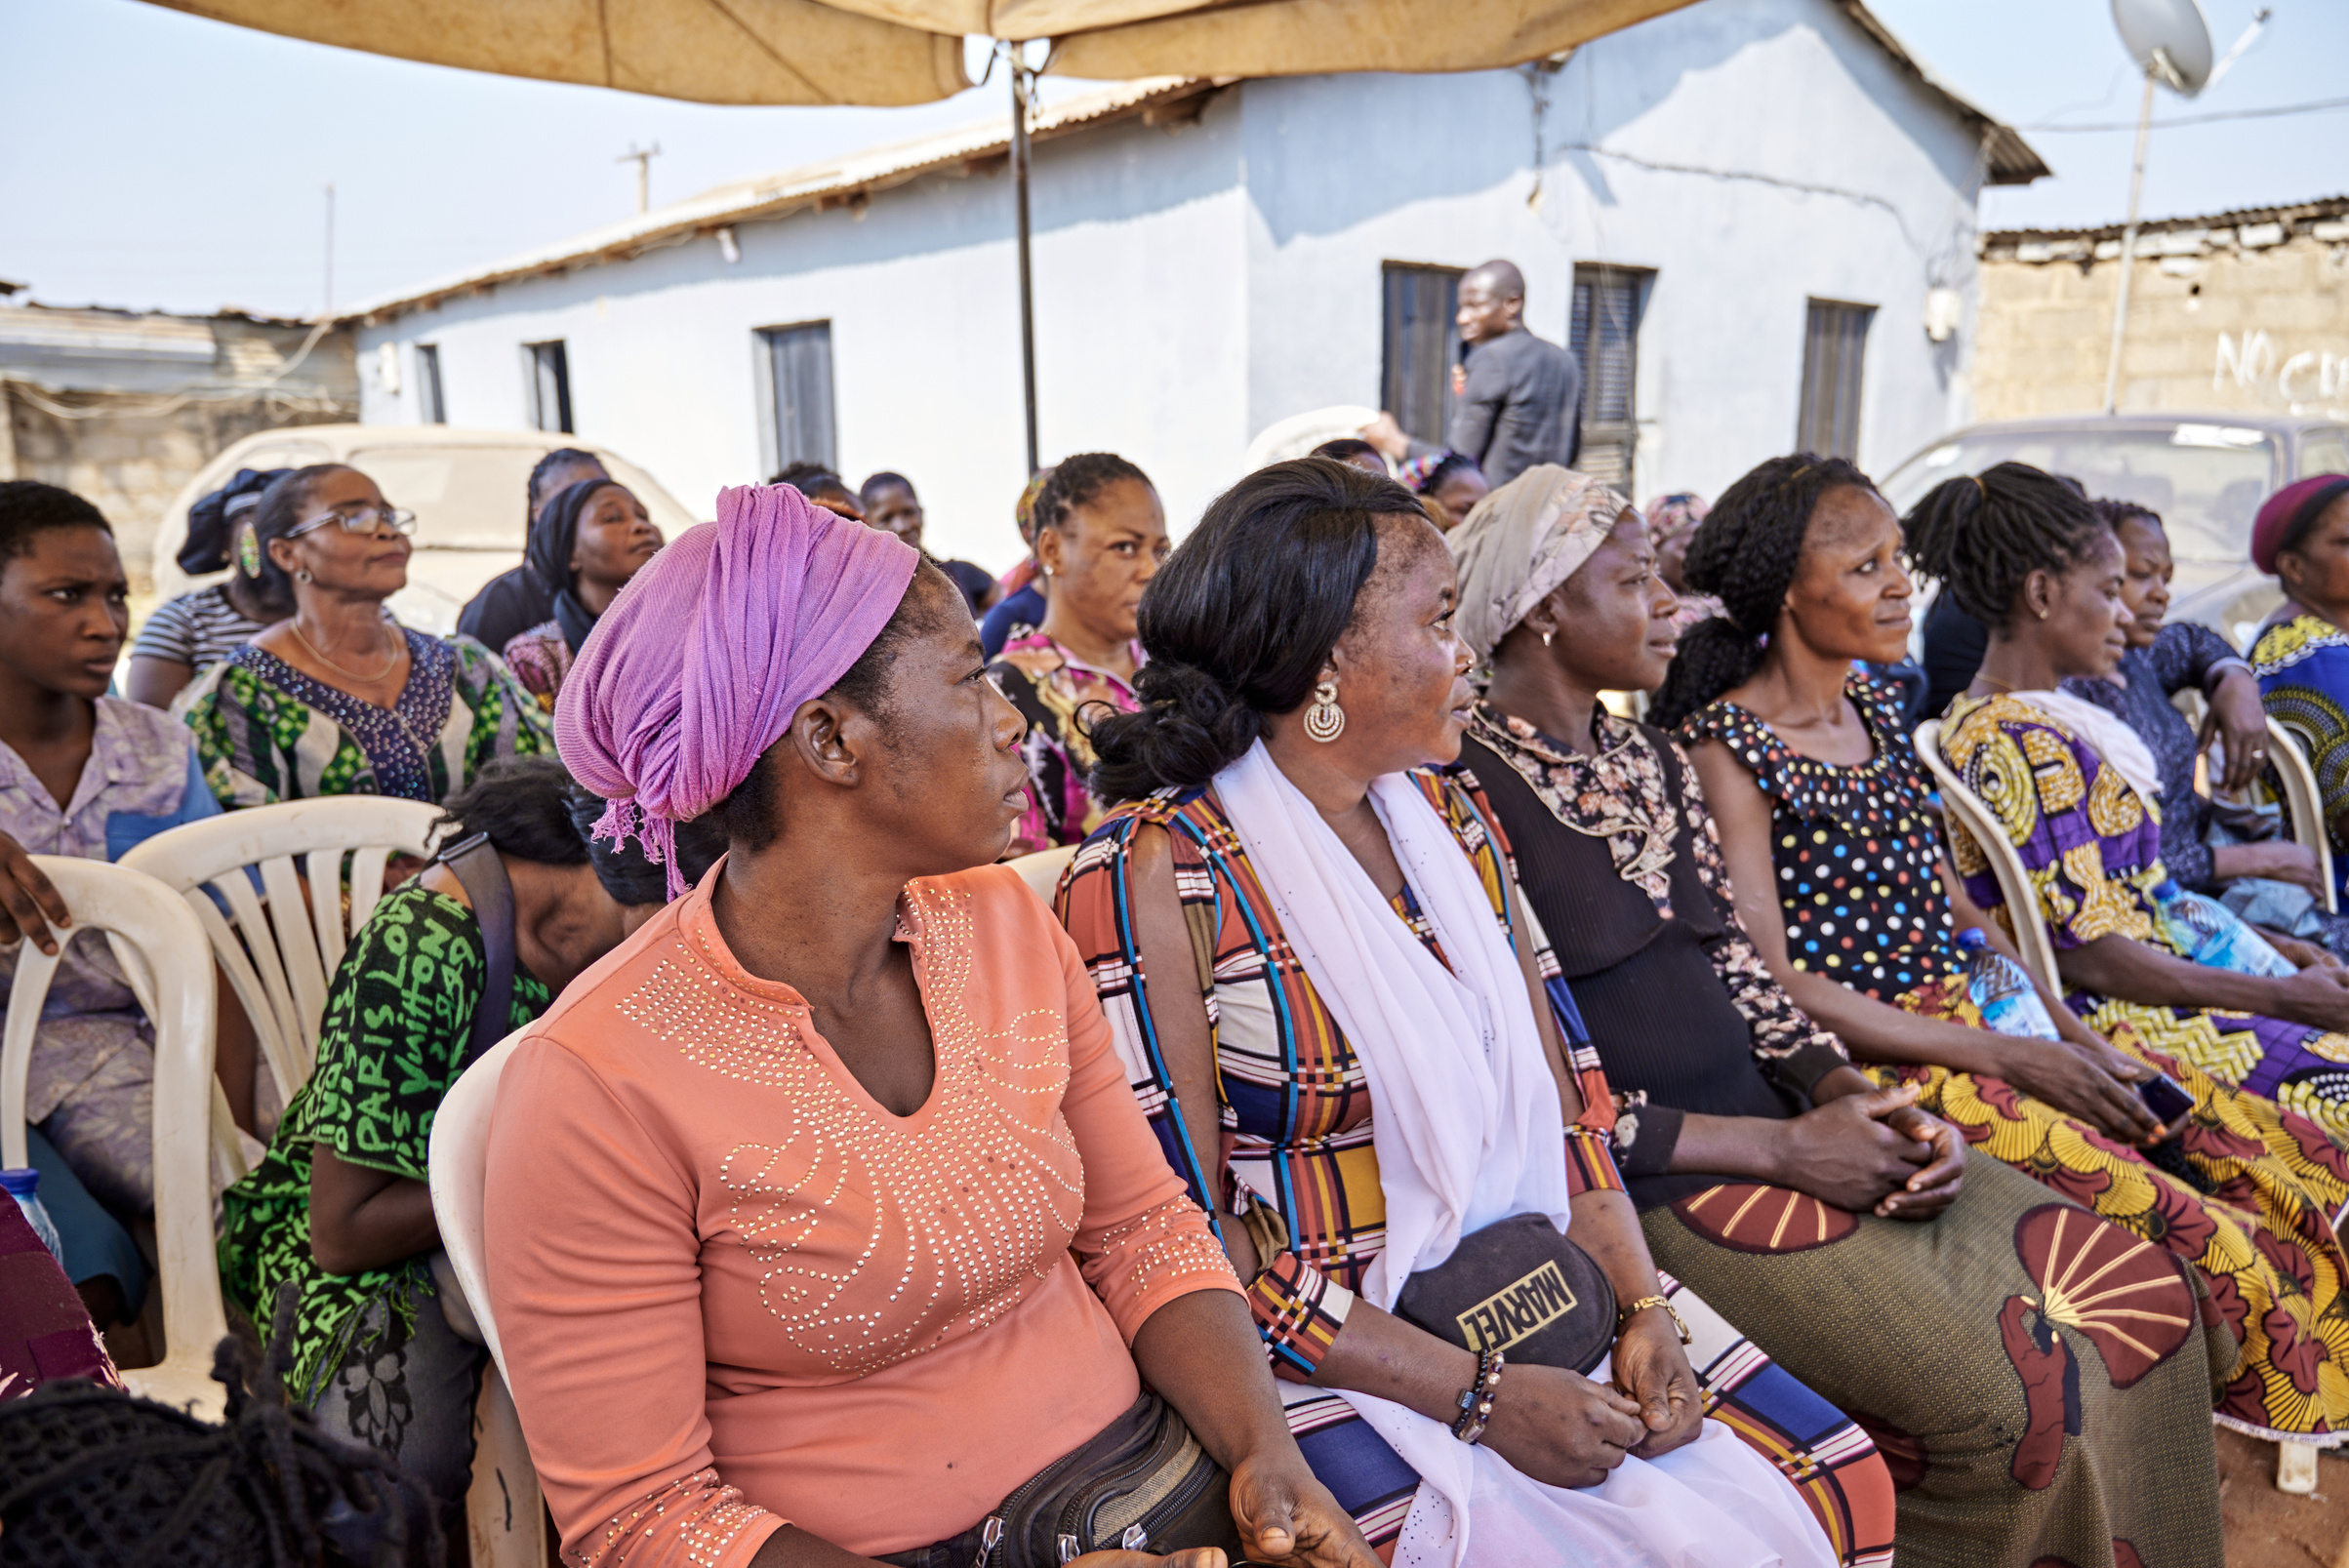
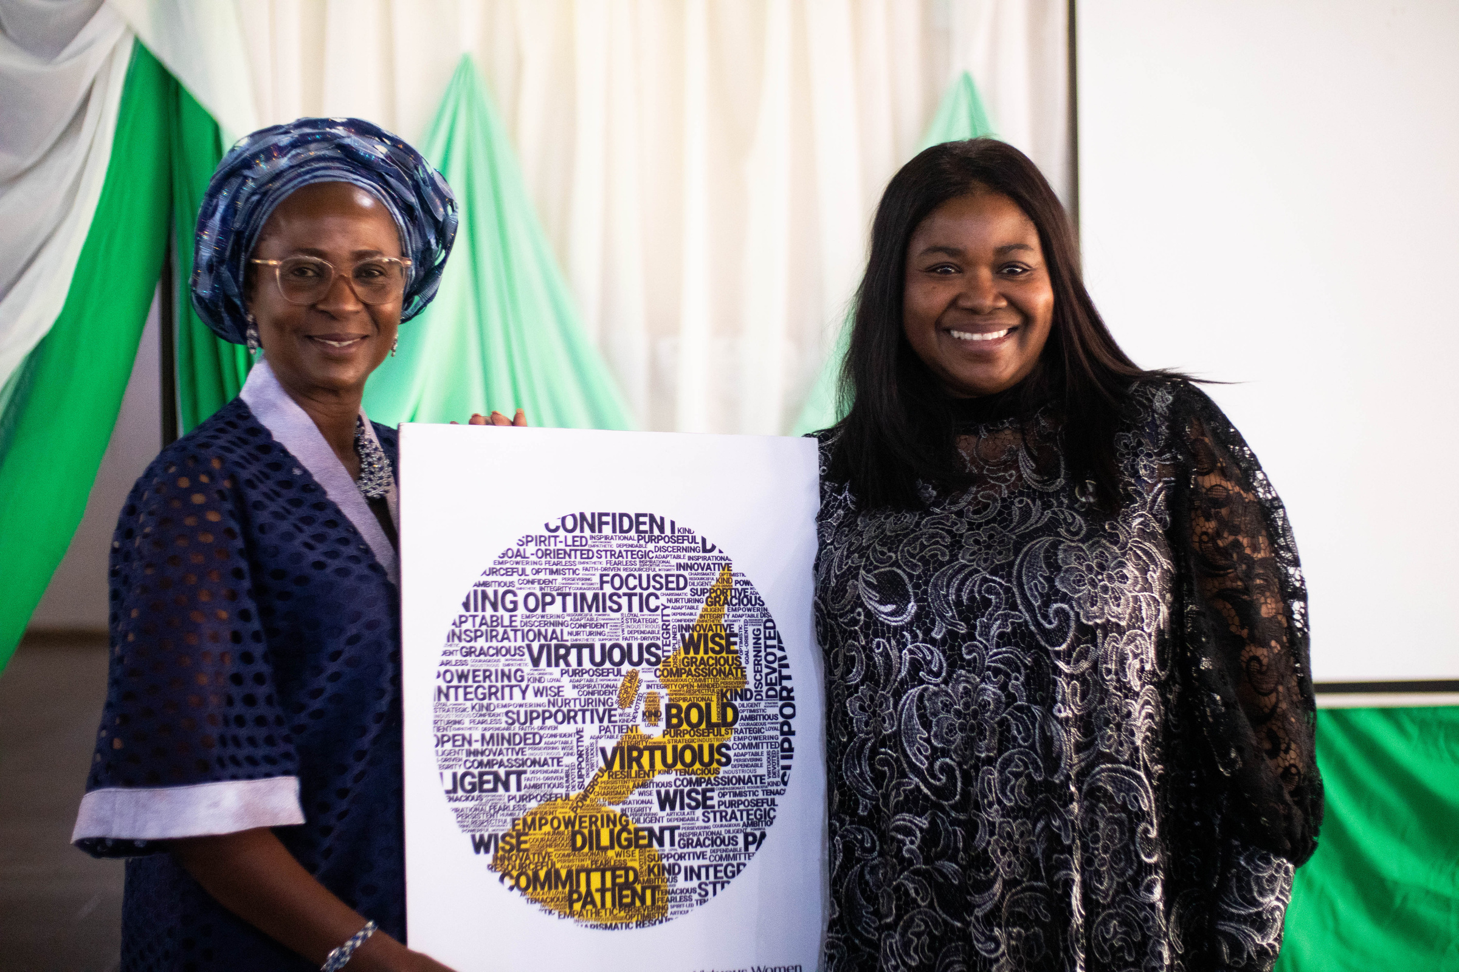
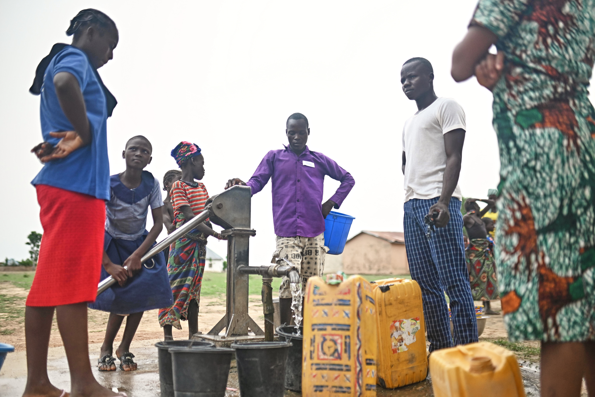
ACT 1 -- PW IN NIGERIA
Meet Our Nigeria Partners
Six LCIs, six different ways of building business that ends poverty
Diamond Stripes
Ennovate Lab
Light Microfinance Bank
Arondizuogu, Imo State
Ogbomosho, Oyo State
Jos, Plateau State
Mini-industrial park with off-grid solar, processing palm kernel and cassava.
Innovation hub fostering enterprise thinking in underserved communities.
Microfinance bank empowering the economically active poor.
PEAK Empowerment & Dev. Fdn.
Virtuous Women Credit & Loan
Water Wins Dev. & Empowerment
Abuja, FCT
Jos, Plateau State
Kontagora, Niger State
Driving financial inclusion for those excluded from formal finance.
Women entrepreneurs building financial growth together.
Kingdom servants growing community development in Niger State.

Slide 9
ACT 1 -- PW IN NIGERIA
One Partner, Closer Up: Diamond Stripes
Arondizuogu, Imo State
Diamond Stripes is establishing a mini-industrial park through a robust, independent off-grid solar energy system to process palm kernel and cassava.
100
100%
100%
+50,000
Clients
Female participation
Alternative power
Total projected beneficiaries
Diamond Stripes Limited is also the owner of the company at the center of today's spotlight: Homerun Industries Limited.

Slide 10
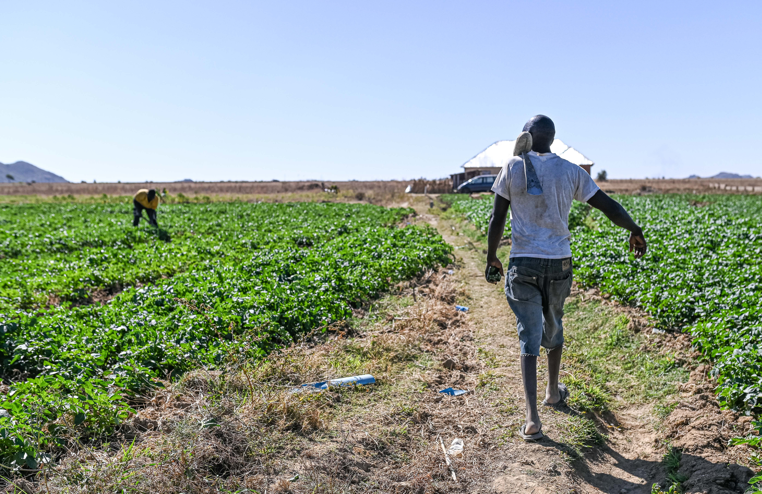
ACT 2
Spotlight: Homerun Industries
A renewable-energy powered agro-processing cluster in Arondizuogu, Imo State

Slide 11
ACT 2 -- SPOTLIGHT: HOMERUN INDUSTRIES
From Diamond Stripes to Homerun Industries
One LCI, one operating company, one project
Diamond Stripes Limited
Homerun Industries Limited
The Renewable Energy Agro-
Processing Cluster
The PW Local Community Institution you just met -- a world-class infrastructure development company with deep experience in Greenfield and Brownfield public-private partnerships in Nigeria.
Owned by Diamond Stripes. A Nigerian agribusiness and industrial development company acting as project developer and operator -- responsible for conception, infrastructure, and day-to-day operations.
A 4-hectare industrial park -- plus a 2,500-hectare cassava back-integration farm -- processing cassava starch, rice, and palm oil.
→
→

Slide 12
ACT 2 -- SPOTLIGHT: HOMERUN INDUSTRIES
Homerun Industries at a Glance
The essentials, as we head into this conversation
2025
Abuja FCT
19
Founded, and a PW
partner since
HQ, with operations in
Arondizuogu, Imo State
Staff
130
~35%
50
Farmers onboarded
(outgrower scheme)
Women among the
onboarded farmers
Women registered
into cooperatives
Who we serve: Smallholder farmers and agro-entrepreneurs in the cassava value chain, across Ideato North LGA, Imo State.
Our reach: 130 farmers onboarded into the outgrower scheme (about 35% women); 50 women registered into cooperatives, with roughly 100 more awaiting registration.

Slide 13
ACT 2 -- SPOTLIGHT: HOMERUN INDUSTRIES
Why This, Why Now
Nigeria processes far less of its own harvest than it grows
$5.67B → $7.89B
Cassava Starch
Strong, growing demand across food & beverage, pharma, paper, textiles and adhesives -- the project's largest revenue contributor.
Nigeria cassava starch market size,
2025 to 2030 (6.77% CAGR)
Rice
A staple with consistently high demand; local milling and quality gaps leave room for cleaner, better-packaged rice.
Nigeria is the world's largest cassava producer -- yet remains a net importer of industrial starch. That gap is the opportunity.
Palm Oil
Robust household, commercial and industrial demand; outdated local processing limits yield and quality today.

Slide 14
ACT 2 -- SPOTLIGHT: HOMERUN INDUSTRIES
Not a Concept: Already Under Construction
Significant infrastructure is complete before a naira of new funding arrives
Three factory buildings for the cassava, rice and palm oil processing lines
A powerhouse and load base, fully prepared for solar and biodiesel integration
An administrative office complex for management and commercial activity
Security quarters for round-the-clock site protection
Land development and fencing across the full 4-hectare site
An industrial borehole, for reliable water supply
Preliminary access-road development connecting surrounding farming communities
This level of progress substantially de-risks the project and shortens the timeline to revenue.

Slide 15
ACT 2 -- SPOTLIGHT: HOMERUN INDUSTRIES
What the Park Actually Does
Three value chains, one shared renewable-energy backbone
Cassava Starch
15 tons / day
Backed by a 2,500-hectare cassava back-integration farm for stable supply; the same line also yields garri and cassava chips alongside starch.
Rice Milling
750 kg / day
Clean, well-polished rice meeting commercial and institutional quality standards.
Palm Oil
1 ton / hour
Modern extraction technology improving yield and product consistency.
Powered primarily by a dedicated solar energy system: 250kVA in Phase 1, scaling to 1MW (solar and biodiesel) as processing capacity expands.

Slide 16
ACT 2 -- SPOTLIGHT: HOMERUN INDUSTRIES
Progress So Far
Project report, July 2025 – January 2026
Establish & operationalize the
agro-processing industrial park
Accomplishment: Processing centres completed; equipment supplier identified, discussions ongoing.
Needed support: Funds for purchase of machinery.
70%
Build capacity through training
& technical support
Accomplishment: Women's cooperative incorporated and registered; seedling-supply arrangement secured with IITA.
Needed support: Support to run training programmes; funds for seedlings and farm implements.
60%
Provide sustainable & reliable
energy for processing
Accomplishment: Supplier for the solar power system has been identified.
Needed support: Funds for purchase and installation of the 150kVA solar power system.
20%

Slide 17
ACT 2 -- SPOTLIGHT: HOMERUN INDUSTRIES
Our Last Twelve Months
What's gone well, and what's taken longer than planned
WHAT WE'RE PROUD OF
WHAT PROVED HARDER THAN EXPECTED
Completed core infrastructure
Closing the remaining financing gap
Across our 4-hectare agro-industrial park: three factory buildings, an administrative complex, power and security infrastructure, and an industrial borehole.
For Phase 1 equipment and the renewable energy system -- this has taken longer than planned.
Secured a $25,000 SEED100 Scaling Stage Grant from Partners Worldwide, matched by Homerun
$200,000
Procured the cassava processing machine
Still needed to finish
equipping the park
Onboarded 130 farmers (about 35% women) into the outgrower structure
Figures per Homerun's own progress reporting, shared ahead of this meeting.

Slide 18
ACT 2 -- SPOTLIGHT: HOMERUN INDUSTRIES
Where Our Entrepreneurs Are Stuck
Homerun's own self-assessment, ranked by urgency
1
Capital
Our biggest constraint. Raising about $200,000 to complete Phase 1 equipment and the 250kVA-to-1MW renewable energy build-out.
2
Business Environment
Unreliable grid electricity forces reliance on costly diesel generation; weak access roads and logistics also raise the cost of moving produce.
3
Relationships
Need for stronger links to technical partners for equipment and renewable energy, plus institutional/DFI relationships to help close our financing gap.
4
Knowledge & Skills
Farmers and cooperative members need training in sustainable agronomic practices, processing/equipment operation, and business management.
Markets was not flagged as a constraint on Homerun's own information form.

Slide 19
ACT 2 -- SPOTLIGHT: HOMERUN INDUSTRIES
The Current Ask
What Homerun needs to finish equipping the park, right now
$200,000
Phase 1 Equipment
Renewable Energy Build-Out
Completing the equipment still needed to bring the cassava, rice and palm oil lines into full operation.
Scaling the power system from 250kVA to 1MW (solar and biodiesel), ending reliance on diesel generation.
This is Homerun's current, most immediate funding gap -- distinct from the full original project financing plan on the next slide.

Slide 20
ACT 2 -- SPOTLIGHT: HOMERUN INDUSTRIES
The Ask: Funding Structure
A total project cost of ₦6.05Bn (approx. $4.0M)
₦1.8Bn (approx. $1.2M)
₦4.25Bn (approx. $2.8M)
Already invested by Homerun Industries (equity) -- 30% of total project cost
Being raised to complete the project -- 70% of total project cost
This is the full original project financing plan -- see the preceding slide for Homerun's current, most immediate funding gap.
A
Farm & Farming Cooperatives
Seeds, seedlings and implements for farming cooperatives; training on sustainable agriculture and business operations.
₦1.5Bn (~$1.0M)
C
Equipping the Industrial Park
Palm mill and cassava mill machinery, plus the 250kVA power plant for reliable, sustainable electricity.
₦2.37Bn (~$1.58M)
D
Sales & Marketing of Finished Products
Routes to city-centre markets, vehicles and staff connecting women's cooperatives to buyers.
₦375M (~$250K)

Slide 21
ACT 2 -- SPOTLIGHT: HOMERUN INDUSTRIES
Financial Outlook
Per Homerun's own financial model -- worth a BA team's normal diligence
3 yrs 6 mo
₦52Bn
97%
Payback period
Net present value (NPV)
Discounted IRR
Cassava starch
~₦950,000 / ton
Largest revenue contributor
Rice
~₦900 / kg
Milled & packaged, sold to wholesalers
Palm oil
~₦2,000 / litre
Bulk and semi-refined
Revenue projection and pricing per Homerun's financial model; not independently verified by PW.

Slide 22
ACT 2 -- SPOTLIGHT: HOMERUN INDUSTRIES
Risk & Mitigation
Named plainly, with a mitigation already built into the model
Risk Area | The Risk | How It's Mitigated
Supply Chain & Raw Material | Seasonal and climate variability, and fragmented smallholder supply, can disrupt feedstock flow. | A 2,500-hectare cassava back-integration farm plus surrounding cooperatives diversify and stabilize supply.
Operational & Power | Equipment downtime and unreliable grid power / diesel costs are common across Nigerian agro-processing. | Dedicated renewable energy, centralized O&M, preventive maintenance and vendor support agreements.
Market & Pricing | Commodity price volatility can affect revenue predictability. | Diversification across three commodities, plus a mixed offtake strategy (forward sales, aggregation, spot sales).
Regulatory & Community | Policy shifts and land-use or stakeholder-expectation issues. | Early, continuous government engagement; strong community inclusion, women's empowerment and transparent governance.

Slide 23
ACT 2 -- SPOTLIGHT: HOMERUN INDUSTRIES
Who Benefits
The impact case behind the investment case
1,000
+300
2,500 ha
Direct & indirect jobs
Women & youth trained
Cassava back-integration farm
Women-led cooperatives are prioritized as key beneficiaries and processors -- given structured access to modern facilities, technical training, and stable market opportunities.
A structured outgrower scheme gives smallholder farmers guaranteed offtake, stable pricing, and technical support.
Community CSR commitments include local schools, access to clean water, agricultural training programmes, and rural electrification support linked to the renewable energy system.

Slide 24
ACT 3
Your Role as a BA
What walking alongside Homerun Industries could look like for you

Slide 25
ACT 3 -- YOUR ROLE AS A BA
What a Business Affiliate Does
The same four activities, wherever PW works
Training
Coaching
Investing
Network Building
Sharing business and technical expertise directly with LCI leadership and staff.
Ongoing, hands-on mentoring as plans turn into operating reality.
Financial support -- grants, loans, or equity -- sized to what the LCI actually needs.
Opening doors: introductions, partnerships, and market access the LCI can't reach alone.
A BA team rarely does all four in equal measure -- it does whatever the specific LCI needs most.

Slide 26
ACT 3 -- YOUR ROLE AS A BA
In Homerun's Own Words
What they can offer a BA team, and what they're asking for
WHAT WE CAN OFFER
WHAT WE NEED
A renewable-energy agro-processing
+ outgrower model
Partnership
Blended finance (debt, equity and grant) to close our funding gap, and help scale farmer training and community engagement toward 200+ beneficiaries.
A renewable-energy-powered agro-processing cluster combined with a structured cassava outgrower / exclusive-offtake scheme that gives smallholders guaranteed offtake and stable pricing.
Expertise
Financial structuring / blended-finance skills, and market linkages to industrial buyers of cassava starch, garri and cassava chips.
130
$200K
200+
Farmers already inside
this outgrower model
Funding gap to close
Beneficiaries we're
scaling toward

Slide 27
ACT 3 -- YOUR ROLE AS A BA
What Homerun Needs Right Now
Straight from the project's own progress report
01
02
03
Machinery funding
Training & cooperative support
Solar power system funding
70% complete
60% complete
20% complete
The cassava processing machine has now been procured, funded in part by a $25,000 PW SEED100 grant (matched by Homerun). What remains is roughly $200,000 to complete Phase 1 equipment and the renewable energy build-out.
The women's cooperative is incorporated and a seedling-supply partner secured -- the gap is funding and hands-on support to run the training programmes themselves.
A 150kVA solar supplier has been identified. Funding it is what finally gets the park off diesel and onto reliable, affordable power.

Slide 28
ACT 3 -- YOUR ROLE AS A BA
What This Partnership Could Look Like
The same four BA activities, applied specifically to Homerun
BA Activity | Applied to Homerun
Training | Technical training on equipment operation, safety and quality control; business and financial management training for the women's cooperatives and farmer associations.
Coaching | Continuous, hands-on advisory support as Phase 1 moves from construction into commercial operation and the first harvests come in.
Investing | Capital toward closing Homerun's current $200,000 funding gap for Phase 1 equipment and the renewable energy build-out -- sized to what the team can actually commit.
Network Building | Introductions to equipment vendors, institutional offtakers, and development finance institutions already named as strategic partnership priorities.

Slide 29
ACT 3 -- YOUR ROLE AS A BA
Why Homerun, Why Now
The case in four parts
De-risked, not speculative
Factory buildings, powerhouse, offices, security, fencing and a borehole are already built. Funding completes a project already underway, not a concept on paper.
Strong strategic fit
Women's economic empowerment, redemptive business, and import-substitution agro-industrialization -- squarely inside PW's Vista 2030 priorities.
A countable step for the network
Only 3 of PW's 7 Nigeria LCIs currently have a BA team. A team for Homerun -- through Diamond Stripes -- would be the fourth.
A clear, bounded ask
₦4.25Bn (~$2.8M) across three named blocks in the full project plan -- plus a current, immediate gap of just $200,000 to finish equipping the park.

Slide 30
ACT 3 -- YOUR ROLE AS A BA
Discussion & Next Steps
Questions worth exploring together
1
Which of the three needs -- machinery, training and cooperative support, or the solar system -- fits this team's expertise and capacity best?
2
What would a first, concrete commitment look like -- a site visit, a scoping call with Homerun and Diamond Stripes, or a specific funding pledge?
3
What additional information or introductions would help the team evaluate this opportunity further?
Partners Worldwide and Diamond Stripes / Homerun Industries are both ready to follow up on whatever the team decides.

Slide 31
Businesspeople Faithfully Pursuing
a World Without Poverty

