Slide 1
PEAK Empowerment & Development Foundation
Formal Loan Application
Jeremiah Akoyere · Partnership Manager
Notes:
Opening: welcome the committee and thank them for their time.
Introduce yourself and PEAK Empowerment & Development Foundation — a Nigerian NGO-MFI and existing Partners Worldwide LCI partner.
Frame the ask immediately: this is PEAK's second formal loan request to PW, built on a clean track record from the first.
Preview the structure: why now, who PEAK is, the track record, the ask and terms, the products and numbers behind them, the risks, then questions.

Slide 2
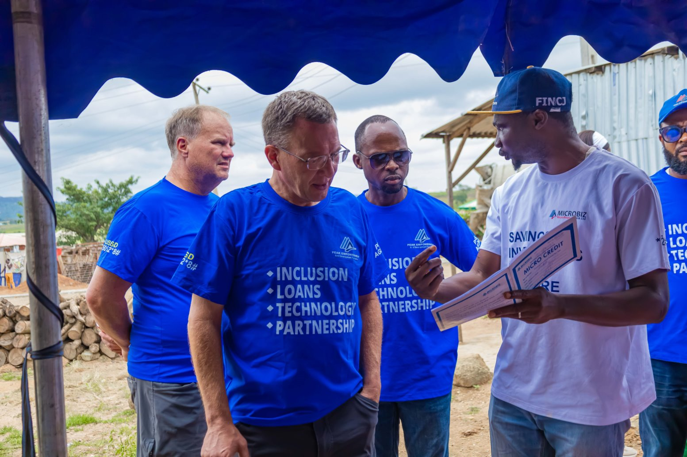
  Time allocated: (3 minutes)
CONTEXT
Why is there a current need for a PW loan?
PEAK's current $187,889 loan portfolio is healthy — only 0.98% overdue — but capital is the binding constraint on growth.
This facility would extend affordable credit to 2,000+ underserved customers, 70%+ of them women and youth
Notes:
Core message: this is a growth loan, not a rescue loan — the existing $187,889 book is healthy (only 0.98% overdue).
The binding constraint is capital, not capacity or discipline — PEAK has shown it can manage credit well; it simply needs more of it to lend.
End on the reach number — 2,000+ underserved customers, 70%+ women and youth — to set up why this matters beyond the balance sheet.
If asked for more detail on the $187,889 figure or the 0.98% overdue rate, the full aging breakdown is on the Credit Quality & Portfolio Aging slide later.

Slide 3
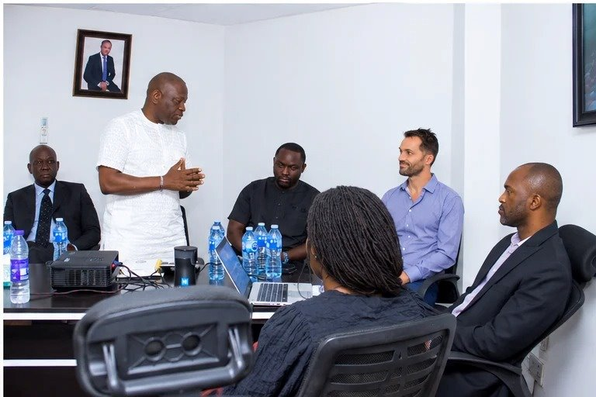
  Time allocated: (2 minutes)
LCI OVERVIEW
PEAK Empowerment & Development Foundation — a Nigerian NGO-MFI established in 2021.
Focus: microcredit, enterprise financing, savings mobilisation, financial literacy and digital financial services for underserved communities.
5 credit products — MiniMonie, PeakLite/MicroGroup, Sabi Trader, SME and BetaBiz — plus savings at 17% p.a., agency banking and micro-health insurance partnerships.
This facility funds PEAK's core lending book — the engine behind all five credit products.
Governed by a Board of Trustees; led day-to-day by CEO Joe Onyeabor and Executive Director Abiodun Yusuph.
70+ staff across 6 functional teams: credit & field operations, branch operations, human capital, customer service and partnerships.
Notes:
Establish PEAK's credibility as an institution, not just a borrower: founded 2021, five credit products plus a licensed savings arm at 17% p.a.
Name the five products briefly (MiniMonie, PeakLite/MicroGroup, Sabi Trader, SME, BetaBiz) — the Credit Products slide later breaks each one down in full.
Governance: Board of Trustees oversight, with CEO Joe Onyeabor and Executive Director Abiodun Yusuph running day-to-day operations.
Scale point: 70+ staff across 6 functional teams — this is an operating institution, not a small informal effort.
If asked for exact board size or composition, keep the answer general ("a functioning Board of Trustees") rather than citing a specific headcount — the source materials aren't fully consistent on this point.

Slide 4
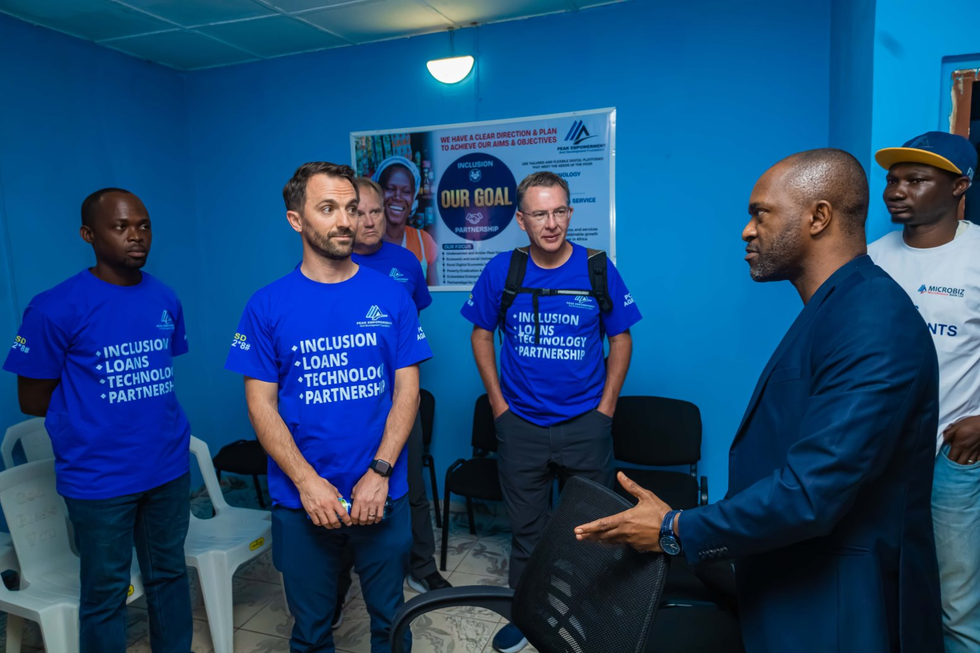
  Time allocated: (3 minutes)
LCI HISTORY WITH PW
an official Partners Worldwide LCI since 2023 — this is PEAK's second facility request.
BA Team: Letter of Recommendation submitted; response pending at the time of this submission.
Prior PW support: a $100,000 loan facility and a $20,000 Digital LEAP Grant — both fully repaid / fully utilized, no issues recorded.
2025 was the year PEAK's lending operation turned: the loan book grew 54% to $217,485, after being flat across 2023–2024.
Total assets up 26% to $495,531; accumulated funds up 72% to $176,628.
Leverage improved from 2.3x accumulated funds (end-2024) to 1.4x (end-2025) — this facility would take it to ~3x, vs ~5x had it been granted a year ago.
Notes:
Likely the single most important slide for this audience: it answers "did they handle our money well last time?"
Key facts, in order: official PW LCI since 2023; this is the SECOND facility request; the first — $100,000 loan plus $20,000 Digital LEAP Grant — was fully repaid and fully utilized with no issues recorded.
Give a live update on the BA Team's Letter of Recommendation if the response has come in since this was written (it was "pending" at submission).
Pivot to the audited FY2025 numbers: loan book +54% to $217,485, total assets +26% to $495,531, accumulated funds +72% to $176,628.
Close on leverage: improved from 2.3x to 1.4x in a single year — growing into this facility gradually (to ~3x) is safer than if it had been granted a year ago (~5x).

Slide 5
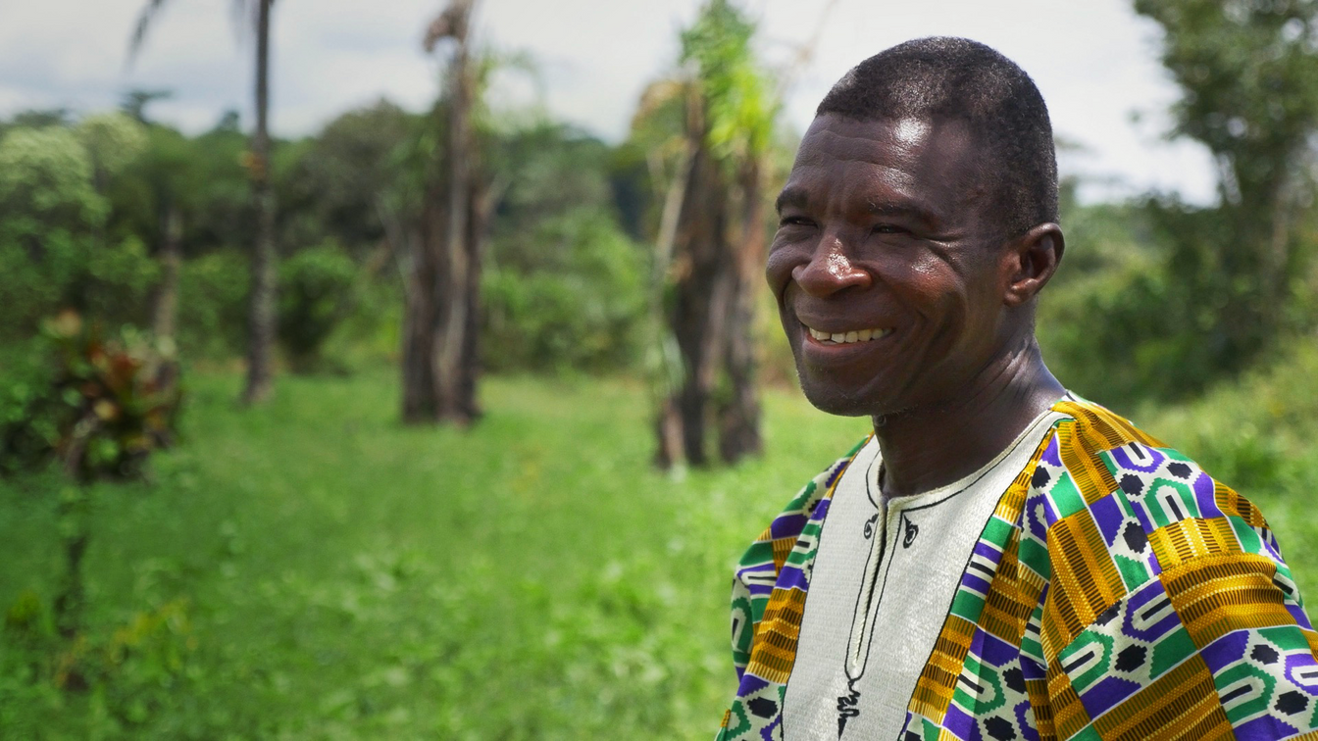
PM, BA & LCI Input
  Time allocated: (2 minutes)
Why a PW loan is the right next step
“
PEAK did what it said it would do with the first cycle — the strongest case I can make for a second.
— Jeremiah Akoyere, Partnership Manager
BA TEAM
REGIONAL DIRECTOR (RD)
IN-COUNTRY ENGAGEMENT
No material concerns raised; fully supportive of this application.
Also supportive of this application, with no material concerns raised.
BA Team engaged PEAK in person in Nigeria, with strong willingness to help strengthen the loan portfolio.
Notes:
This is PW's own internal sign-off — it tells the committee that PW's people on the ground believe in this, not just PEAK's own account of itself.
Lead with the quote: "PEAK did what it said it would do with the first cycle — the strongest case I can make for a second."
Confirm both the BA Team and the Regional Director (RD) raised no material concerns and support the application.
Mention the BA Team engaged PEAK in person in Nigeria — this was not a remote, paper-only review.
If pressed on what "no material concerns" means in practice, connect it back to the clean repayment history on the LCI History slide and the credit-quality numbers later in the deck.

Slide 6
APPLICATION SUMMARY
  Time allocated: (3 minutes)
LOAN AMOUNT
LOAN PURPOSE
US$280,000
100% deployed into PEAK's lending portfolio — expanding affordable credit for women-owned businesses, youth entrepreneurs, rural traders, artisans and SMEs.
LOAN REPORTING METHOD
Mid-term review and evaluation to affirm continuance of the loan, alongside regular reporting on portfolio performance.
Notes:
The concrete ask, stated plainly: US$280,000, 100% deployed into PEAK's lending portfolio — none of it goes to overhead or administration.
Name who it reaches: women-owned businesses, youth entrepreneurs, rural traders, artisans, SMEs.
Pre-empt the "how will we know it's working" question: mid-term review plus regular portfolio-performance reporting are built into the ask, not an afterthought.

Slide 7
  Time allocated: (4 minutes)
PROPOSED FUNDING TERMS
01.
02.
03.
04.
05.
LOAN DISTRIBUTION
INTEREST RATE
REPAYMENT TERM
FORECASTED LOAN LOSS
COLLATERAL
Deployed across PEAK's lending book to reach 2,000+ customers.
5%
36 months (3 years), with a 6-month moratorium and mid-term review.
None (no guarantors required).
3% forecasted loan loss rate.
06.
OTHER LOAN CONDITIONS:
Sufficient loan reserve, based on portfolio aging and trending.
Notes:
This is the term sheet — slow down here, reviewers will want to follow each line exactly.
Walk the six terms in order: loan distribution, 5% interest rate, 36-month term with a 6-month moratorium and mid-term review, no collateral or guarantors required, 3% forecasted loan loss, and the loan-reserve condition tied to portfolio aging.
If asked why there's no collateral requirement: PW's LCI model underwrites on institutional track record and governance, not asset-backed security — exactly what the previous two slides were building the case for.
The loan-reserve condition connects directly to the Credit Quality & Portfolio Aging slide later — the aging bands shown there are the basis for that reserve.

Slide 8
Credit Products
Each product is sized to a different income pattern
Product | Who it serves | Range (USD) | Range (₦) | Term & collection
MiniMonie | Daily income traders, contribution-based businesses | $22–$75 | ₦30,000–100,000 | 2 months, daily
PeakLite / MicroGroup | Group-based microcredit, shared repayment | $112–$149 | ₦150,000–200,000 | 5 months, daily
Sabi Trader | Established retailers beyond group limits | $149–$373 | ₦200,000–499,999 | 5–6 months, monthly
SME | Eligible small & medium businesses | $149–$373 | ₦200,000–499,999 | 5–6 months, monthly
BetaBiz / Working Capital | Business expenses, stock, cash flow | $373+ | ₦500,000+ | 5–6 months, monthly
10%
5.5%
17%
3.5%
Interest rate, all products
Equity contribution required
Management fee & insurance
Savings rate, p.a.
Plus: financial literacy, digital payments, agency banking, and micro-health insurance & renewable-energy financing through partnerships.
Notes:
Purpose of this slide: show the loan isn't going into one undifferentiated pool — it funds five distinct products, each sized to a different borrower's cash-flow pattern.
Walk the ladder from smallest to largest: MiniMonie (daily traders) through PeakLite/MicroGroup, Sabi Trader, SME, up to BetaBiz (established working capital).
Note the collection rhythm matches the borrower: daily collection for the smallest, most frequent-income products; monthly for the larger ones.
The four stat tiles are PEAK's own on-lending economics: 3.5% interest rate to borrowers, 10% equity contribution required of them, 5.5% management fee and insurance, and a 17% p.a. savings rate for those who save alongside their loan.
If asked about the spread between PW's 5% rate to PEAK and PEAK's own on-lending economics: the difference covers PEAK's operating costs and loss provisioning across the book.

Slide 9
Growth, FY2025
Projected beneficiary mix and PEAK's audited growth, 2024 → 2025
Audited financial performance (Ismaheel and Co., FYE 31 Dec 2025): +26% assets, +54% loan book, +72% accumulated funds
Notes:
The single richest data slide in the deck — give it real time and don't rush past it.
Lead with the fact these are AUDITED numbers (Ismaheel and Co., FYE 31 December 2025), not PEAK's own internal estimate — that credibility matters to this audience.
Headline the three growth figures together: +26% total assets, +54% loan book, +72% accumulated funds, all in a single year.
The donut chart answers "who does this reach": 70%+ women and youth, 20% SMEs/MSMEs, 10% artisans.
This is the slide to return to if anyone questions whether PEAK can responsibly absorb and grow a larger facility — the growth is already happening before this money arrives.

Slide 10
• Time allocated: (1 minute)
08D — IS THE BOOK ACTUALLY HEALTHY?
Credit Quality & Portfolio Aging
$187,889
0.98%
Total outstanding loan portfolio
of portfolio overdue ($1,850)
No balance has aged beyond 90 days.
Provisioning is graduated: 1% at current, 5% at 1–30 days, 20% at 31–60 days, 50% at 61–90 days, 100% beyond 90 days — built into the lending model from the outset, not introduced in response to losses.
Aging of the $1,850 currently overdue — none beyond 90 days
Notes:
Directly answers the skeptical question "is this book actually healthy, or are they just asking because they're in trouble?"
$187,889 outstanding, only 0.98% overdue ($1,850) — and nothing has aged beyond 90 days.
Make the point that the graduated provisioning policy (1% at current, up to 100% beyond 90 days) was built in from day one — it is not a new discipline adopted because PEAK is asking for more capital now.
The aging chart shows the shape of that $1,850: concentrated in the 31–60 day band, nothing chronic or written off.

Slide 11
  Time allocated: (4 minutes)
Projected Social Impact
Who this facility reaches, and what changes for them
2,000+
70%+ Women & youth
Working capital for traders and SMEs; structured liquidity replacing costly informal borrowing.
customers and businesses reached across PEAK's operating communities.
20% SMEs / MSMEs
Tools, inputs and working capital sized to established small businesses.
10% Artisans
Tools and inputs suited to artisan production cycles.
Savings mobilised at 17% p.a. alongside every loan — building resilience, not just credit access.
HOUSEHOLD LEVEL
ENTERPRISE LEVEL
More stable income.
Continuity, growth and preserved livelihoods.
Notes:
This is the "why this matters beyond the balance sheet" slide — translate the dollars into people.
Lead with the headline number: 2,000+ customers and businesses reached across PEAK's operating communities.
Break down who: 70%+ women and youth, 20% SMEs/MSMEs, 10% artisans — be specific about what capital does differently for each (working capital and structured liquidity for traders and SMEs; tools and inputs for artisans).
Don't let savings get lost under the credit story: 17% p.a. savings mobilised alongside every loan is building resilience, not just extending debt.
Close on the household/enterprise framing: more stable income at the household level; continuity, growth and preserved livelihoods at the enterprise level.

Slide 12
  Time allocated: (4 minutes)
Risk Assessment
Four categories, with mitigations already built into how PEAK operates
Risk Area | Risk / Description | Mitigation
CREDIT | Repayment delays or default. | Appraisal & guarantees.
LIQUIDITY | Insufficient funds or delayed partner funding. | Cash-flow monitoring, diversified funding, liquidity reserves.
MARKET & CURRENCY | Inflation and naira volatility. | Market monitoring, flexible products, digital-channel improvement.
OPERATIONAL & COMPLIANCE | Internal controls or fraud. | Segregation of duties, internal controls, periodic audits.
Notes:
Walk all four risk categories and, for each, show the mitigation is already operating today — not a plan for later.
Credit risk (repayment delays/default): mitigated by appraisal and guarantees, consistent with the 0.98% overdue rate already shown.
Liquidity risk (insufficient funds or delayed partner funding): mitigated by cash-flow monitoring, diversified funding, and liquidity reserves.
Market & currency risk: naira volatility and inflation are real and worth naming unprompted rather than waiting to be asked — PEAK operates entirely in Nigeria. Mitigated by market monitoring, flexible products, and digital-channel improvement.
Operational & compliance risk: mitigated by segregation of duties, internal controls, and periodic audits.

Slide 13
  Time allocated: (10 minutes)
Questions & Answers
Notes:
Total presentation time: 35 minutes maximum
Anticipate the hardest likely questions before they're asked: board governance detail (keep general, per the LCI Overview slide note); what happens if the BA Team's recommendation comes back with conditions attached; how the naira/FX exposure named on the Risk Assessment slide is actually tracked day to day.
If a question goes beyond what's in the deck, it's fine to commit to a written follow-up rather than guessing.

Slide 14
Notes:
Short closing beat: thank the committee again and restate the ask in one sentence — US$280,000 to fund PEAK's next stage of growth on a proven track record.
Invite any final questions, or offer to follow up in writing on anything Q&A didn't cover.

