Slide 1


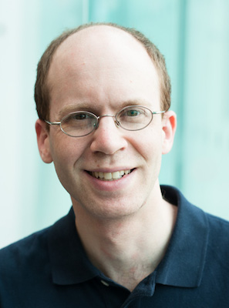
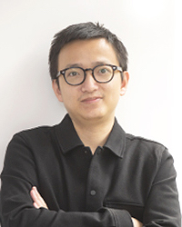


Linguistic Frameworks Go Toe-to-Toe at Neuro-symbolic Language Modeling
NAACL-HLT 11th July 2022
Jakob Prange
Nathan Schneider, Georgetown
Lingpeng Kong, University of Hong Kong

Slide 2
Symbolic Linguistic Representation
PTB
UD
Syntax/"Grammar"
verb, noun, subject, object
Tree structure
Captures grammatical structure
AMR
Semantics/Meaning
predicate, event, entity, argument
DAG structure
Captures what relations are expressed
UCCA

Slide 3
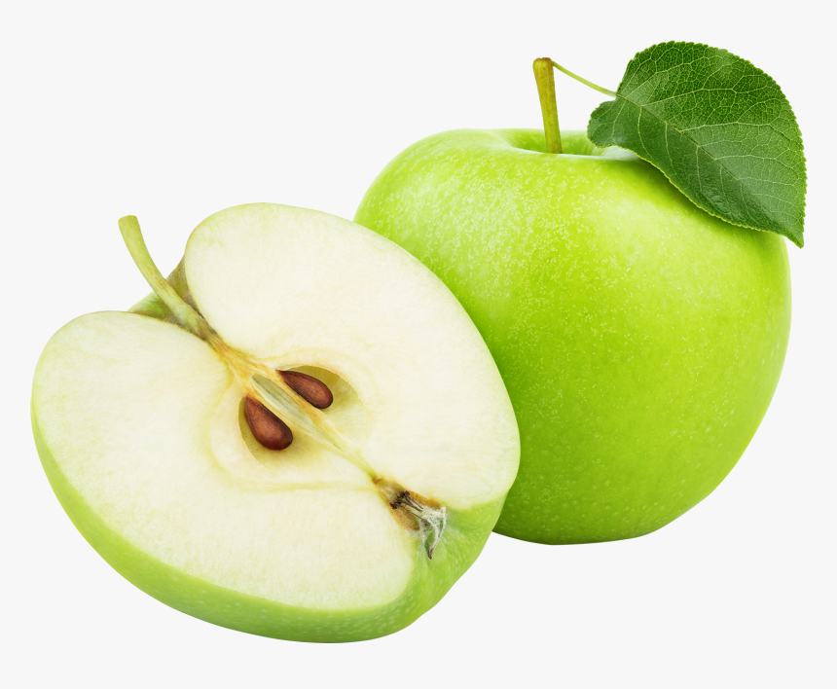
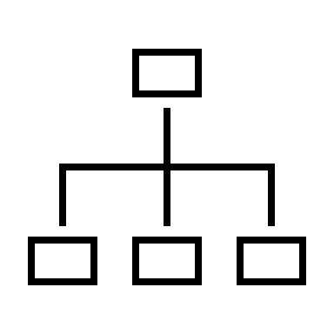


Symbolic Linguistic Representation
Comparison-by-combination?
[Prange+ 2019]
Syntax
verb, noun, subject, object
Tree structure
Captures grammatical structure
Comparison-by-conversion?
[Hershcovich+ 2020]
Semantics
predicate, event, entity, argument
DAG structure
Captures what relations are expressed

Slide 4
Symbolic Linguistic Representation
Comparison-by-conditioning
Comparison-by-combination?
[Prange+ 2019]
Syntax
verb, noun, subject, object
Tree structure
Captures grammatical structure
Comparison-by-conversion?
[Hershcovich+ 2020]
Semantics
predicate, event, entity, argument
DAG structure
Captures what relations are expressed

Slide 5
Experimental Setup
7 sentence-structure SLRs with different properties
Semantic constituencies: 2 (EDS, PTG)
Syntactic constituencies: 2 (PTB with 2 different label sets)
Semantic dependencies: 2 (DM, PSD)
Syntactic dependencies: 1 (UD)
All annotated over the same text corpus (the subset of English WSJ used in the MRP shared tasks)
Relatively fair comparison
Use ground truth graphs at training and test time
Controls for parser performance
Upper bound for LM performance potential
w₁
w₂
w₃
w₁
w₂
w₃

Slide 6
Experimental Setup
1. Compare-by-conditioning next-token predictions on different SLRs
2. Compare-by-combining with pretrained incremental transformer: GPT-2 [Radford+ 2019]
UD, PTB, …
PTG, EDS, …
…

Slide 7
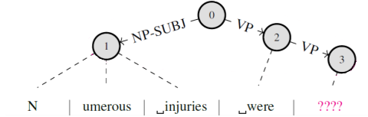
Mechanism: Factoring -> Encoding -> Ensembling
Factoring
Encode token-relevant subgraphs over and including preceding contexts
= "Slices"
Generate one token at a time
"Token-relevant": framework-general structural relations (parent, child, sibling, coparent, grandparent, aunt)

Slide 8
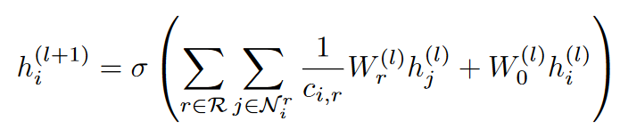
Mechanism: Factoring -> Encoding -> Ensembling
Encoding
"High resolution"
Edge labels + anchor token embeddings
"Low resolution"
R-GCN [Schlichtkrull+ 2018; Kipf & Welling 2017]
0 | 1 | 0
1 | 0 | 0
0 | 0 | 1
.15 | .25 | .6
.75 | .05 | .2
.3 | .65 | 1
Structural relations
Inefficient in the incremental setting
Twice as fast, equal or better LM quality

Slide 9
Mechanism: Factoring -> Encoding -> Ensembling
Encoding
logits_{SLR}
NP-SUBJ
VP
Feed-forward
Parent
0 | 1 | 0
1 | 0 | 0
0 | 0 | 0
Lookups
Sibling

Slide 10
Mechanism: Factoring -> Encoding -> Ensembling
Ensembling
logits_{LM}
GPT-2
logits_{SLR}
NP-SUBJ
VP
Feed-forward
Parent
0 | 1 | 0
1 | 0 | 0
0 | 0 | 0
Lookups
Sibling

Slide 11
Results in Perplexity (lower is better)
***
***
**
***
***
***
--

Slide 12
Results
Marked differences between SLR frameworks of different types
Massive improvement over baseline (purely neural) transformer LM
Thus far: Many simplifying oracle assumptions. Ongoing work: Couple with incremental parser and marginalize at test time!
→ Subtle differences in linguistic representation really do matter!
→ Huge datasets and attention go a long way, but maybe not ALL the way?

Slide 13
Shuffling Ablations (skip)

Slide 14
Perplexity by Part-of-speech (skip)
GPT-2
GPT-2 + POS
Content words are much more unpredictable than function words (cf. PPL ≤ 20).
Modifiers (adjectives & adverbs) are more surprising than nouns and verbs.
SLRs… reduce PPL (to varying extents)!
Maybe, at best, SLRs encode which (syntactic) class of word comes next?
syn dep
sem dep
sem dep
syn const
syn const
sem const
sem const
Comparison by combination:
SLR structure is complementary (to varying extents)!

Slide 15

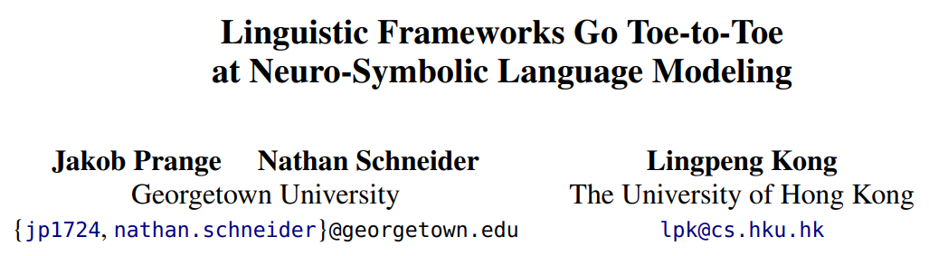
Thank you!

Slide 16
Backup Slides

Slide 17
Language Models (LM)
n-grams, Markov chains, RNNs, Transformers
Syntactic language modeling [Pauls & Klein 2012; Gubbins & Vlachos 2013; Mirowski & Vlachos 2015; inter alia]
Recurrent Neural Network Grammars [Dyer+ 2016]
Parsing as language modeling [Peng+ 2019]
Injecting shallow semantics into LMs [Wu+ 2021]
→ Extend to arbitrary linguistic graphs

Slide 18
Linguistic-Structure-conditional Language Models
Encode entire graph?
Generate entire utterance?
Awkward modeling assumptions:
Removes any local structural ambiguity by "knowing the future"
Depending on how much autoregression is used, may favor flat "dictionary lookups" over abstract structure
UD, PTB, …
PTG, EDS, …
…
injury.01
report.01

Slide 19
Limitations and Future Work
Application and evaluation on different languages and domains (topics, genres, registers, …)
Application and evaluation w.r.t. downstream NLP tasks (inference, question answering, translation, …)
SLR-conditional → Joint parser + LM
More detailed analyses of specific linguistic phenomena (coreference, conditionals, polysemy, …) and challenges (e.g., compositional generalization)
Relation to human processing (surprisal, acceptability, …)

Slide 20
Data Statistics

Slide 22
Marked differences between SLR frameworks of different types!
Massive improvement over baseline (purely neural) transformer LM!
Hold on… what if these effects are just artifacts of your weird new encoding method?
Maybe an established graph encoder like R-GCN is better or yields different results?
w₁
w₂
w₃
w₁
w₂
w₃
~Grammar
~Meaning
Perplexity (lower is better)

Slide 23
Marked differences between SLR frameworks of different types!
Massive improvement over baseline (purely neural) transformer LM!
Hold on… what if these effects are just artifacts of your weird new encoding method?
Maybe an established graph encoder like R-GCN is better or yields different results?
Maybe the additional model capacity (+ 50—60M params) just helps the model memorize spurious signals?
w₁
w₂
w₃
w₁
w₂
w₃
~Grammar
~Meaning
Perplexity (lower is better)

Slide 24
Marked differences between SLR frameworks of different types!
Massive improvement over baseline (purely neural) transformer LM!
→ Subtle differences in linguistic representation really do matter!
→ Huge datasets and attention might not be all you need!
Hold on… what if these effects are just artifacts of your weird new encoding method?
Maybe an established graph encoder like R-GCN is better or yields different results?
Maybe the additional model capacity (+ 50—60M params) just helps the model memorize spurious signals?
w₁
w₂
w₃
w₁
w₂
w₃
~Grammar
~Meaning
Perplexity (lower is better)

Slide 25
Without Early Stopping
0

Slide 26
With Early Stopping

Slide 27
With Early Stopping
Perplexity
Accuracy

Slide 28
POS Classes

Slide 29
POS Classes

Slide 30
POS Classes

Slide 31
Perplexity by Part-of-speech (skip)
GPT-2
GPT-2 + POS
Content words are much more unpredictable than function words (cf. PPL ≤ 20).
Modifiers (adjectives & adverbs) are more surprising than nouns and verbs.
SLRs… reduce PPL (to varying extents)!
Maybe, at best, SLRs encode which (syntactic) class of word comes next?
syn dep
sem dep
sem dep
syn const
syn const
sem const
sem const
Comparison by combination:
SLR structure is complementary (to varying extents)!

Slide 32
Shuffling Ablations

Slide 33
Shuffling Ablations

Slide 34
Encoding Graph Slices as Vectors

