Slide 1
Analysis of College Dating
By Daniel Smith

Slide 2
This Dataset was provided by:
https://www.kaggle.com/datasets/annavictoria/speed-dating-experiment
The experiment consisted of 8378 volunteers for a study conducted by Columbia Business School professors Ray Fisman and Sheena Iyengar
It took place from 2002-2004, and each participant filled out a questionnaire.

Slide 3
The Data

Slide 4
Subset of Data
195 questions were asked
This project focuses on a small subset where every individual is a college age student (190 Total or 180 after NaN values were removed)

Slide 5
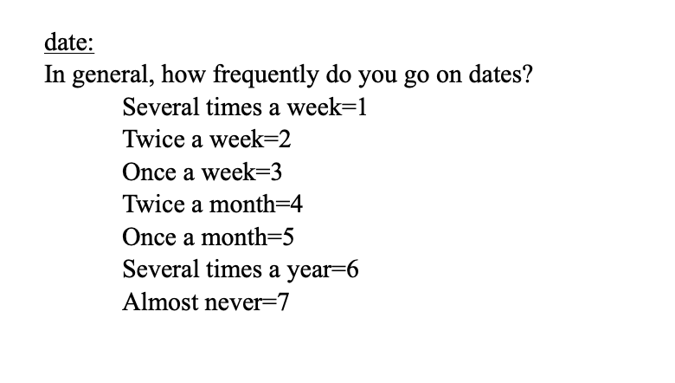
Selecting Features
The feature to predict is labeled as [DATE]
The values in this feature are numerical from 1 to 7 where every number corresponds to how often an individual goes on dates
I decided to leave them as numerical values, since I wanted to preserve the ordering/ranking of each value
This feature is now representative of a “loneliness” score (Higher score = more lonely; lower score = less lonely)
This comes directly from the study’s rubric

Slide 6
Features used to Predict “Loneliness”

Slide 7
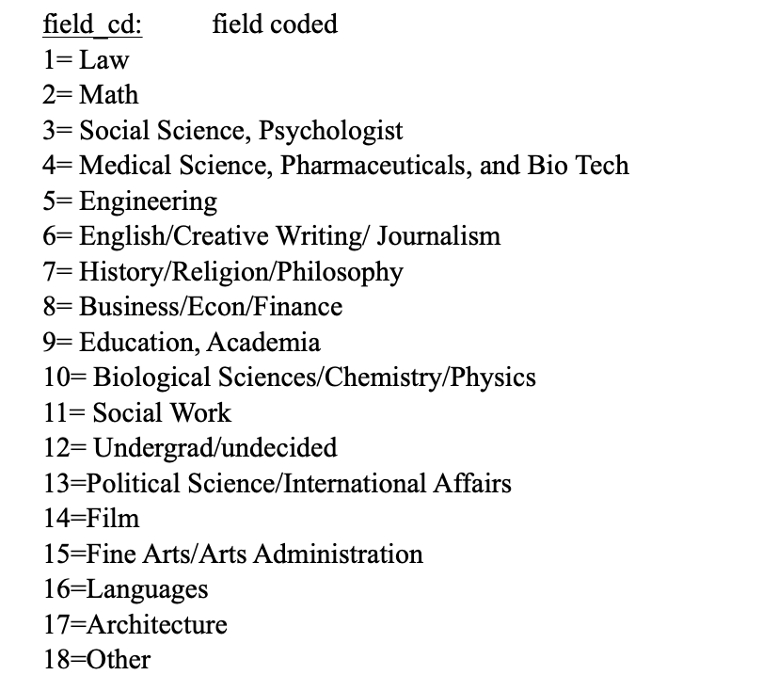
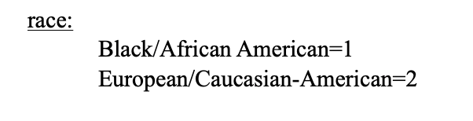
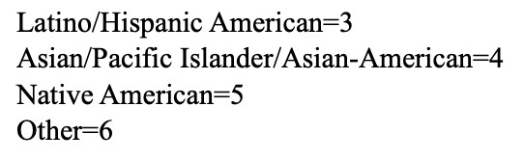
Features used
I used
[GENDER] was one hot encoded as Boy = 1 or Girl = 0
[AGE] age of person
[OCCUPATION/MAJOR] where Each possible value was one hot encoded
[RACE] where each possible race was one hot encoded

Slide 8
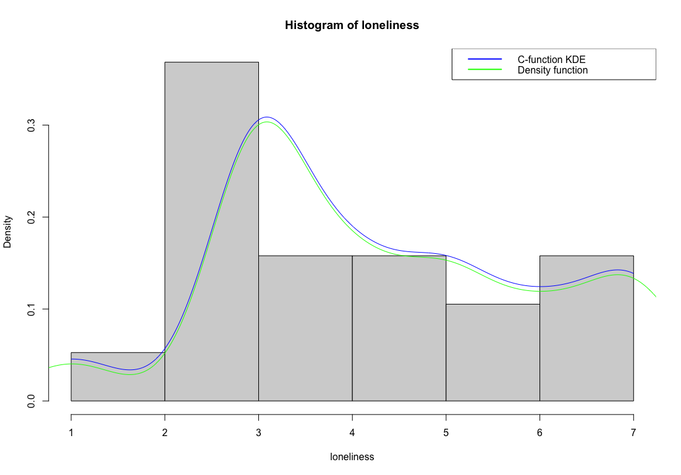
Continued

Slide 9
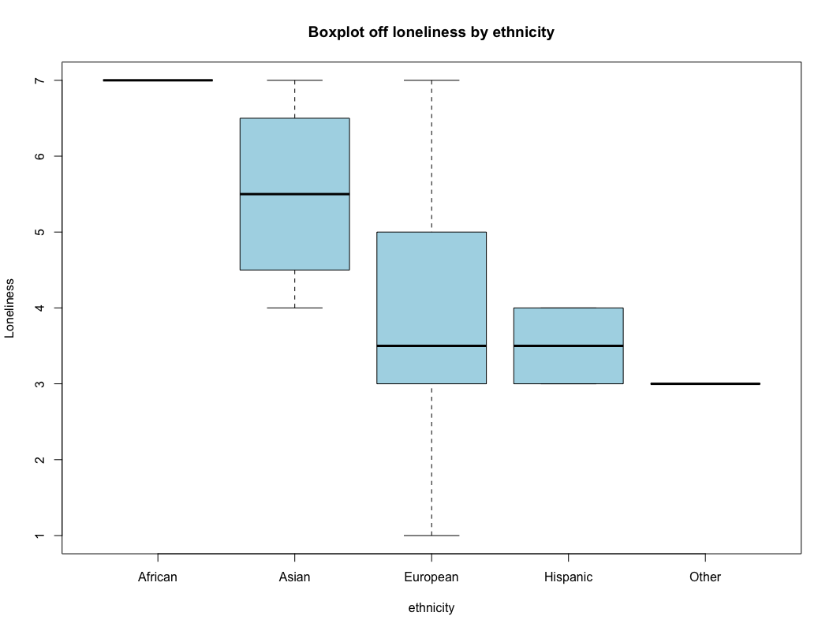
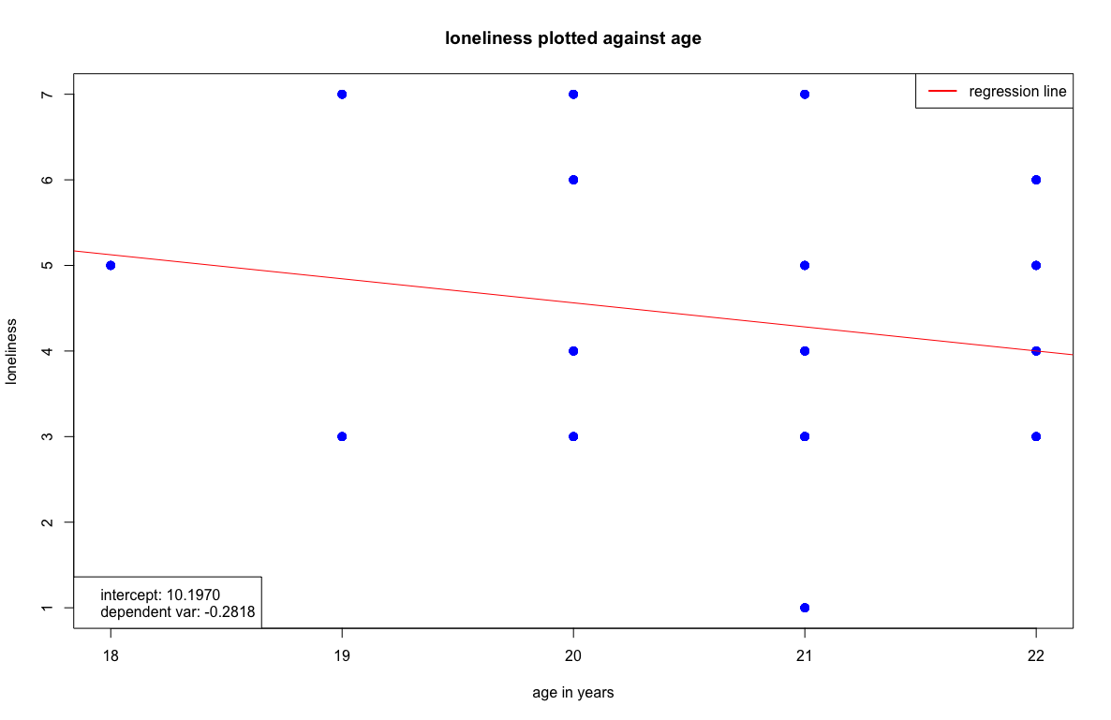
Data Analysis

Slide 10
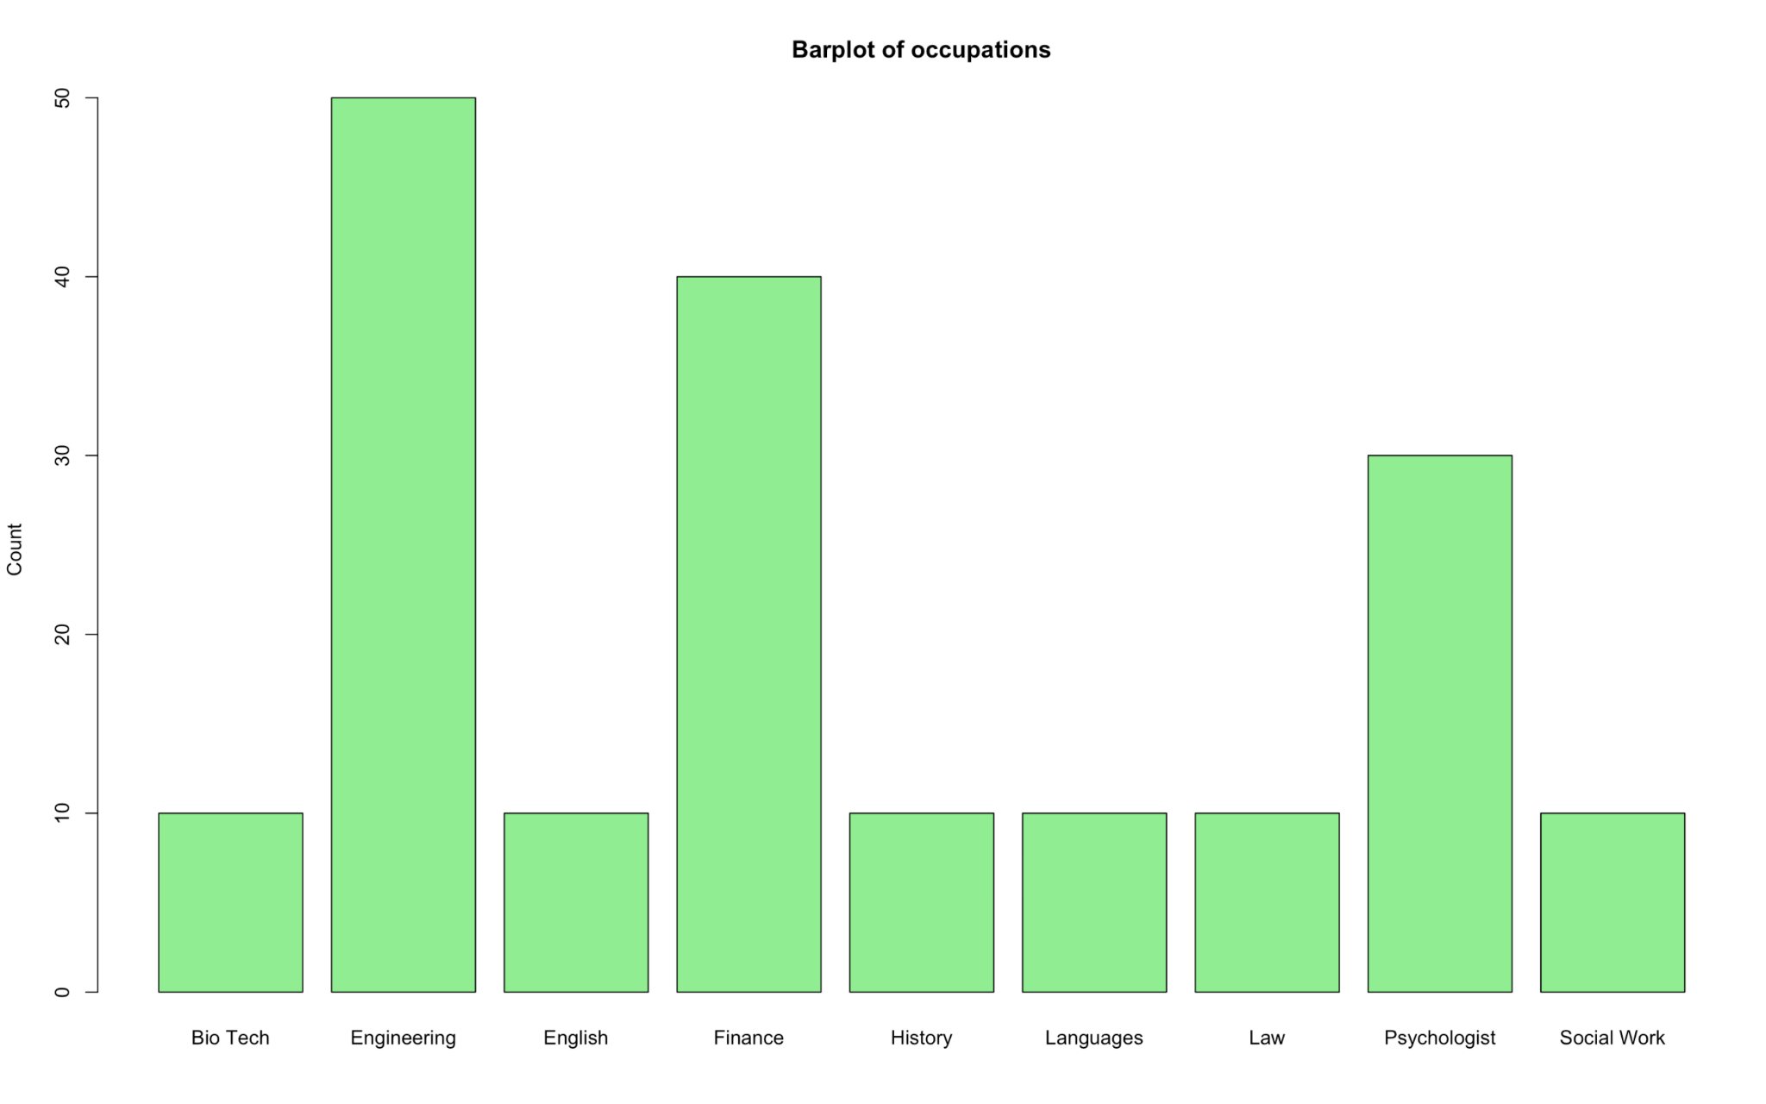
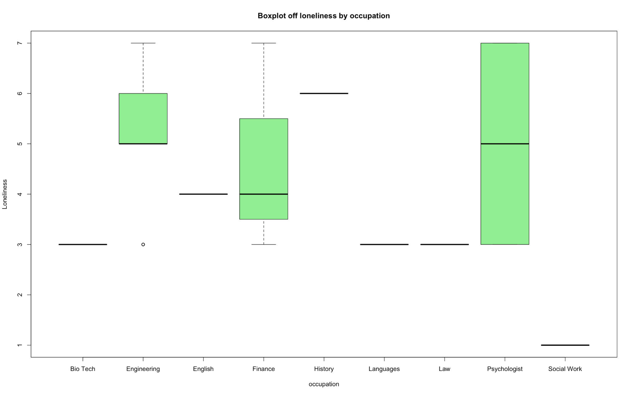
Continued

Slide 11
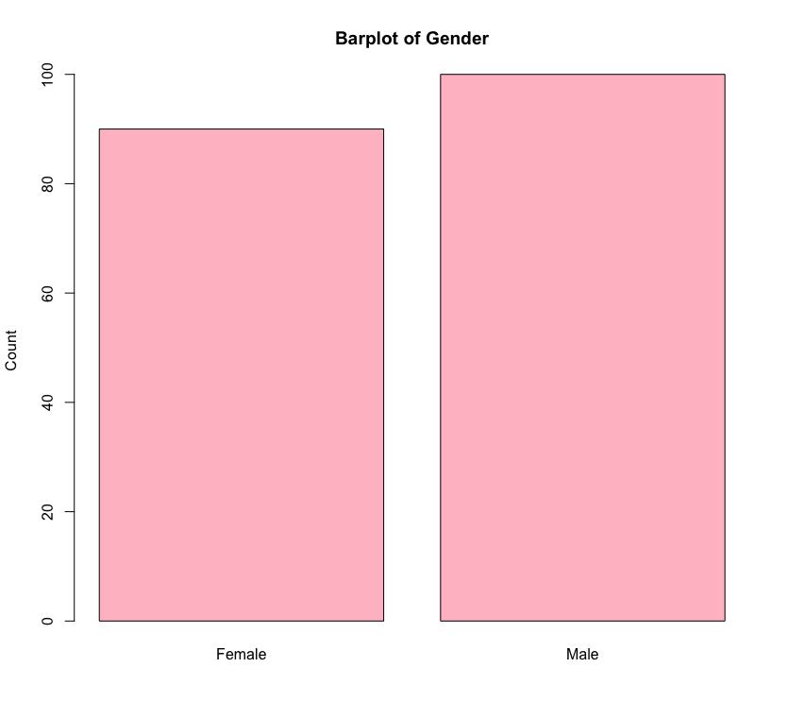
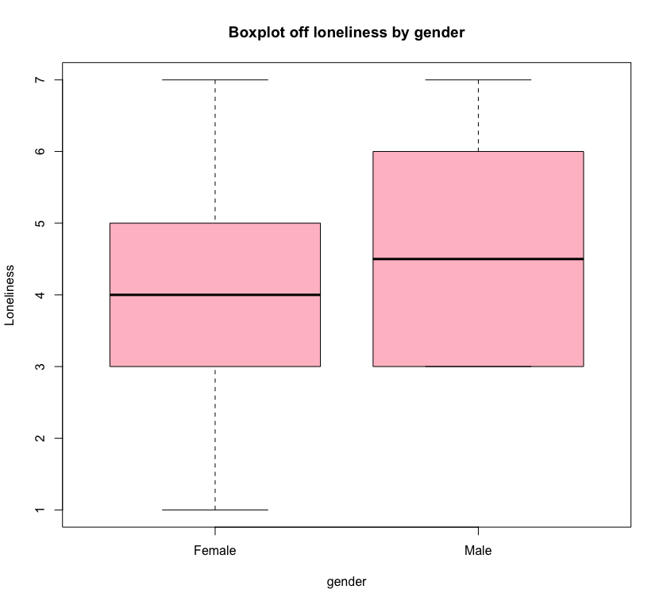
Continued

Slide 12
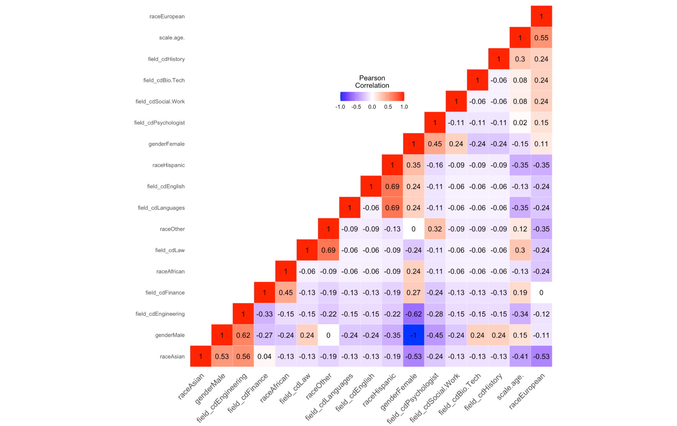
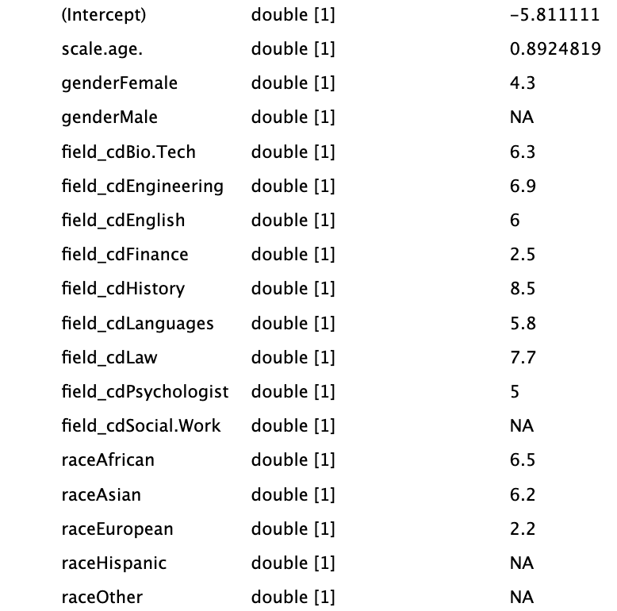
Continued
Coefficients of linear regression model

Slide 13
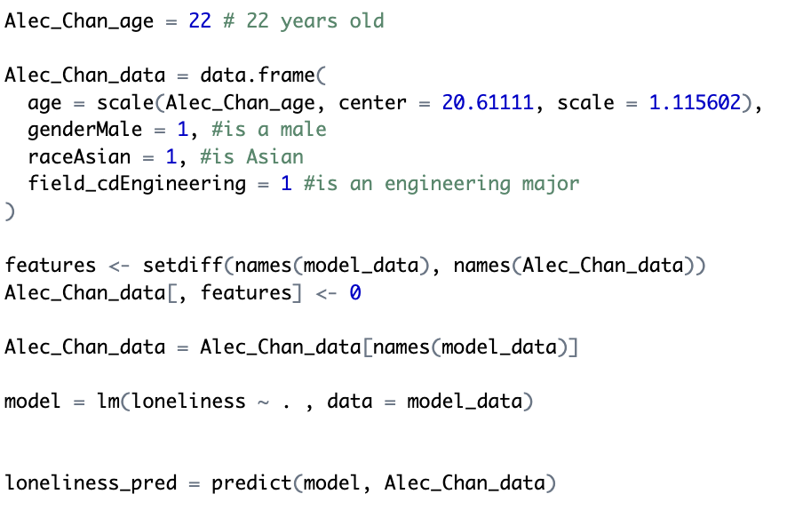
Continued
Loneliness Score of my friend was 7.29 , which roughly matches matches what I know about him.

Slide 14
Questions?

