Slide 1
HDI & IQ
An analysis of correlations between Human Development Index and IQ scores around the world
01
02
06
03
04
05

Slide 2
Introducing the Project
Problem
How do HDI and IQ interplay on
Hypotheses
Average Country IQ and HDI are positively correlated.
Note on Causality
This project is an analysis if correlation not causaility. We believe that the causailty is that HDI implies IQ, not the other way around.
country level
regional levels
Analysis
Cleaning, Preperationg and Merging
Univariate for HDI and IQ
Bivariate
Legislators can use the result to evaluate their country's IQ performance relative to others.
Countries underperforming in IQ should focus on enhancing education and mental fitness.
The goal is to improve the average IQ in the long term (currently decreasing)
Less developed regions are more prune to outliers – weaker indicators for country correlation.
What the results can be used for
The IQ is biased towards western countries.

Slide 3
Introducing the Data
Human Development Index
Range from 0-1
IQ
Measurement of analytic intelligence
Normal distributed around 100 (world population)
Indicating Countries Overall Achievements such as health, economic factors and living standards

Slide 4
Cleaning and Merging the Data
Cleaning the HDI dataframe
Checking for missing values and duplicated rows
No regions for some countries (mostly European and North American countries)
Checking for missing values and duplicated rows
Cleaning the IQ dataframe
For some countries the IQ was estimated from the neighbouring countries but we keep these so that we have enough countries for the analysis
Sorting countries by HDI
Setting the 'Country' column as the index
We remove the brackets from these values and sort the countries by IQ
Merging the data
Checking for the country names which we want the two datasets to merge on
If they differ we rename them
We merge on the HDI dataframe

Slide 5
Regions
SA
SSA
AME
AS
South Asia
Sub Saharan Africa
ECA
Europe and Central Asia
Rest of Asia
Americas
EAP
East Asia and Pacific

Slide 6
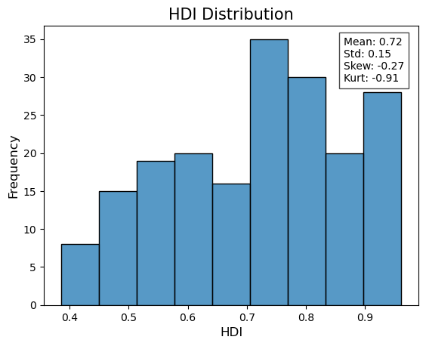
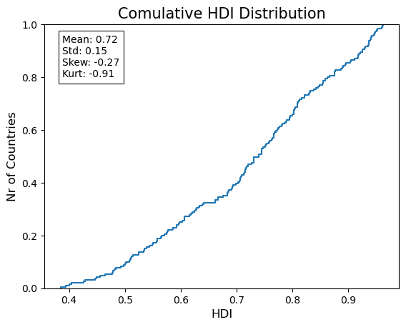
Univariate Analysis HDI

Slide 7
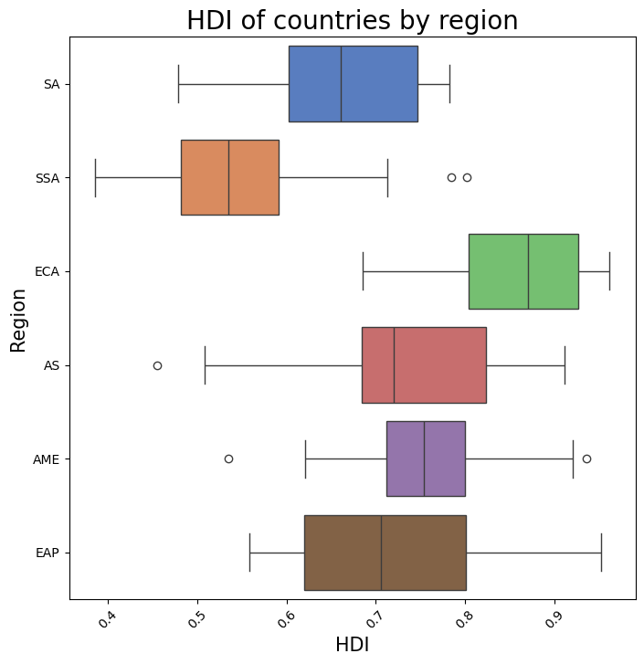
Univariate Analysis HDI

Slide 8
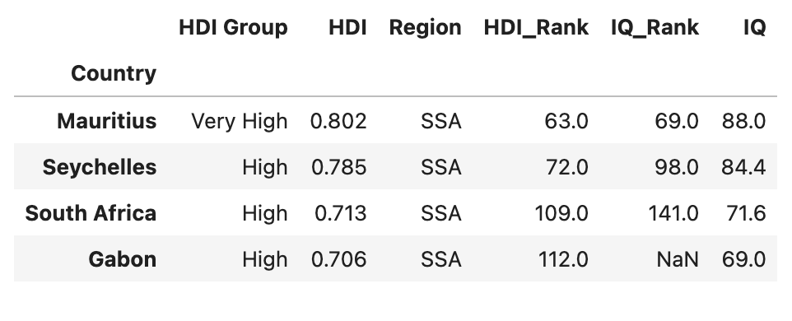
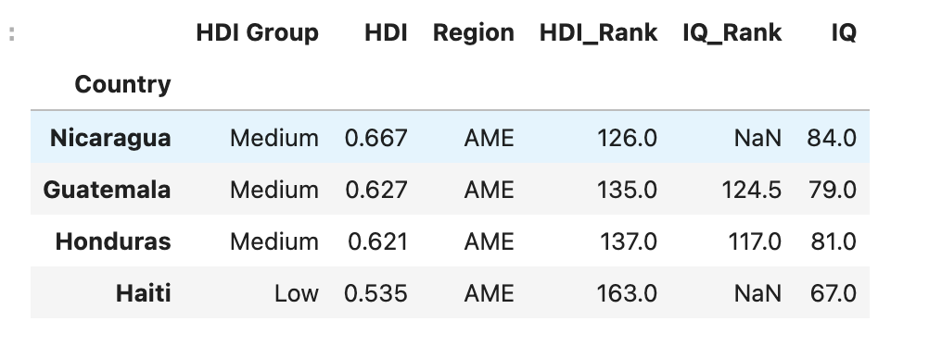
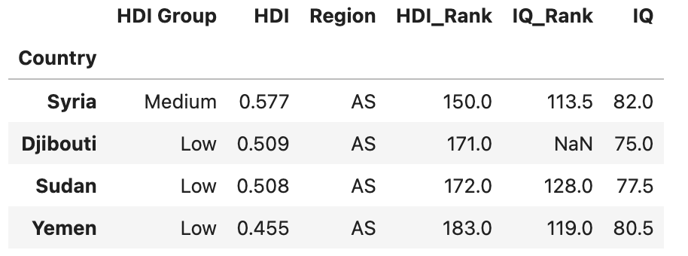
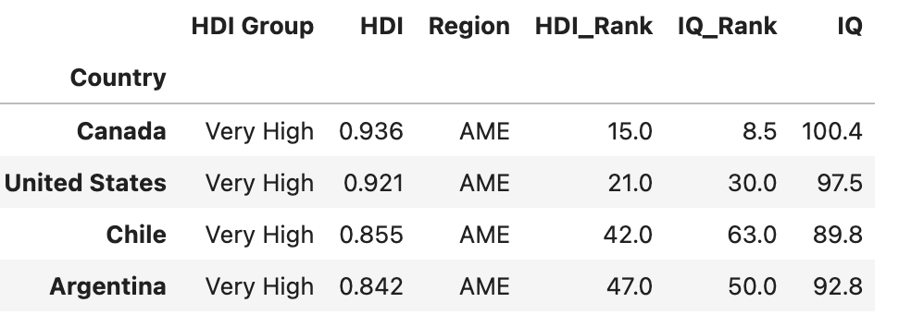
Lower Outliers Americas:
Outliers Sub-Saharan Africa:
Outliers Asia:
Upper Outliers America

Slide 9
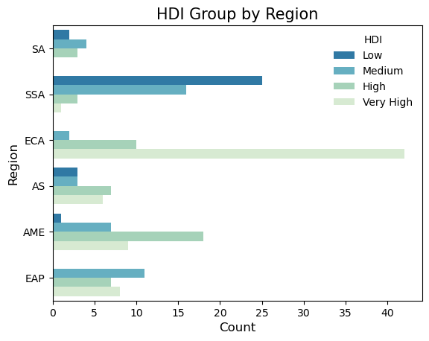
Univariate Analysis HDI

Slide 10
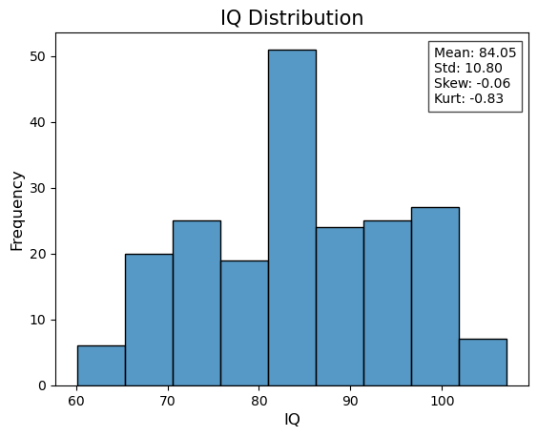
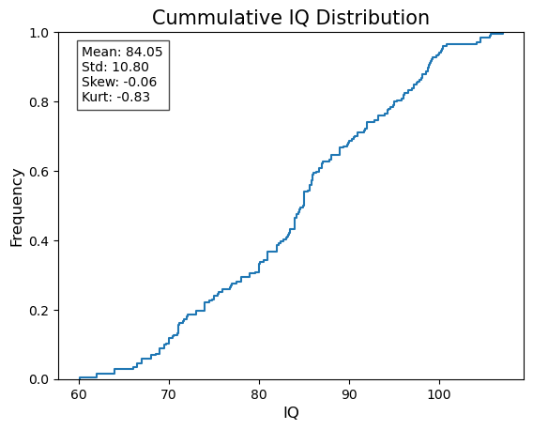
Univariate Analysis IQ

Slide 11
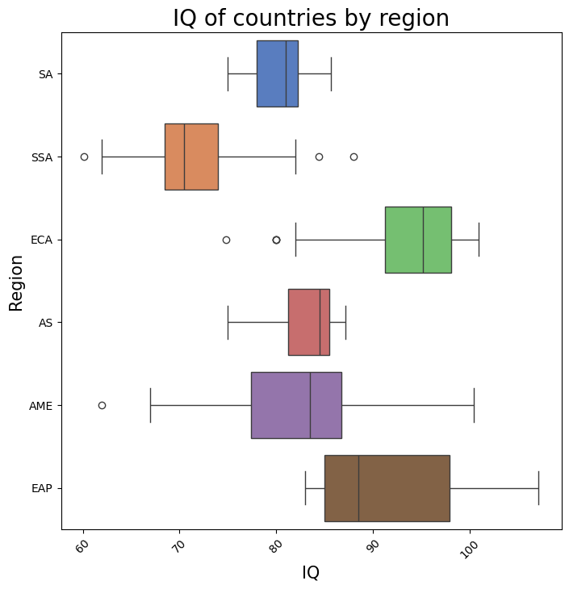
Univariate Analysis IQ

Slide 12
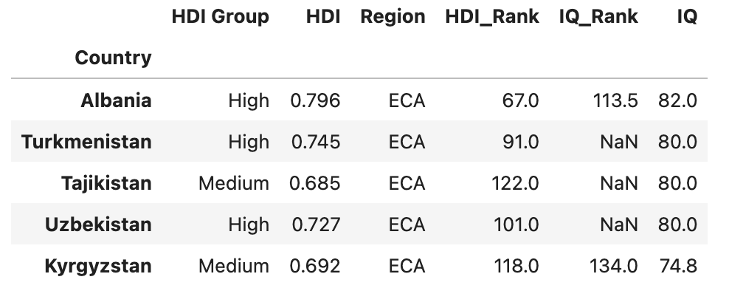
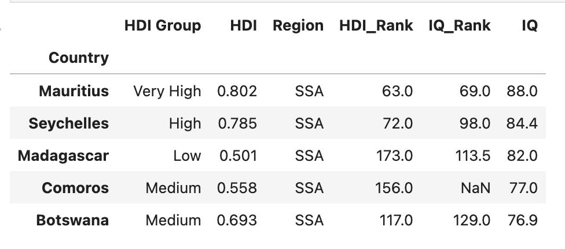
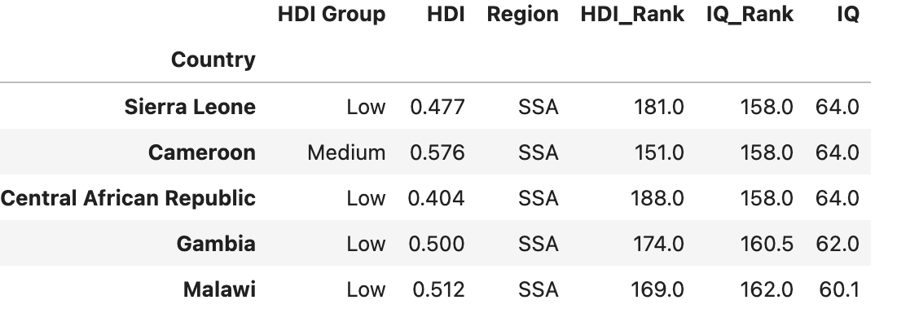
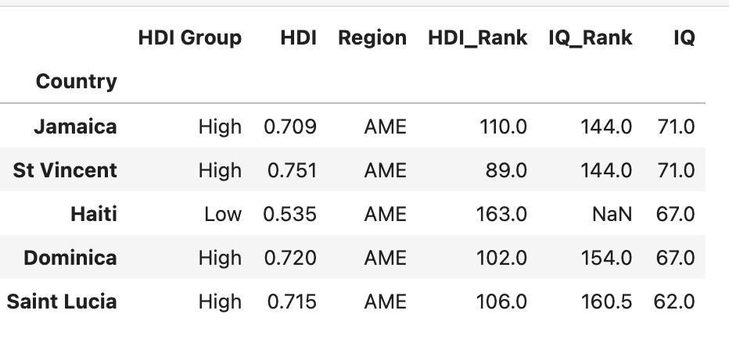
Outliers
Sub-Saharan Africa
Europe and Central Asia
Americas

Slide 13
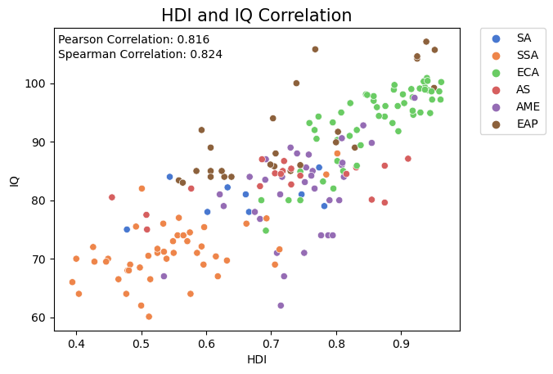
Bivariate Analysis - Global

Slide 14
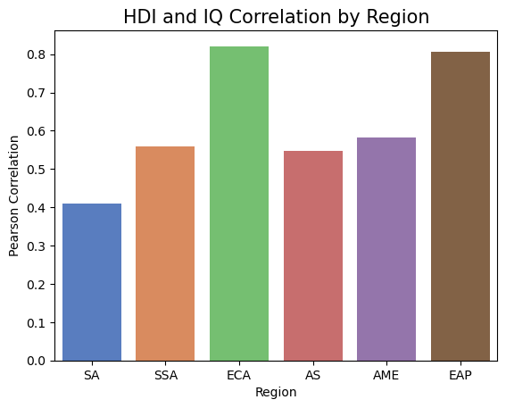
Bivariate Analysis - Region
Notes:
Stronger correlation for developed regions
'SA': 'South Asia',
'SSA': 'Sub-Saharan Africa',
'ECA': 'Europe and Central Asia',
'AS': 'Asia',
'LAC': 'Latin America and the Caribbean',
'EAP': 'East Asia and Pacific'

Slide 15
Conclusions on Hypotheses
Average Country IQ and HDI are indeed positively correlated.
01
Less developed regions are indeed prune to outliers – weaker indicators for country correlation.
02
The IQ is biased towards western countries.
03

Slide 16
01
02
06
03
04
05

