Slide 1
Multi-Class Object Detection in Pediatric Wrist X-rays
Project topic presentation
Group members: Piotr Stachowicz, Jakub Malczak
Dataset: GRAZPEDWRI-DX

Slide 2
Formal Problem Definition
A multi-class detector learns a mapping from an input X-ray image to a set of localized objects with class labels and confidence scores.
Given:
Find:
Objective:
Here, b is a bounding box, c is a class label, and s is the confidence score. The loss combines classification, box regression, and objectness terms.

Slide 3
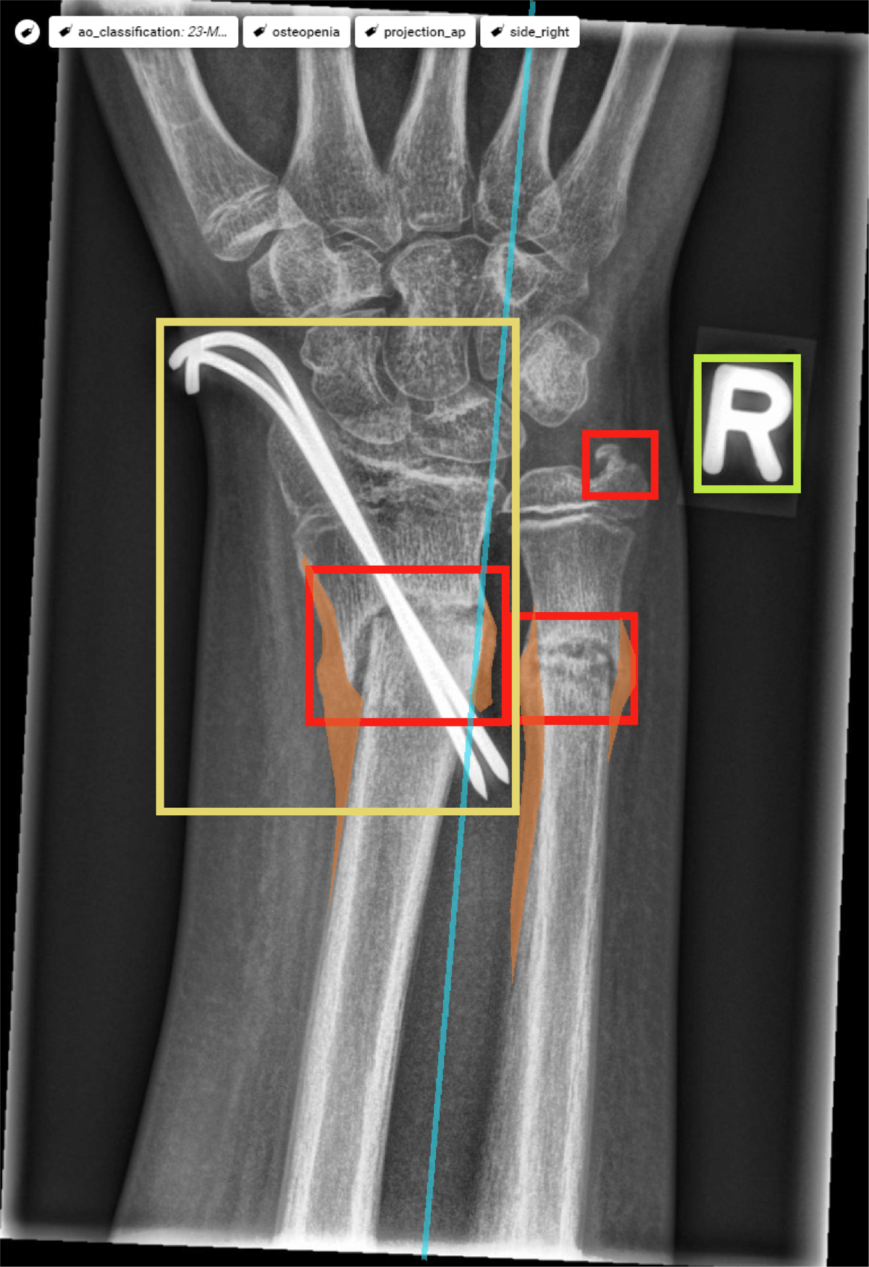
Dataset Overview
GRAZPEDWRI-DX
- 20,327 wrist trauma X-ray images from 6,091 pediatric patients.
- 10,643 studies collected at University Hospital Graz between 2008 and 2018.
- 16-bit grayscale PNG images, mostly PA and lateral views.
- Metadata includes age, sex, laterality, projection, fracture visibility, cast and metal flags.
- The dataset paper reports 74,459 image tags and 67,771 labeled objects.
- License: CC BY 4.0.
Source: Nagy et al., Scientific Data (2022). The image on the right is an annotated sample from the dataset paper.

Slide 4
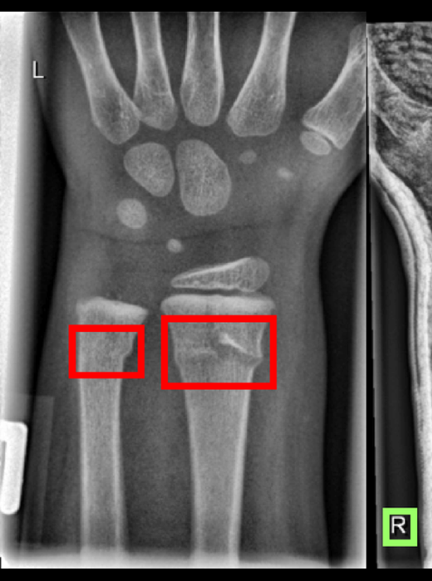
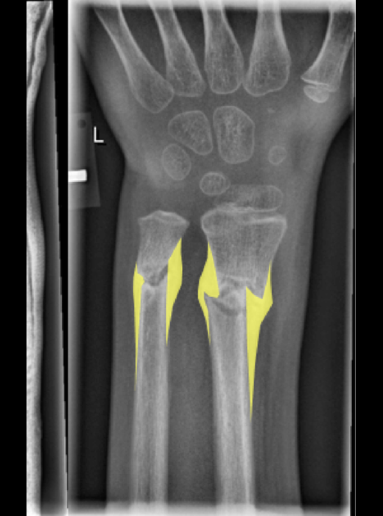
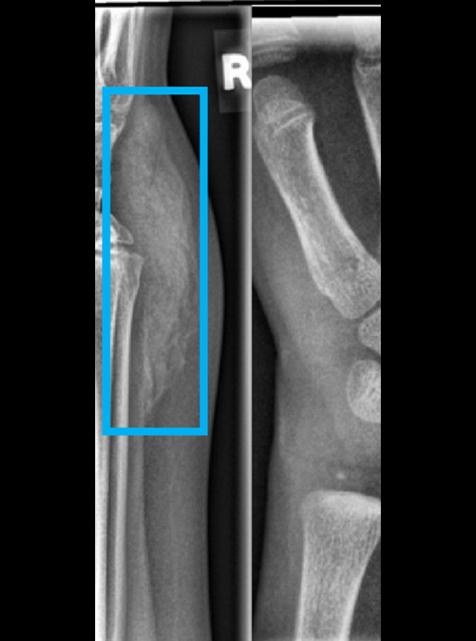
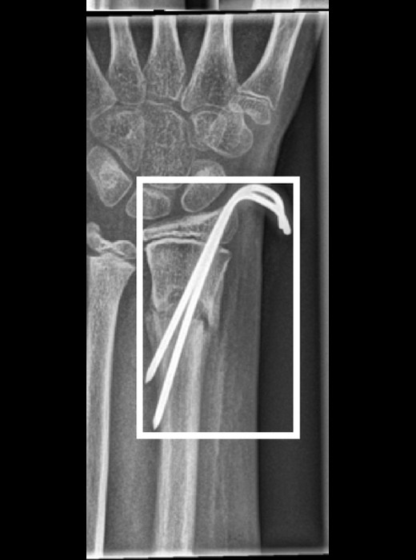
Example Data Points from the Dataset
Fracture
Periosteal reaction
Soft tissue swelling
Metal implant
These examples illustrate the label diversity in GRAZPEDWRI-DX. Other classes and tags include text markers, pronator quadratus sign, foreign body, bone anomaly, cast, and osteopenia.
Across 9 labels, text markers and fracture annotations dominate; most images carry one or two labels.

Slide 5
Clean Dataset for Downstream Modeling
20,327
X-ray images
6,091
pediatric patients
17
fields per record
Demographics
- Age range: 0.2-19.0 years
- Sex: 55.84% male, 44.15% female
- Laterality is balanced across left/right wrists
Data Quality Checks
- Duplicate records: 0
- Missing / empty annotations: 0
- Uncertain diagnoses: 537 cases (2.64%)
The dataset is consistent enough for model training: no duplicate records, no empty annotations, and a low uncertainty rate.

Slide 6
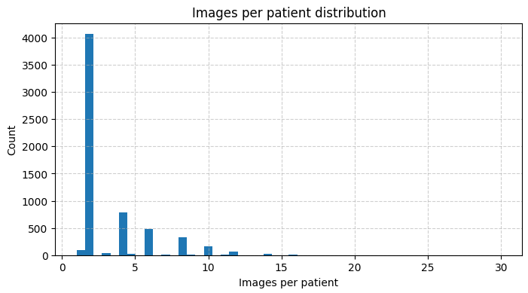
Images per Patient
Summary statistics
- Mean: 3.34 images per patient
- Median: 2.0 images
- IQR: 2-4 images
- Range: 1-30 images
The long tail likely reflects repeated visits, follow-up exams, or multiple projections per study.
Computed via groupby on patient_id across the full dataset (n = 6,091 patients).

Slide 7
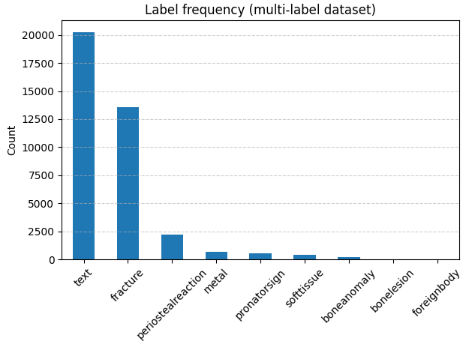
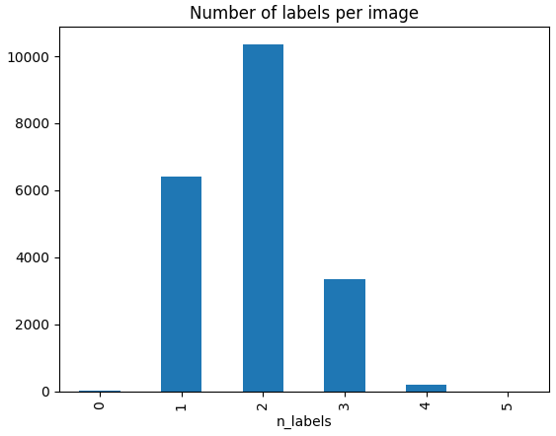
Fracture and Text Labels Dominate
Across 9 possible labels, text and fracture dominate; images carry 1.87 labels on average (median 2, max 5).
Label frequency across the multi-label dataset (n = 20,327 images).
Labels per image, showing that the dataset is mostly sparse.

Slide 8
YOLO26l Leads, YOLO11n Is Most Efficient
Best validation mAP50-95 from each requested run's results.csv.
TOP OVERALL
BEST NANO DEFAULT
FASTEST RUN
31.8%
29.5%
3.1h
yolo26l_default
yolo11n_default
yolo11n_default
Ranked best mAP50-95
Takeaways
- YOLO26l default has the strongest best-epoch score, but is also the slowest run.
- YOLO11n default is the strongest nano/default baseline and the fastest complete run.
- P2 and CBAM variants do not improve mAP50-95 in these logs.
Source: selected training results.csv files in the project workspace.

Slide 9
Best-Epoch Metrics Across Runs
Each row uses the epoch with the highest mAP50-95 for that run.
Run | Epoch | Precision | Recall | mAP50 | mAP50-95 | Val box | Val cls | Time
yolo26l_default | 53 | 77.2% | 41.9% | 52.4% | 31.8% | 1.501 | 0.835 | 10.8h
yolo11n_default | 73 | 71.2% | 47.0% | 48.0% | 29.5% | 1.430 | 0.824 | 3.1h
yolo26n_default | 51 | 76.3% | 43.7% | 47.3% | 27.7% | 1.484 | 0.863 | 4.0h
yolo26n_p2 | 59 | 69.9% | 41.0% | 49.4% | 27.6% | 1.489 | 0.856 | 5.5h
yolo26n_p2_cbam | 68 | 76.3% | 42.9% | 44.5% | 26.6% | 1.488 | 0.871 | 5.6h
yolo26l_p2_cbam-2 | 100 | 62.6% | 40.7% | 42.5% | 24.7% | 1.522 | 0.919 | 6.2h
yolo26n_cbam | 92 | 71.6% | 42.2% | 42.1% | 24.1% | 1.577 | 1.001 | 3.2h
The top row is highlighted. Losses are validation losses from the same best-mAP50-95 epoch.

Slide 10
Precision Is Stronger Than Recall
Best-epoch precision is generally high, while recall remains the main limiting metric.
BEST PRECISION
77.2%
yolo26l_default
BEST RECALL
47.0%
yolo11n_default
The best overall run is precision-heavy: it reaches 77.2% precision but only 41.9% recall at its best mAP50-95 epoch.

Slide 11
Strict mAP Separates the Runs
mAP50 is the looser IoU metric; mAP50-95 is stricter and better reflects localization quality.
Gap to strict metric
yolo26l_default
20.6% gap
yolo11n_default
18.5% gap
yolo26n_default
19.5% gap
yolo26n_p2
21.8% gap
yolo26n_p2_cbam
17.9% gap

Slide 12
Validation Losses Are Similar Across Nano Variants
Box and class losses are shown from each run's best mAP50-95 epoch; lower is better.
Run | Val DFL
yolo26n_default | 0.0103
yolo26n_p2_cbam | 0.0103
yolo26n_p2 | 0.0103
yolo26l_default | 0.0104
yolo26l_p2_cbam-2 | 0.0107
yolo26n_cbam | 0.0110
yolo11n_default | 1.3562
DFL scale differs strongly between these logs, so it is listed separately instead of mixed into the main chart.

Slide 13
YOLO26l Peaks Earliest and Highest
mAP50-95 trajectories sampled every 10 epochs show when each configuration peaked.
Peaks
yolo26l_default
31.8% at epoch 53
yolo11n_default
29.5% at epoch 73
yolo26n_default
27.7% at epoch 51
yolo26n_p2
27.6% at epoch 59
yolo26n_p2_cbam
26.6% at epoch 68
Interpretation: larger variants improve peak accuracy here, while P2/CBAM variants do not beat the default baselines in these requested runs.

Slide 14
YOLO11n Is the Fastest Complete Run
Elapsed training time is taken from the final time value in each results.csv.
Run | mAP50-95 / h
yolo11n_default | 0.097
yolo26n_cbam | 0.076
yolo26n_default | 0.070
yolo26n_p2 | 0.051
yolo26n_p2_cbam | 0.048
yolo26l_p2_cbam-2 | 0.040
yolo26l_default | 0.029
YOLO11n default gives the best accuracy-per-hour tradeoff in these completed logs.

Slide 15
Model Size vs Efficiency
Parameter counts and GFLOPs come from W&B model summaries; efficiency uses best mAP50-95 per million parameters.
Run | Params | GFLOPs | mAP/M
yolo11n_default | 2.59M | 6.45 | 0.114
yolo26n_default | 2.51M | 5.79 | 0.111
yolo26n_p2 | 2.52M | 7.53 | 0.110
yolo26n_p2_cbam | 2.52M | 7.54 | 0.106
yolo26l_p2_cbam-2 | 2.52M | 7.54 | 0.098
yolo26n_cbam | 2.57M | 5.80 | 0.094
yolo26l_default | 26.2M | 93.2 | 0.012
Readout
YOLO26l default gets the best absolute mAP but is about 10x larger than the nano-scale runs. YOLO11n default is the best efficiency point by mAP50-95 per million parameters.

