Slide 1
BITCOIN TRANSACTION CLASSIFICATION
Detecting illicit Bitcoin transactions
The project combines the Elliptic transaction dataset, temporal validation, graph exploration, and supervised models to classify transactions as licit or illicit.
Transaction graph
Nodes are transactions, edges are payment flows, labels mark illicit / licit / unknown behavior.
Raw data
EDA & graph
Temporal split
Models
Risk scores
Sources: Elliptic dataset, project notebooks and generated analysis figures
01

Slide 2
ELLIPTIC BITCOIN TRANSACTIONS
Dataset at a Glance
203,769
234,355
49
165
transactions / nodes
directed edges
time steps
features
all observed transactions
transaction graph links
temporal snapshots
plus time step
Class labels are sparse and imbalanced
What makes the dataset challenging
Only 22.9% of transactions are labeled; the remaining 77.1% are unknown.
Illicit transactions are 9.8% of labeled data, so recall and precision trade off strongly.
The graph is sparse overall, but a small set of nodes has very high degree.
Sources: Elliptic dataset, project notebooks and generated analysis figures
02

Slide 3
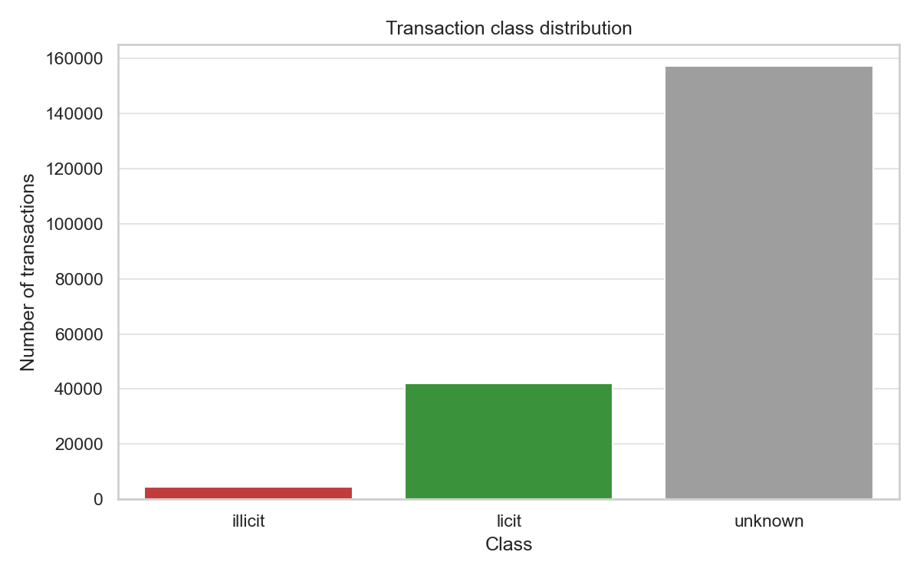
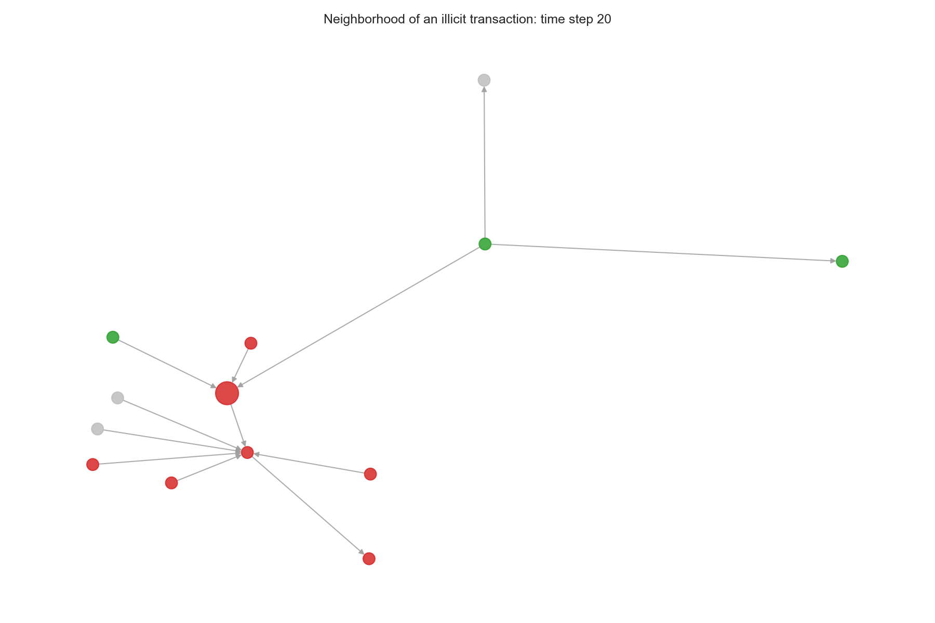
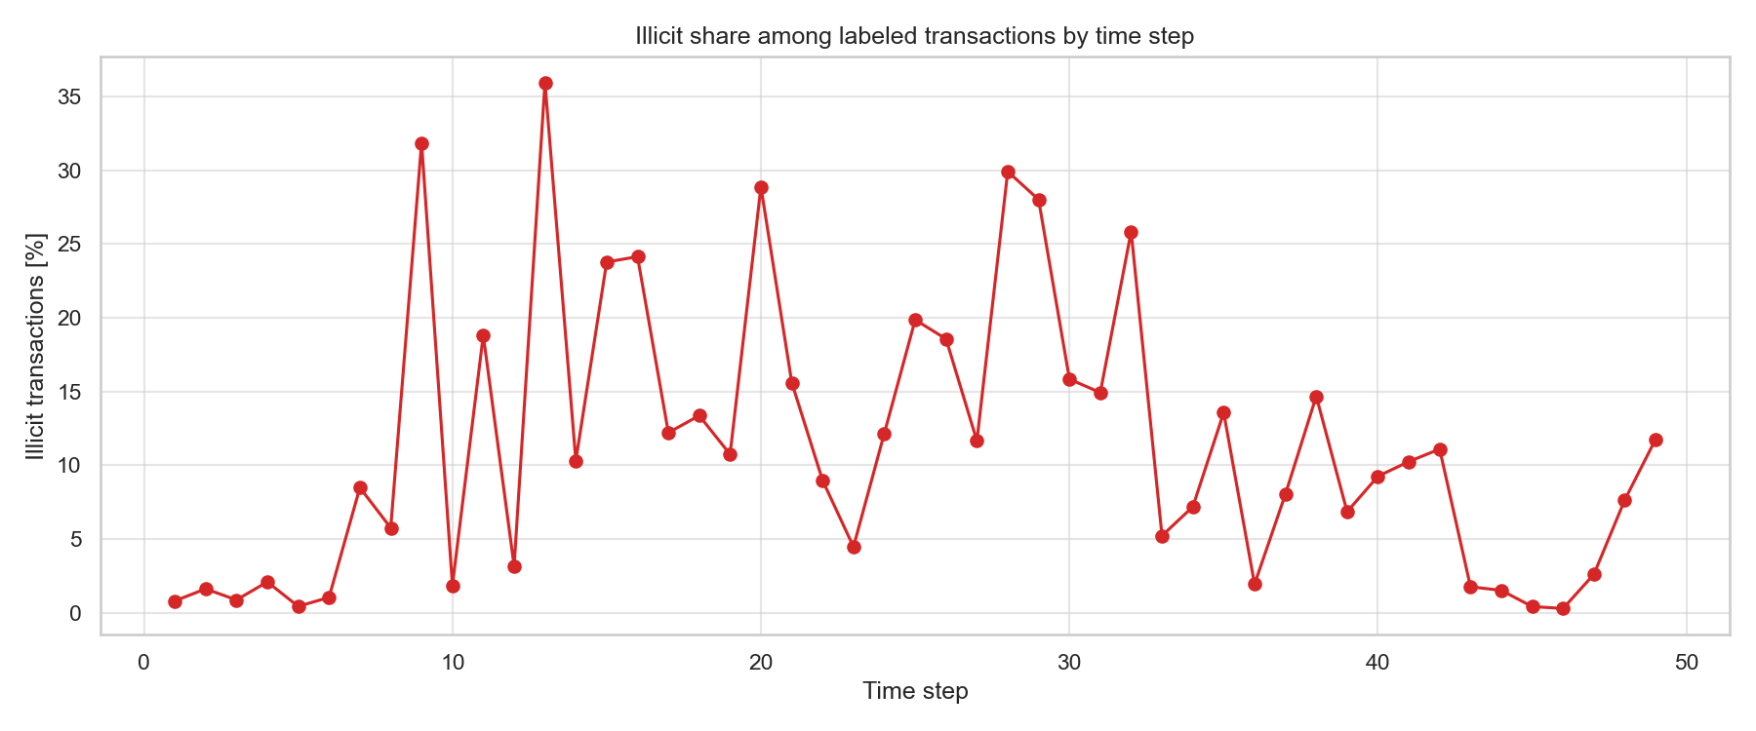
EDA SNAPSHOTS
Exploratory Analysis Highlights
Unknown labels dominate the dataset; illicit cases are the minority class.
Illicit prevalence changes over time, suggesting concept drift risk.
Local graph neighborhoods reveal mixed illicit, licit, and unknown context.
Sources: project EDA figures generated from the Elliptic dataset
03

Slide 4
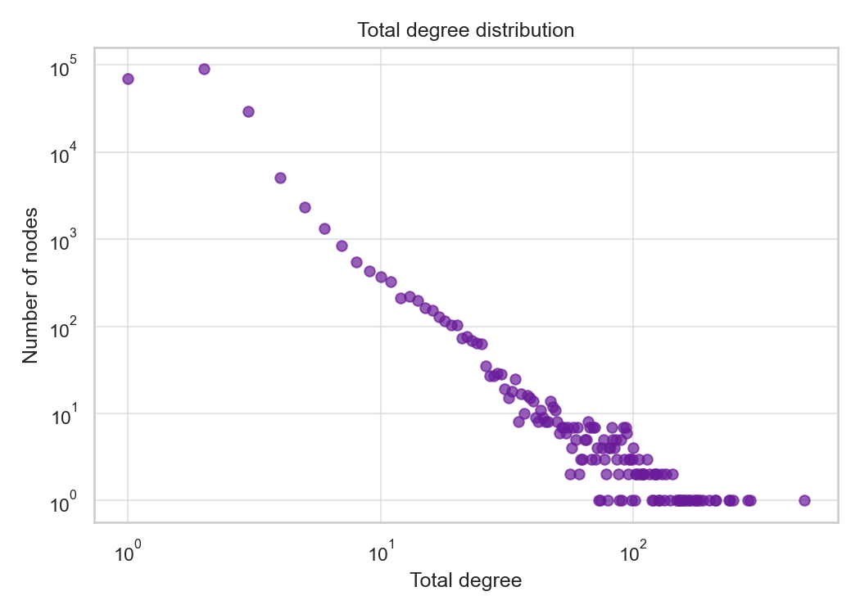
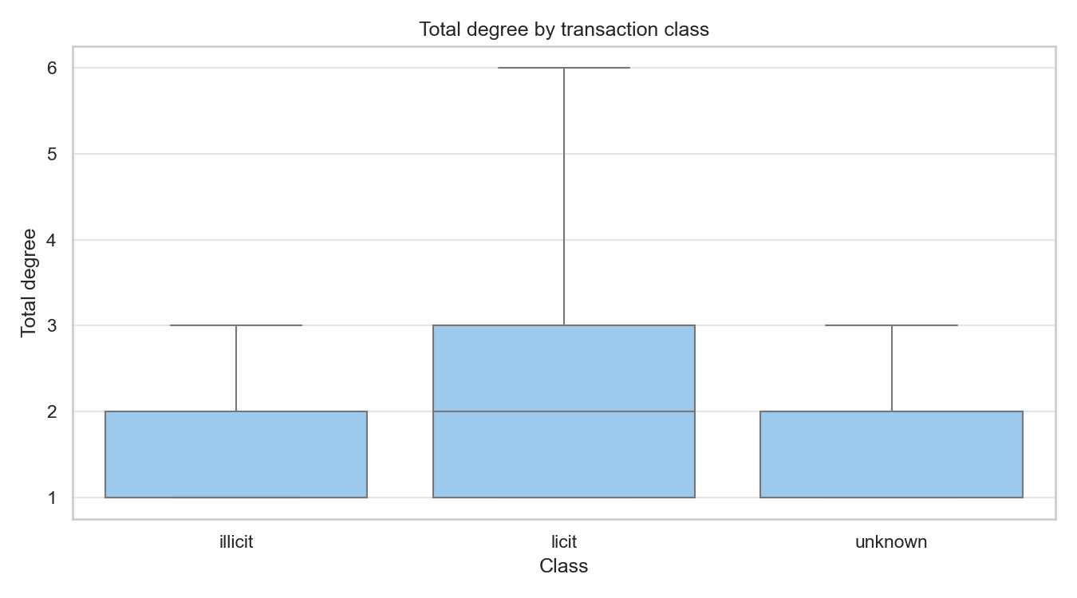
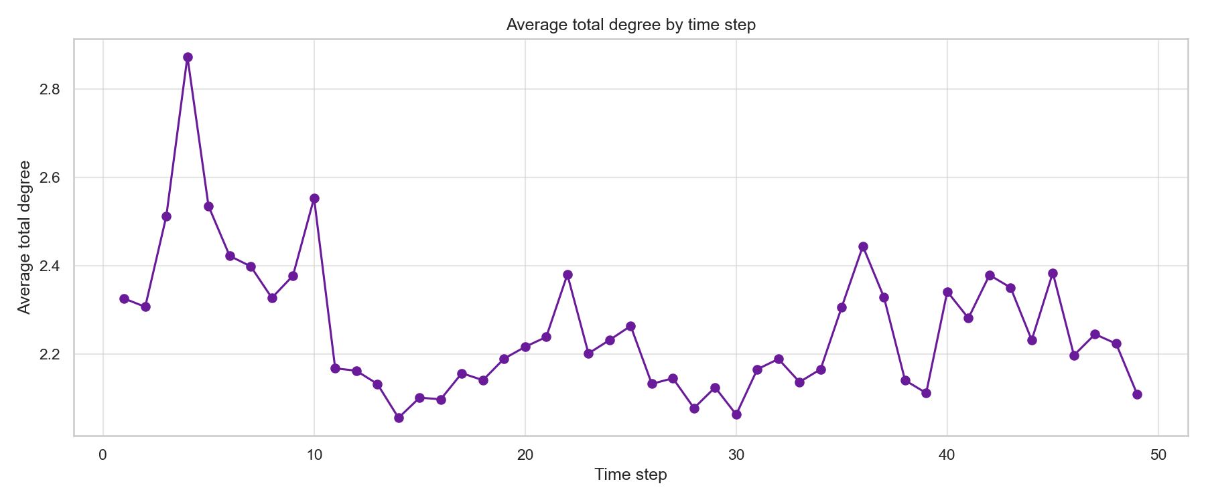
SPARSE NETWORK, LONG-TAIL DEGREE
Graph Structure
Most nodes have low degree, with a visible long-tail pattern.
Licit transactions show a slightly higher average degree in this dataset.
Connectivity intensity shifts over time.
2
13
473
median degree
99th percentile
max degree
typical transaction connectivity
upper-tail degree
largest observed hub
Sources: project graph EDA figures and dataset-derived degree statistics
04

Slide 5
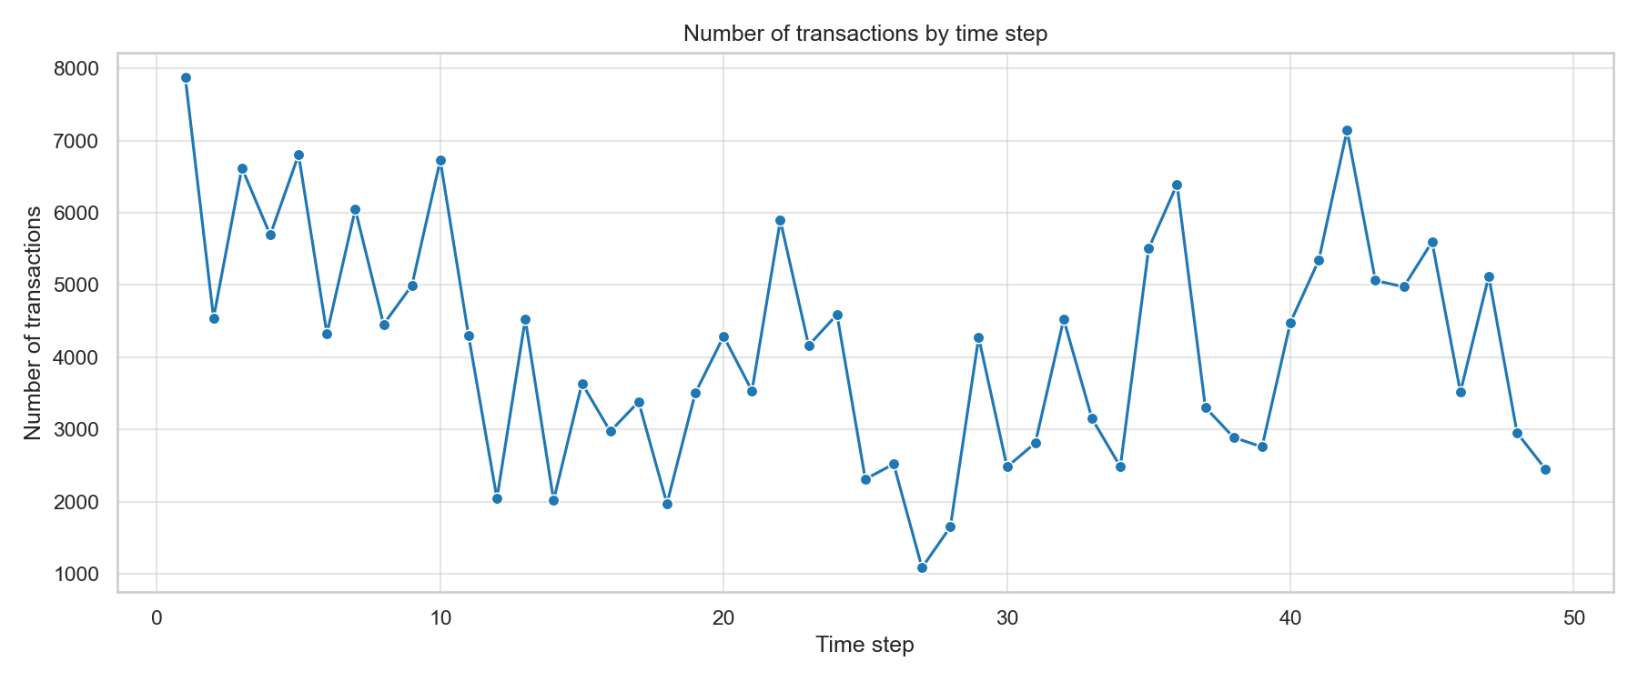
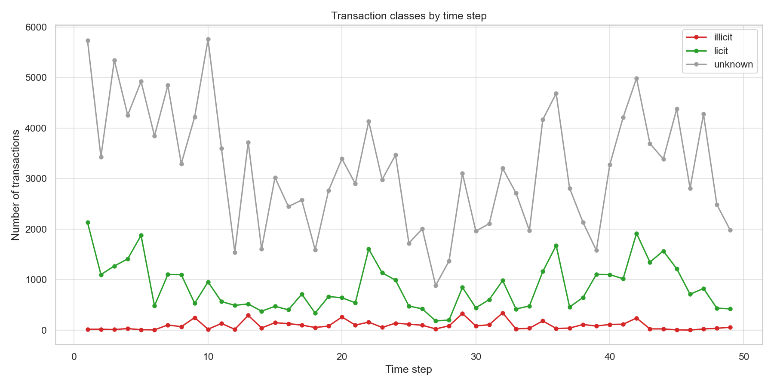
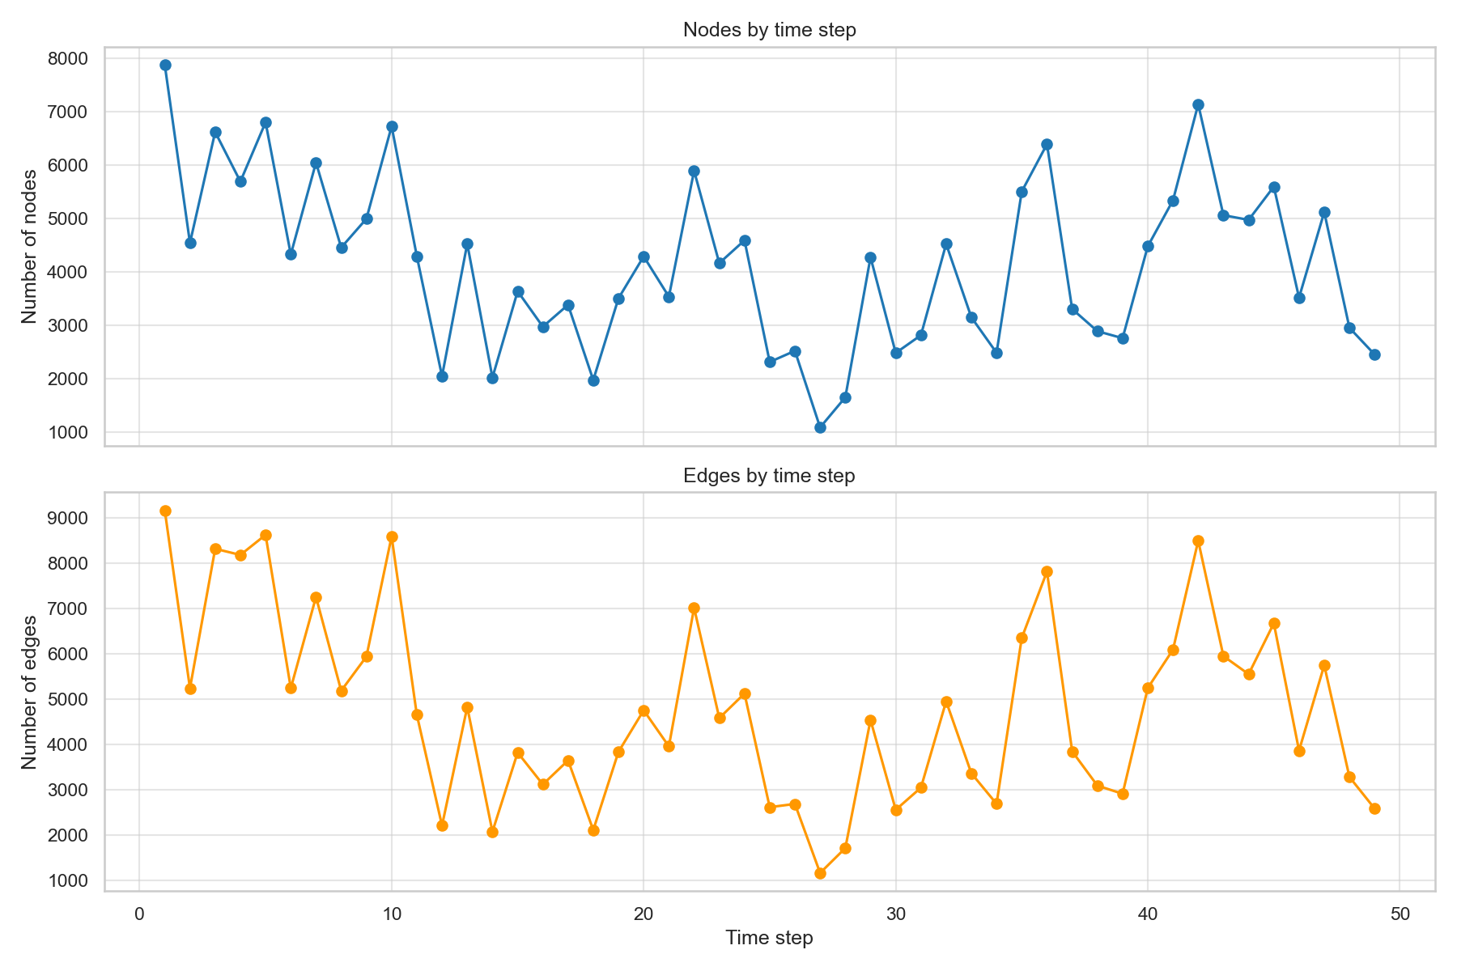
WHY TIME-AWARE VALIDATION MATTERS
Temporal Dynamics
Transaction volume varies sharply across the 49 timesteps.
Labeled class counts shift over time, especially for unknown labels.
Implication for modeling
Random splits would leak future distribution patterns into training.
Validation thresholds should be selected on past data before scoring future timesteps.
Nodes and edges rise and fall together, but not perfectly.
Sources: project EDA figures and temporal split design
05

Slide 6
TEMPORAL VALIDATION
Overall Test Results
Best model
Thresholded detection quality
XGBoost
Precision 0.958 | Recall 0.652 | ROC AUC 0.907
trained on all available transaction features
Predicted licit
Predicted illicit
Actual licit
12,728
25
0.776
0.748
Actual illicit
302
566
F1 illicit
PR AUC
main selection metric
minority-class ranking
At a validation-selected threshold of 0.84, the model correctly flags 566 illicit transactions while producing 25 false positives on the test set.
Source: notebooks/04_classic_models_results.ipynb, temporal 70-15-15 split
06

Slide 7
F1 FOR THE ILLICIT CLASS
Model Comparison
Top model runs
1
XGBoost
0.776
all
2
Random Forest
0.767
all
3
Random Forest
0.746
local
4
XGBoost
0.736
local
5
Random Forest
0.730
all + GCN embeddings
Full feature set + tree models performs best; GCN embeddings did not improve the strongest runs.
Source: notebooks/04_classic_models_results.ipynb
07

Slide 8
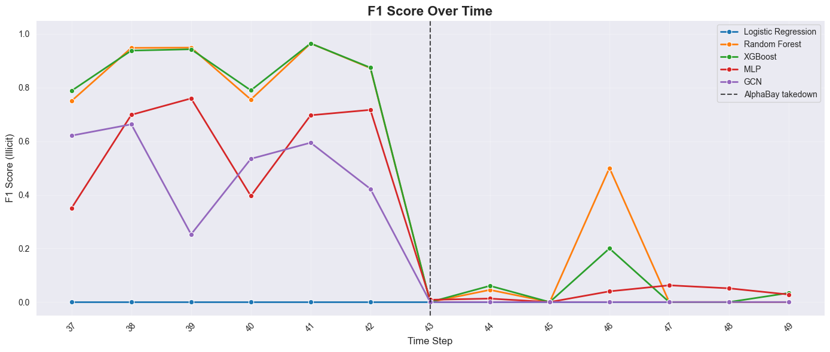
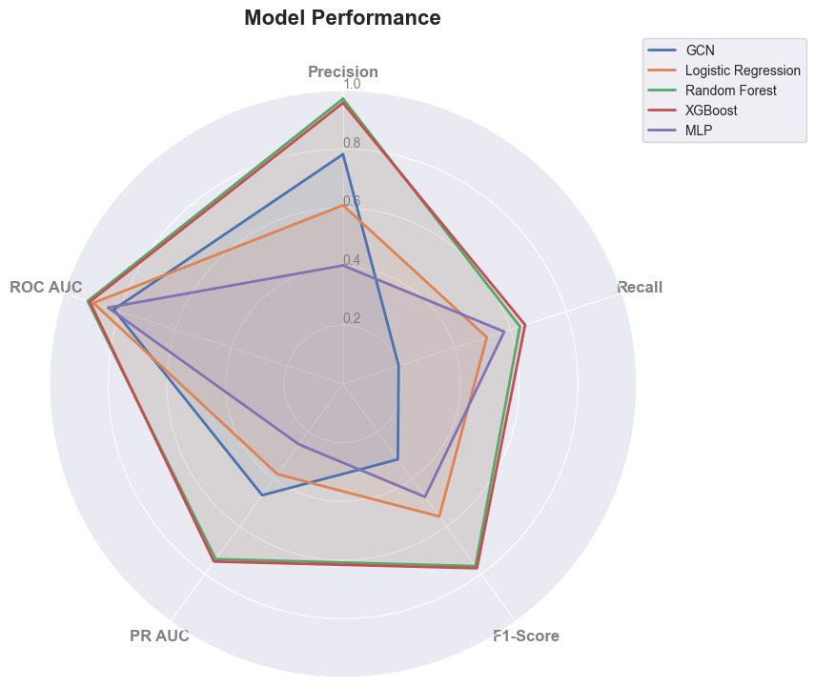
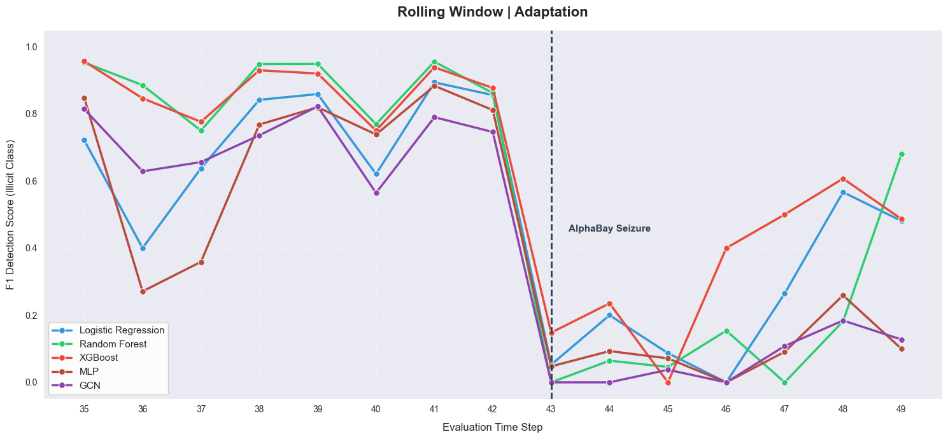
NOTEBOOK RESULT PLOTS
Additional Result Diagnostics
Static temporal test split: performance drops sharply after the marked event.
Radar view across precision, recall, F1, PR AUC, and ROC AUC.
Rolling-window adaptation recovers some later timesteps but remains volatile.
Sources: PNG result plots saved in notebooks/
08

Slide 9
PROJECT SUMMARY
Takeaways
Tree models lead
Full features matter
XGBoost and Random Forest give the strongest illicit-class F1 and PR AUC on the temporal test split.
The best run uses all anonymized features plus time step, outperforming local-only and embedding-augmented variants.
Imbalance is central
Time drift remains
Illicit transactions are under 10% of labeled examples, making PR AUC and threshold selection more useful than accuracy.
Temporal shifts in class mix and graph size suggest rolling-window evaluation and period-aware calibration as next steps.
Recommended next experiment: rolling temporal retraining with calibrated model thresholds and graph-derived features added to the strongest tree-based baseline.
Sources: Elliptic dataset, project notebooks and generated analysis figures
09

