Slide 1
Django – what’s what
Virtual environment
Created by migrate
then: python manage.py runserver
Django instance
defines tables
1 atribute = 1 field
Data model (.py):
database
settings.py
views
templates

Slide 2
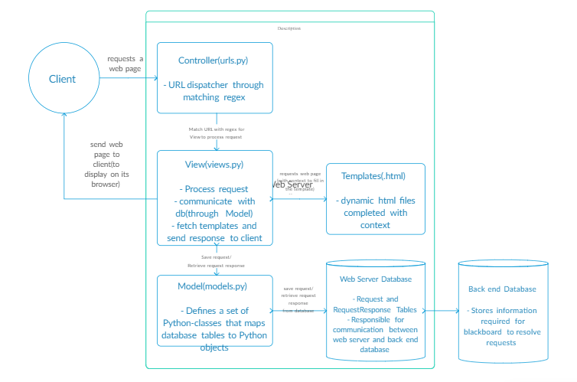
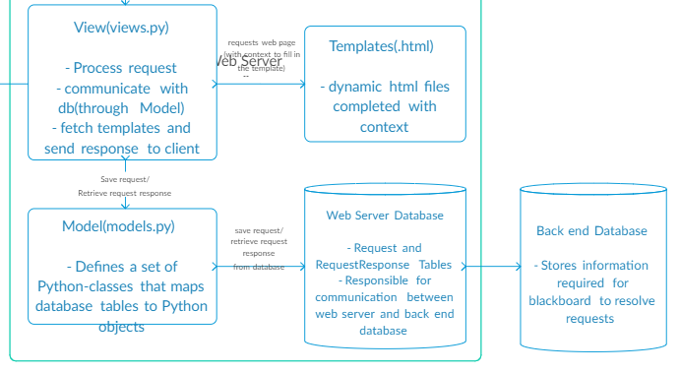

Slide 3
