Slide 1
BATMAN: Virtual Stock
Mengyuan Zhu, Sungjae Kim, Sharon Kim, Hyeun Kang, Jakub Pietrasik

Slide 2
Batman
Mengyuan Zhu
Sungjae Kim
Sharon Kim
Hyeun Kang
Coordinator
Documents handler
Java coder
Problem Statement
Requirements Traceability Matrix
User Guide
Finalize code documentation
Java coder
Requirements Traceability Matrix
Gannt Chart
Category Interaction Diagram
Function Point Cost Analysis.
Program tester
Rationale
Program tester
Javadoc
Comments
Java coder
Other
Jakub Pietrasik
Legacy
Object Design
Program tester

Slide 3
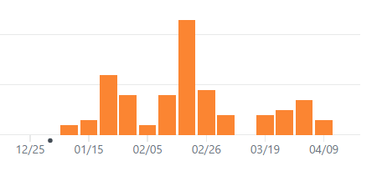

Github (commits)
https://github.com/MengyuanZhu/SoftwareEngineering

Slide 4
Overview/Purpose
We developed a PC software with a user-friendly GUI. The software is for virtual stock trading. The price is real-time while the exchange is virtual. It’s easy to use for stock market beginners.
1. Access market quotes and data in real-time
2. View detailed charts of historical market data
3. Transfer money from/to a virtual bank
4. View User history

Slide 5
Background
Google Finance API
http://finance.google.com/finance
Yahoo Finance API
http://chartapi.finance.yahoo.com

Slide 6
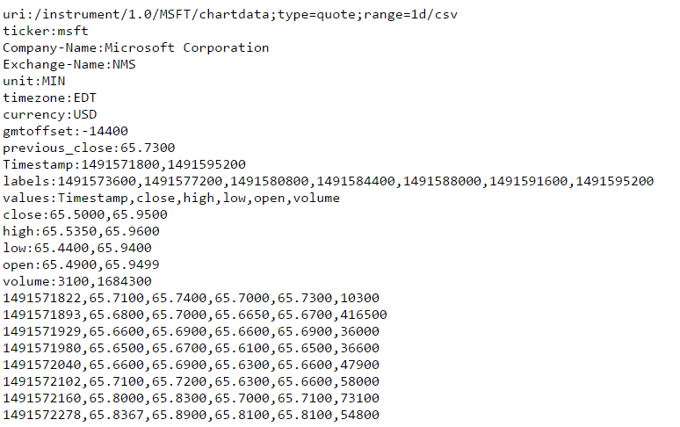
Background Yahoo API
Used in getting basic information
Used in plot

Slide 7
Third party library
gson
To parse JSON
https://repo1.maven.org/maven2/com/google/code/gson/gson/2.6.2/
sqlite
To process SQL
https://mvnrepository.com/artifact/org.xerial/sqlite-jdbc/3.16.1

Slide 8
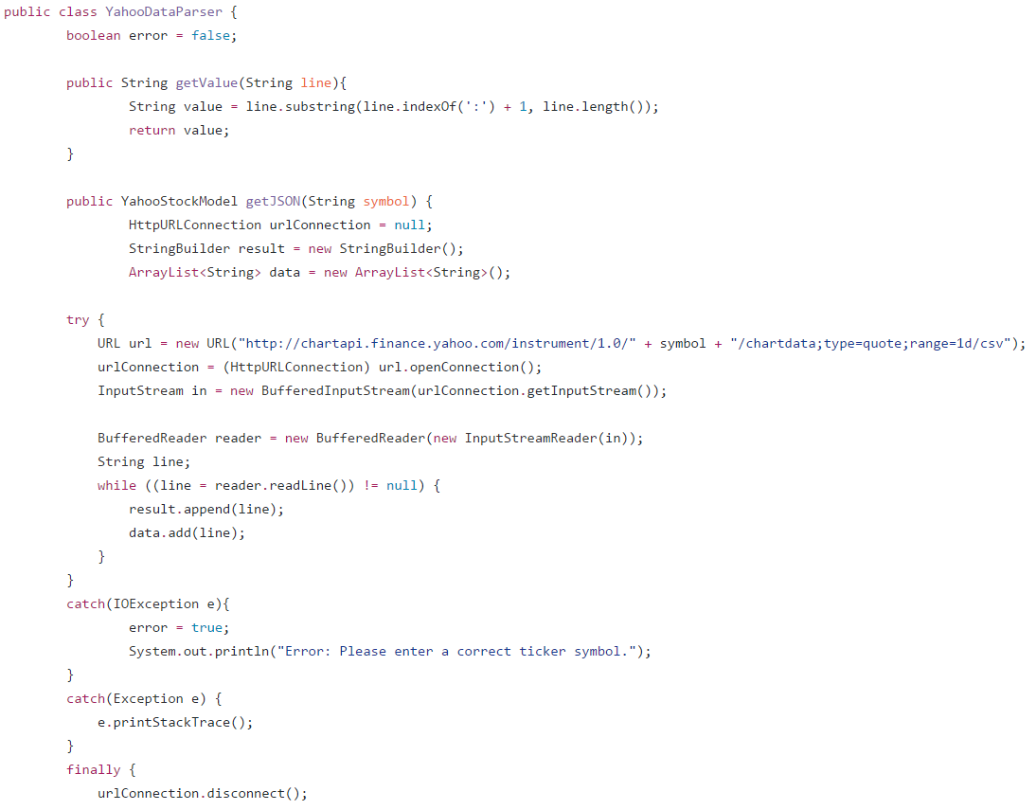
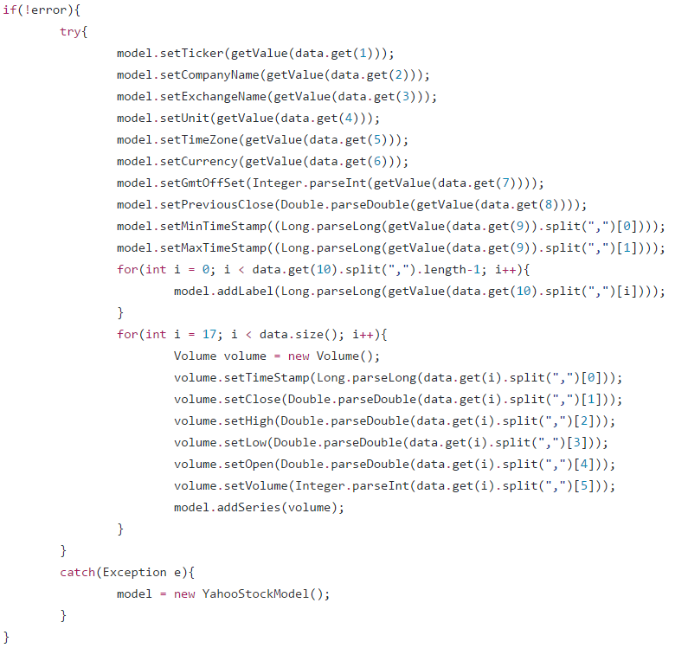
JSON for Yahoo Data

Slide 9
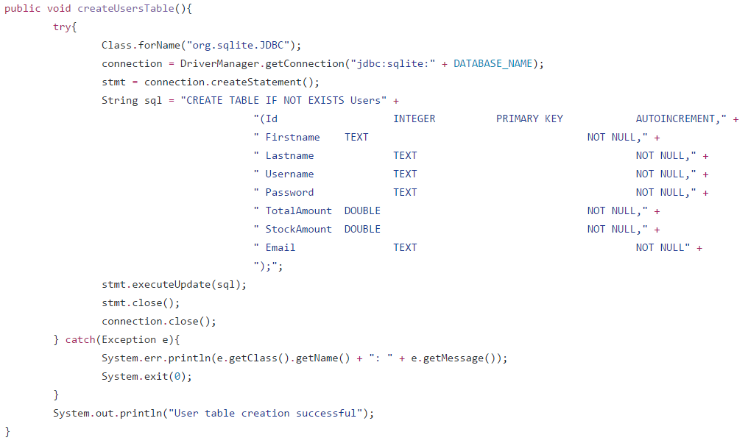
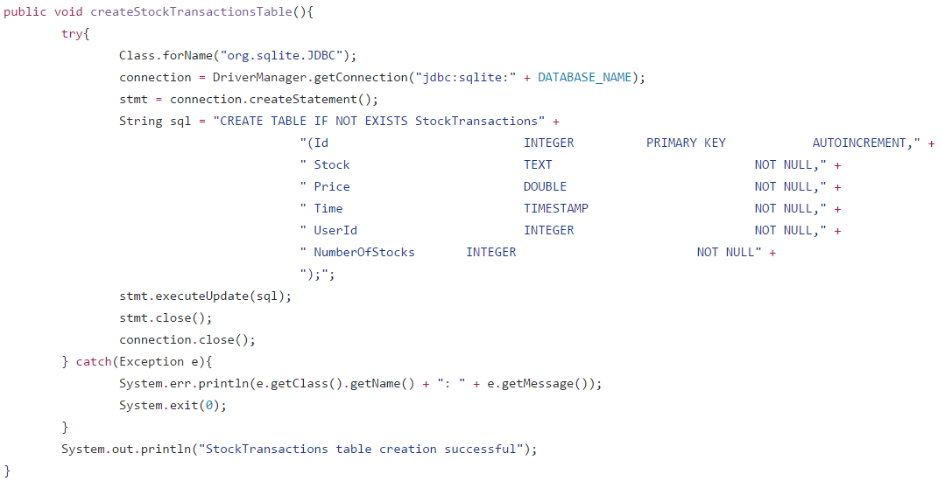
SQLITE for USER and transactions

Slide 10
System Model (MVC)
Model
TransactionModel.java
View
BankAccountView.fxml
EditAccountView.fxml
Controller
AccountController.java
EditAccountController.java
UserModel.java
Volume.java
YahooStockModel.java
BankAccountController.java
HistoryController.java
LoginController.java
MainController.java
PortfolioController.java
SignupController.java
StockController.java
History.fxml
LoginView.fxml
MainView.fxml
Portfolio.fxml
PortfolioView.fxml
RootLayout.fxml
SignupView.fxml
StockView.fxml

Slide 11
Metrics (lines of code)
Source code + GUI + Javadoc = ~6000 lines
Calculated using Github graphs

Slide 12
Metrics (Pages of Report)
Topic | Pages
Topic description | 1
Requirements traceability matrix | 1
Use cases | 8
Interaction diagram | 5
Software architecture | 1
Database | 1
Work structure document | 1
Dictionary | 1
Object design | 2
Topic | Pages
Test cases | 1
Rationale | 2
Function point cost analysis | 2
Construction cost model | 2
Source code link to Github | 1
Resumes | 7
User Guide | 3
Gannt Chart | 1
Category Interaction diagram | 1

Slide 13
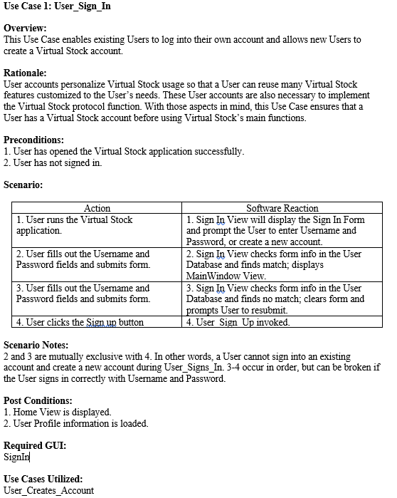
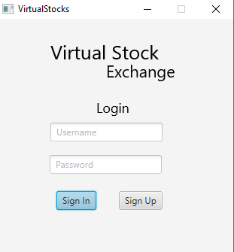
use cases 1. Sign IN

Slide 14
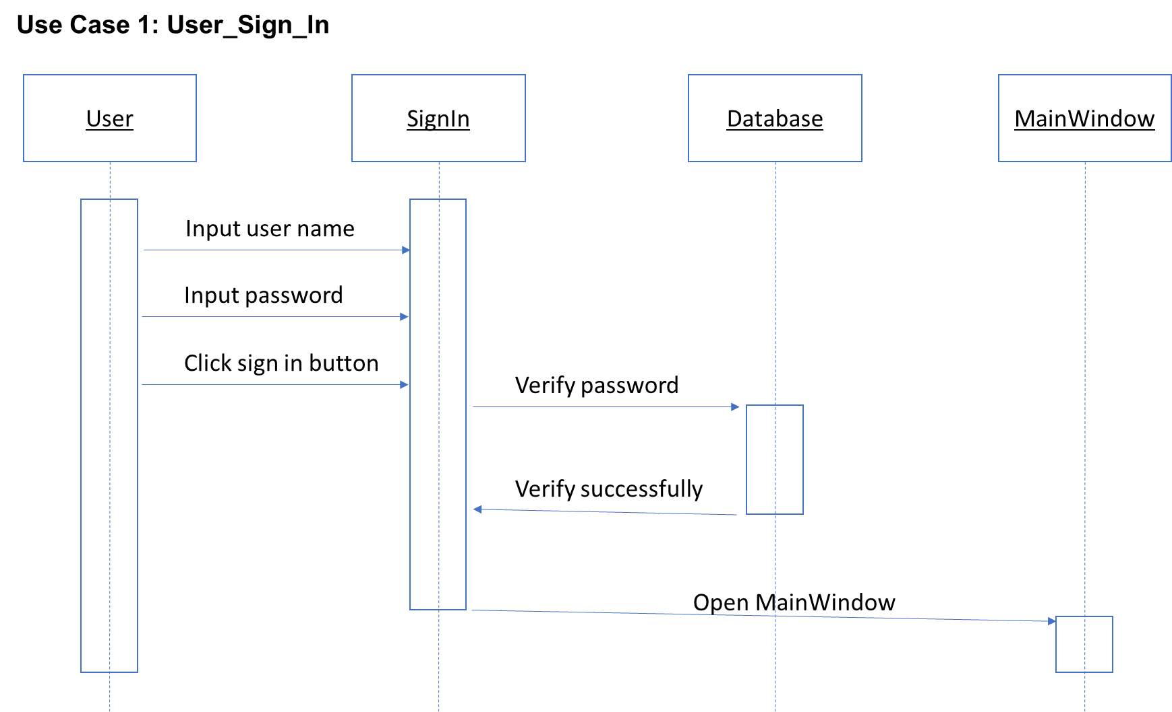
use cases 1. Sign IN

Slide 15
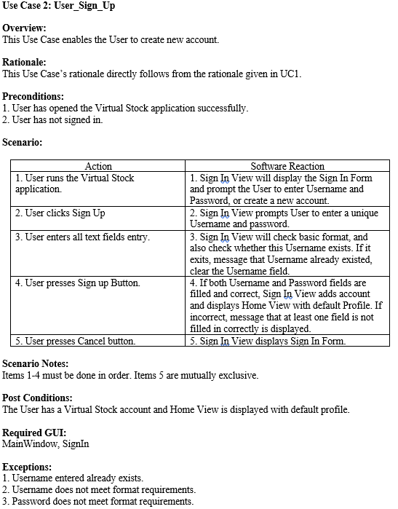
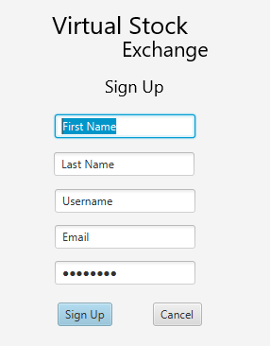
use cases 2. Sign up

Slide 16
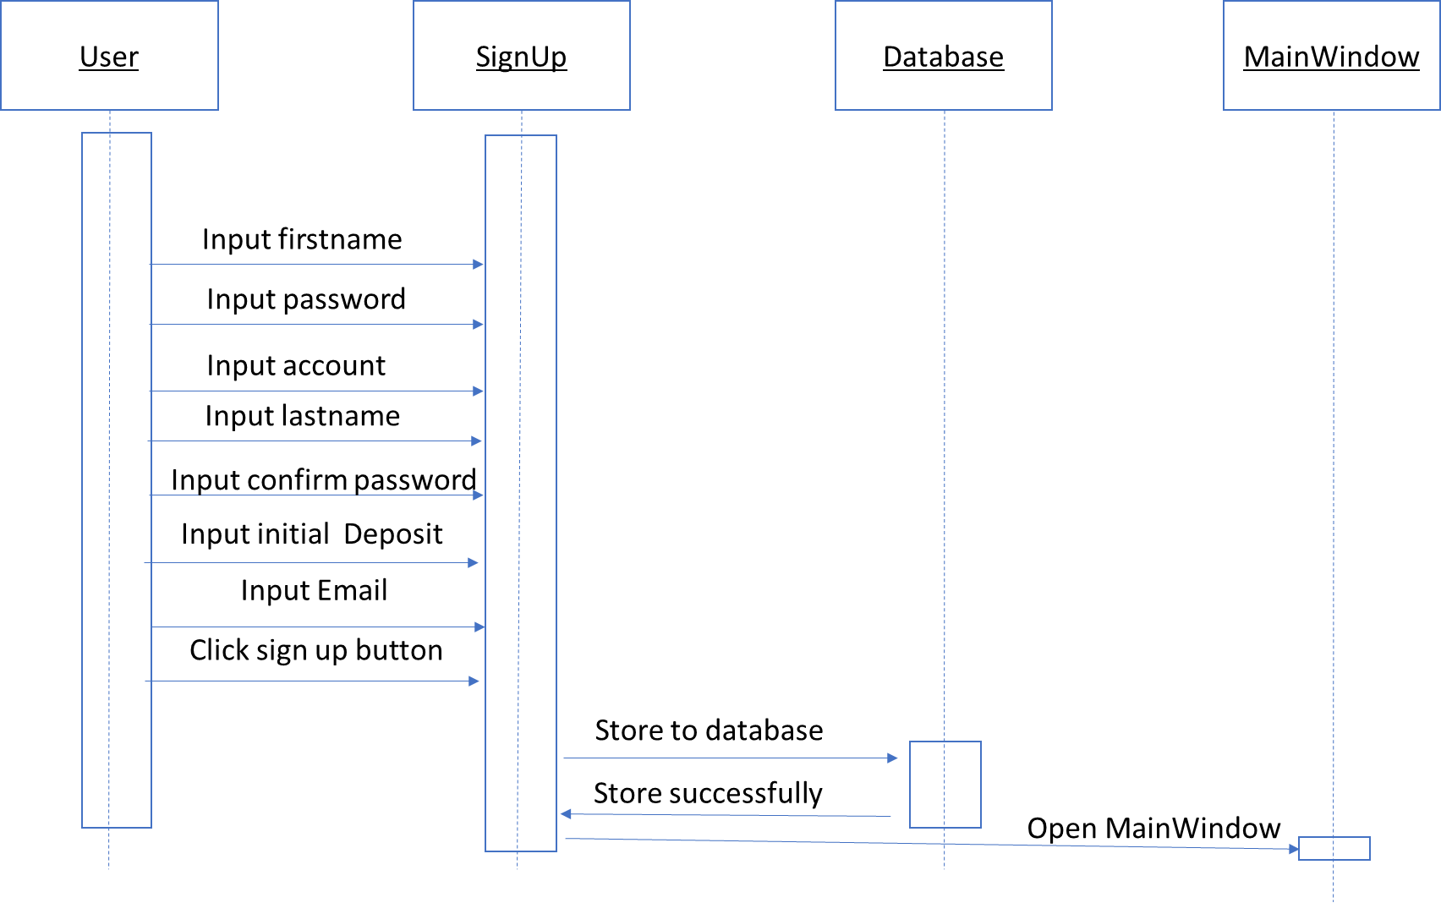
use cases 2. Sign up

Slide 17
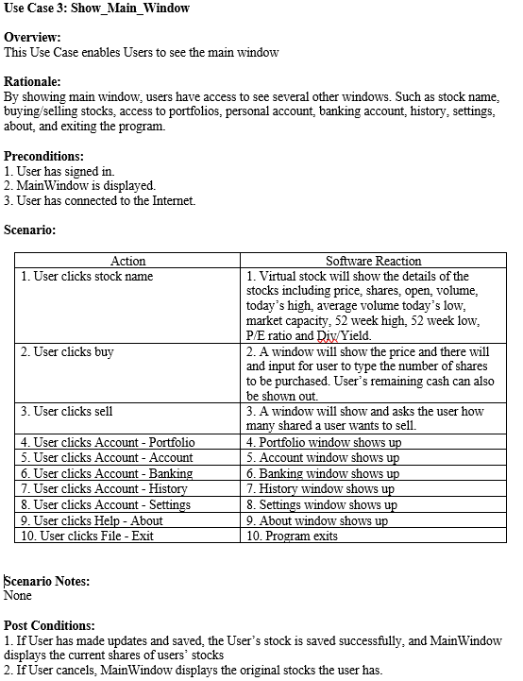
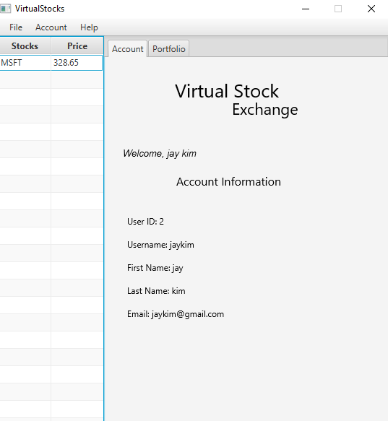
use cases 3. SHOW_MAIN_Window

Slide 18
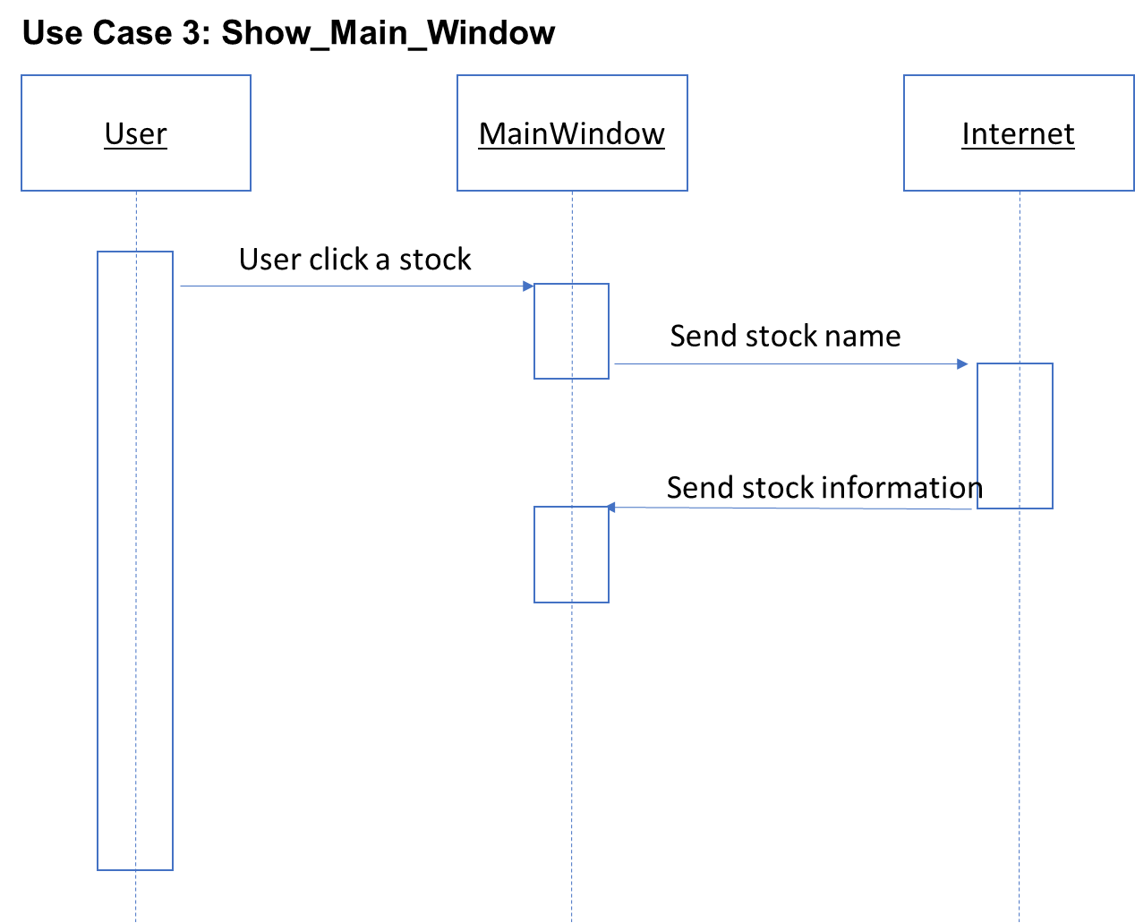
use cases 3. SHOW_MAIN_Window

Slide 19
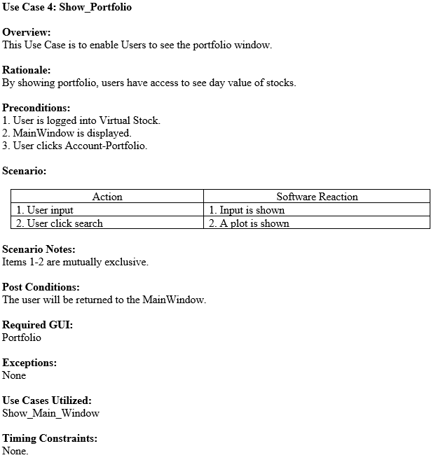
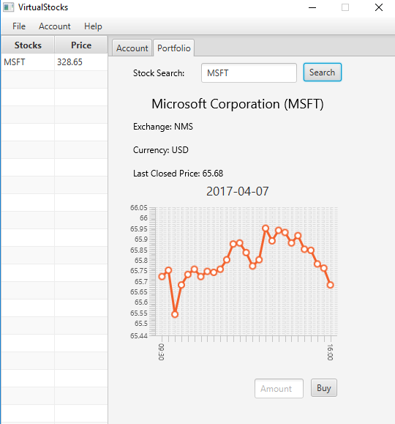
use cases 4. SHOW_Portfolio

Slide 20
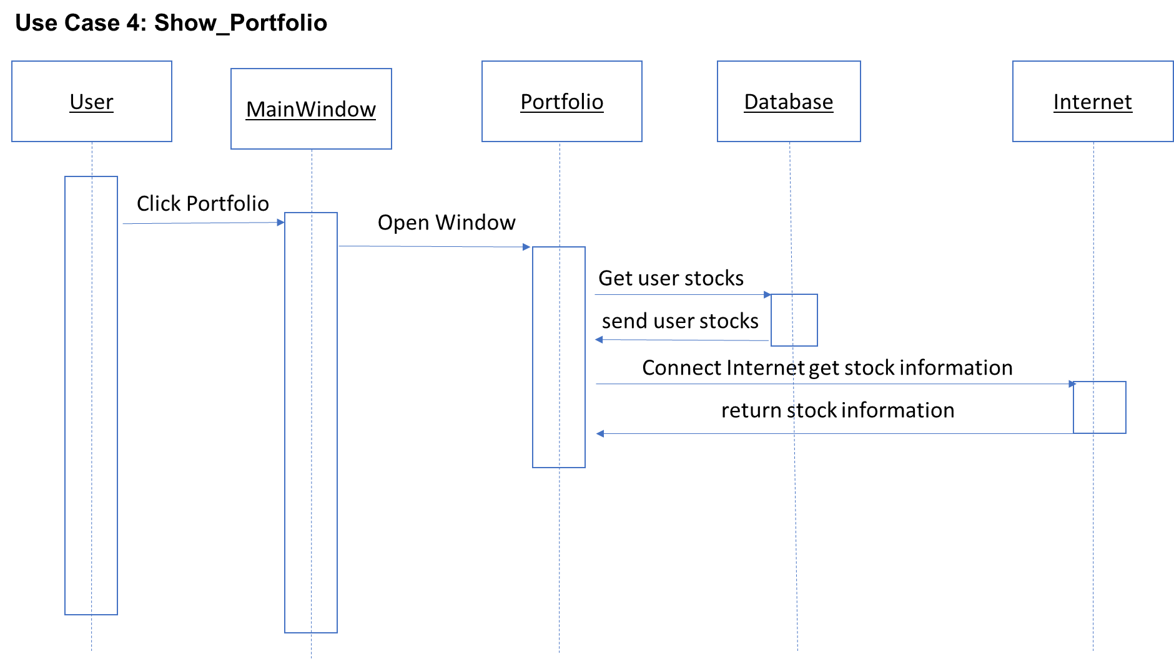
use cases 4. SHOW_Portfolio

Slide 21
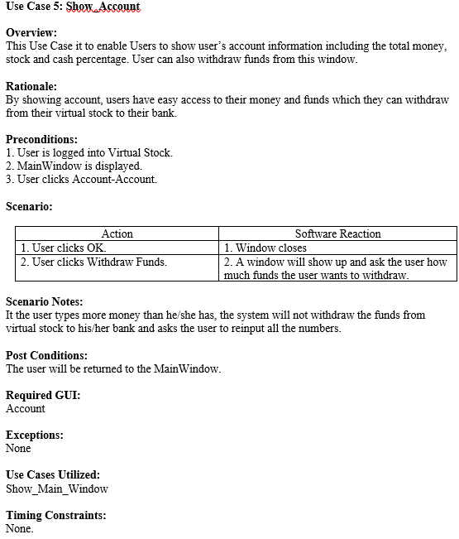
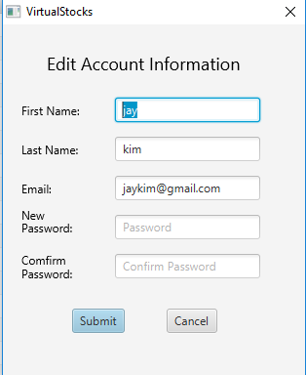
use cases 5. Show_account

Slide 22
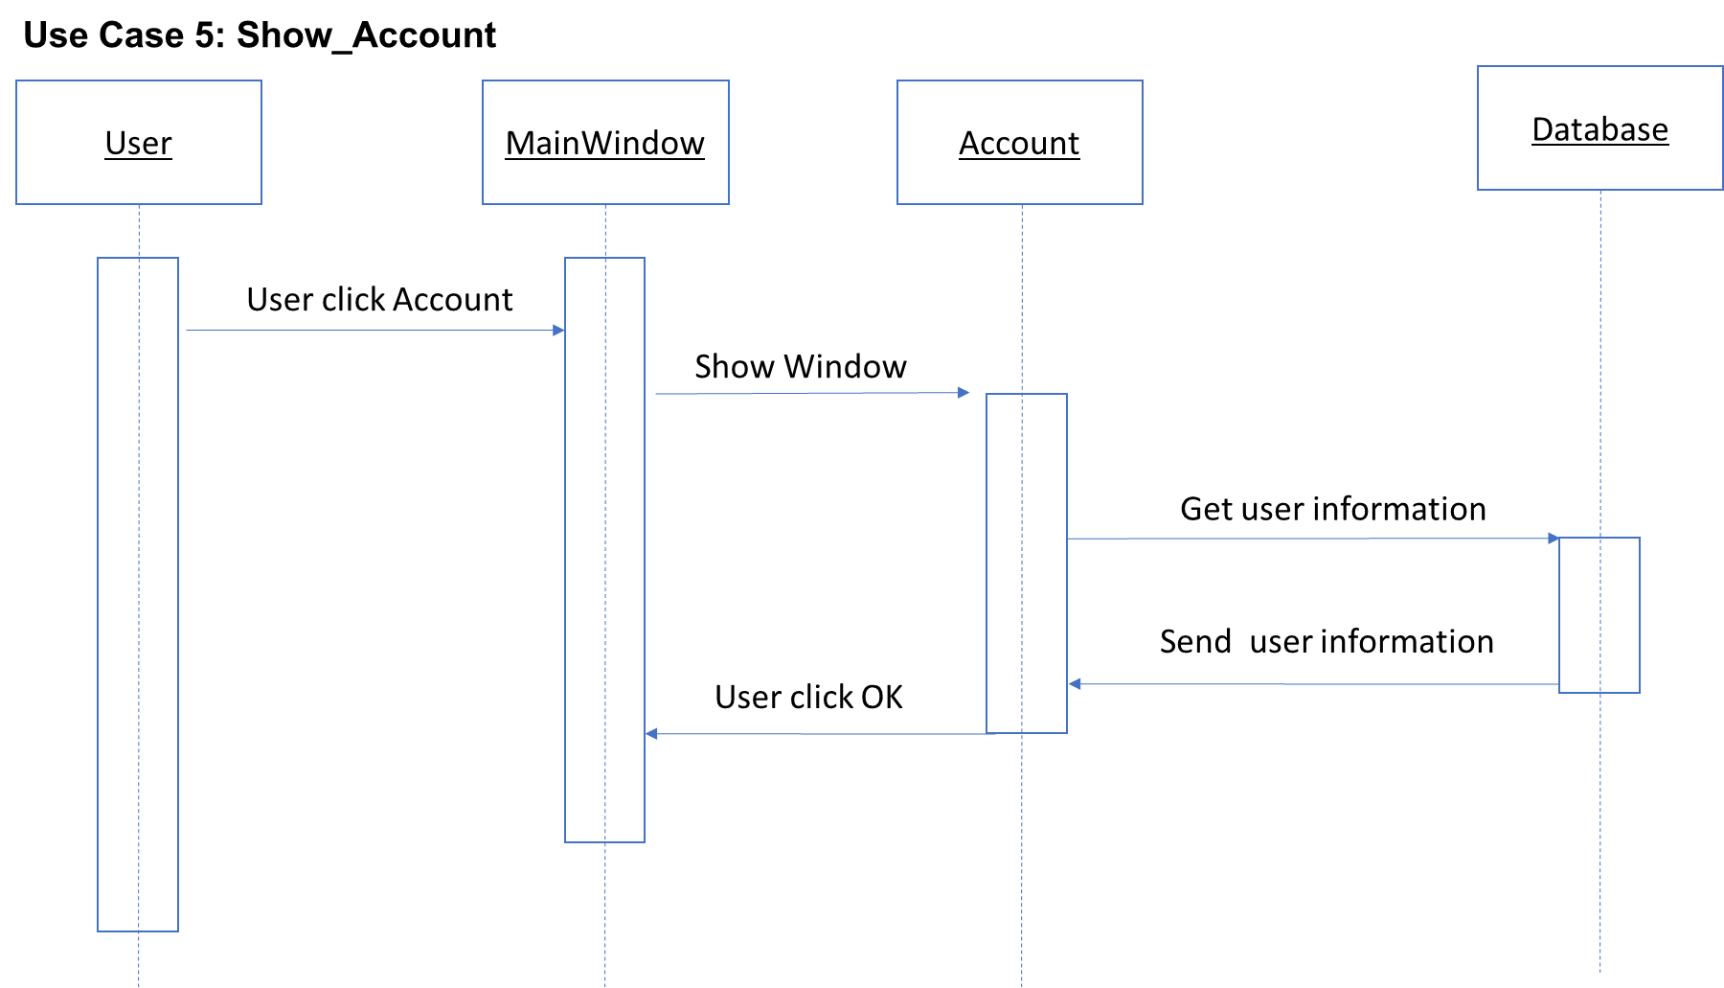
use cases 5. Show_account

Slide 23
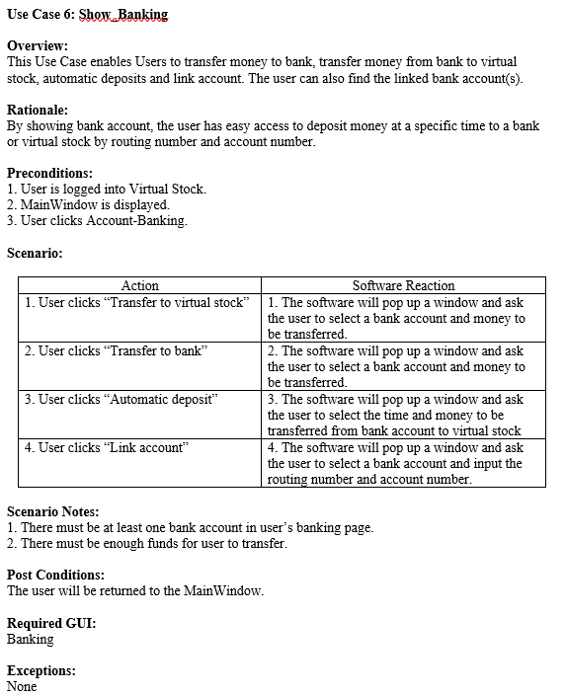
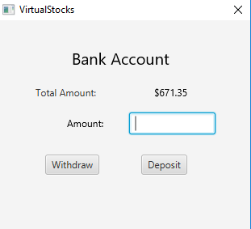
use cases 6. Show_banking

Slide 24
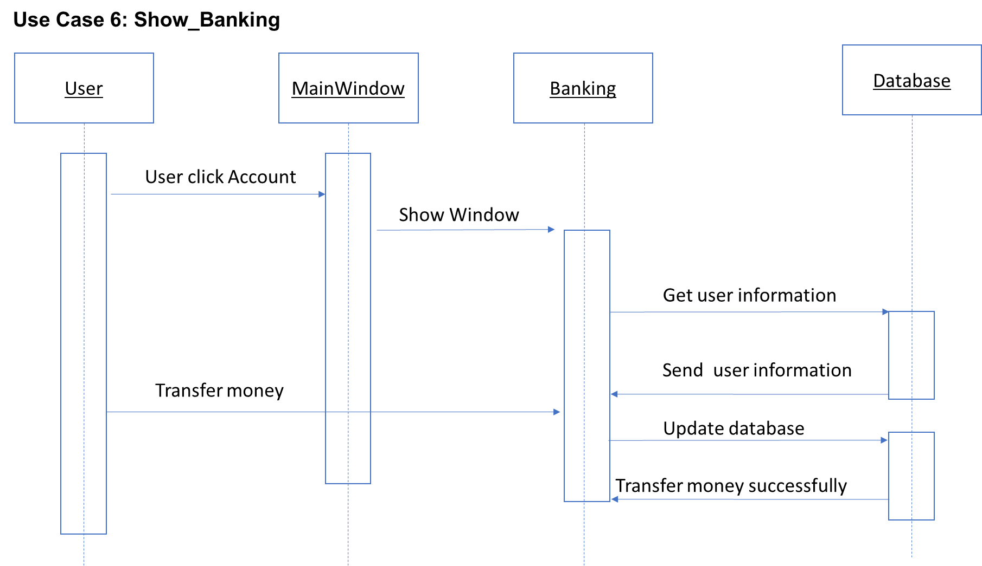
use cases 6. Show_banking

Slide 25
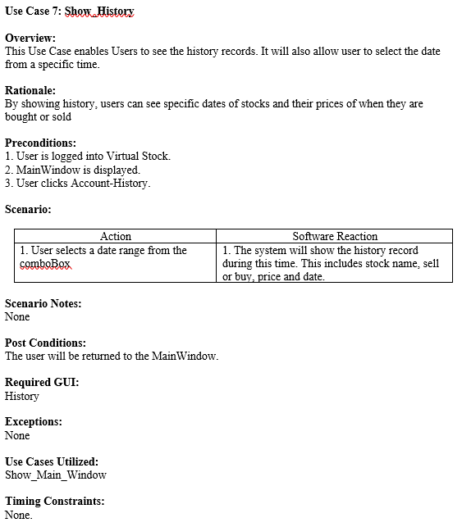
use cases 7. Show_HISTORY

Slide 26
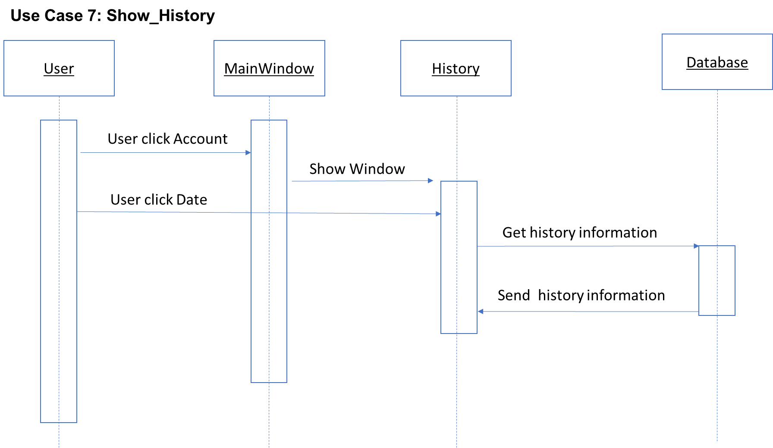
use cases 7. Show_HISTORY

Slide 27
Object design: MainApp.java
Start() –Sets stage title while connecting to the database helper and calling the log in method.
establishDatabase()- creates a new SQL database helper and connects to SQL. Also creates the parser to use with JSON.
initLogin()- initializes log in page and loads the root layout from an FXML file.
getPrimaryStage()- getter from primary stage object.
main() – launches program.

Slide 28
Object design: StockModel.java
getTicker()- getter for ticker string.
setTicker()- setter for ticker string.
getExchange()- getter for exchange string.
setExchange()-setter for exchange string.
getPrice()- getter for price double.
setPrice()- setter for price double.
getLastTradeTime() - getter for lastTradeTime string.
setLastTradeTime() - setter for lastTradeTime string.
printInformation()- Prints ticker, exchange, last price and last trade time to console.

Slide 29
Object design: TransactionModel.java
getTransactionId()- getter for transactionId int.
setTransactionId()-setter for transactionId int.
getStockPrice()-getter for stockPrice double.
setStockPrice()-setter for stockPrice double.
getBoughtDate()-getter for boughtDate date.
setBoughtDate()-setter for boughtDate date.
getUserId()-getter for transaction id int.
setUserId()-setter for transaction id int.
getNumBought()-getter for transaction id int.
setNumBought()-setter for transaction id int.

Slide 30
Object design: UserModel.java
getUserName() – gets userName string value.
setUserName() – sets userName string value.
getFirstName() – gets FirstName string value.
setFirstName() – sets FirstName string value.
getLastName() – gets LastName string value.
setLastName() – sets LastName string value
getFullName() – concatenates the first and last name string into one string nad returns it.
getUserId() – gets userId int value.
setUserId() – sets userId int value
getPassword() – gets password string value.
setPassword() – sets password string value
getPortfolioData() – getter for a linked list of the stock model.
buyStocks()- adds a stock to the stockPortfolio object. Also makes sure to add the stock price and number to the totalAmount object.
getTotalAmount()-getter for the total amount double value.
setTotalAmount()- setter for the total amount double value.
getEmail()- getter for email String.
setEmail()- setter for email String.

Slide 31
Object design: Volume.java
setTimeStamp()- setter for the timestamp.
getTimeStamp()- getter for the timestamp.
setClose()- setter for the close double.
getClose()- getter for the close double.
setHigh()- setter for the high double.
getHigh()- getter for the high double.
setLow()- setter for the low double.
getLow()- getter for the low double.
setOpen()- setter for the open double.
getOpen()- getter for the open double.
getVolume()- returns the volume int.
printSeries()- prints out to console the timestamp, close, high, low, open and volume values.

Slide 32
Object design: YahooStockModel.java
setTicker()- setter for the ticker value.
getTicker()- getter for the ticker value.
setCompanyName()- setter for the companyName value.
getCompanyName()- getter for the companyName value.
setExchangeName()- setter for the exchangeName value.
getExchangeName()- getter for the exchangeName value.
setUnit()- setter for the unit value.
getUnit()- getter for the unit value.
setTimezone()- setter for the timeZone value.
getTimezone()- getter for the timeZone value.
setCurrency()- setter for the currency value.
getCurrency()- getter for the currency value.
setGmtOffSet()- setter for the gmtOffSet value.
getGmtOffSet()- getter for the gmtOffSet value.
setPreviousClose()- setter for the previousClose value.
getPreviousClose()- getter for the previousClose value.
setMinTimeStamp()- setter for the minTimeStamp value.
getMinTimeStamp()- getter for the minTimeStamp value.
setMaxTimeStamp()- setter for the maxTimeStamp value.
getMaxTimeStamp()- getter for the maxTimeStamp value.
getLables()- getter for the labels array list of long values.
addLable()- adds a label to this instance.
getSeries()- getter for the array list of volumes values.
addSeries()- adds a volume to this series instance.
printStockModel()- prints out to the console the ticker, company name, exchange name, unit, time zone, currency, gmt off set, previous close, min time stamp, max time stamp, labels and series values.

Slide 33
legacy
Organization is a task in itself.
Understand each group member to understand the project.
Communication becomes increasingly important.
Documentation helpful for everyone.
Take into account possible setbacks in scheduling.

Slide 34
Software Implementation
Eclipse
Scene Builder
JavaFX
SQL
Javadoc
Git

Slide 35
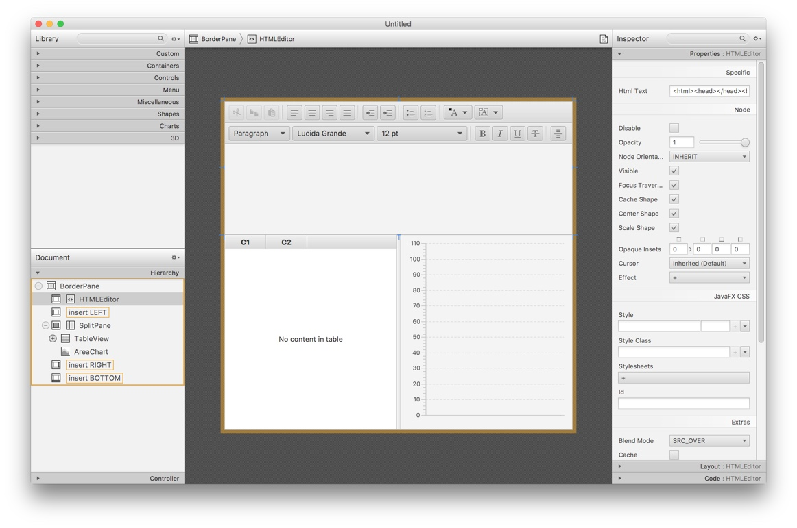
Scene Builder
Drag & Drop user interface design allows for rapid iteration. Separation of design and logic files allows for team members to quickly and easily focus on their specific layer of application development.

Slide 36

GUI (JavaFX)
JavaFX is a software platform for creating and delivering desktop applications, as well as rich internet applications (RIAs) that can run across a wide variety of devices. JavaFX is intended to replace Swing as the standard GUI library for Java SE, but both will be included for the foreseeable future. JavaFX has support for desktop computers and web browsers on Microsoft Windows, Linux, and macOS.

Slide 37

Eclipse
Eclipse is an integrated development environment (IDE) used in computer programming, and is the most widely used Java IDE.[6] It contains a base workspace and an extensible plug-in system for customizing the environment. Eclipse is written mostly in Java and its primary use is for developing Java applications, but it may also be used to develop applications in other programming languages via plug-ins.

Slide 38
JAVAdoc
Javadoc (originally cased as JavaDoc) is a documentation generator created by Sun Microsystems for the Java language (now owned by Oracle Corporation) for generating API documentation in HTML format from Java source code. The HTML format is used to add the convenience of being able to hyperlink related documents together.

Slide 39
Git
Git is a version control system (VCS) for tracking changes in computer files and coordinating work on those files among multiple people. It is primarily used for software development, but it can be used to keep track of changes in any files. As a distributed revision control system it is aimed at speed, data integrity, and support for distributed, non-linear workflows.

Slide 40
SQL
SQL Structured Query Language is a domain-specific language used in programming and designed for managing data held in a relational database management system (RDBMS), or for stream processing in a relational data stream management system (RDSMS).

Slide 41
Summary
1. A PC Java program was designed
2. JavaFX was used to build GUI
3. Most of functions are implemented

Slide 42
DEMO

