Slide 1

Introduction to Angular with a simple but complete project
Artem Sikirinskyi 65119 Group 8

Slide 2


Introduction
Angular is a framework for building client applications in HTML, CSS and TypeScript ( that compiles to JavaScript ).
It has changed the way we develop client side applications, by providing the possibilities to apply the best practices usually applied on server side like modular programming, separation of concerns, testability and many other, on client side.

Slide 3
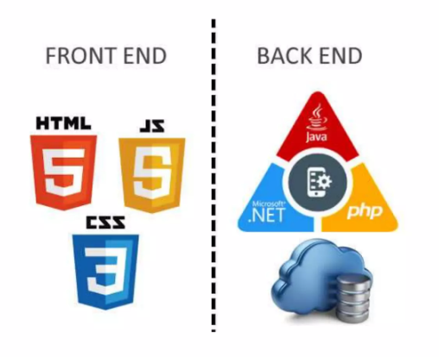
Angular is oriented to develop the front end uncoupled of the back end

Slide 4
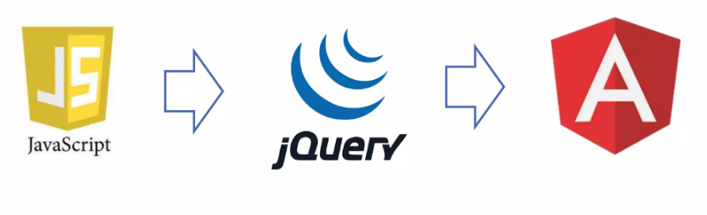
Angular Evolution

Slide 5
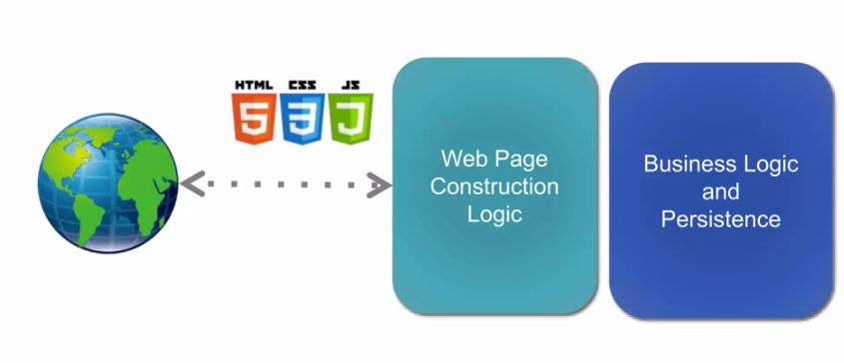
Traditional WEB Architecture

Slide 6
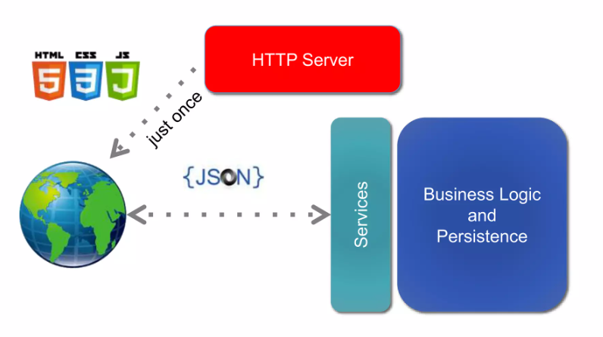
Service Oriented Front End Architecture - SOFEA
SOFEA advantages:
Scalability (processing, stateless, caching)
Interoperability (BaaS - Back-end as a Service, Web and Mobile)
Offline Applications
Asynchronous development ( front-end x back-end)

Slide 7
Angular uses the concept of Single Page Application (SPA)
SPA is not an application of a unique html file but a fully contained applications in the browser that do not need to make requests for new pages on the server.
Usually SPA makes request just of the data that will be show inside of the pages ( accessing back end REST+JSON services)
Single Page Application Advantages: Faster, eliminate the download of html, js and css code in each request Possibility to create off line applications

Slide 8
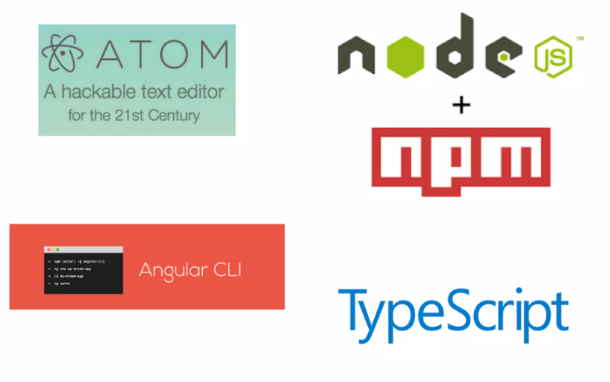
Angular Environment
ATOM : Text editor
Node.js + npm: dependence management (npm = gradle/maven in java world)
Angular CLI: Command Line Interfaces for angular
TypeScript: The language of angular 2

Slide 9
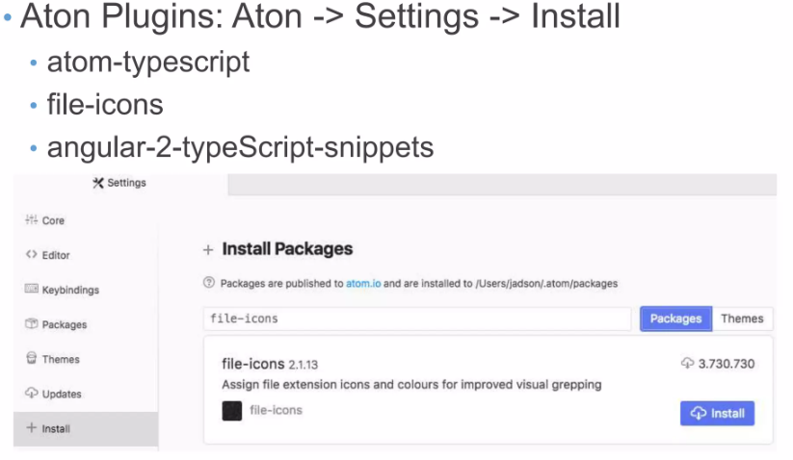

Slide 10
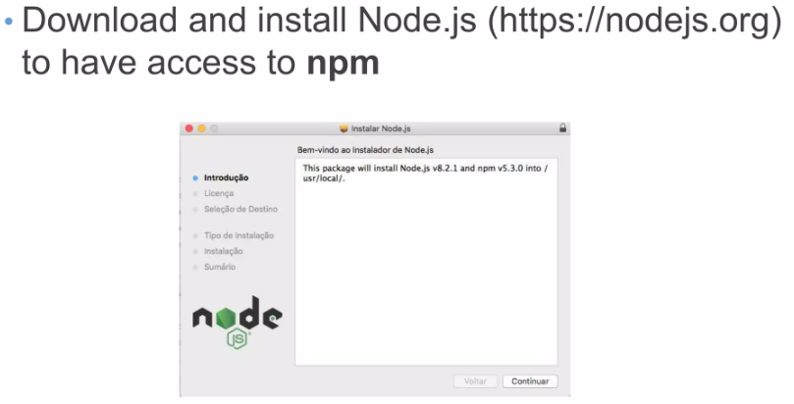
After install npm, install typescript and angular cli using the npm of node. js
sudo npm intall —g typescript
sudo npm intall -g @angular/cli

Slide 11
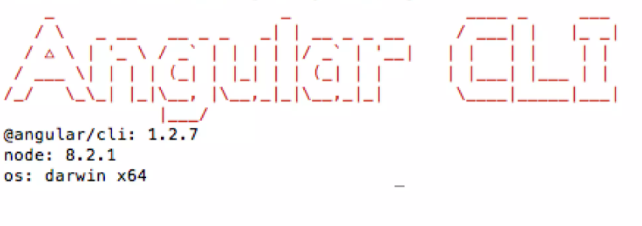

Slide 12
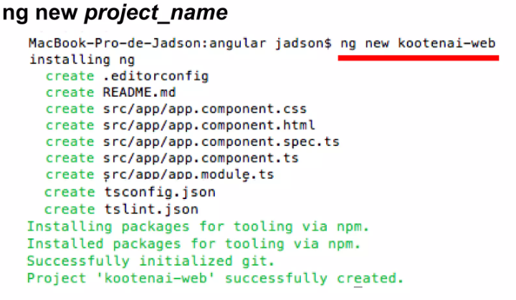
Create a new Project by Angular

Slide 13
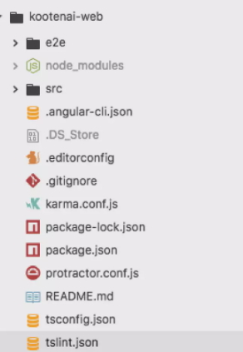
Open angular project in Atom

Slide 14
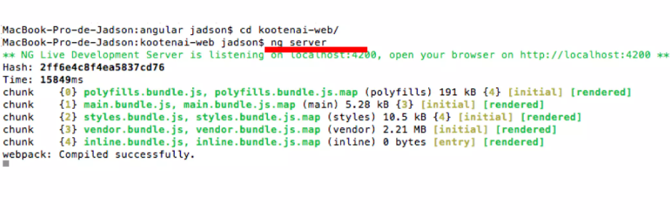
Running the project: ng server inside of project folder open the browser on http://localhost:4200

Slide 15
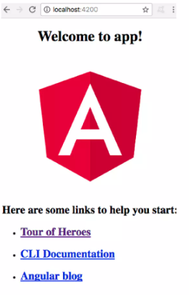
Default Angular Page

Slide 16
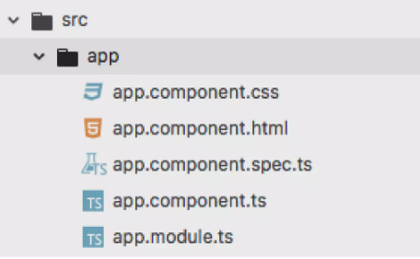
Angular is based on components:
There is already the main component called app.component that shows the “Wellcome to App” page ‘when you access localhost:4200

Slide 17
Angular component have 3 basics parts:
name-component.html (the html code of component) + name-component.css (css style of component)
name-component.ts (the typescritp of component)

Slide 18
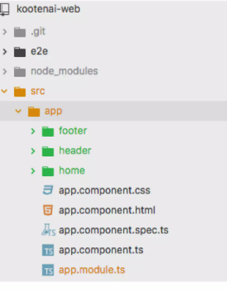
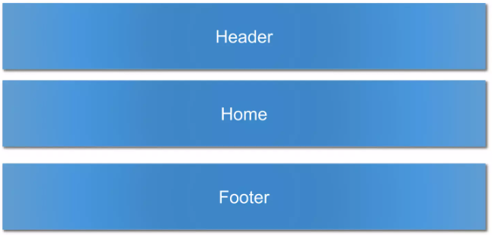
Create Angular components:
ng g c header
ng g c home
ng g c footer

Slide 19
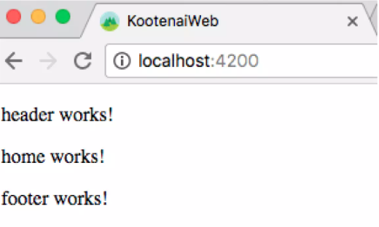

Slide 20
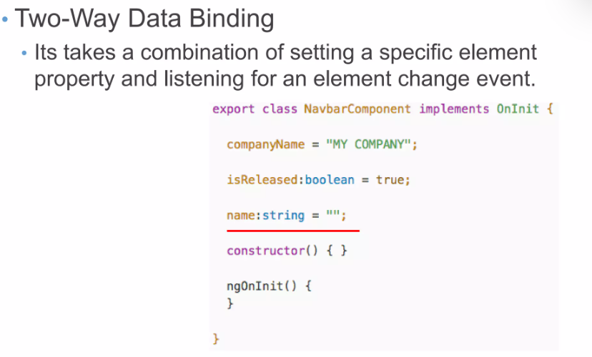

Slide 21
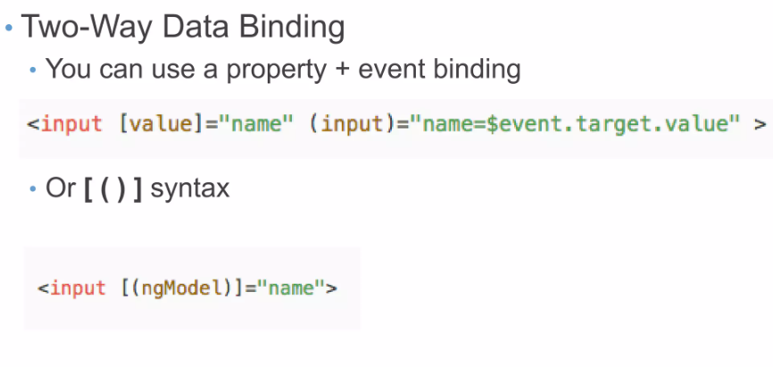

Slide 22
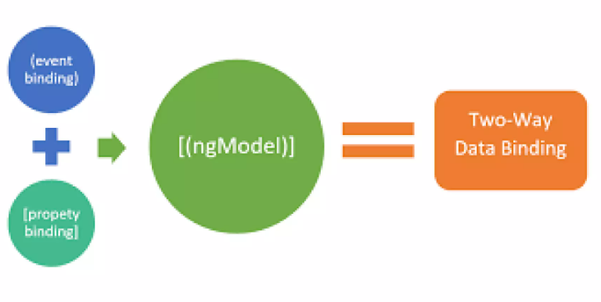

Slide 23
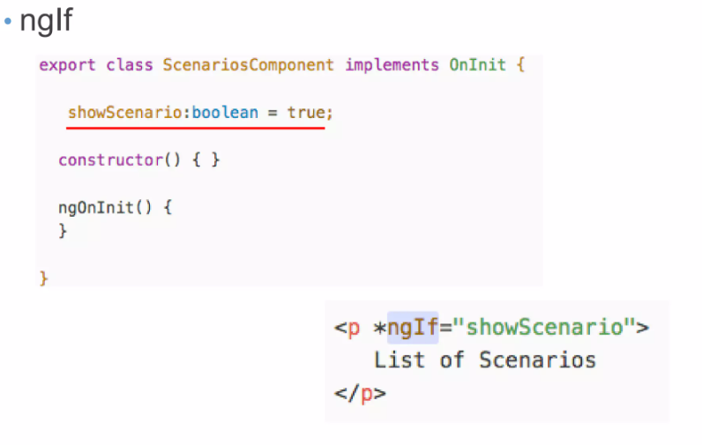
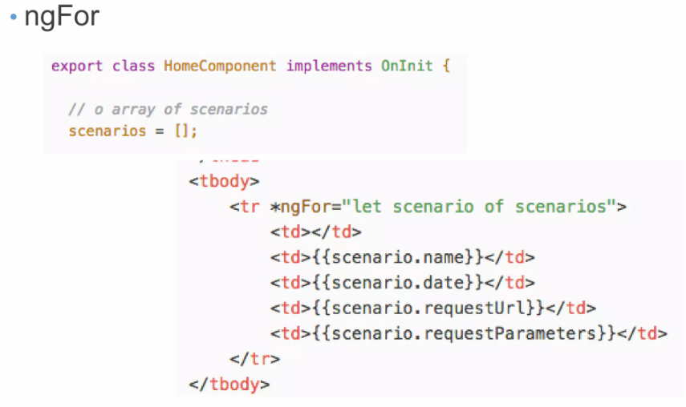
Attribute Directives and Structural Directives:
Attribute Directives: changes the appearance or behavior of a DOM element
Structural Directives: Change the DOM's structure, typically by adding, removing, or manipulating elements.

Slide 24
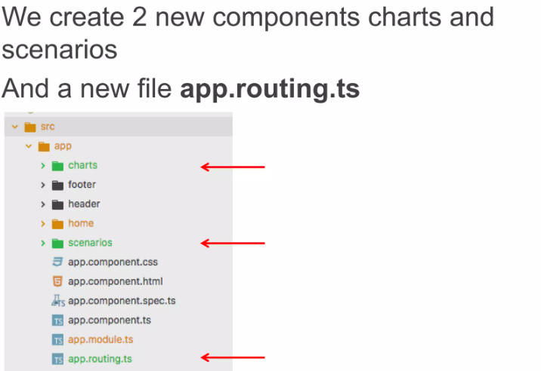
Angular Routes: Routes is a functionally that helps your application to become a Single Page Application It redirect the user to another component without reload the page or call the back end.

Slide 25
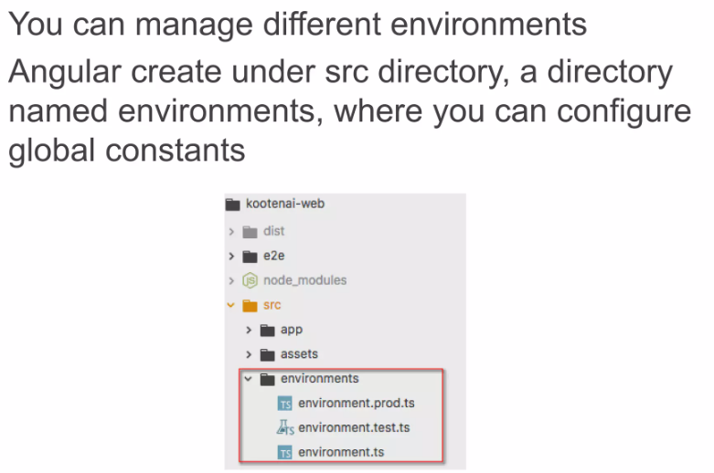
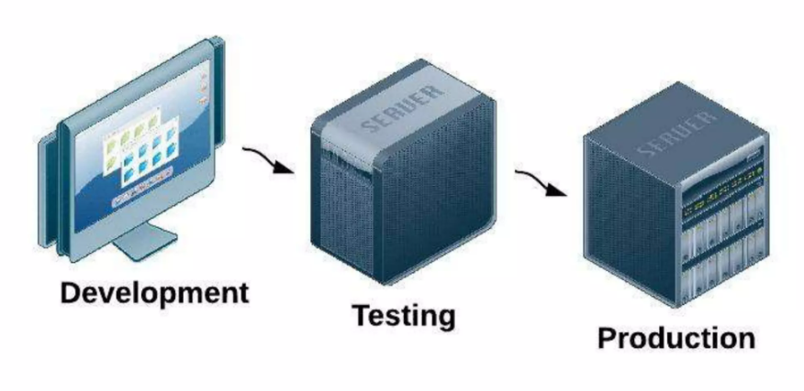
Angular Environment Variables

Slide 26
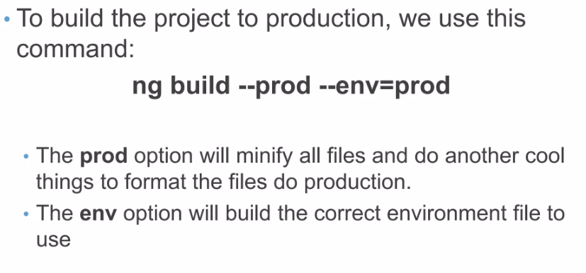

Slide 27
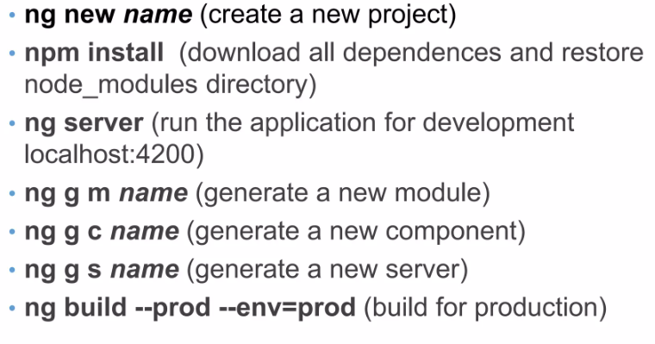
Angular Commands Summary

Slide 28
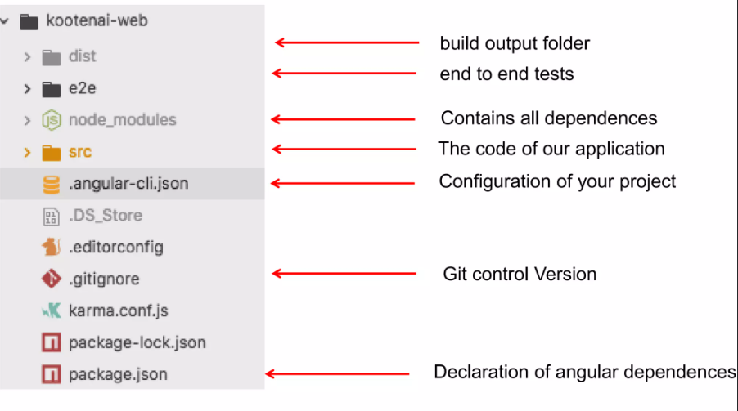
Angular Project Structure Overview

Slide 29
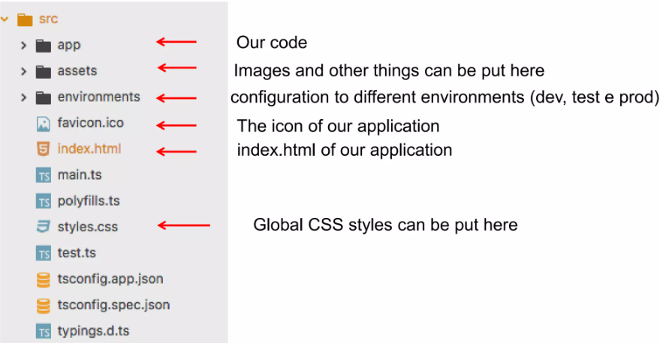
Angular Project Structure (Inside src folder)

Slide 30
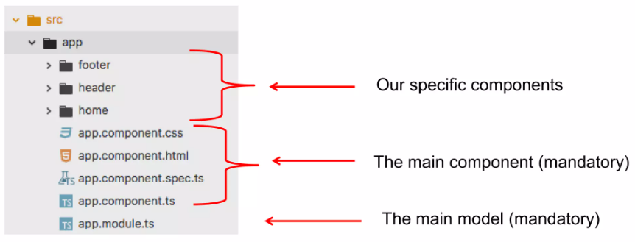
Angular Project Structure (Inside app folder)

Slide 31

Thanks for Attention

