Slide 1
Create containerized solutions
Jakub Gwoźdź

Slide 3
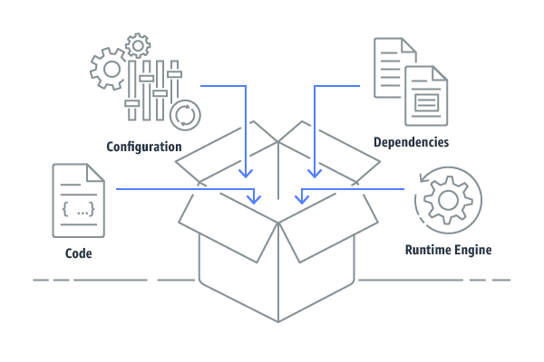
Containers & Docker
Containers provide a standard way to package your application's code, configurations, and dependencies into a single object.

Slide 4
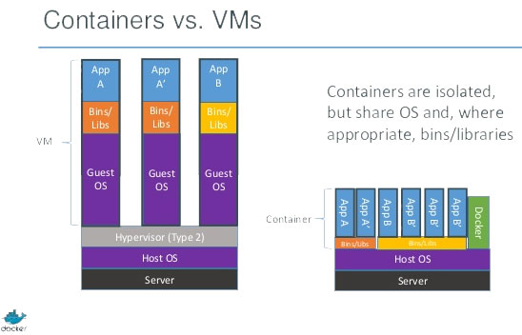
Containers & Docker
Containers share an operating system installed on the server and run as resource-isolated processes, ensuring quick, reliable, secure and consistent deployments, regardless of environment.

Slide 5
Containers & Docker
Docker’s main concepts
Image - read-only template with instructions for creating a Docker container
Container - runnable instance of an image. We can create, start, stop, move, or delete it.
Volume – mechanism to persist data. We can bind local file or directory to location in the container

Slide 6
Containers & Docker
Docker main commands
docker build -f .\Dockerfile -t jakubgw/test-image .
docker run -p internal:external -v"$(pwd):/var/www" azuredockerrepotest
docker pull remote-repo-name
docker push repo-name
docker images
docker run image-name
docker rmi image-id
docker ps
docker ps -a
docker rm container-id
docker exec -it container-id bash

Slide 7
Containers & Docker
Let’s play ! Run ./createAndRunImage.ps1 script
Build image
Run container
Login into container
Remove container & image

Slide 8
Containers & Docker
Much broder topic
Networks
Windows docker images
Docker Compose
Docker Swarm (better use K8s ☺ )
And so on..

Slide 9
Azure Container Register
The Registry is a stateless, highly scalable server side application that stores and lets you distribute Docker images.
There are many avaliable :
Docker hub
Google Cloud Register
AWS Container Registry
Azure Container Register
And so on..

Slide 10
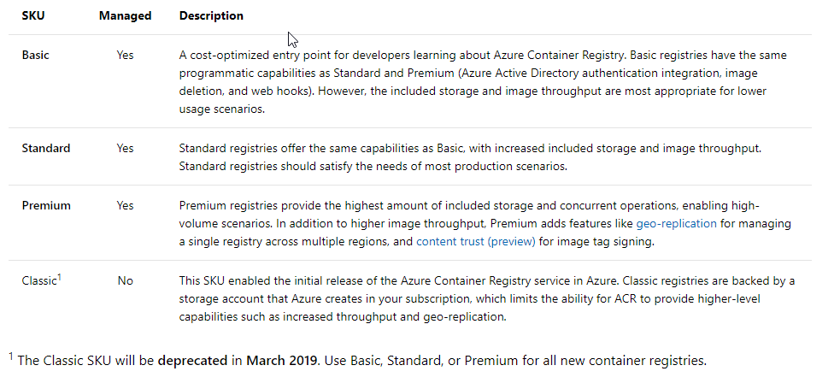
Azure Container Register

Slide 11
Azure Container Register

Slide 12
Azure Container Register
Let’s play ! Run ./createRegister.ps1 script
- Create ACR
Build image
Push image into ACR
Run image locally

Slide 13
Azure Container Instances
Fast and super simple way to run a container in Azure.
Provides public IP and DNS name
Good solution for small application, POC’s, simple scenarios
If more containers / more sophisticated solution – use K8s or Azure Service Fabric

Slide 15
Azure K8s Services

