Slide 1
Create containerized solutions
Jakub Gwoźdź

Slide 2
Presentation and scripts ara available on GitHub
https://github.com/jakubgw/azure-containerization
Examples are in the Azure CLI scripts, in the containers world this is proper way to do things.
With external tools like docker or kubectl lot of things are not possible with portal UI.

Slide 3
Create containerized solutions
Create containerized solutions
Create container images for solutions
Publish an image to the Azure Container Registry
Create an Azure Managed Kubernetes Service (AKS) cluster
Run containers by using Azure Container Instance or AKS

Slide 4
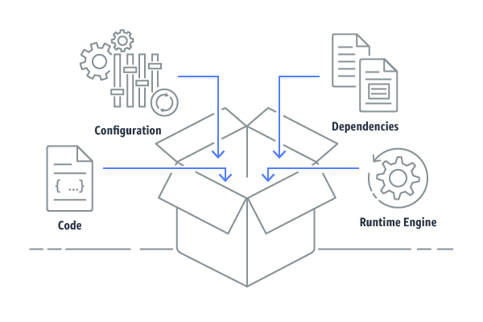
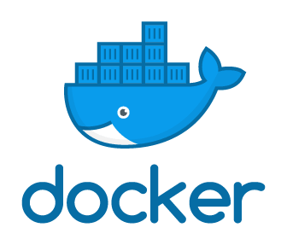
Containers & Docker
Containers provide a standard way to package your application's code, configurations, and dependencies into a single object.

Slide 5
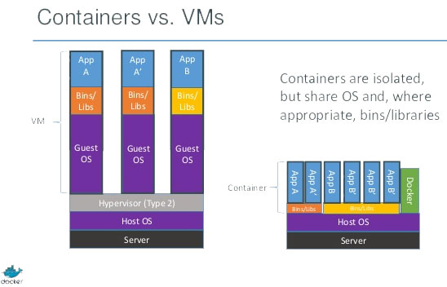
Containers & Docker
Containers share an operating system installed on the server and run as resource-isolated processes, ensuring quick, reliable, secure and consistent deployments, regardless of environment.

Slide 6
Containers & Docker
Docker’s main concepts
Image - read-only template with instructions for creating a Docker container
Container - runnable instance of an image. We can create, start, stop, move, or delete it.
Volume – mechanism to persist data. We can bind local file or directory to location in the container

Slide 7
Containers & Docker
Docker main commands
docker build -f .\Dockerfile -t jakubgw/test-image .
docker run -p internal:external -v"$(pwd):/var/www" azuredockerrepotest
docker pull remote-repo-name
docker push repo-name
docker images
docker run image-name
docker rmi image-id
docker ps
docker ps -a
docker rm container-id
docker exec -it container-id bash

Slide 8
Containers & Docker
Let’s play ! Run ./createAndRunImage.ps1 script
Build image
Run container
Login into container
Remove container & image

Slide 9
Containers & Docker
Much broder topic
Networks
Windows docker images
Docker Compose
Docker Swarm (better use K8s ☺ )
And so on..

Slide 10
Azure Container Register
The Registry is a stateless, highly scalable server side application that stores and lets you distribute Docker images.
There are many avaliable :
Docker hub
Google Cloud Register
AWS Container Registry
Azure Container Register
And so on..

Slide 11
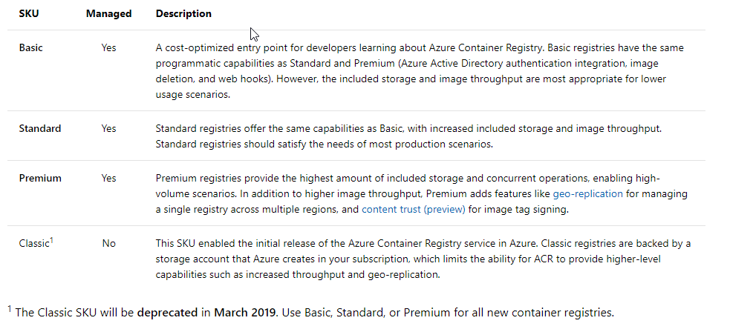
Azure Container Register

Slide 12
Azure Container Register
Let’s play ! Run ./createRegister.ps1 script
- Create ACR
Build image
Push image into ACR
Run image locally from ACR

Slide 13
Azure Container Instances
Fast and super simple way to run a container in Azure.
Provides public IP and DNS name
Good solution for small application, POC’s, simple scenarios
If more containers / more sophisticated solution – use K8s or Azure Service Fabric

Slide 14
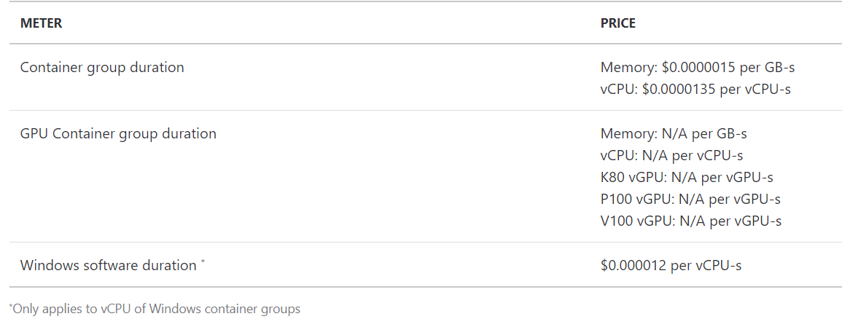
Azure Container Instances
Container group - single container instance can contains multiple images, they shared the same network.

Slide 15
Azure Container Instances
Let’s play ! Run createImageContainerInstance.ps1 script
- Login into ACR
Get login and password
Create container instance using image from ACR
Run container

Slide 16
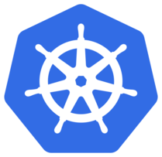
Azure K8s Services
Containers orchestration freamwork.
System for automating deployment, scaling, and management of containerized applications.
deploys multi-container applications
scales containerized apps
rolls out new versions of apps without downtime
provides networking
provides monitoring, logging, and debugging
operates in any environment

Slide 17
Azure K8s Services
Originally from Google, but now one of the biggest open-source projects ever (~80k commits and ~2k contributes.).
Becomming industry standard :
Google Kubernetes Enging
Kubernetes on AWS
Azure Kubernetes Services
IBM Cloud, Baidu, CloudStack end so on..
We can deploy kubernetes on our own infrastracture

Slide 18
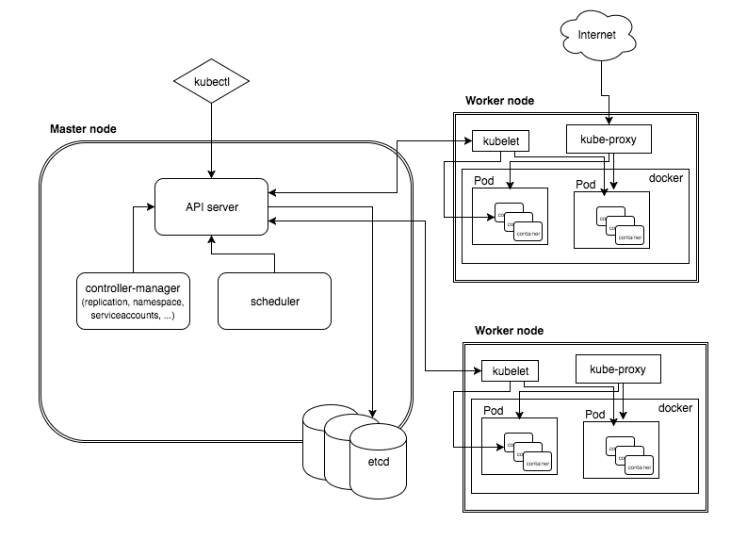
Azure K8s Services
Too broad topic for part of single L&L.

Slide 19
Azure K8s Services
But few fundamental concepts :
Node - abstraction over real commputing units
Kubectl - kubernetes command-line client
Pod - encapsulates an application container (or containers)
Service – logical set of pods – can be used to expose pods to outside network
Deployment – is responsible for pods lifecycle

Slide 20
Azure K8s Services
Pricing
There is no fee for cluster managments
Fee for nodes – only pay for what you use. Virtual machines instances, storage and networking resources consumed by your Kubernetes cluster.
IP address options. By default free dynamic virtual IP, can be extended

Slide 21
Azure K8s Services
Let’s play !
Run createK8sCluster.ps1 script
Creates K8s cluster
Checks nodes
Run publicApplicationIntoK8s.ps1 script
Authenticate k8s cluster into ACR
Loginto kubectl
Deploy pod and service

Slide 22
Azure Service Fabric
Another and older way to orchestrate containers in the Azure Cloud
It looks, not in the scope of az-203

Slide 23
Thanks !

