Slide 1
Robocode
Peter Babič
Jakub Hanák

Slide 2
What is Robocode
Robocode is a programming game, where the goal is to develop a robot battle tank to battle against other tanks in Java or .NET. The robot battles are running in real-time and on-screen.

Slide 3
A* search algorithm
is a computer algorithm that is widely used in pathfinding and graph traversal
efficiently traversable path between points
best-first search and finds a least-cost path from a given initial node to one goal node
path of the lowest expected total cost or distance, keeping a sorted priority queue of alternate path segments along the way

Slide 4
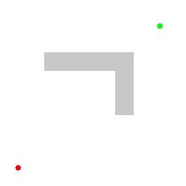
A* search algorithm
The one we have implemented

Slide 5

Dijkstra's algorithm
finding the shortest paths between nodes in a graph
assign some initial distance values and will try to improve them step by step

Slide 6
Manhattan distance
based on the well-known gridlike street geography of the New York borough of Manhattan
The distance between two points in a grid based on a strictly horizontal and/or vertical path as opposed to the diagonal or "as the crow flies" distance
is the simple sum of the horizontal and vertical components

Slide 7
Euclidean distance
is the "ordinary" distance between two points in Euclidean space
The Euclidean distance between points p and q is the length of the line segment connecting them
In Cartesian coordinates, if p = (p1, p2,..., pn) and q = (q1, q2,..., qn) are two points in Euclidean n-space, then the distance (d) from p to q, or from q to p is given by the Pythagorean formula

Slide 8
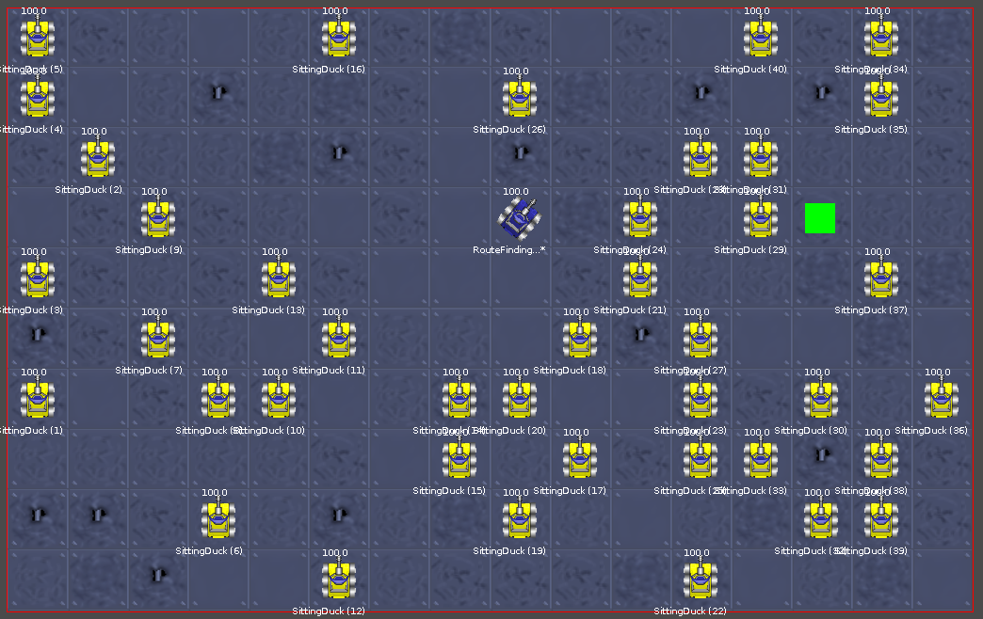
Solution preview

Slide 9
Implementation problems
World generation for the search algorithm and for the robot sandbox simultaneously
Viable open set data structure
Stopping algorithm cycle when the destination was found (== vs .equals())
Reversing the List of objects representing the path
Turret rotation through shorter arc

Slide 11
Possible improvements
Algorithm's path optimization
Removing some constants – increasing flexibility
Implementing diagonal movement

Slide 12
Thank you for your attention

